Slide 1
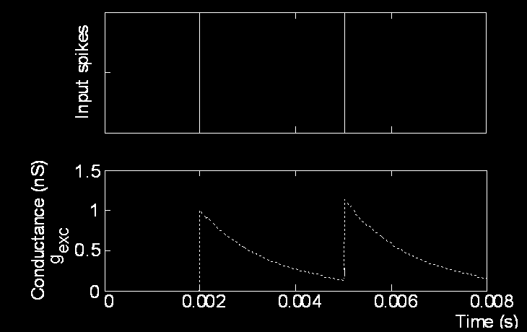
Cerebellar Spiking Engine: EDLUT simulator
UGR with input from other partners.
Motivation
Simulation of biologically plausible spiking neural structures
Allow the simulation of different neuron models
Allow the incorporation of new neural features into neuron models without needing to modify the simulator code.
Real-time simulation of middle-scale neural networks (thousands of neurons).
Using tables
Synaptic plasticity&architecture
Euler / Runge-Kutta method
(N+1)-dimensional table for v_{n}
Table 1…, Table N
Table-based event-driven simulator
Long Term Depression (LTD):
1
Learning laws
Each time a spike from inferior olive arrives:
0.8
x*e
-x
2
-x
Before the simulation
sin(x)
* e
0.6
sin(x)
20
* e
-x
Amount of LTD
0.4
0.2
During the simulation
0
-5
-4
-3
-2
-1
0
Long Term Potentiation (LTP):
Contribution last IO spike arrival (ms)
Cerebellum model
The precision of the simulation will mainly depend on:
Table size and access mode (interpolation)
Table structure (coordinate distribution)
If neuron behavior exhibits abrupt changes along a specific dimension denser sampling is required.
It is also possible to use non-uniform coordinate distribution
Each incoming spike causes the conductance of the corresponding synapse (g_{j}) to follow an exponential decay function.
When the membrane potential (Vm) reaches the threshold, the neuron emits a spike.
Each time a spike from granule cell arrives at synapse i:
Network topology
teaching signal
If the end time is not yet reached
Extract the event with the shortest latency from the spike heap
Update the corresponding neuron state to the current event time
Apply the current event effect
Insert new produced event in the spike heap
Excitatory connections
Inhibitory connections
Teaching signal
Inferior Olive Neurons [48]
[8]
[8]
[8]
[8]
[8]
[8]
Granule Cells [1500]
Parallel fibers
Purkinje Cells [48]
Plastic synapses
[8]
[8]
[8]
[8]
[8]
[8]
4 rand
mossy
4 rand
mossy
4 rand
mossy
Joint related Mossy [120]
Joint related Mossy [120]
[20]
[20]
[20]
[20]
[20]
[20]
[20]
[20]
[20]
[20]
[20]
[20]
Deep Cerebellar Nuclei Cells [24]
[4]
[4]
[4]
[4]
[4]
[4]
Cerebellum model. Inputs encoding the movement are sent (upward arrow) through the mossy fibers to the granular layer. These inputs encode the desired and actual position and velocity of each joint along the trajectory and also context-related information. Inputs encoding the error are sent (upper downward arrow) through the inferior olive (IO). Cerebellar outputs are provided by the deep-cerebellar-nuclei cells (DCN) (lower downward arrow). The DCN collects activity from the mossy fibers (excitatory inputs) and the Purkinje cells (inhibitory inputs). The outputs of the DCN are added as corrective torque
Simulator
Synaptic Weights
Input Spikes
Output Spikes
Net Definition:
1.-Neurons
-Numbers
-Types
2.-Connections
-Delays
-Synapses
Neuron Model look up tables
-Vm(Vi,Gi,Ge,t)
-Ge(t),...
-Tf(Vi,Gi,Ge)
Tf end(Vi,Gi,Ge)
Function Approximation
Neuron Model Definitions
-Equations
-Table definitions
MODEL_N.DAT
WEIGHTS.DAT
Conductance-based synaptic input
NET.CFG
Neural parameters: C_{m}, E_{exc}, τ_{exc}, E_{inh}, τ_{inh}, E_{rest}, g_{rest}
Neural state variables: V_{m}, G_{exc}, G_{inh}
TAB2.CFG.C
Translation of coordinates into spike trains
trajectory in
joint coordinate
. . .
Dependent on: V_{m}, G_{exc}, G_{inh}, t
4-dimensional table Vm(V_{m0},G_{exc0},G_{inh0},Δt)
Dependent on: G_{exc}, t
2-dimensional table Gexc(G_{exc0},Δt)
Dependent on: G_{inh}, t
2-dimensional table Ginh(G_{inh0},Δt)
I_{N1}(t)
I_{N2}(t)
. . .
I_{N-1}(t)
I_{N}(t)
Some implementation details
Leakage integrate-
and-fire neurons
. . .
Uniform treatment of all possible events that could occur in the simulation process
Heritage of Event class.
Different event types (Shot an unique spike, propagation, TCP/IP communication, synchronization with other system, save the current simulation status, simulation ending …etc ).
ProcessEvent method implements the specific treatment of each event.
Implementation in C++ for Linux and Windows (with Cygwin) until now .
Same precompiled look up tables both 32bits and 64 bits architectures.
.
Mossy fibers
Population coding
Advantages: Spikes of biological neurons are well localized in time and not very frequent. Thus low number of events (sparse coding).
Disadvantages: We need a mathematical expression (or method) to calculate the value of each state variable after an arbitrary time (the time of the next event).

