Slide 1
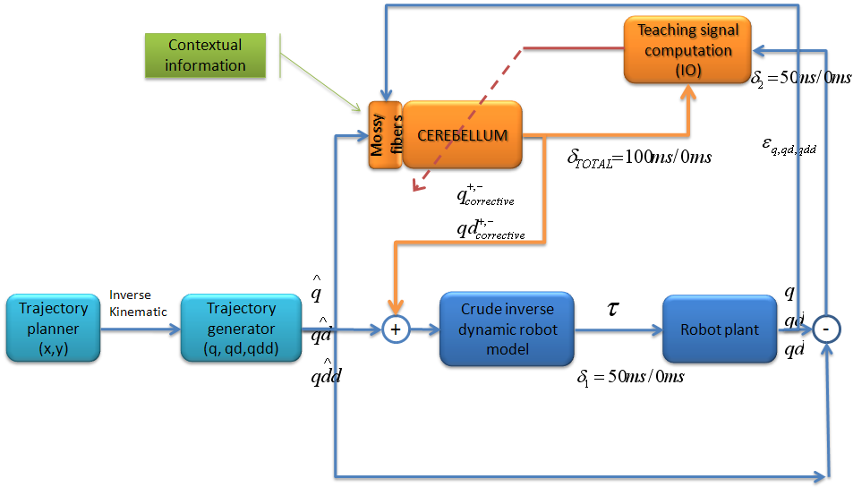
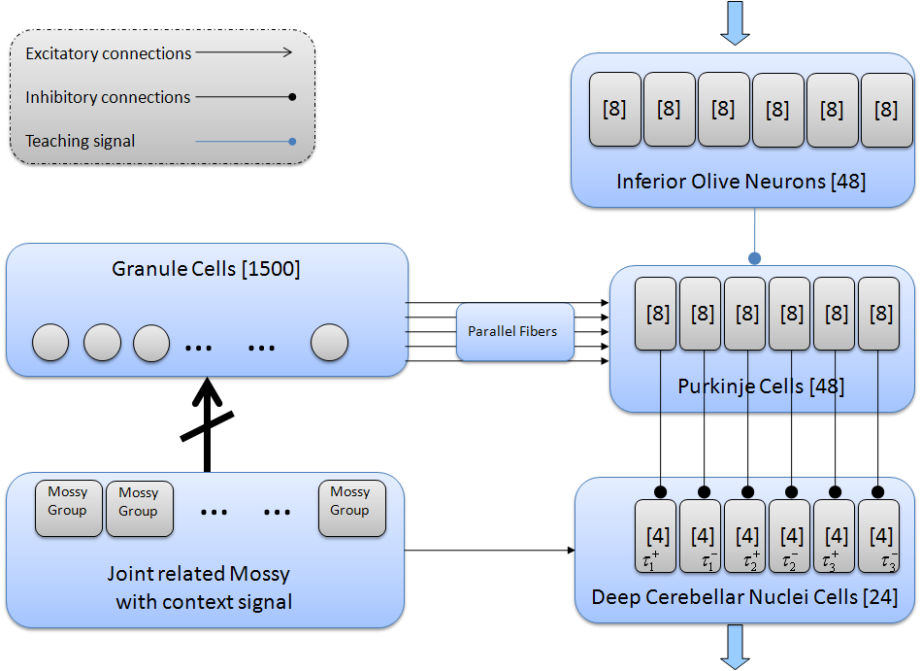
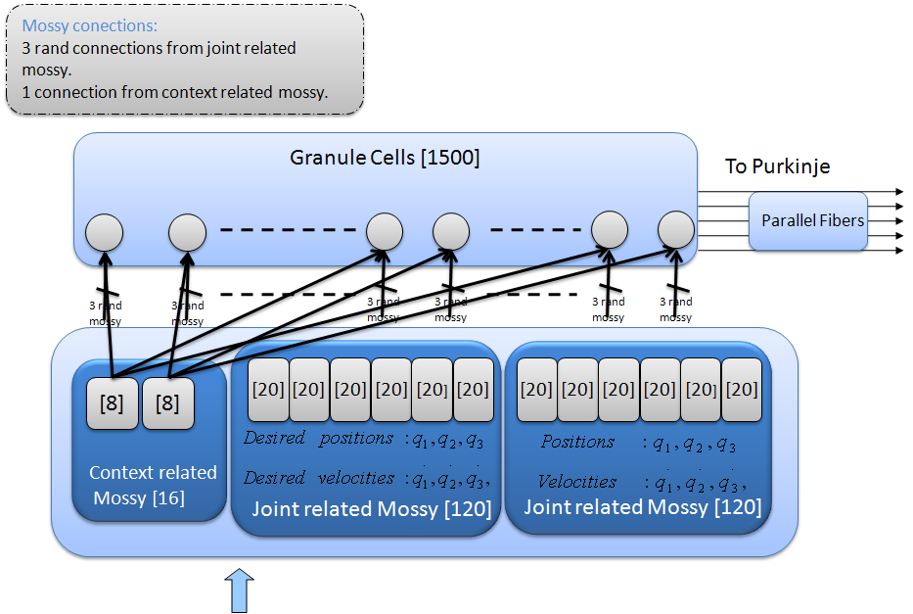
Cerebellar Spiking Engine: Towards Object Model
Abstraction in Manipulation
UGR with input from PAVIA and other partners
Motivation
Abstract corrective models in the framework of a robot control task when manipulating objects that significantly affect the dynamics of the system using non-stiff-joint robot with low-power actuators.
Evaluate the way in which the cerebellum stores a model in the granule layer.
Evaluate how input sensory-motor representations can enhance model abstraction capabilities during accurate movements, making use of explicit (model-related input labels) and implicit model representations (sensory signals).
Evaluate how our cerebellum model (using a temporal correlation kernel) properly deals with transmission delays in sensory-motor pathways.
Control loop
Experimental Results
a)
b)
Control loop. The desired arm states in joint coordinates are used at each time step to compute a crude torque commands (crude inverse dynamic robot model). They are also used together with the contextual information (related to the manipulated object) as input to cerebellum which produces the predictive corrective commands which are added to these crude torque commands. Total torque is delayed (on account of the biological motor pathways) and supplied to the robot plant. The difference between the actual robot trajectory and the desired one is also delayed and used by the teaching signal computation module to calculate the inferior olive (IO) cerebellum input signal. This signal will be used by the cerebellum to adapt its output.
Learning Performance when manipulating different objects (0.5kg, 1kg, 1.5kg and 2kg) during a 250-trial leaning processes. a) MAE evolution during the whole learning process. b) Accuracy gain estimate achieved for each manipulated object. The different initial error for each manipulated object is revealed by this estimate.
Cerebellum model
The cerebellum module consists of a network which contains a considerable amount of spiking neurons. To simulate this network efficiently we use the EDLUT simulator (currently available as open software: http://code.google.com/p/edlut/)
a)
b)
Cerebellum model. Inputs encoding the movement are sent (upward arrow) through the mossy fibers to the granular layer. These inputs encode the desired and actual position and velocity of each joint along the trajectory and also contex-related information. Inputs encoding the error are sent (upper downward arrow) through the inferior olive (IO). Cerebellar outputs are provided by the deep-cerebellar-nuclei cells (DCN) (lower downward arrow). The DCN collects activity from the mossy fibers (excitatory inputs) and the Purkinje cells (inhibitory inputs). The outputs of the DCN are added as corrective torque
Non-destructive learning in a context switching scenario. The dynamics of the plant is alternately changed between two contexts. In the first context, the end-segment of the robot arm is loaded with a 2kg object and in the second one with a 1kg object.
Three-joint periodic trajectories describing 8-shape movements a) Angular coordinates of each joint of the LWR robot b) 3D view of the robot end-effector trajectory in Cartesian coordinates.
Conclusions
We demonstrate how a cerebellar adaptive module operating together with a crude inverse dynamics model can provide corrective torques to compensate deviations in the dynamics of a base plant model (due to object manipulation).
We have evaluated how a new temporal-correlation kernel driving an error-related LTD and a compensatory LTP component can adapt the corrective cerebellar output overcoming the sensory-motor delays.
This cerebellar module can abstract models corresponding to manipulated objects that affect the dynamics of the plant providing corrective torques for more accurate movements. The cerebellar model includes two new proposed state input representations encoding context-specific inputs and current sensory signal encoding the immediate state during the experiment.
.
LWR robot
Granular layer model. Explicit and implicit context encoding approach. Each granule cell receives an explicit context signal and three randomly-chosen mossy fibers from current and desired positions and velocities

