Slide 1
Public Goods and Social Contracts
Karl Sigmund
University of Vienna and IIASA, Laxenburg

Slide 2
Evolutionary games with cultural transmission
Notes:
3-4 min

Slide 3
Simple cases
Notes:
6 min

Slide 4

Prisoner‘s Dilemma
Notes:
9 min

Slide 5
Example: Mutual Aid Game
Notes:
11-12 min

Slide 6
Example: Mutual Aid Game
Notes:
11-12 min

Slide 7
Mutual Aid Game
For 2-player groups, PD game
Reciprocation helps (sometimes) to overcome the social dilemma
But what if more than 2 players?
Many economic experiments in game labs
Notes:
13 min

Slide 8
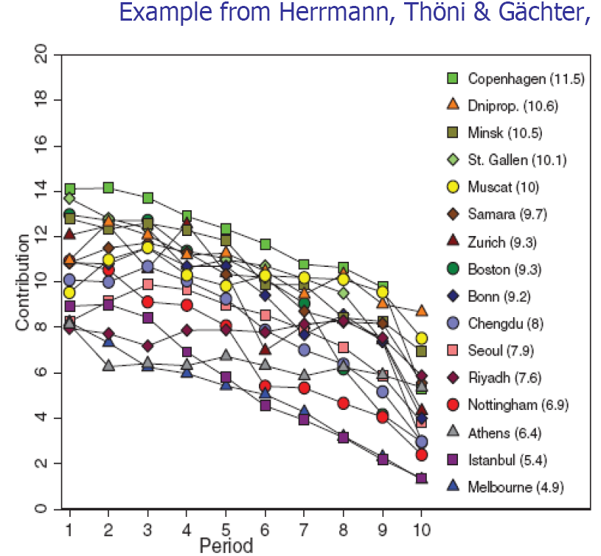
Herrmann, Thöni,
Gächter (Nature 2009)
Notes:
----- Besprechungsnotizen (24.09.12 07:41) -----
15 minuten

Slide 9
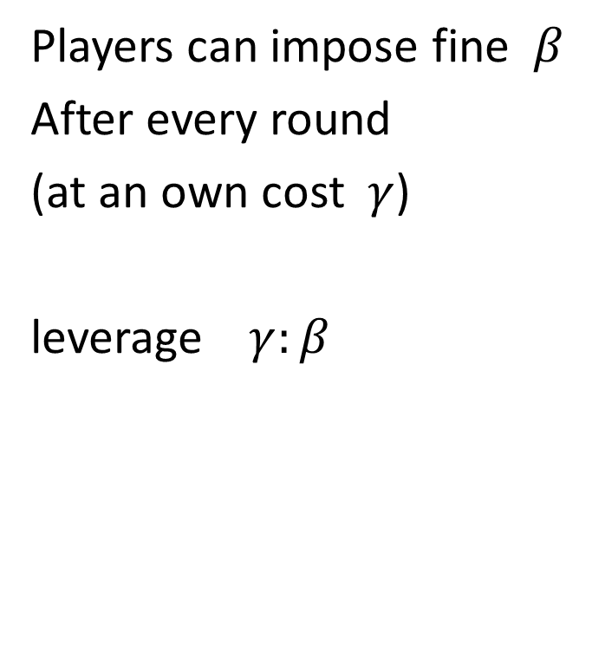
Peer Punishment (self-justice)
Players can impose fine $β$
After every round
(at an own cost $γ$)
leverage $γ:β$

Slide 10
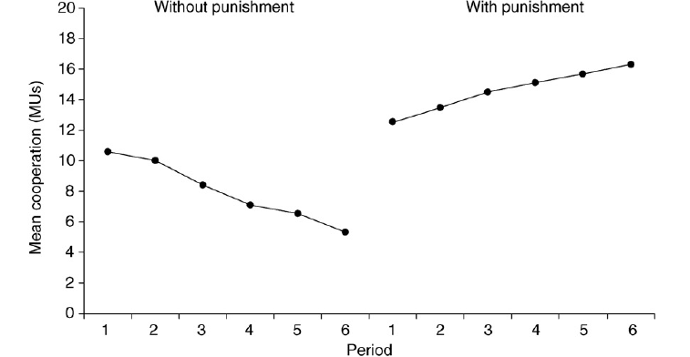
Fehr and Gächter (Nature 2002)
Notes:
27 min

Slide 11
Costly Peer Punishment
To be a punisher is costly
Opportunity for second-order free-riders
(who contribute to Mutual Aid, but not to punishment)
They do better than punishers if free-riders around (and equally well if not)
Notes:
28 min

Slide 12
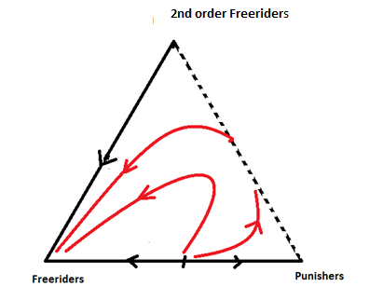
Peer Punishment vanishes
Infinite population
Strong selection
Stationary distribution:
100 percent freeriders

Slide 13
Peer Punishment vanishes

Slide 14
Optional Mutual Aid Game
Notes:
32-33 min

Slide 15
Optional Mutual Aid Game
Notes:
32-33 min

Slide 16
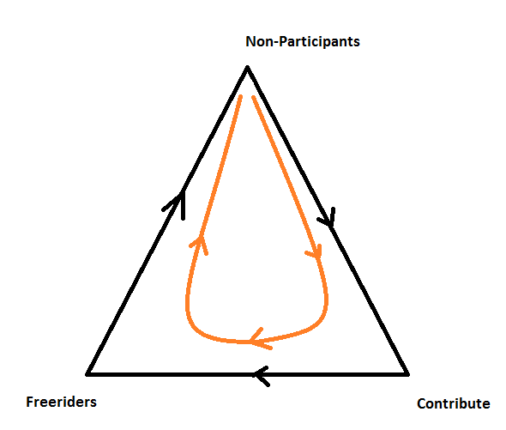
Optional Mutual Aid

Slide 17
Optional Public Good game

Slide 18
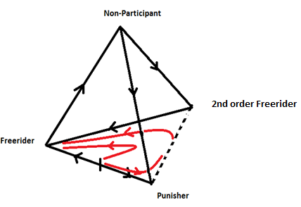
Optional, with peer punishment
Notes:
35 minuten

Slide 19
Peer Punishment

Slide 20
Peer Punishment

Slide 21
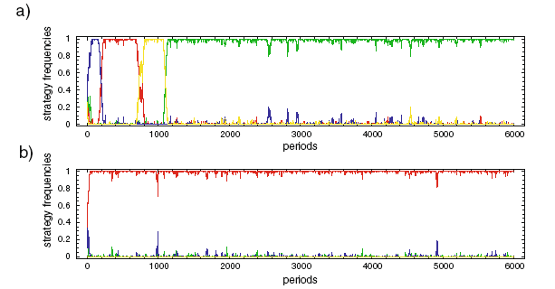
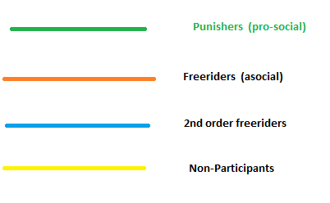
Voluntary vs Compulsory Games

Slide 22
Peer punishment?
Reputation effects (Hauert, Hilbe, Barclay)
Consensus (Boyd, Gintis, Ertan, Puttermann…)
Asocial punishment (Herrmann, Gächter, Nikiforakis…)
Hardly any second order punishment
Little peer punishment of free riders (Guala)

Slide 23
Peer punishment?
Counter-punishment, asocial punishment
John Locke (Two treatises on government, 1689):
‚…resistance (by defaulters) many times makes the punishment dangerous, and frequently destructive, to those who attempt it‘.

Slide 24
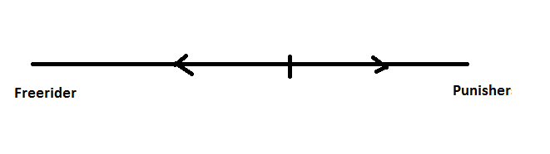
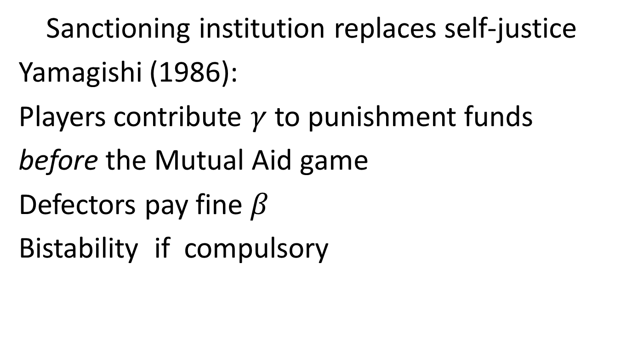
Pool punishment
Sanctioning institution replaces self-justice
Yamagishi (1986):
Players contribute $γ$ to punishment funds
before the Mutual Aid game
Defectors pay fine $β$
Bistability if compulsory
Notes:
37 min

Slide 25
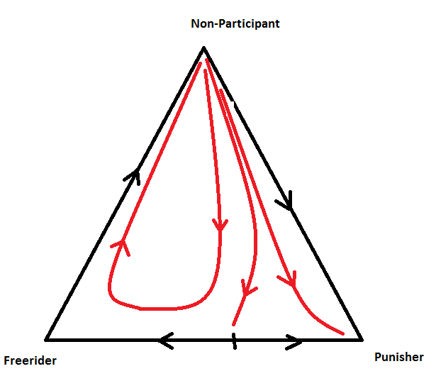
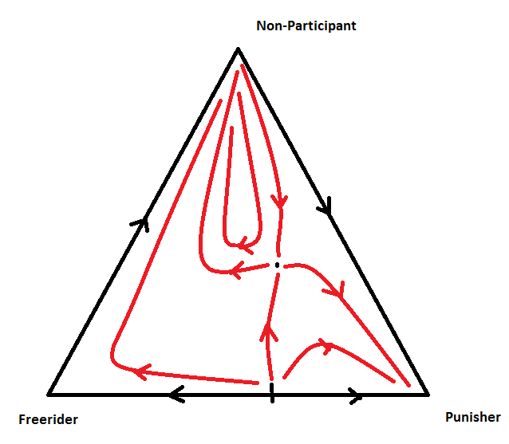
Optional Pool Punishment

Slide 26
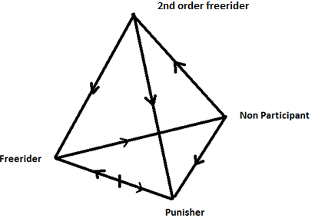
Optional Pool Punishment

Slide 27
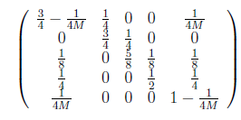
Competition of pool with peer
Second order free riders,
Free riders,
Non-participants,
Peer punisher
Pool punisher:
without second order
punishment
stationary distribution

Slide 28
Competition of pool with peer

Slide 29
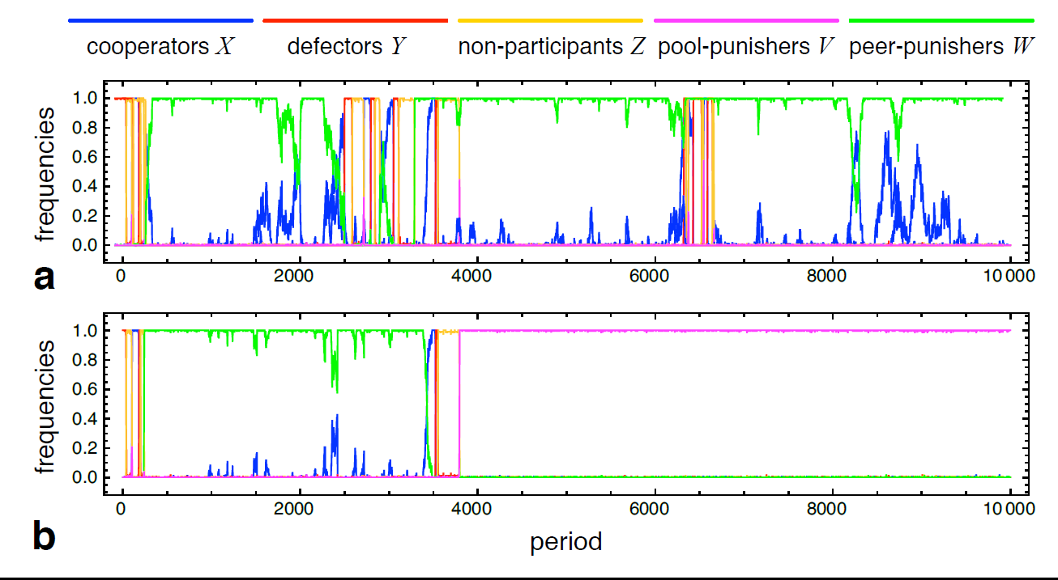
Without or with second order punishment
Sigmund, DeSilva,Hauert,
Traulsen (Nature 2010)
Notes:
44 min

Slide 30
Mutual coercion, mutually agreed
Whether in conditions of anarchy
(peer punishment, i.e. self-justice)
Or if institutions provide the sanctions,
voluntary participation promotes cooperation
self-committment
No rational deliberation, just social learning
Notes:
48 min

Slide 31
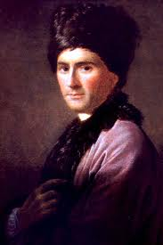
Du Contrat Social
Jean-Jacques Rousseau (1712-1778)
‚L‘homme est né libre,
et les hommes sont partout dans les fers.‘

Slide 32
Experiments?
Experimental Economics (2013)
The evolution of sanctioning institutions.
An experimental approach to the social contract
(with Boyu Zhang, Cong Li, Hannelore DeSilva,
Peter Bednarik)

Slide 33
Other experiments on Peer vs Pool
Traulsen, Röhl, Milinski (Proc. Royal Soc. B, 2012)
Kamei, Putterman, Tyran (preprint 2011)
Markussen, Putterman, Tyran (preprint 2011)
‚Formal‘ vs. ‚Informal‘ sanctions

Slide 34
On offer: Peer Punishment
Players see number of freeriders
Can decide: Punish freerider?
It costs a punisher 0.5 MU (Monetary units)
to substract 1 MU from a freerider

Slide 35
On offer: Pool Punishment
Alternatives:
Contribute nothing (Freerider)
Contribute 1 MU to Mutual Aid Game (2nd order free rider)
Contribute 1 MU to Mutual Aid Game
AND 0.5 MU to Punishment Pool (punisher)
(for each 0.5 to Punishment Pool, each freerider is fined 1 MU)
Two versions:
First and second order punishment

Slide 36
25 practice rounds
5 rounds (a) Mutual Aid without punishment
5 rounds (b) Mutual Aid with peer punishment
5 rounds (c) Mutual Aid with pool punishment
10 rounds full game: choice between (a),(b),(c) and (d) (no participation)

Slide 37
50 rounds experiment
9 groups of 12-14 play first-order version
9 groups of 12-14 play second-order version

Slide 38
50 rounds experiment
9 groups of 12-14 play first-order version
9 groups of 12-14 play second-order version
6 end up with peer regime: 3 from each version
6 end up with pool regime: all second-order

Slide 39
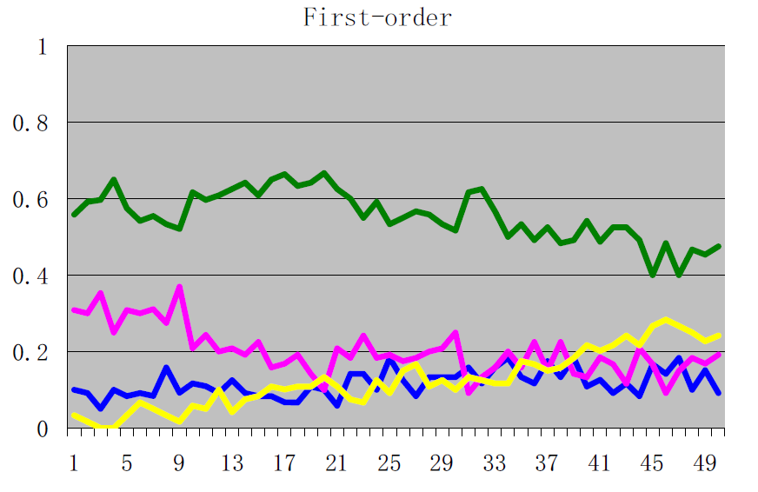

Slide 40
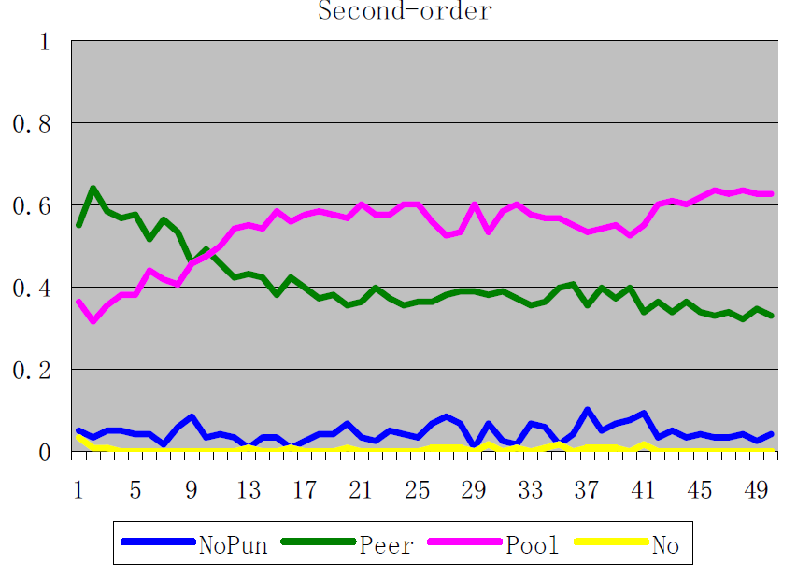

Slide 41
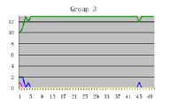
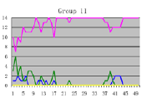
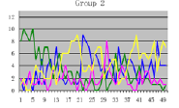
Parallel histories

Slide 42
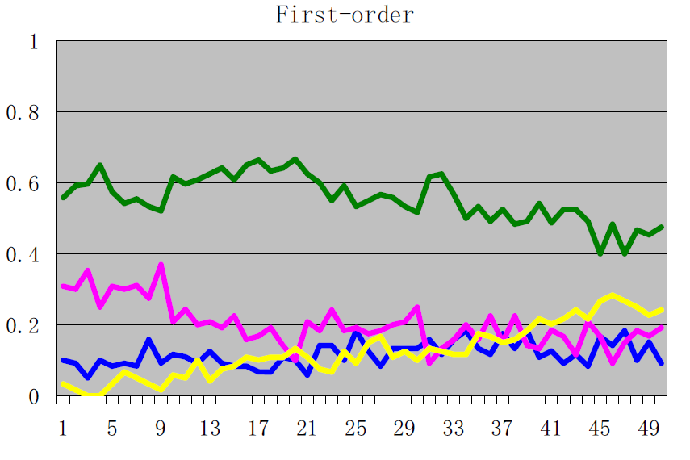
Time evolution

Slide 43
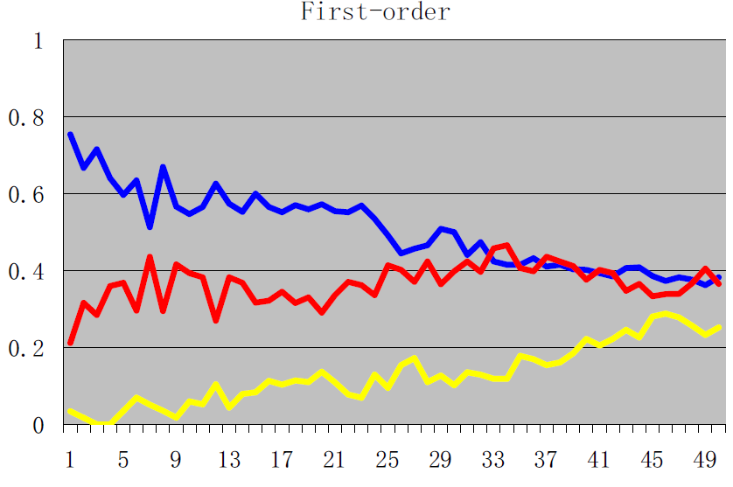
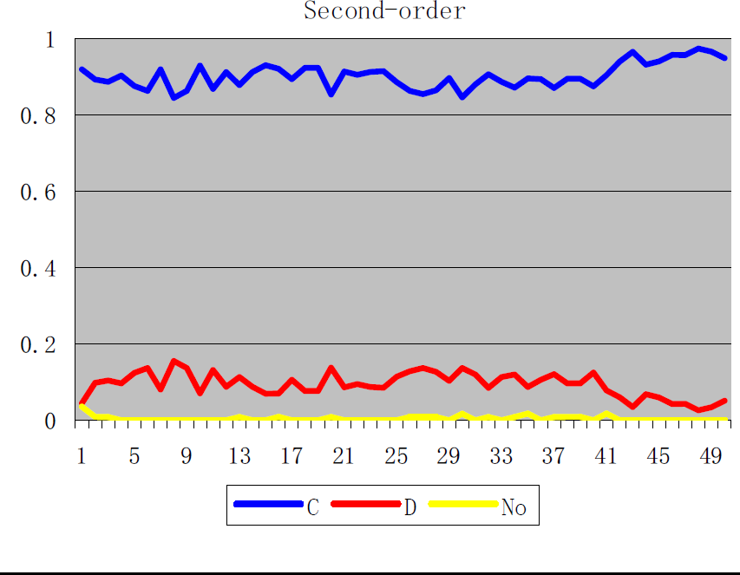
Contribution to Mutual Aid

Slide 44
Social learning of social contract
Decisions to switch: 70 percent to higher payoff
Decisions NOT to switch: 76 percent had optimal payoff
After optimal payoff: 81 percent do not switch

Slide 45
Social learning of social contract
‚social learner‘
if at least 90 percent of decisions
can be explained as switching towards higher payoff, or sticking with optimal payoff
80 percent of players social learners

Slide 46
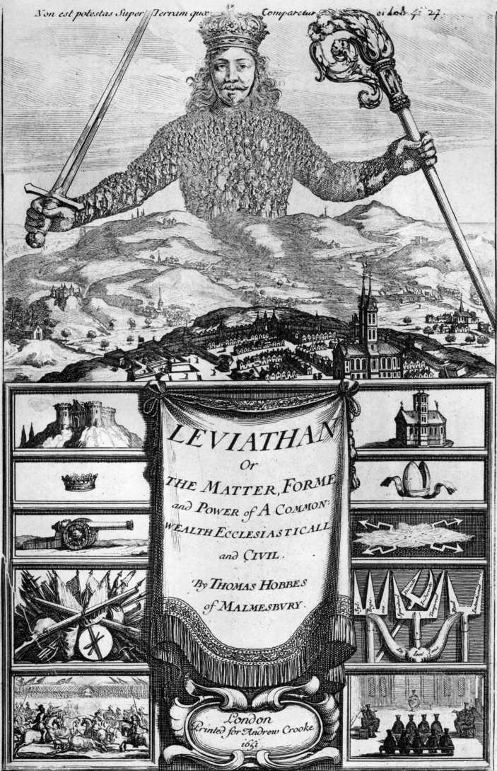

Sanctioning institutions

Slide 47
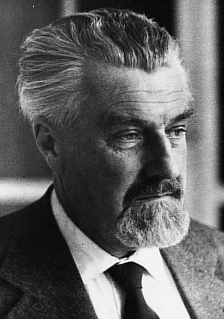
Self-domestication?
Blumenbach (1752-1840):
Humans as ‚the most perfect domestic animal‘
Konrad Lorenz (1903-1989)
‚Verhausschweinung‘
(Fat belly, soft skin, neoteny, infantility)

