Slide 1
The Solar System
Fundamental Astrophysics

Slide 2
The solar system
The solar system is composed by:
One star → Sun
8 planets:
Terrestrial/Inner Planets : Mercury, Venus, Earth, Mars
Giant/Jovian Planets: Jupiter, Saturn, Uranus, Neptune
Dwarf planets : Pluto, Ceres, Eris, Makemake, Haumea (+tens of candidates)
Asteroids
Comets
Interplanetary medium

Slide 3
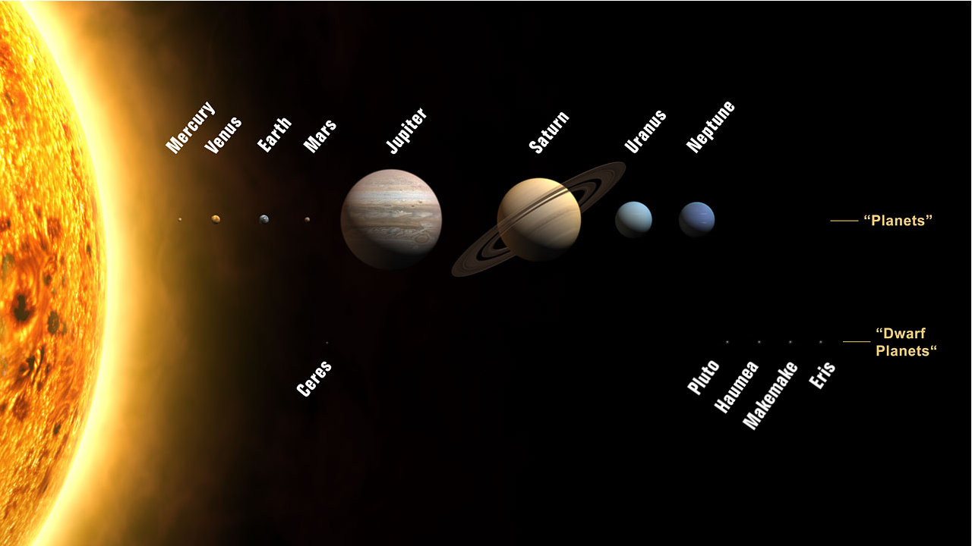

Slide 4
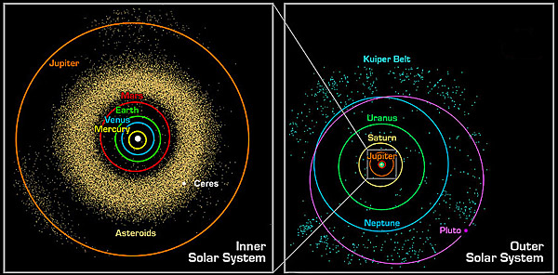

Slide 5
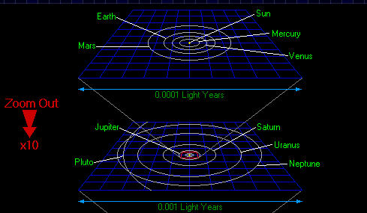

Slide 6
Planetary motion
Planets move in the sky, wrt stars, from west to east → Direct or prograde motion.
Occasionally they slow down and stop →Standstills, Stationary points.
For a brief period (with respect to their sidereal cycle) they move from east to west → Retrograde motion
After a new stationary point, they retake their normal direct motion.

Slide 7
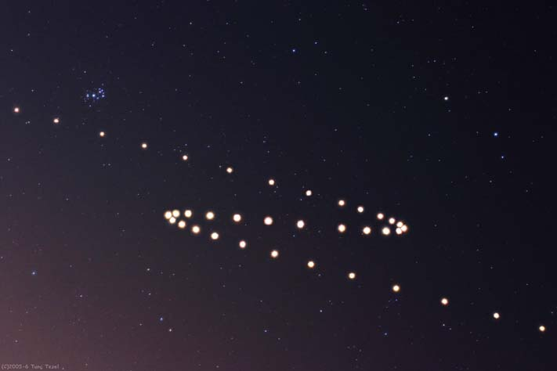

Slide 8
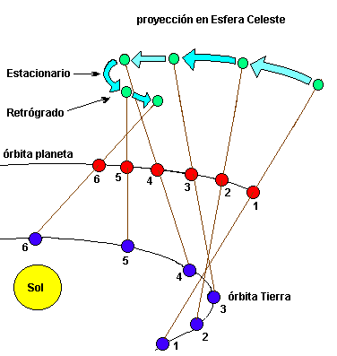

Slide 9
Planetary configurations
Outer planets:
Conjunction → Same longitude than the sun
Oposition → 180º away from sun
Quadrature → 90º away from sun
Inner planets:
Conjunction → Same longitude than the sun
Superior: Further than the sun
Inferior: Closer than the sun
Maximum Elongation → (28º M y 47º V)
East
West:

Slide 10
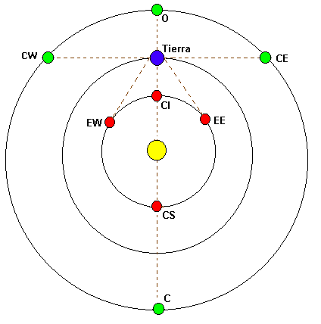

Slide 11
Synodic and sidereal periods
The time required for a planet to complete a revolution with respect to the stars (zodiac) → Sidereal period
The time required for a planet to return to the (approx) same position with respect to the sun (conj, opos, etc) → Synodic period
When a planet and an outer planet meet for a second time, the inner planet has revolved one extra time around the sun and therefore:
S/P_{I}=S/P_{O}+1
S → Synodic, P → Sidereal

Slide 12
Inner Planet:
P=1/(1+1/S) (years)
Outer Planet:
P=1/(1- 1/S) (years)

Slide 13
Laws of planetary motion
After two millenia trying to understand planetary motion, J. Kepler will state his three laws of planetary motion in the early XVII cent:
1st Law: Law of elliptical orbits
2nd Law: Law of equal areas
3rd Law: Harmonic Law

Slide 14
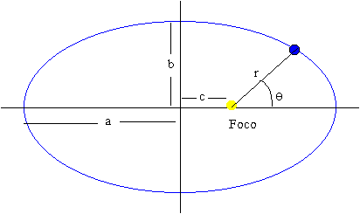

Slide 15
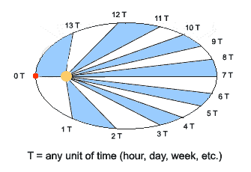

Slide 17
Celestial mechanics
It is the branch of Astronomy that deals with the motion of celestial objects.
It was, together with positional astronomy, the main subject of Astronomy until the XIX century.
With the advent of Newton laws of motion and gravitation, the (empirical) laws could now be deduced from first principles.

Slide 18
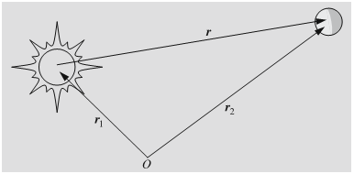
The two body problem Equations of motion

Slide 19
Solution to the two body problem. Integrals of motion

Slide 21
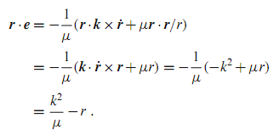
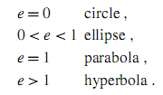
Solution to the two body problem. Integrals of motion (II)

Slide 22
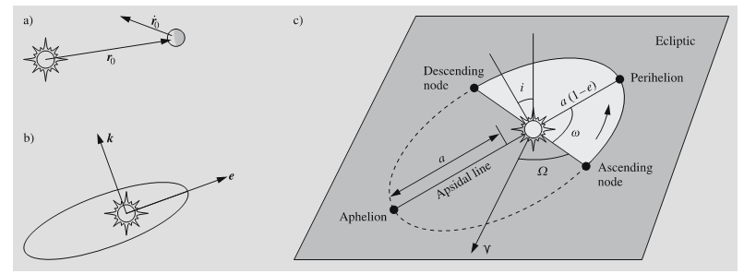
Orbital Elements
Semi-major axis (a)
Excentricity (e)
Inclination (i)
Longitude of the ascending node (Ω)
Argument of the perihelion (ω)
Long. of perihelion →
Time of the perihelion (τ)

Slide 24
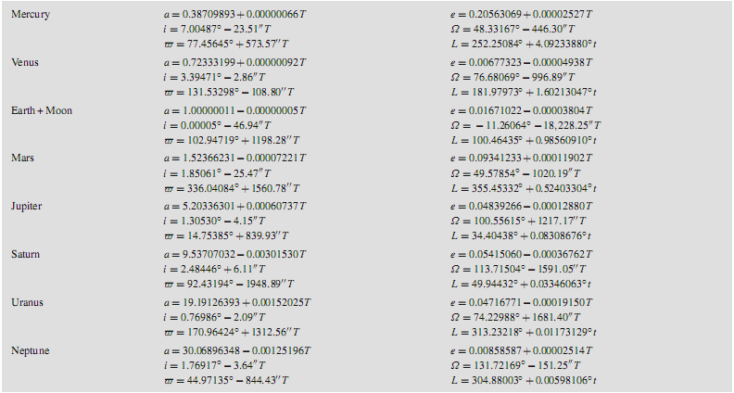

Slide 25
Areal Velocity and Harmonic Law

Slide 26
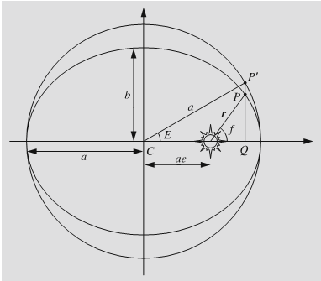
Position as a funtion of time
1.- We calculate the mean anomaly:
2.- We calculate eccentric anomaly from Kepler’s equation:
3.- We calculate true anomaly by using:
4.- We calculate distance to sun using the orbit equation:

Slide 27
Escape velocity
A body moving fast enough can escape the gravitational attraction of another body. That minimum speed is given by:
It can also be expressed in terms of the orbital velocit:

Slide 28
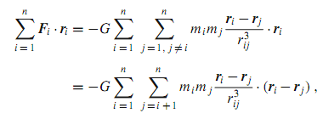
Virial Theorem
Si t→∞

Slide 30
Earth Movements
Rotation → Day
Revolution → Year/Seasons
Precession
Nutation

Slide 31
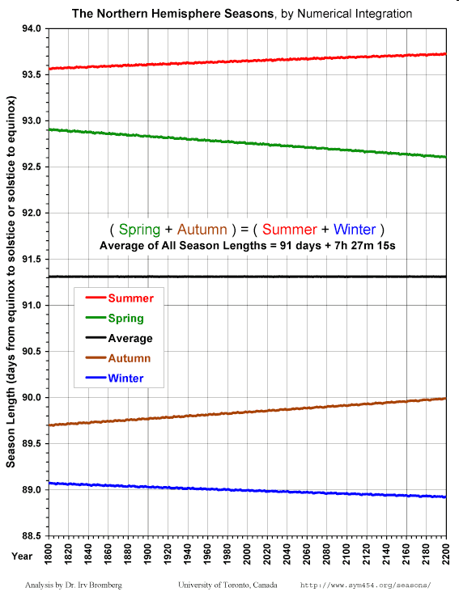
Length of seasons
Due to the varying speed of earth on its orbit and to precession, the length of seasons varies with time.

Slide 32
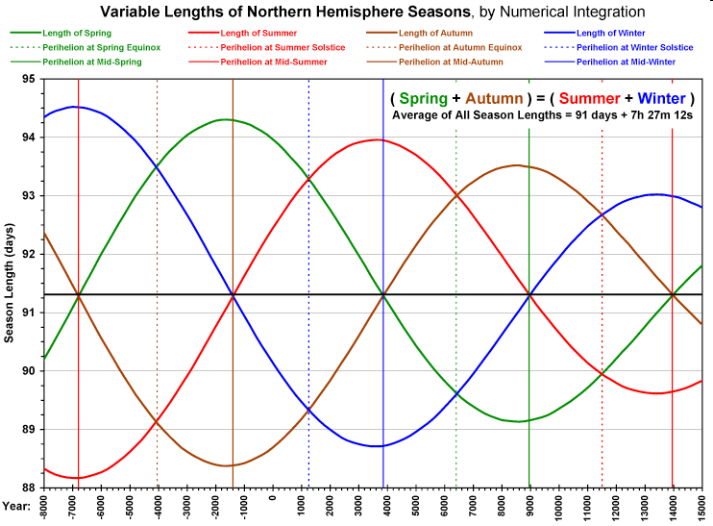

Slide 33
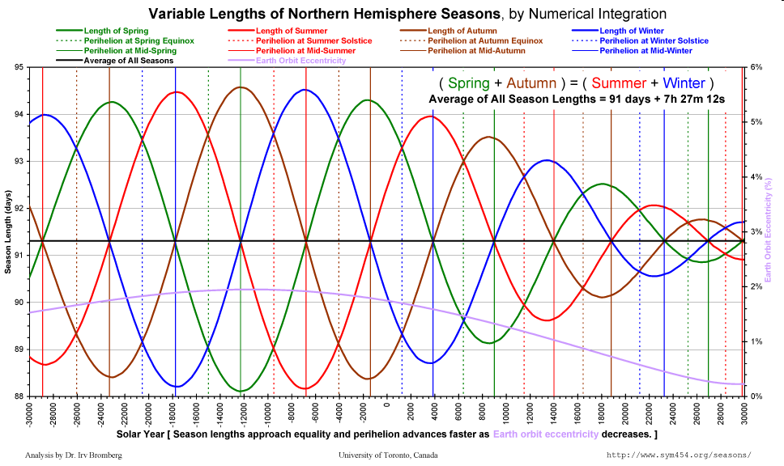

Slide 34
Types of year
La duration of a year is:
Measured with respect to the stars
365.256363051 d_{sol} (J2000) =
365d 6h 9m 9.7676 s → Sidereal year
Measured with respect to a point on its orbit in relation to equinox.
365.24218967 d =
365d 5h 48m 45s → Mean Tropical Year
Measured with respect to the line of apses
365.259635864 d=
365d 6h 13m 52s → Anomalistic year

Slide 35
Year and the calendar
The duration of a tropical year is not an integer number of days.
Moreover, we use to divide the year into months.
Months are moon related periods:
Sidereal month: 27.32 days.
Synodic month: 29.53 days.
Draconitic month: 27.21 days.
Anomalistic month: 27.55 days.

Slide 36
Year and the calendar (II)
If we take 12 (syn) months of 29.5 días, the tropical year is long by some 11 days.
If we take 13 months of 29.5 días, tropical year is shoft by some 18.5 days.
To put 12 months in a year of 365 days we need months of (average) 30.417.
Indeed, 365 days is roughly ¼ of day too short compared to the tropical year.
On 46 B.C. a reform was enforced by Juluis Cesar -> Julian Year -> “Last year of confusion”.

Slide 37
Julian Calendar
46 B.C. was 445 days long (67 extra days between Nov and Dec + intercalary in Feb. Of 23 days.).
From 44 B.C. onwards, years are 365 days long…. Except…
Every fourth year, an extra day is added (leap day). It used to be added after 23rd of February → “Dies bis sextus ante Kalendas Martias“ → Bisiesto.
Quintilis → Julius Cesar (44 B.C)
Sextilis → August (8 B.C)

Slide 38
Gregorian Reform
Julian calendar lags by nearly 1 day every 134 years with respect to the mean tropical year.
Holy days (most importantly Easter Sunday) was being shifted with respect to civil calendar.
In 1582 the shift of the Julian Calendar was already significant (10 days) and a reform was promoted by Pope Gregory XIII … wich is still in use:
The day after 4th Oct. 1582 is15th Oct. 1582.
A leap day is to be added on years divisible by 4, except years which are divisible by100 but not by 400. This way, the average duration of the year is:
(365*400+100-3)/400=365.2425 days (m.t.y.=365.24219)

Slide 39
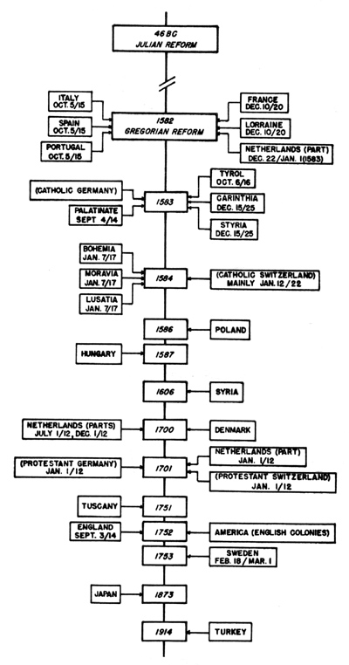
Aceptance of the Gregorian Calendar throughout the world

Slide 40
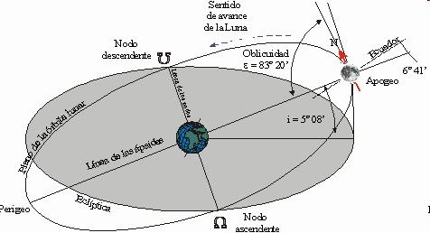
The Moon
Moon orbits earth with a period of:
Sidereal Month: 27.32 days.
Synodic Month: 29.53 days.
Draconitic Month: 27.21 days.(P(r)=18.6 y)
Anomalistic Month: 27.55 days. (P(d)=. 8.85 y)

Slide 41
Tides
A tide is the change in sea level produced by the effect of differential gravity.
The moon is the main cause. Sun does also has an influene, but roughly half as large as the moon.
It has a cycle of roughly 12h (modulated with the diurnal cycle).

Slide 42
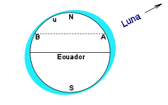

Slide 43
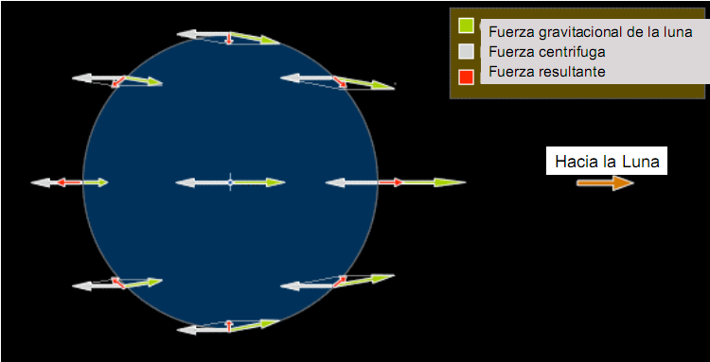

Slide 44
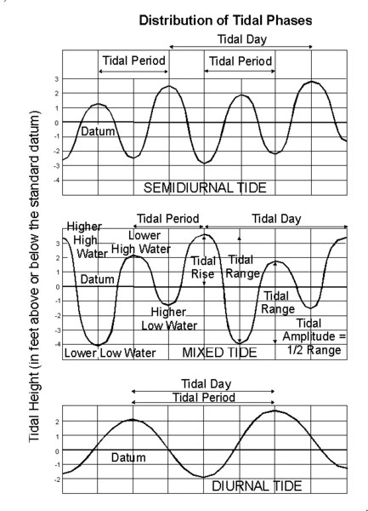

Slide 45
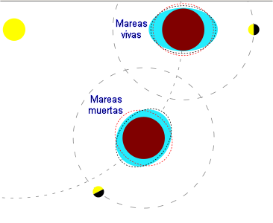
Spring and Neap tides

Slide 46
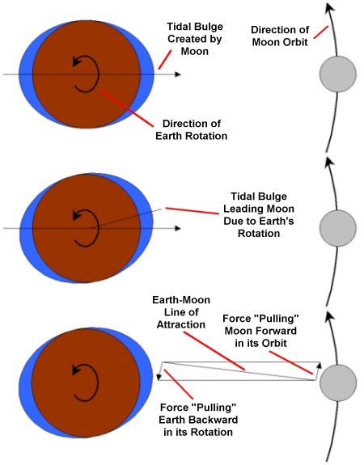
Tidal locking
Tidal forces have slowed down moon rotation to a point where their rotation and revolution periods match. Thus, we always see the same face of the moon.
This is a rather common phenomenon in the solar system known as tidal locking.
Now, moon slows down earth rotation, while it gets farther from earth.

Slide 47
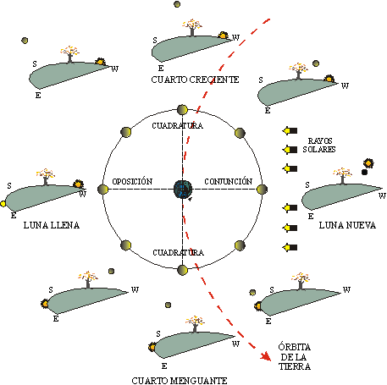
Moon Phases

Slide 48
Libration
Due to Kepler’s 2nd law, moon can run fast/slow during its revolution →longitude libration
Due to the inclination of its axis (88º) with respect to its orbit, we can see a but more in latitude → latitude libration
Due to the non negligible size of earth with respect to the moon’s distance → dirunal libration
All these effects make that we can see 58% of the surface of the moon.

Slide 49
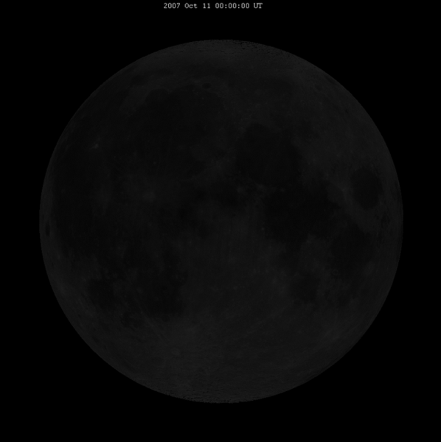

Slide 50
Transits and ocultations
When a celestial body passes in front of another we can get transits and/or ocultations:
The (app) smallest is in front → Transit
The smallest is behind → Ocultation

Slide 51
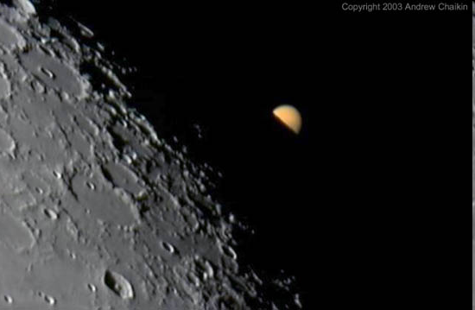

Slide 52
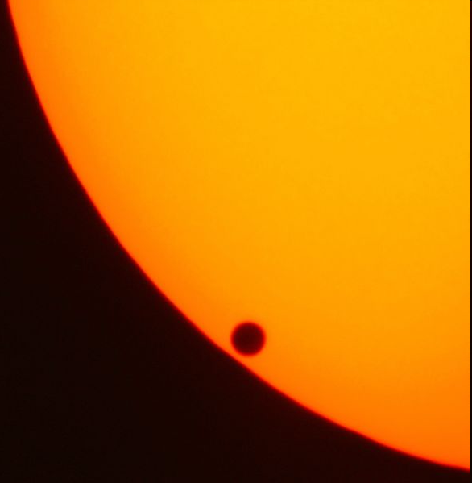

Slide 53
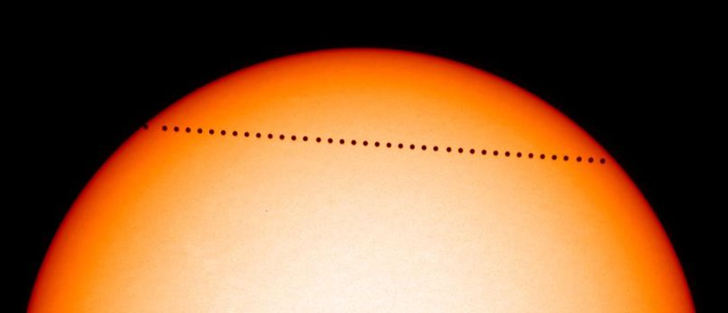

Slide 54
Eclipses
Eclipses take place when moon, earth and sun are in line:
If earth is between moon and sun → Moon Eclipse (Moon on earth shadow)
If moon is between earth and sun → Sun Eclipse (Sun is covered by moon)

Slide 55
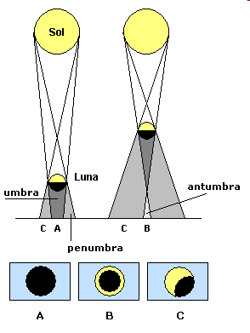
Sun Eclipse
They can be:
Total
Partial
Anular - Hybrid
Saros: Period of
223S=6585,3211 days
242D=6585,3567 days
239A=6585,5374 days
18 years and 11 days
Saros series do not last forever, but cycles of between 1226 and 1550 years.
Periods of three saros (exeligmos) produce similar eclipses over the same region of the earth.

Slide 56
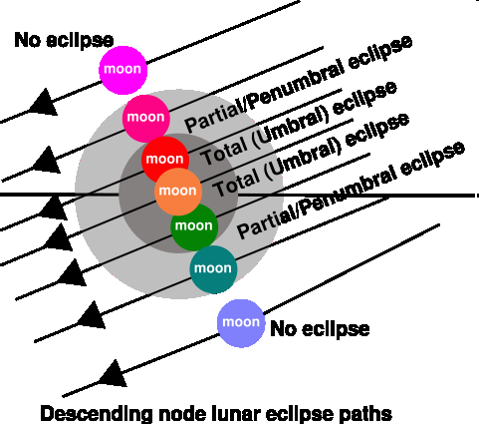

Slide 57
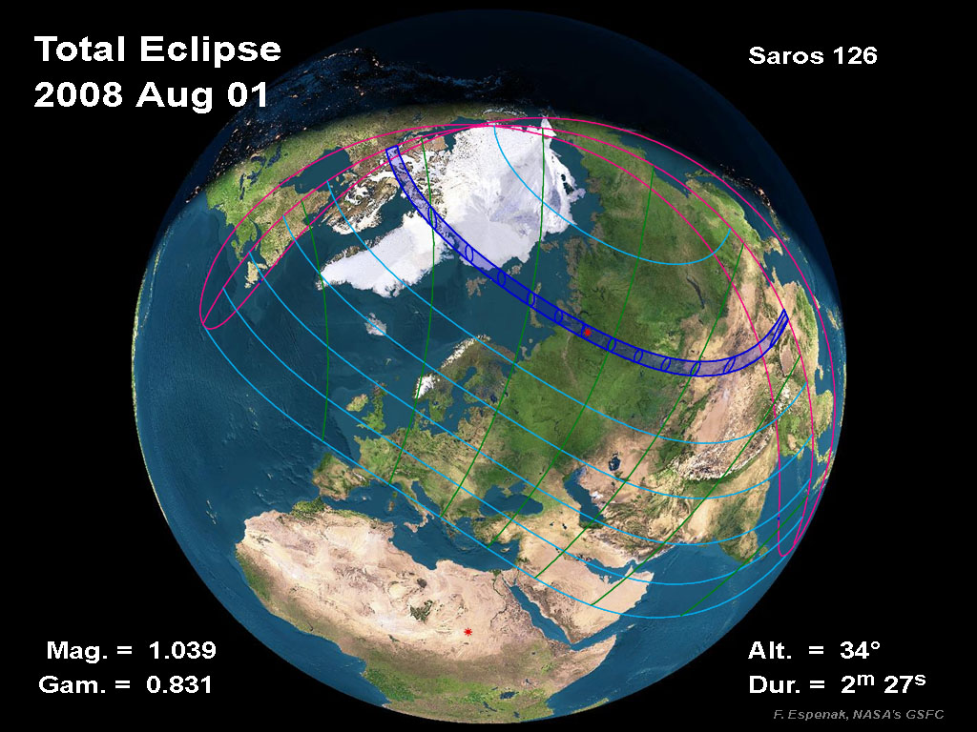

Slide 58
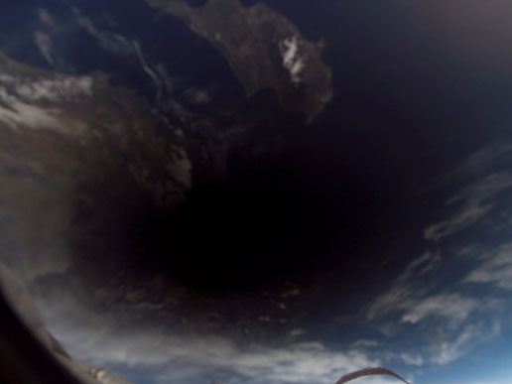

Slide 60
Moon Eclipse
It can be:
Total
Partial
Penumbral

Slide 61
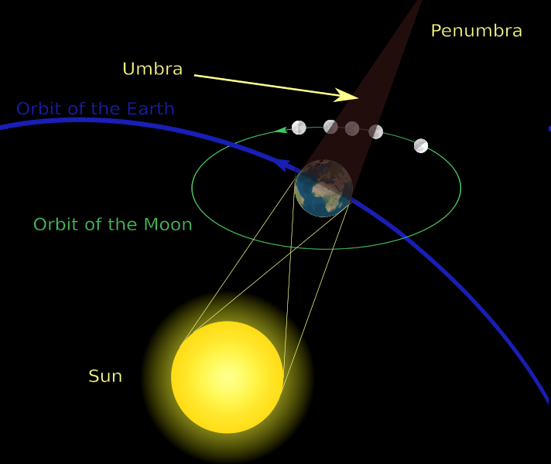

Slide 62
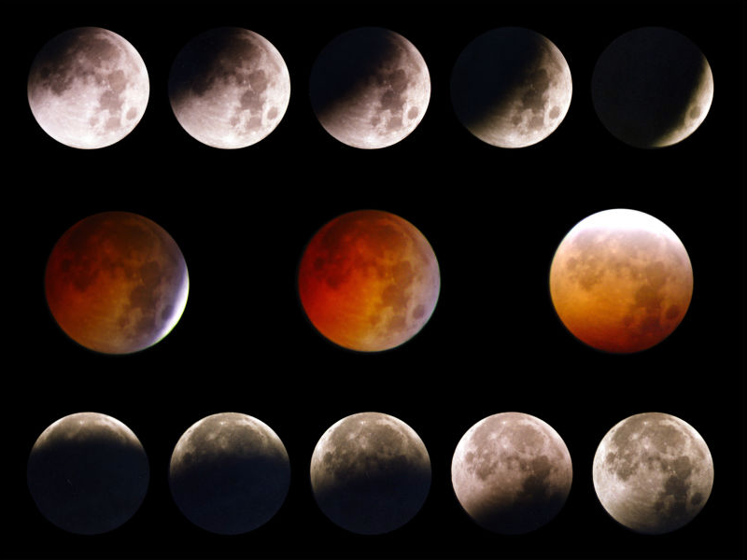

Slide 63
General Properties
 | Mercury | Venus | Earth | Mars | Jupiter | Saturn | Uranus | Neptune | (Pluto)
diámeter | 0.382 | 0.949 | 1 | 0.532 | 11.209 | 9.44 | 4.007 | 3.883 | 0.180
diámetrer (Km) | 4.878 | 12.104 | 12.756 | 6.787 | 142.800 | 120.000 | 51.118 | 49.528 | 2.300
Mass | 0.055 | 0.815 | 1 | 0.107 | 318 | 95 | 15 | 17 | 0.002
Distance | 0.39 | 0.72 | 1 | 1.52 | 5.20 | 9.54 | 19.18 | 30.06 | 39.44
Orbital Period | 0.24 | 0.62 | 1 | 1.88 | 11.86 | 29.46 | 84.01 | 164.8 | 247.7
Excentricity | 0.2056 | 0.0068 | 0.0167 | 0.0934 | 0.0483 | 0.0560 | 0.0461 | 0.0097 | 0.2482
Rotation Period | 58.65 | -243* | 1 | 1.03 | 0.41 | 0.44 | -0.72* | 0.72 | -6.38*
Axis Inclination | 0.0 | 177.4 | 23.45 | 23.98 | 3.08 | 26.73 | 97.92 | 28.8 | 122
Gravity | 0.38 | 0.9 | 1 | 0.38 | 2.64 | 0.93 | 0.89 | 1.12 | 0.06
Escape velocity | 4.25 | 10.36 | 11.18 | 5.02 | 59.54 | 35.49 | 21.29 | 23.71 | 1.27
density | 5.43 | 5.25 | 5.52 | 3.93 | 1.33 | 0.71 | 1.24 | 1.67 | 2.03
composition atm | Ninguna | CO₂ | N₂+O₂ | CO₂ | H₂+He | H₂+He | H₂+He | H₂+He | CH₄
Satellites | 0 | 0 | 1 | 2 | 17 | 28 | 21 | 8 | 1

Slide 64
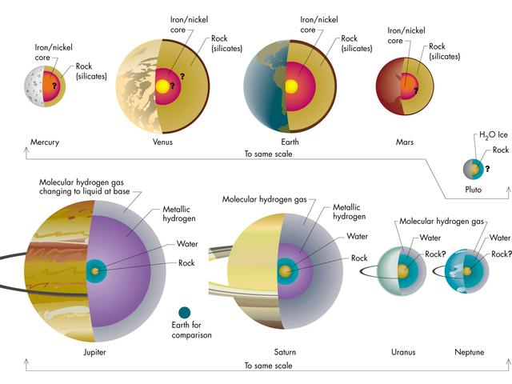
Notes:
Sketches of the interiors of the planets. Details of sizes and composition of inner regions are uncertain for many of the planets. (Pluto is shown with the terrestrial planets for scale reasons only.)
Planetas terrestes:
Todos tienen núcleo de Ni-hierro.
El interior se estudio con ondas sísmicas, y mediendo (cuando una sonda se acerca) el campo gravitatorio.

Slide 65
General Properties
 | Mercury | Venus | Earth | Mars | Jupiter | Saturn | Uranus | Neptune | (Pluto)
diámeter | 0.382 | 0.949 | 1 | 0.532 | 11.209 | 9.44 | 4.007 | 3.883 | 0.180
diámetrer (Km) | 4.878 | 12.104 | 12.756 | 6.787 | 142.800 | 120.000 | 51.118 | 49.528 | 2.300
Mass | 0.055 | 0.815 | 1 | 0.107 | 318 | 95 | 15 | 17 | 0.002
Distance | 0.39 | 0.72 | 1 | 1.52 | 5.20 | 9.54 | 19.18 | 30.06 | 39.44
Orbital Period | 0.24 | 0.62 | 1 | 1.88 | 11.86 | 29.46 | 84.01 | 164.8 | 247.7
Excentricity | 0.2056 | 0.0068 | 0.0167 | 0.0934 | 0.0483 | 0.0560 | 0.0461 | 0.0097 | 0.2482
Rotation Period | 58.65 | -243* | 1 | 1.03 | 0.41 | 0.44 | -0.72* | 0.72 | -6.38*
Axis Inclination | 0.0 | 177.4 | 23.45 | 23.98 | 3.08 | 26.73 | 97.92 | 28.8 | 122
Gravity | 0.38 | 0.9 | 1 | 0.38 | 2.64 | 0.93 | 0.89 | 1.12 | 0.06
Escape velocity | 4.25 | 10.36 | 11.18 | 5.02 | 59.54 | 35.49 | 21.29 | 23.71 | 1.27
density | 5.43 | 5.25 | 5.52 | 3.93 | 1.33 | 0.71 | 1.24 | 1.67 | 2.03
composition atm | Ninguna | CO₂ | N₂+O₂ | CO₂ | H₂+He | H₂+He | H₂+He | H₂+He | CH₄
Satellites | 0 | 0 | 1 | 2 | 17 | 28 | 21 | 8 | 1

Slide 67
Atmospheres
Hidrostatic Equilibrium: dP = -gρ dh
Ideal Gas : P = NkT/V = NµkT/(Vµ) = ρkT/µ
→ ρ = Pµ/kT
where:
N: Number of atoms or molecules
k : Boltzmann constant
µ : mass of atom or molecule
dP = -g µPdh/kT →
P = P₀ exp(-∫gµdh/kT) = P₀ exp(-∫dh/H)
Scale height H = kT/µg → indicates the height in which pressure diminishes by 1/e

Slide 68
Thermal radiation of planets
Albedo is the fraction of reflected radiation. Is the ratio of the reflected to the incident flux.
Thermal radiation of planets: Planets are warmed by sun and they emit as a blackbody (when in thermal equilibrium)
Can we calculate the temperature of a planet?
How much energy does it radiate?

Slide 69
Thermal radiation of planets (II)
Slow Rotation:
Fast Rotation:

Slide 70
Temperaturas teóricas y reales
Planeta | Albedo | Distancia del Sol [UA] | Temp. teórica, rotación lenta [K] | Temp. teórica, rotación rápida [K] | Temp. Medida máxima [K]
Mercurio | 0.06 | 0.39 | 525 | 440 | 615*
Venus | 0.76 | 0.72 | 270 | 230 | 750
Tierra | 0.36 | 1.00 | 290 | 250 | 310
Marte | 0.16 | 1.52 | 260 | 215 | 290
Júpiter | 0.73 | 5.20 | 110 | 90 | 130
Temperatura medida > Temperatura teórica. Razones:
Calor interno (planetas exteriores)
Radiación térmica no puede salir de la atmósfera → efecto invernadero
*Más alta que temperatura teórica por la excentricidad de la órbita: La temperatura promedia en Mercurio es 440K.
Notes:
De “Fundamental Astronomy”, p. 177

Slide 71
Magnetic field
For a planet to have a magnetic field it needs a conducting material and a fluid interior + rotation.
Strong magnetic field: Saturn, Jupiter,Earth, Uranus, Neptune
Weak magnetic field: Mars (cold and viscous nucleus), Mercury (slow rotation)
No magnetic field: Venus (slow rotation), Moon (cold nucleus and slow rotation)

Slide 72
Magnetospheres
Earth (and some other planets) have an important magnetic field.
Magnetosphere protects the planet (us !!) from solar wind (high energy charged particles coming from the sun)
Magnetopause

Slide 73
Mercury
Very eccentric orbit (e = 0.21). Perihelion is at 46 mill km and aphelion at 70 mill km → huge temperature variations (100K).
Rotation period of 59 days and revolution period of 88 días (ratio 2:3) → A day in Mercuriy is 2 years or 176 or earth days. This spin-orbit resonance is due to tidal forces early on (similarly to what happened to the Moon).
Temperature varies from 700º C at midday to -100º C at night.
Very weak magnetic field (1% of the value on earth).
It is small and has no atmoshere. His surface is covered with craters as in the Moon’s surface
It was the least known planet. It was visited by Mariner 10 in the 70’s and by MESSENGER in 2011.

Slide 74
Venus
Is the most similar planet to Earth in size, but still, very different!!.
It has no satellites or magnetic field.
Atmosphere: CO₂ (96.5%), N₂ (3.5%). Atmospheric pressure is 92 times higher than on Earth!!.
Just 3% of solar radiation reaches its surface. Infrared radiation cannot escape due to absorption by CO₂ → greenhouse effect -> surface temperature of 750 K!!

Slide 75
Venus
Retrograde rotation with a period of 243 days (measured by radar)
Despite a chemical composition similar to Earth, it has lost all water and its surface is extremelly dry.
Highest mountain: 11km.
There are volcanic structures
Craters by meteorite hits, but less than in Mercury → Its surface is younger because of volcanic activity
Imagen por radar

Slide 76
Earth
Densest planet in the solar sysmtem with 5.52 gr/cm^{3.}
Atmosphere composed by 78% N and 21% O.
Earth-Moon system is somewhat peculiar: Moon is quite big compared to Earth (1/3.7).
Outer nucleus and mantle are fluid.
The outer nucleus is indeed responsible for the earth magnetic field.
Notes:
El núcleo interior es posiblemente sólido

Slide 77
Mars
Highly eccentric orbit 0.093 (> 5 times larger than Earth’s) produces strong temperature variations from -170º C at sunset in winter to 20º C at midday in summer. Average temperature is some -60ºC.
Its characteristic red colour is due to rusty irion dust kicked up in the atmosphere.
Vallis Marineris,is a 5000 km long cannon.
Mount Olympus is a 24 km high moutain
Notes:
Se ve Valles Marineris, un cañon enorme (5000 km de largo).
Altura del Monta Olimpo (montaña más alta): 25km

Slide 78
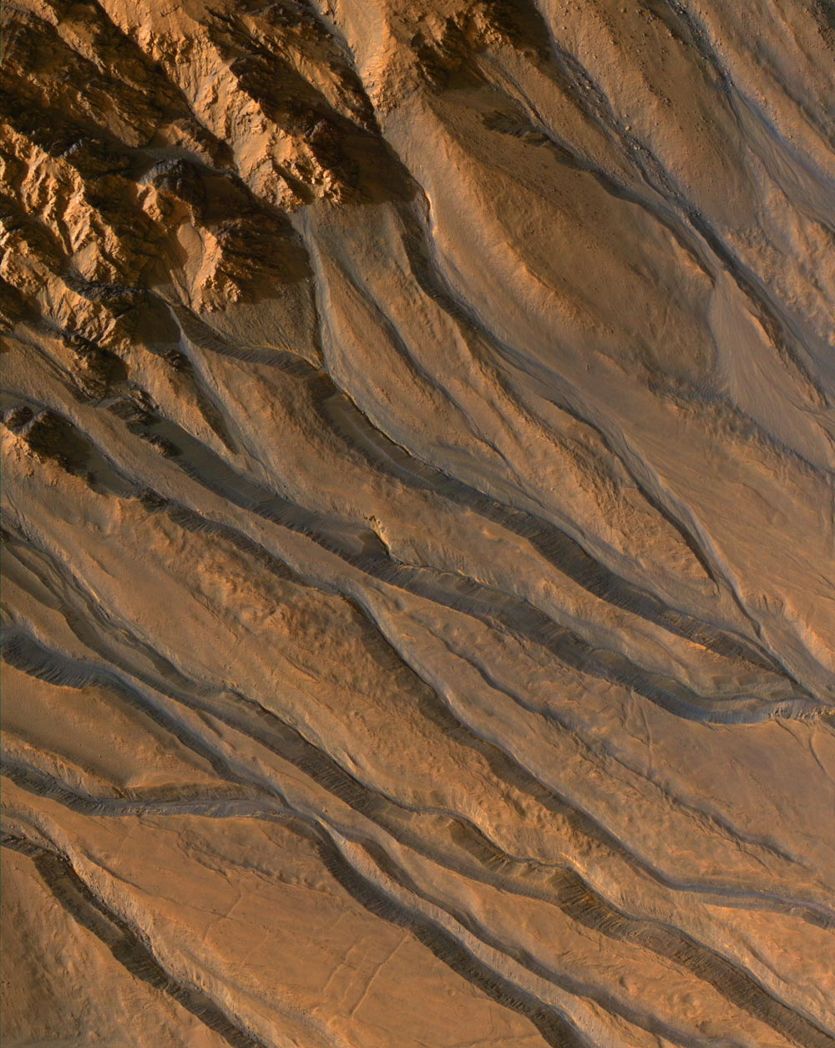
Mars has a thin atmosphere (compared to Earth) composed by 95 % CO₂, 2% N₂ and 0.1-0.4% O_{2.}
Due to seasonal changes, one fourth of the atmosphere freezed during winter in the polar caps (water and CO₂ ice)
There are evidences of the past existence of fluid water on the surface.
Hubble Space Telescope image of Mars taken in 1995 (opocition). Polar caps can be seen.
Notes:
Picture of Mars made by the Hubble space telescope orbiting Earth. (Courtesy HST.)
How big across is the polar cap in this picture? (Estimate its size from the radius of Mars, which you can look up in the appendix).

Slide 79
Mars surface as seen by Viking Lander (EEUU, 1976)
Notes:
Viking Lander

Slide 80
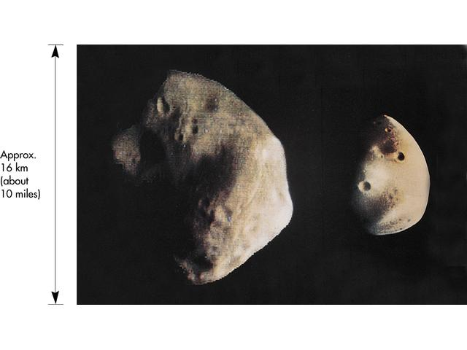
Mars satellites: Phobos y Deimos. Ph. Orb. Per.: 7h39m.
Notes:
Picture of Phobos and Deimos, the moons of Mars. These tiny bodies are probably captured asteroids. (Courtesy NASA/JPL.)

Slide 81
Jupiter
Jupiter is the largest planet in the solar system. Its mass doubles the sum of the mass of all the other planets.
If Jupiter was ~70-80 times more massive, it would have become a star!!.
It is the fourth brightest object in the sky (after the Sun, Moon and Venus) and known since prehistoric times.
It emits 2 times more energy that what receives from the sun (mostly internal energy).
Jupiter has a very strong magnetic field.
Fast rotator -> flattened

Slide 82
Jupiter
Jupiter presents light and dark bands due to different temperature and composition with winds of over 600 km/h.
The most conspicuous feature is the Great Red Spot. A huge (12000x25000 km -> bigger than earth!!) anticyclonic storm persistent for over 300 years !!.

Slide 83
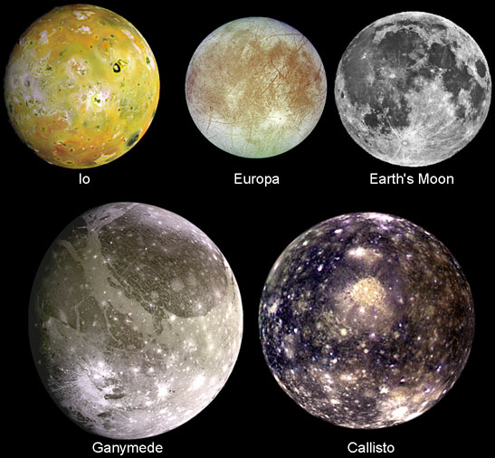
Jupiter ring and satellites
Although not as conspicuous as Saturn’s ring, Jupiter also features a ring, which is composed mostly of dust particles.
Jupiter has more than 63 satellites. The four biggest Galilean moons (shown with the Moon for comparison)

Slide 84
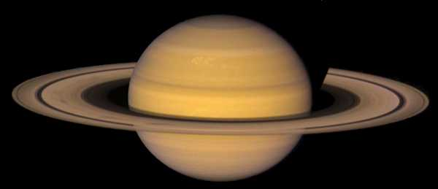
Saturn
Saturn is the second largest planet in the solar system.
Galileo already noticed something “strange”, but it was not until 1659 that Huygens correctly understood the geometry of the ring.
A gaseous planet, as the other giants, it is made mostly of hydrogen and helium.
The less dense planet of the solar system (d=0.7g/cm³). It would float on water!!!

Slide 85
Saturn
Saturn is very flattened (the polar and equatorial radii differ by 10%) due to its fast rotation.
The rings are made by rocks of different sizes (from cm to several m).
They are extremely thin (<1.5km thick!!) for a huge diameter of 250000 km!!!
(Paper is 0.1mm thick !!)

Slide 86
Saturn’s satellites
Saturn has 47 known satellites. Only 7 of them are large enough to adquire spherical shape.

Slide 87
Uranus
Uranus was discovered in 1781 by Sir William Herschel. Although it had been seen before but taken for a star.
Uranus is peculiar with its rotation axis inclined 98 degrees with respect to the ecliptic.
Uranus atmosphere is composed of H (83%), He (15%), methane (2%), and traces of acetylene and hidrocarbures .
Absorption by methane is responsible for its characteristic blue colour.
It has rings less pronounced than Saturn’s but more than Jupiter’s. It has 27 satellites.
Its magnetic field is inclined 60º with respect to the axis and off centered.

Slide 88
Neptune
Its existence was predicted!! In 1845/46 by John Adams and Urbain Le Verrier as responsible for the perturbed orbit of Uranus.
First seen by Galle and D’Arrest the 23rd september 1846.
Neptune’s atmosphere is composed of hydrógen, helium and methane.
The outermost planet of the solar system.
It was weak rings and 8 satellites
It also has an inclined and off centered magnetic field.

Slide 89
Long period comets and the Oort cloud
Cometas are classiffied according to their periods:
Short period comets (T between 20 and 200 years)
Long period comets (T between 200 and thousands of years)
In 1950 Oort noticed that:
Long period omets do have a peak in their aphelia at 20 000 UA (0.1 pc)
They are quite isotropic.
He proposed the existance of a spherical cloud “Oort cloud”
Gravitaonal interaction (among comets themselves or with other bodies) alter their orbits and comets are thrown towards the inner solar system in eliptic orbitas .
Its existence has not yet been confirmed!!
Notes:
Cual es la distancia del afelio de un cometa con periodo de 200 años y uno con 10 milliones de año?

Slide 90
Kuiper belt and “transneptunian” objects
In 1951 Kuiper proposed the existence of a disc in the outer solar system formed of small bodies.
In 1992 the first object of this “Kuiper belt” was found
Over 1000 objetcs are known to date.
Estimates are that there should be some 70 000 objects with diam >100km
Kuiper belt is shaped as a torus between ~ 30 y 50 AU
Proposed to be the home of short period comets, this theory is now superseded.
There is a region, overlapping with the outer Kuiper belt called scattered disc
Unstable orbits
May be the home of short period comets.
Objects with orbits larger than Neptune are called “transneptunian objects”
Notes:
Cual es la distancia del afelio de un cometa con periodo de 200 años y uno con 10 milliones de año?

Slide 91
Transneptunian objects
Quaoar:
Kuiper Belt Object
Sedna:
Huge orbit (aphelion at 937AU!!)
. Scattered disc object? Oort cloud?

Slide 93
Pluto?
Planet or Kuiper Belt Object?

Slide 94
Definition of planet and similar bodies
A planet is (→ 8):
A body orbiting the sun
Massive enought as to reach hydrostatic equilibrium (→spherical shape)
Has cleaned its orbit of other large bodies.
A dwarf planet is (→ Pluto):
A body orbiting the sun
Massive enought as to reach hydrostatic equilibrium (→spherical shape)
Has NOT cleaned its orbit of other large bodies.
It is NOT a satellite
Rest of bodies are called “small solar system bodies”

Slide 95
Formation of solar system
First theories pointed towards a catastrophic event:
A comet passing by close to the sun originates mass loss.
Comet mass is too small
Nearby star passing by generates sun mass loss
Star collision or nearby passing by very unlikely
Alternative: Formation from a gas cloud
1755: Kant proposes in his “Universal Natural History and Theory of Heaven” the formation from a flat rotating nebula
1796: Laplace, independently, makes the same proposal
→ Quite close, but it cannot explain angular momentum distribution in the Solar System

Slide 96
Observational evidence
Orbits of planets:
Nearly circular
Same plane
Sense of rotation equal to Sun’s rotation
Planet rotation:
Rotation axis nealry perpendicular to solar systema plane (except Uranus)
Direct rotación (same sense as revolution) (except Venus)
Angular Momentum Distribution:
Sun has 99.87% of mass, but only 0.54% of angular momentum
Planets have 0.1355 % of mass (mostly in Jupiter and Saturn), but 99.46% of angular momentum

Slide 97
Observational evidence (II)
4) Diferences between inner and outer planets
Innner: slow rotation, small, high density (contain many metals)
Outer: fast rotation,big, low density (large fraction of H)
5) Planet-Satellite systems are similar to Sun-Planets system:
Impact Craters in some planets and satellites
Asteroids, comets – Oort Cloud, Kuiper’s belt
Meteorite composition is differents to planets and satellites
Solar system age: formed quickly.

Slide 98
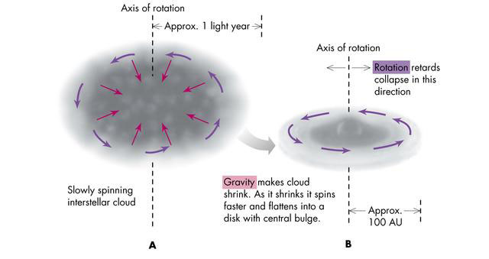
Stellar formation
Interstellar Cloudr:
Composed of:
H, He (primordial elements)+ Heavier elements (created inside earlier stars)
Notes:
Photograph of an interstellar cloud (the dark region at top) which may be similar to the one from which the Solar System formed. (Anglo-Australian Telescope Board, photo by David Malin.)
Sketch illustrating the (A) collapse of an interstellar cloud and (B) its flattening.

Slide 99
Los granos de polvo se pegaron y formaron objetos más grande
Se formaron “planetisimales” (objetos de diametros de unos km)
Planetisimales colisionan y forman planetas

Slide 100
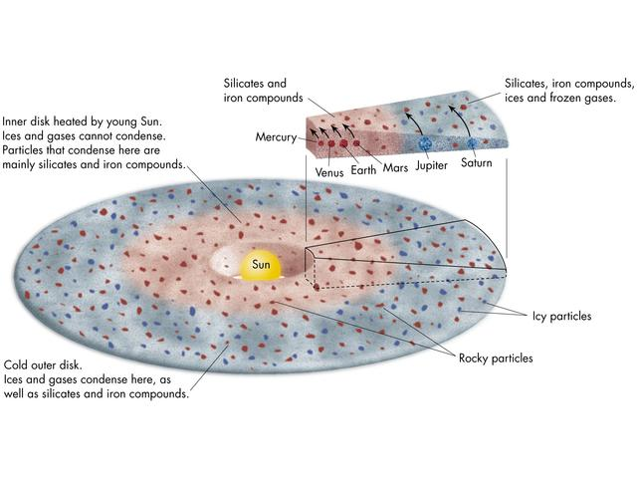
Diferences between inner and outer planets: Lower Temperature in the outer regions.
Diferencie betwen inner and outer planets: water freezing → “ice line” at ~5 AU
Outer regions:
Lower Temperatures → material with low evaporation temperature can condense (gases)
Condensation starts earlier → bodies become larger
Once formed, planets gravitatioally attract surrounding material. They clean a ring around them. Jupiter and Saturn attract a lot of matter, including much gas, due to their large mass and early formation
Once nuclear system in the sun starts, solar wind cleans the system from small planetisimals → end of planet formation
Notes:
Artist's depiction of the condensation of dust grains in the solar nebula and the formation of rocky and icy particles.
De donde viene elementos mas pesados que H y He?

Slide 101
Origin of other objects
Oort Cloud:
Objects ejected by interactions with giant planets
Kuiper Belt:
Remanent from planetary disk
Planetesimals and asteroids not accreting enough material to become larger.
Asteroids: Planetisimimals large enough to be blown away but which coulnt not form a planet due to Jupiter tidal effects.
Satellites : Different scenarios :
Disk around a planet similar to planet formation
Some satellites of giant outer planets
Capture of an asteroid (→ Mars)
Impacto of a big object (→Earth)

