Slide 1
Introduction
Fundamental Astrophysics

Slide 2
Definition and purpose
Astronomy appeared a few thousand years ago as a descriptive “science” on the position and motion of sun, moon, planets and stars.
Today, it is more directed towards understanding the universe in physical terms→ Astrophysics
Astronomy is an “observational” science -> We can “observe” the skies, but we cannot manipulate it (make experiments) … maybe with a few exceptions

Slide 3
What does Astrophysics study?
It studies:
  Earth (as a planet), moon, planets, comets, and other objects in the solar system.
  Stars: how the form, evolve, work, their distribution, motions, etc..
  Galaxies: their structure, motions, what are they made of, their evolution, the interstellar medium, etc..
  Galaxy clusters, large scale structure …and … the universe as a whole.

Slide 4
Sources of information
Matter:
  Fragments of meteorites
  Material taken by space vehicles
  Cosmic rays and neutrinos
Waves:
  Electromagnetic waves
  Gravitational waves

Slide 5
A little bit of history
Prehistoric interest in astronomy (6000 b.C. – 700 b. C.)
  Seasons
  Cultural/Religious
Early civilizations (Near East/Egypt) (2000 b.C. – 600 b.C.)
Greek astronomy
  Presocratics (6th century b.C. – 5th cent. b.C.)
  Plato and Aristotle (4th cent. b.C.)
  Eratosthenes and Aristarchus (3rd cent. b.C.)
  Hipparchus and Ptolemy (2nd cent. b.C – 2nd cent. A.D)

Slide 6
Newgrange (Ireland)
Newgrange is a prehistoric tomb (approx. 3000 b.C.) located in northern Ireland.
A couple of decades ago it was foud that its entrance was carefully oriented.

Slide 7
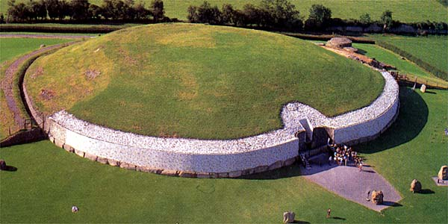
Newgrange (II)

Slide 8
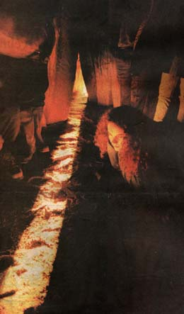
Newgrange (VI)

Slide 9
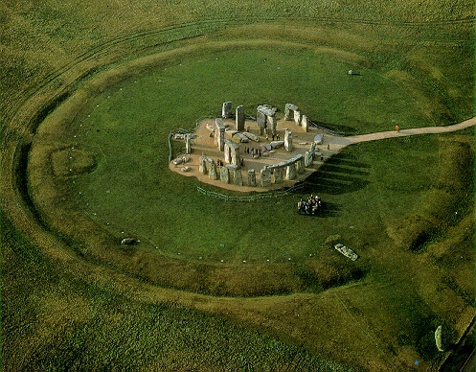
Stonehenge

Slide 10
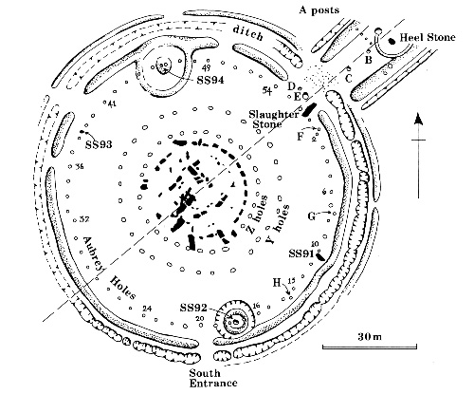
Stonehenge (present state)

Slide 11
Babylon
Babylon was a great city located some 90 km south of present day Baghdad (Irak).
Dominated by the Hammurabi dinasty (2000-1600 b.C.), conquered by hittites, then kassites, then assyrians (Niniveh lib. destroyd in 612 b.C.).
After a brief period of independence it felt under persian domination until it was conquered by Alexander the Great.

Slide 12
Babylonian Astronomy
Babylonians developed a very effecient counting system.
They are the orgin of our present use of division into 60 parts in:
  Grades (angles)
  Hours, minutes…
Their interest in astronomy was mainly to look for “omens”… warnings from heaven…

Slide 13
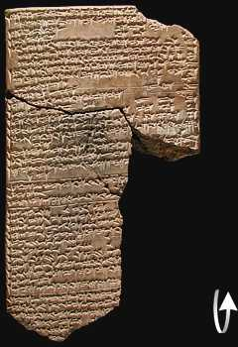
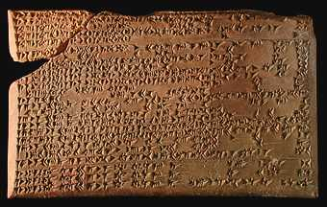
Enuma (II)

Slide 14
Egyptian Astronomy
Egyptians lacked an efficient numeric system.
They used stars (36 “decans”) to measure the passing of time during night.
The need to determine the flooding period of the Nile river made necessary to have an accurate calendar.
Around 2500 b.C. , the year was divided into three seasons of four months each:
  Inundation, growth and harvest.
They used Sirius (Sothis) heliacal rising as a signal to determine the period of Nile flooding.
Forcing this event to take place in the12th month, the calendar can be put under control .

Slide 15
Egyptian Astronomy (II)
Afterwards, this system changed for a year of 12 months of 30 days eahc + 5 extra days (epagomenal).
This sytem was used until modern times !!!
It shifts with respect to the seasons, but a leap year system was not tried until the end of the 3rd century b.C.

Slide 16
Greek Astronomy
The movements of “planets” (particularly retrograde movs.) seem to contradict the idea of “regular” and inmutable skies.
Plato proposed that their motions must be regular and must follow circular uniform patterns.
Eudoxus of Cnidus (400-347 b.C.) proposed an ingeniuos solution: the hippopede

Slide 17
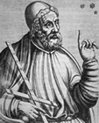
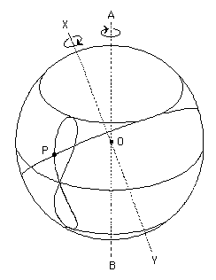
Eudoxus’ Hippopede (~370 b.C.)
Planets need four spheres, and sun and moon only three.
A total of 27 spheres were necessary to explain the motions of all planets.
Calippus de Cyzicus increased the model to 34 spheres

Slide 18
Aristarchus of Samos
Aristarchus of Samos (310-230 b.C.) calculated the ratio of sun to moon distances by measuring the angle moon-earth-sun at the exact instant of quadrature.
  It is a very difficult measurement. Aristarchus failed in his measurement (he took 3º away from 90º when the real value is only 1/18th of that estimate). He deducted that the moon is 19 times closer that the sun (which is 20 times less that the real ratio).
  He even dared to propose that earh was also a moving planet !!!. He preceded Copernicus by some 17 centuries!!!

Slide 19
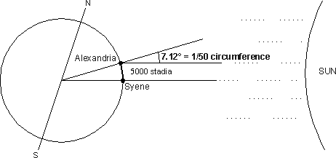
Eratosthenes and the size of the earth

Slide 20
Circular orbits
Greek astronomers exploited all possibilities of circular orbits to explain planetary motions.
Around 200 b.C. Apollonius of Perga studied two alternatives to variants of the hippopede to explain planetary motions:
  Uniform motions on an excentric circle.
  Epicycles and deferents.
His work is conserved in book 12th in the Almagest.
Circular uniform models of this type can never reproduce accurately planetary motion… but we had to wait until the 17th century for someone else to explore other alternatives…

Slide 21
Hipparchus of Nicaea
All his works but one are lost. But his findings have reached us by the constant references to his work within the Almagest.
He used babylonian data on eclipses and he tried to develop a suitable model.
  Translate and date (to a common calendar) all those measurements.
  Develop the geometry necessary to solve the problems.
He made a catalogue with positions and brightness of some 800 stars.
He defined the magnitude system
He discovered the precession of the equinoxes (1º per century vs the real 1º per 70 years).

Slide 22
Ptolemy and the Almagest
He lived in the 2nd century.
He spent most of his life in Alexandria.
He wrote the “Megale sintaxis” known in antiquity as “The great compilation”. It was translated to arabic as “al-majisti” and then to latin “Almagestum”.
It provides geometrical models and tables to calculate the position of the sun, the moon and the planets at any time.
It contains a catalogue of nearly 1000 stars in 48 constellations, including positions and brightness.

Slide 23
Ptolemaic cosmology
This cosmological model, as well as the geometrical models of planetary motion will survive with little modifications until Renaissance.
It will be used, studied and taught during nearly 14 centuries.
During the following centuries, the geometrical models will be refined, as well as their parameters, but geocentrism will not be abandoned until Copernicus,…or even later, until Kepler’s time!.

Slide 24
A little bit of history (II)
A travel to the east and back (4th – 12th cent.)
Recovery of greek tradition ( 12th – 15th cent.)
Copernicus and heliocentrism (16th cent)
A change of perspective (16th – 17th cent)
  Tycho Brahe (1546 -1601)
  Johannes Kepler (1571 - 1630)
  Galileo Galilei (1564 -1642)
  René Descartes (1596 – 1650)
Newton and newtonianism (1643 -1727)
Enlarging the universe (s. XVIII – s. XXI)
  Stars (Herschel, Kelvin, Helmholtz, Eddington, Hertzsprung, Russel, etc…)
  Galaxies (Herschel, Huggins, Shapley, Kapteyn, Hubble,…)
  Cosmology (Einstein, Hubble, ….)

Slide 25
Astronomy in the Middle Ages
After the fall of the roman empire, the knowledge of the classical world move to the east, where they are appreciated and even enlarged under islamic domain.
With the reconquest of the iberic peninsula by christians (and also by contacts with the bizantine empiera) that knowldege is recovered for the western world.
During the 12th to 15th centuries a great cultural resurgence takes place in Europe (including the birth of universities)

Slide 26
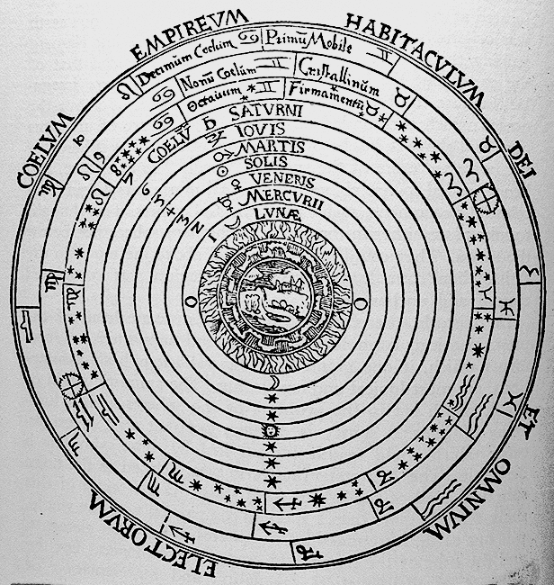

Slide 27
Copernicus and heliocentrism
Nicolaus Coprnicus (1473-1543) introduced a mathematical model of planetary motion which is (more or less) sun centered.
It also includes epicycles and it assigns three movements to the earth.
It was not superior to Ptolemy’s in accuracy or simplicity (except for a few… but relevant points).

Slide 28
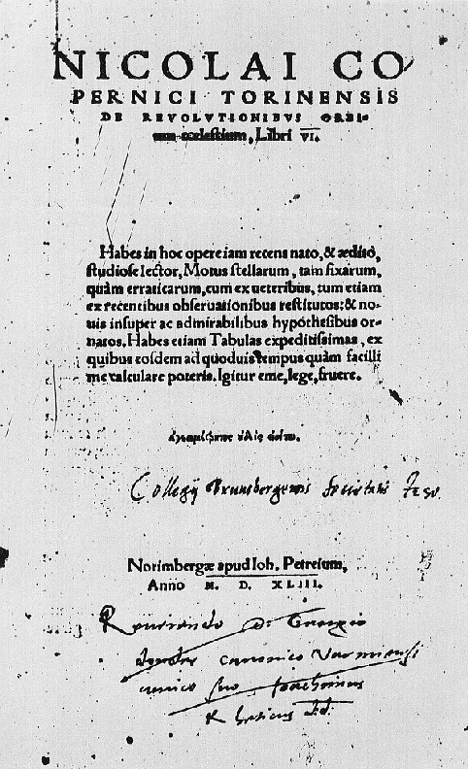

Slide 29
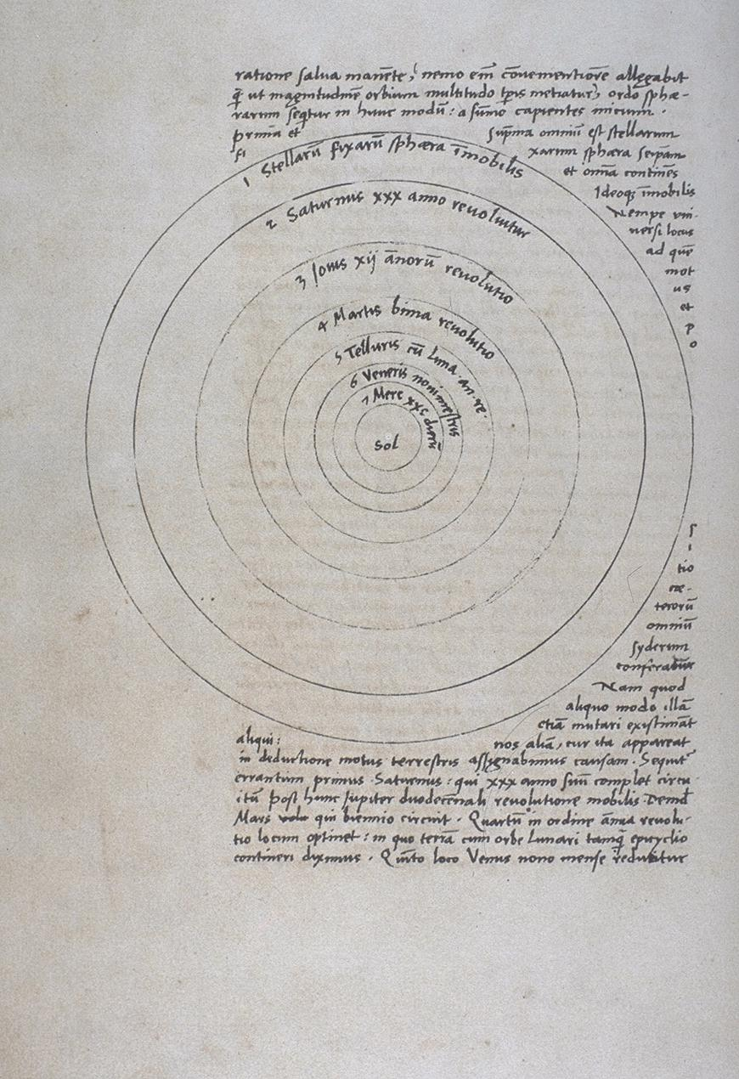

Slide 30
Tycho Brahe
Tycho Brahe (1546-1601) achieves an extraordinary improvement in the precission of astronomical observacions (still without telescopes).
His observations, particularly those of planet Mars, will be key for further avances.

Slide 31
Johannes Kepler
Johannes Kepler (1571-1630) will use Tycho Brahe’s observations of Mars.
He will apply the heliocentric hypothesis assuming that the sun is the origin of planetary motions, and he will find his famous three laws:
  First law: Elliptical orbits
  Second law: Equal area law
  Third aw: Harmonic law

Slide 32
Galileo Galilei
Galileo Galilei (1564-1642) introduced the use of the telescope into astronomy.
He observed:
  Many more stars that cannot be seen with the unaided eye
  Sun spots
  Jupiter satellites
  Saturn “companions”
  Venus phases

Slide 33
Galileo Galilei
Galileo:
He DID NOT invent the telescope
He DID NOT proved heliocentric theory

Slide 34
Newton
Isaac Newton (1643-1727) will manage to explain planetary motion from the law of gravitation and the fundamental laws of dynamics.
This will give birth to “Celestial Mechanics”, which will allow to explain many observational facts, and will allow new discoveries (like that of planet Neptune)

Slide 35
More progress..
During the 17th and 18th centuries, telescope construction develops.
Since the 18th century, astronomy gets more interested in stars.
Distance to stars will be measured by the 19th century.
During the 19th century, the introduction of spectral analysis and photography into astronomy will lead to a new era → Astrophysics.
In the early 20th century, we will find that we live in a galaxy among the many that populate the universe.
The 20th century lead us to space travel and scientific cosmology…
In the 21st century…. TO BE CONTINUED

Slide 36
Astrophysics - Extremes
Size:
  From asteroids (m) to the size of the universe (10²⁶ m). Subatomic scales are also relevant.
Density:
  From the intergalactic medium (10⁻²⁷ kg/m³) to a neutron star (10¹⁸ kg/m³) or a black hole (10²⁰ kg/m³)
Temperature:
  From a few K (IGM o CMB) to 10¹¹ K (SN)

Slide 37
Astrophysics - Time
In the universe, things take a long time for our earth standards:
Fortunately ….
We can “travel” back in time…
And see how the universe was long time ago.
Human/earth scale | Astronomic scale
Earth formation: 4.5 Gyr | Solar System: days to years
Origin of: 3.5 Gyr | Star formation: Myr
Dinosaurs: 250-65 Myr | Star life: 10 Gyr
Hominids: 7 Myr | Galaxy rotation: 225 Myr
Homo sapiens: 0.2 Myr | Universe: 14 Gyr
Human History: 5 Kyr
Human life: 75 yr

Slide 38
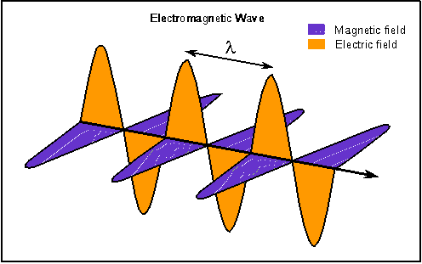
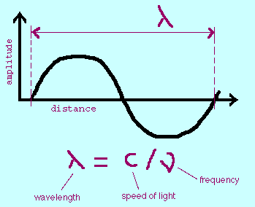
A science of light
Astronomy is mostly done by studying light coming from the sky.
Light is and electromagnetic wave.
The main characteristics of a wave are:wavelength, frecuency and speed.

Slide 39
Light: wave and particle
Light has a dual nature:
  Wave: Maxwell laws
  Particle:Quantum mechanics
We can obtain a great amount of information by analyzing the intensity, spectrum, etc…

Slide 40
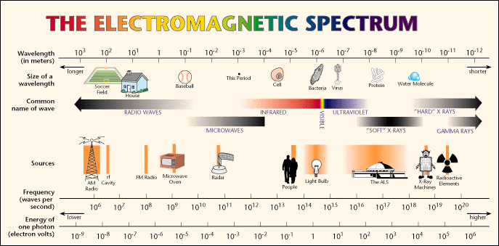
The electromagnetic spectrum

