Slide 1
Positional Astronomy
Fundamental Astrophysics

Slide 2
Movement of stars

Slide 3
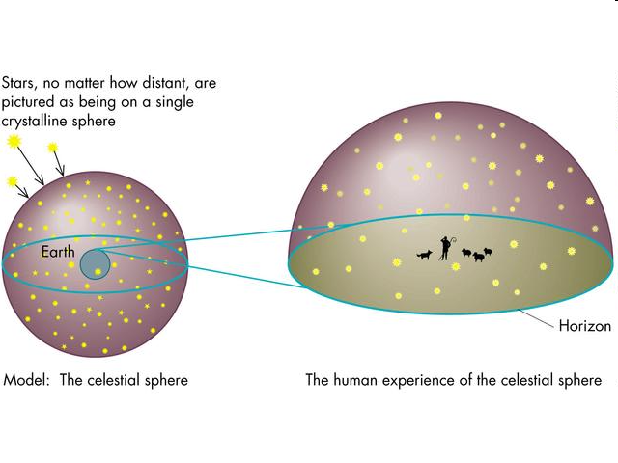
Celestial sphere

Slide 4
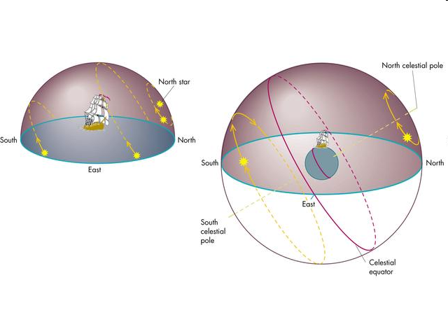
Celestial sphere (II)

Slide 5
Constellations
They are groups of stars which, from our earth perspective, seem to have some particular, more or less recognizable figure.
Some of them are thousands of years old, although they are culturally dependent.
In 1922 the IAU established the 88 present constellations with their boundaries.

Slide 7
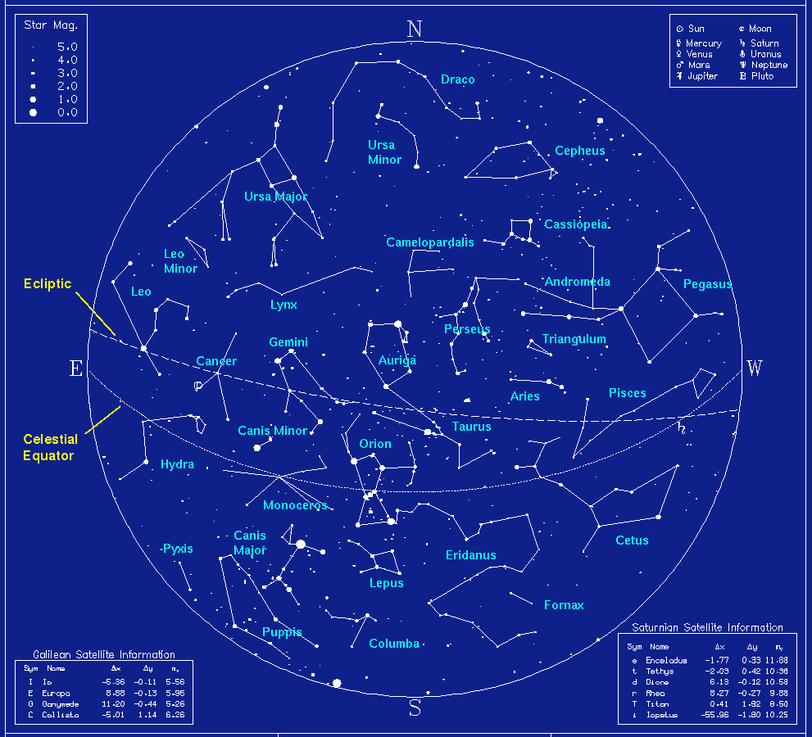

Slide 8
Eath movements
Rotation → Day
Revolution → Year/Seasons
Precession
Nutation

Slide 9
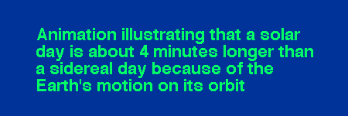
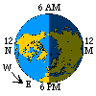
Earth rotation
Rotation on its axis (CCW).
A rotation is completed in:
24h with respecto to the sun (MSD) → Solar or synodic day
23h 56m 4seg with respect to the stars → Sidereal day

Slide 10
Solar and sidereal day
During a year (time for a revolution around the sun, P=365.256363 d_{sol}(s)) there is one extra sidereal day (over solar days).
This means:
P/d_{sid} = P/d_{sol}+1 → d_{sid}=0.99727 d_{sol}
d_{sid}= 23h 56m 4.1s

Slide 11
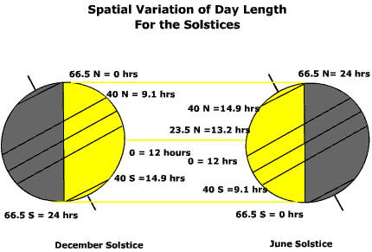
Seasons
The inclination of earth axis with respect to its orbit is responsible for the seasons.

Slide 12
Movements of the sun as seen from earth
Throughout the year, the sun moves along a circle called the ecliptic.
Its largest distance to the equator takes place at the solstices, when its declination is ±23º 27’.
The two celestial parallels at this declination (and the corresponding equivalents on earth) define the tropics:
Tropic of Cancer (N)
Tropic of Capricorn (S)
On earth, two more parallels, called polar circles are defined at the same angular distance from the earth poles (lat=66º 33’). Above (below) this latitude, the sun does not set or rise at least one day per year.

Slide 13
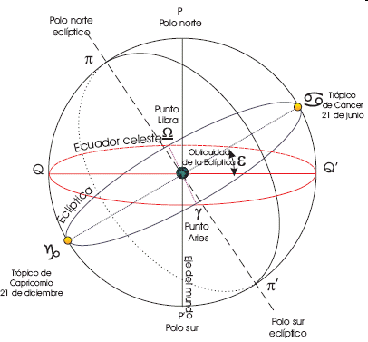

Slide 14
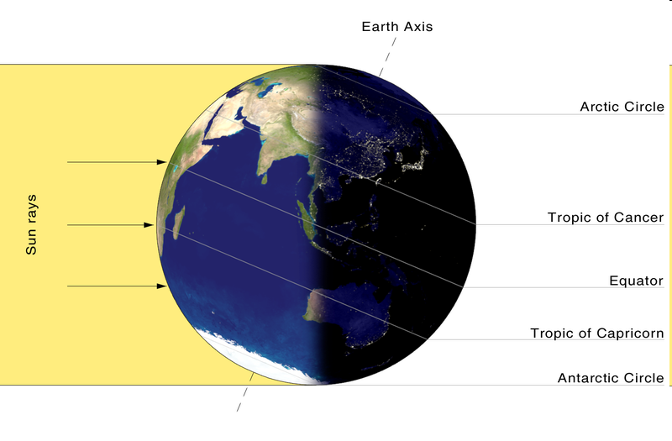

Slide 15
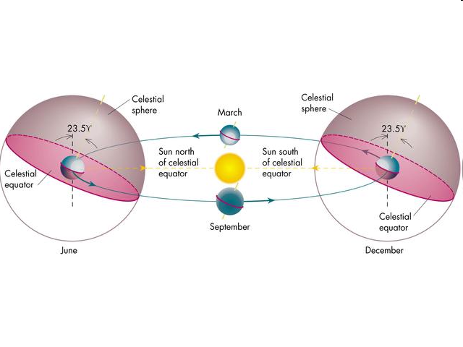

Slide 16
Twilight
Three different type of twilight:
Civil: The sun is 6º below horizon
Nautical: The sun is 12º below horizon
Astronomical: The sun is 18º below horizon
Twilight lasts longer at higher latitudes.

Slide 17
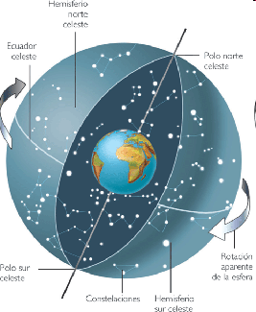
Equator and Poles
Earth rotation defines two points and a plane which are very important :
Poles:
North Pole
South Pole
Equator:

Slide 18
Terrestrial Coordinates
Earth rotation defines:
Poles: Intersection of rotation axis with earth surface.
Equator: Plane perpendicular to axis passing through earth’s center.
A set of “polar” coordinates are defined with respect to the equator:
Latitude: angle measured from the equator towards the poles: + if N and – if S. Measured in degrees.
Longitude: angle measured along the equator from an (arbitrary) origin → Greenwich Meridian: + if E and – if W. Measured in º,’ y ‘’. It can also be measured in time units using 1h=15º.

Slide 19
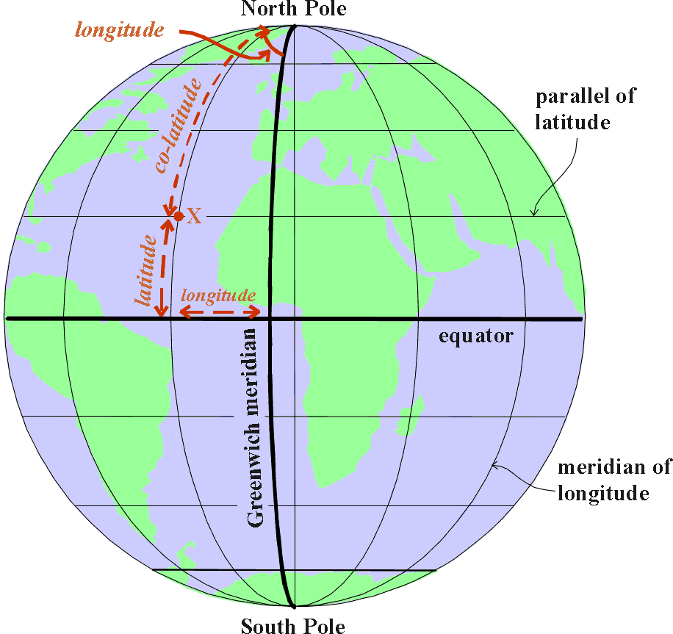

Slide 20
Geographic coordinates (II)
Earth is slightly flattened at the poles. We can define a geoid (equipot.) which is similar to an ellipsoid of revolution.
The flattening is:
Circles of equal latitude are called PARALLELS
Circles of equal longitude are called MERIDIANS

Slide 21
Geographic Coordinates (III)
A “nautical mile” is defined as the length of 1 arcmin of longitude at the equator.
1nmi=1852m (1 stat mile=1609.344m)
A cable is a tenth of a nmi=185.2m
El knot is a speed of 1nmi/hour
At different latitude, 1 arcmin of longitude is shorter by a factor cosΦ.
To be able to determine longitude (specially at sea) was a very difficult astronomical problem which resisted great minds as Kepler, Galileo, Newton, etc..

Slide 22
Earth revolution
Earth revolves around the sun in a period of one year.
The orbital plane is inclined 23º 27’ with respect to the equator → Axis tilt or Obliquity of the ecliptic
The orbital plane defines a plane on the sky known as the Ecliptic. It is the path of the sun on the sky with respect to the stars.
The equator and the ecliptic intersect at two points called Nodes or equinoctial points
Vernal equinox. Ascending node or first point of Aries
Libra point, Autumn equinox or descending node.

Slide 23
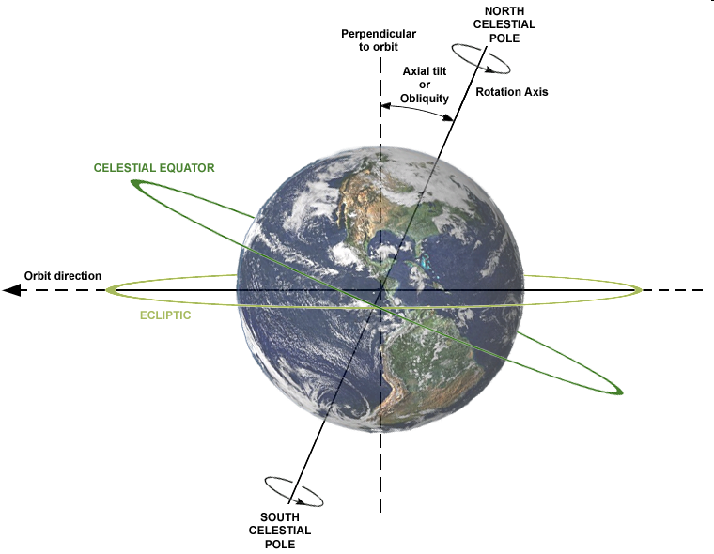

Slide 24
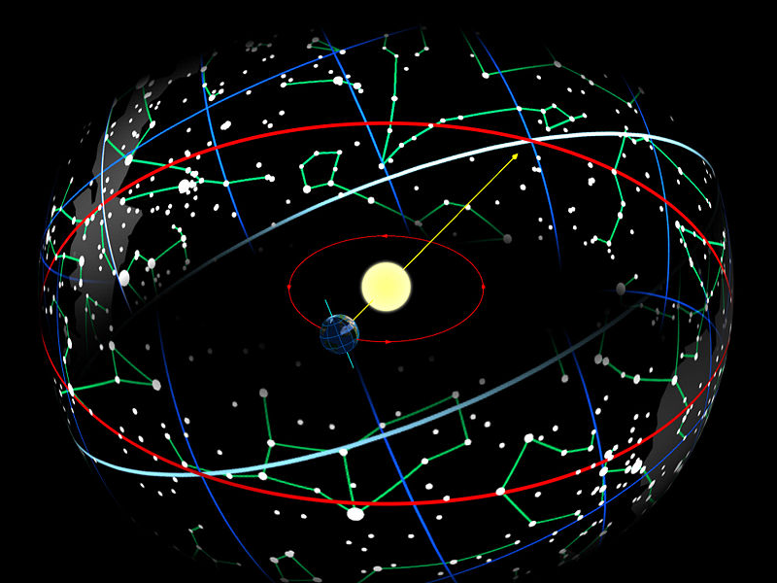

Slide 25
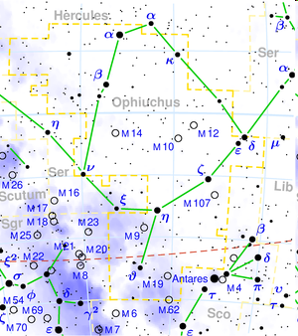
Zodiac
Zodiac is the set of 12 (13?) constellations crossed by the ecliptic.
BEWARE!
Precession has changed the dates in which the sun enters each constellation.
There is a 13th sign!!
(Ophiucus)

Slide 26
Spherical geometry
On the surface of a sphere we can define:
Great circle: Is the intersection with a plane passing through the center of the sphere.
Spherical triangle is that formed by three arcs of great circle.
In an spherical triangle we have: A+B+C=180+E (E=Excess)
Laws of spherical trigonometry:
Sine rule
Cosine rule

Slide 27
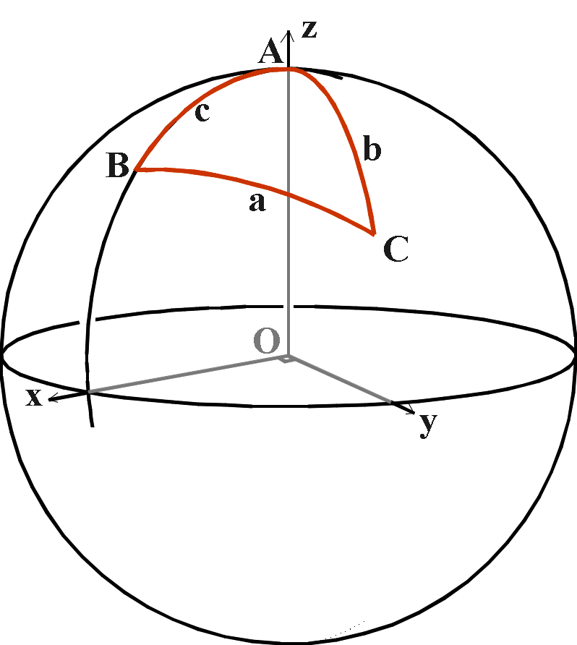

Slide 28
Sine and cosine rules
Sine rule
sin(a)/sin(A) = sin(b)/sin(B) = sin(c)/sin(C)
Cosine rule
cos(a) = cos(b) cos(c) + sin(b) sin(c) cos(A)
cos(b) = cos(c) cos(a) + sin(c) sin(a) cos(B)
cos(c) = cos(a) cos(b) + sin(a) sin(b) cos(C)

Slide 29
Astronomical coordinates
Depending on the plane used as reference there are several coordinate systems:
Horizontal coordinates
Equatorial coordinates
Ecliptic coordinates
Galactic coordinates
To transform coordinates we need to solve an spherical triangle.

Slide 30
Horizontal or altazimuthal coordinates
The reference plane is the horizon
They are local coordinates.
They are time dependent coordinates.
Extending the vertical: Zenith and Nadir.
Great cicles passing through the zenith are called verticals.
Stars culminate in a great circle → Meridian
Intesection of the meridian and the horizon define N and S cardinal points.
Coordinates are two angles:
Altitude (a) : Angle between star and horizon
Azimuth (A): Angle along the horizon between the projection of the star and an origin. We will use S and will measure the angle clockwise.

Slide 31
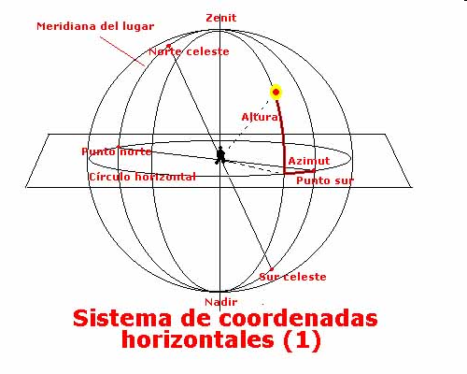

Slide 32
Equatorial coordinates
The reference plane is the equator.
They are non-local coordinates.
Coordinates of stars do not change with time (app)
The origin point on the equator is taken to be the spring equinox.
The coordinates are two angles:
Declination (δ) : Angle between the star and the equator (+ if N and – if S)
Right ascension (α) : Angle along the equator measured from the spring equinox in the counterclockwise direction.

Slide 33
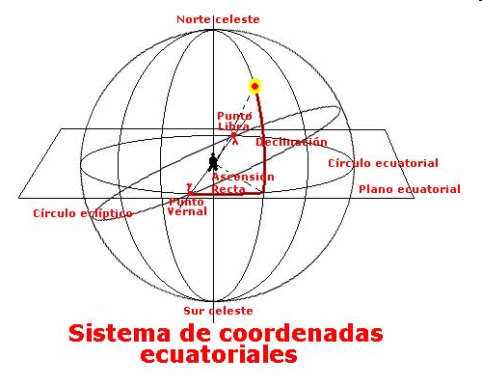

Slide 34
Hour angle, right ascension and sidereal time
The hour angle (H) is defined as the angle (along the equator in clockwise dir.) between the projection of the star and the meridian.
Sidereal time (t) is defined as the hour angle of the equinoctial point.
Whith these definitions and the definition of the R.A (α) we have: t= α+H
A rough approximation of sidereal time can be calculated from solar time as: t=T_{s}+12+d*4/60 (where d is the number of days elapsed since the vernal equinox)
Usally: GMT -> JD -> GMST -> LST

Slide 35
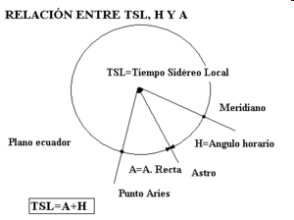

Slide 36
Coordinate transformations: Horizontal and equatorial
From equatorial to horizontal
H = t - α
sin(a) = sin(δ) sin(φ) + cos(δ) cos(φ) cos(H)
sin(A) = sin(H) cos(δ) / cos(a)
cos(A) = -{ sin(δ) - sin(φ) sin(a) } / cos(φ) cos(a)
From horizontal to ecuatorial
sin(δ) = sin(a)sin(φ) - cos(a) cos(φ) cos(A)
sin(H) = sin(A) cos(a) / cos(δ)
cos(H) = { sin(a) - sin(δ) sin(φ)} / cos(δ) cos(φ)
α = t – H

Slide 37
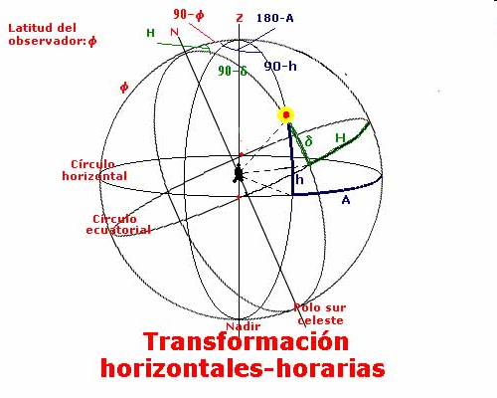

Slide 38
Ecliptic coordinates
The reference plane is the ecliptic.
The ecliptic is tilted wrt the equator ε=23º 26’.
The origin on the ecliptic is taken to be the vernal equinox.
The coordinates are two angles:
Ecliptic latitude (β): Angle between the ecliptic and the star.
Ecliptic Longitude (λ): Angle along the ecliptic (counterclockwise) between the star and the vernal equinox.

Slide 39
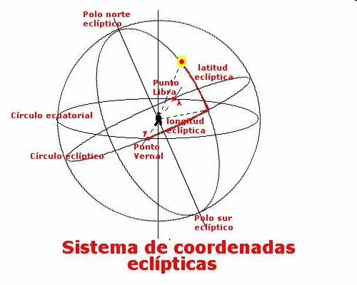

Slide 40
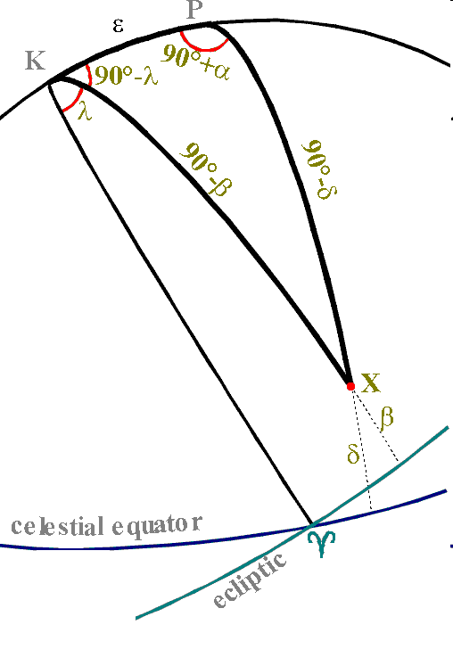
Coordinate transformation: Equatorial and ecliptic
The equations to transform between ecliptic and equatorial coordinates are:
sin(δ) = sin(β) cos(ε) + cos(β) sin(ε) sin(λ)
sin(β) = sin(δ) cos(ε) - cos(δ) sin(ε) sin(α)
cos(λ) cos(β) = cos(α) cos(δ)

Slide 41
Galactic coordinates
The reference plane is the plane of the Milky Way. The direction of the galactic centre is used as origin for longitudes.
The galactic centre has eq. coordinates:
17h45m37.224s −28°56′10.23″ (J2000)
El galactic north pole is:
12h51m26.28s +27º07’42’’ (J2000)
The coordinates are two angles:
Galactic latitude (b):Angle between the plane of the Galaxy and the star.
Galactic longitude (l): Angle along the Galaxy plane between the galactic centre and the projection of the star on the plane (counterclockwise).

Slide 42
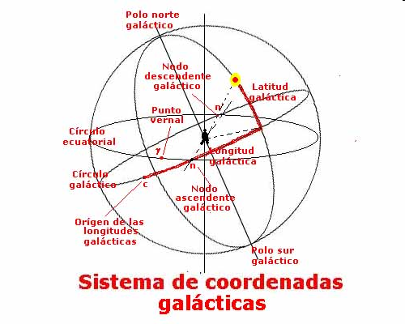

Slide 43
Transformation of coordinates: equatorial and galactic
Equatorial to galactic
Galactic to equatorial:
Where α_{n}=282,25º (18h 51.4m), l_{n}=33,012º and g=62,9º

Slide 44
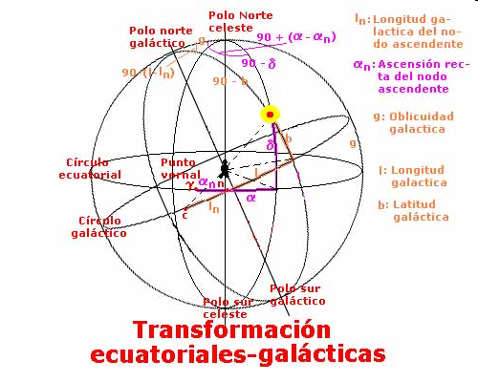

Slide 45
The sun and the measurement of time
As our lives are linked to the day/night cycle, we use the sun cycle as a reference to our daily measurement of time.
The sun’s hour angle (which defines True or apparent solar time) does not keep a uniform rate throughout the year for two reasons:
The sun is not (always) on the equator
Its speed wrt the stars is not uniform
It is convenient to have a time reference with constant rate → Mean solar time is defined with the help of a fictitious mean sun (moving at uniform speed along the equator).
A Mean Solar Day lasts 86400 s (very approx).

Slide 46
The equation of time
The true sun goes ahead or behind the mean sun. The difference between the time marked by both suns (apparent solar time - mean solar time) is called THE EQUATION OF TIME.
An approximate expression for its value is given by:
E=9.87 sin(2B)-7.53 cos(B) -1.5 sin(B) min
with B=2π(N-81)/365
We can use the dates of the begining and end of seasons to make a rough estimate of the sun’s declination throughout the year.

Slide 47
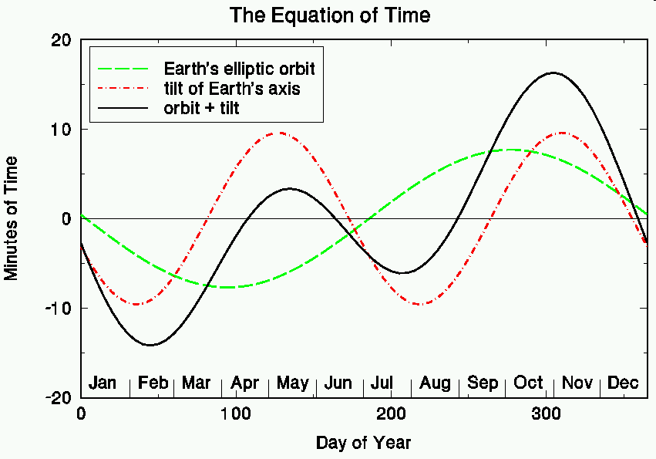

Slide 48
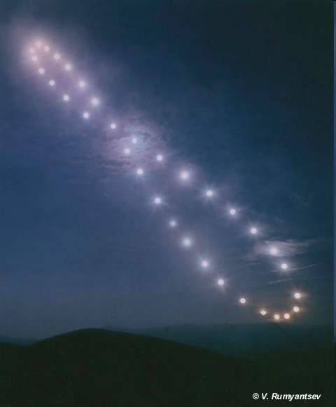
Analemma
Due to the equation of time, the position of the sun at the same time (MST) every day describes a figure of eight called Analemma

Slide 49
Sunset and sunrise
Sun rises and sets northwards in summer and southwards in winter:
The azimuth of sun at sunrise/sunset is:
Cos(A)=-sinδ/cosΦ
The length of day/night can be calculated using the hour angle at sunrise/sunset:
Cos(H)=-tan(δ) tan(Φ)
Taking into account atmospheric refraction and the size of the solar disk we should use a=-0.50’ for sunset/sunrise.

Slide 50
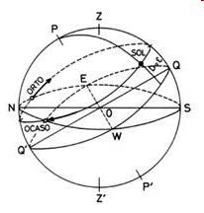
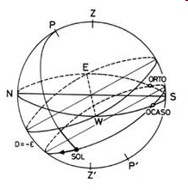

Slide 51
Variations with latitude
At the equator, stars rise and set perpendicular to the horizon.
The inclination of the trajectories of stars near the horizon decreases with latitude.
At the poles, stars only change altitude if they change their declination.
Twilights are short in the equatorial region and longer for higher latitudes.

Slide 52
Time measurements
UT: Universal Time → Mean Solar Time -> Greenwich meridian time (GMT)
UT0: Astronomical without corrections for polar motion
UT1: Corrected for polar motion (±3ms/day)
UTC: Uses a time scale based on IAT (atomic) but stays in phase with UT1. If the difference increases over 0.9s a leap second is added at the end of june or december
IAT/TAI: Determined by atomic clocks

Slide 53
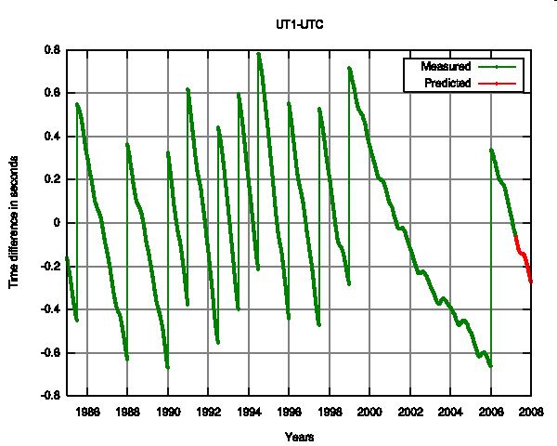

Slide 54
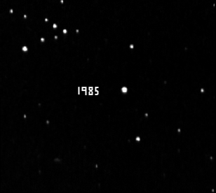
What can affect the direction in which we see a star?
Atmospheric refraction
Precession y nutation
Aberration of light
Movement of the stars
Movement of the solar system
Parallax
PROPER MOTION

Slide 55
Atmospheric refraction
A star with a zenith angle z will be observed with zenith angle z’ due to atmospheric refraction.
The change in zenith angle is given by:
R=(z-z’)=(n-1) tan(z’)=k tan(z’)~k tan(z) with
k=59.6 arcsec a 0ºC y 1 atm o k=16.27’’P/(273+T(ºC))

Slide 56
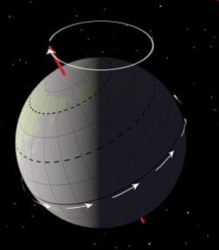
Precession
Earth’s axis is no fixed in space with respect to stars, but describes a cone every (app.) 25767 years (Big or Platonic year).
This motion is originated by the gravitational interaction of sun and moon with the non-spherical, flattened, earth.
Due to this effect the equinox moves 50.3 arcsec per year along the ecliptic.

Slide 57
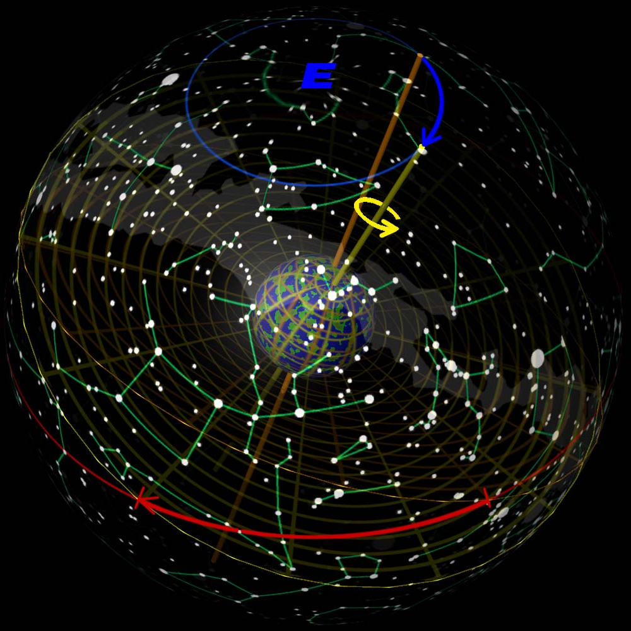

Slide 58
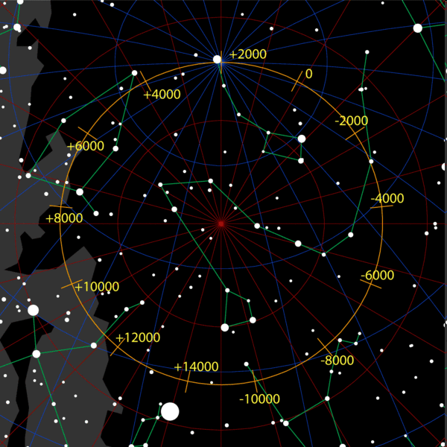

Slide 59
Coordinate variation due to precession
Precession moves the node (equinox) along the ecliptic 50.26 arcsec/year. This produces a variation in the right ascension and declination of stars:
dα=m+n sinα tanδ
dδ=n cosα
Where n and m are the precession constants:
n=1.33589 s/year (trop.)
m=3.07419 s/year

Slide 60
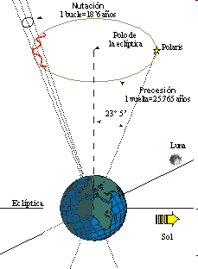
Nutation
The nodes of the moon’s orbital plane (which is tilted 5º 11’ wrt the ecliptic) precesses every 18.6 años.
This precession of the lunar orbital plane induces a perturbation with the same period on the earth axis.
The amplitude of this movement is very small. The induced change in coordinates is less than 9.23’’ in obliquity and 19” in longitude.

Slide 61
Aberration of light

Slide 62
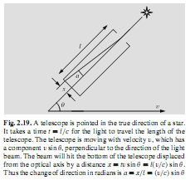
a=v/c sinθ
Aberration constant: v/c=21´´

Slide 63
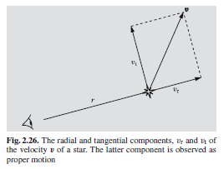
Proper motion
Stars can show apparent motion on the sky due to:
The motion of the solar system with respect to stars
Movement of the star itself
Radial motion
Proper motion

Slide 64
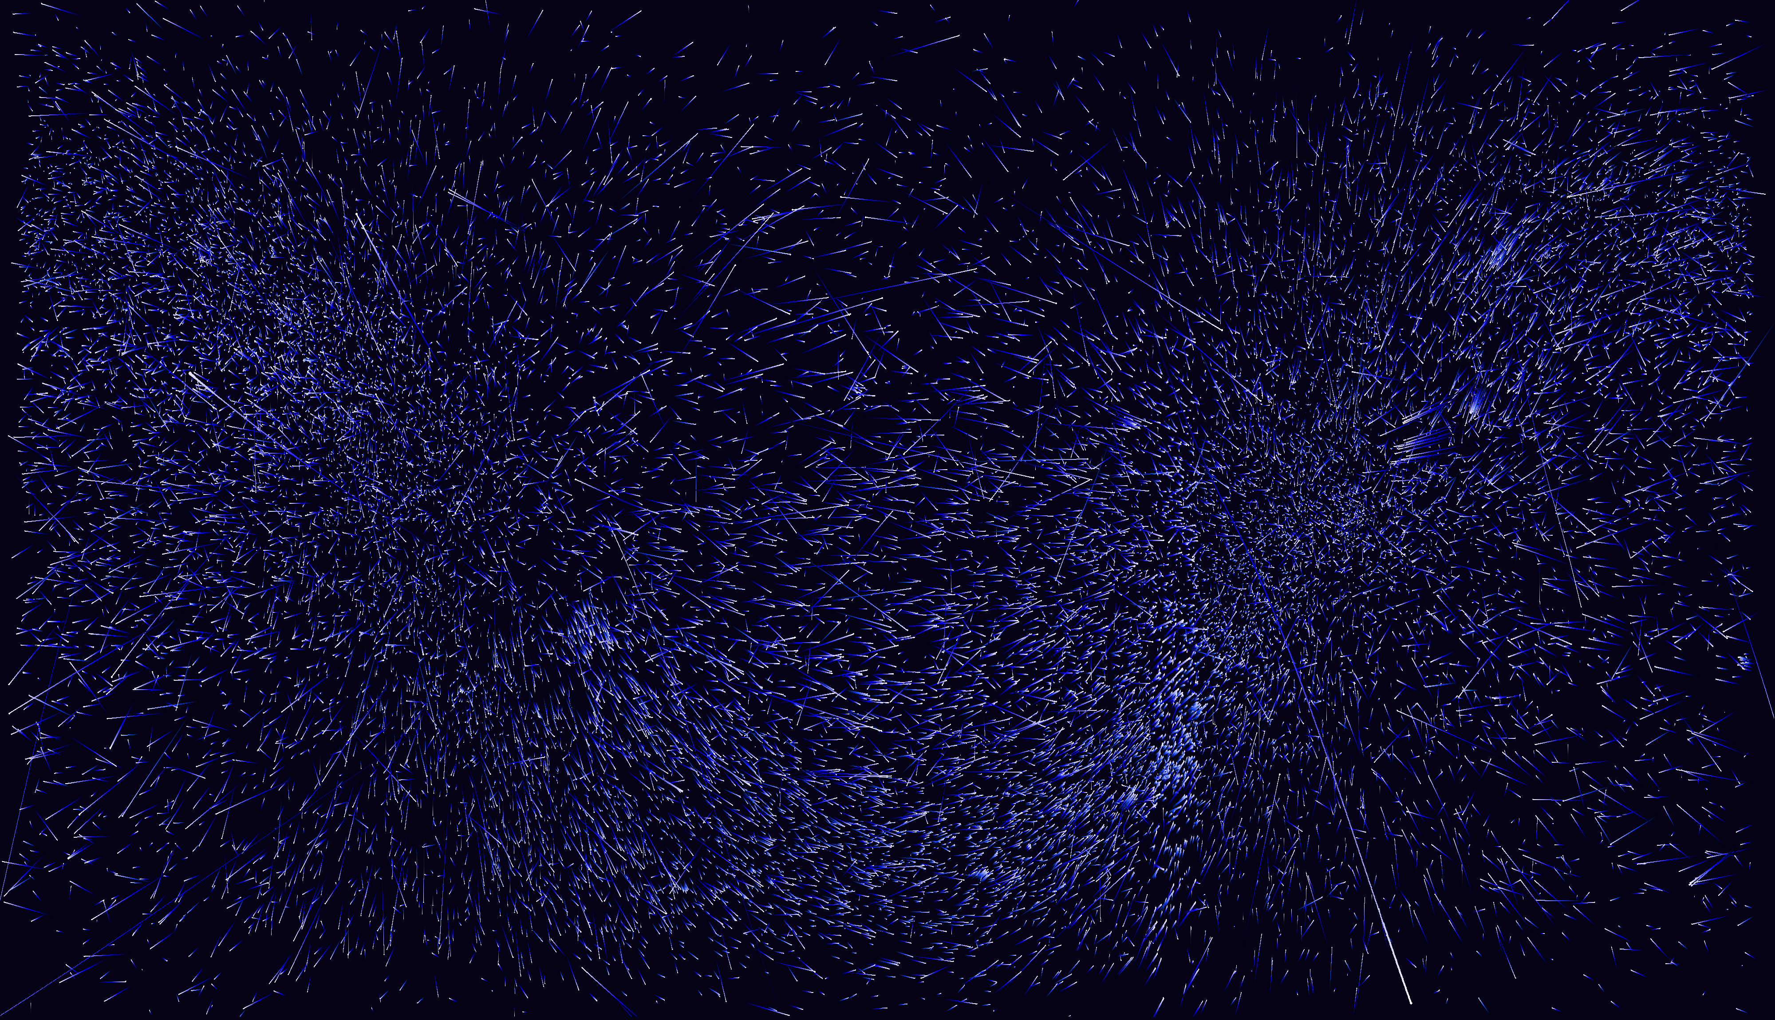

Slide 65
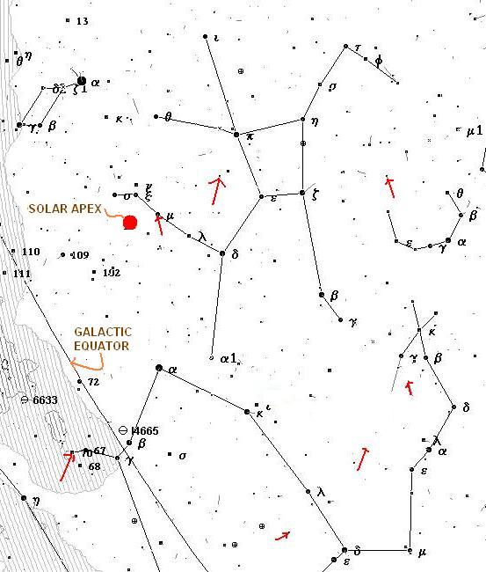

Slide 66
Parallax
Paralax is defined as half the angular change in the direction of an object when seen from two different points of view.
We can look at the object from to diametrally opposite locations at the equator (Daily or equatorial Parallax)
The longest distance we can use is that of two diametrally opposite points in the earth orbit (Anual parallax).
A length unit, the parsec (pc) is defined as the distance to an object with an anual paralax of 1 arcsec.
Measuring parallaxes is very difficult because:
Huge distances involved
Atmospheric refraction
Aberration of light
Proper motions, precession, nutation, etc..

Slide 67
