Slide 1
STRUCTURE OF THE ROSEBERY PB-ZN ORE DEPOSIT
Supplementary material to
Aerden, 1991 (J. Struct. Geol.)

Slide 2
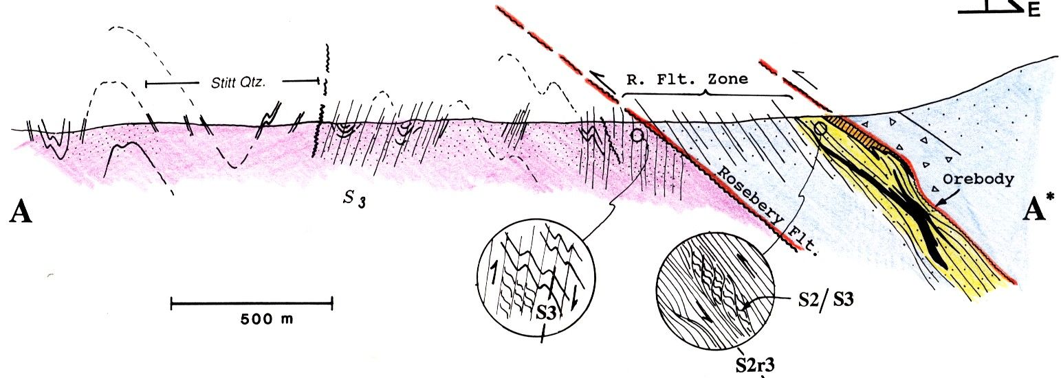
Aerden 1991 – J. Struct. Geol.

Slide 3
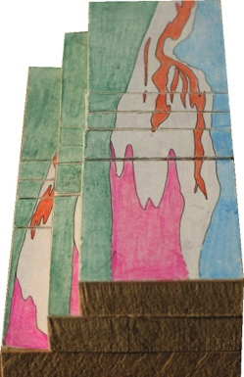
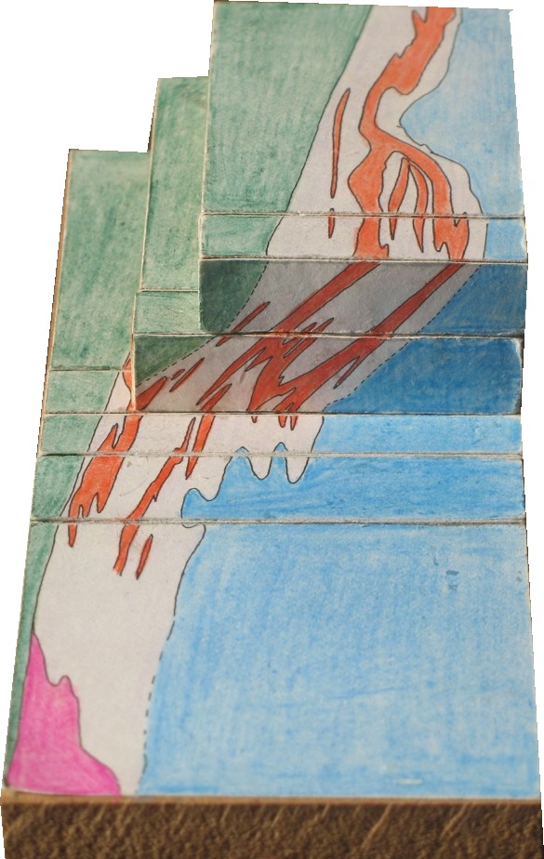
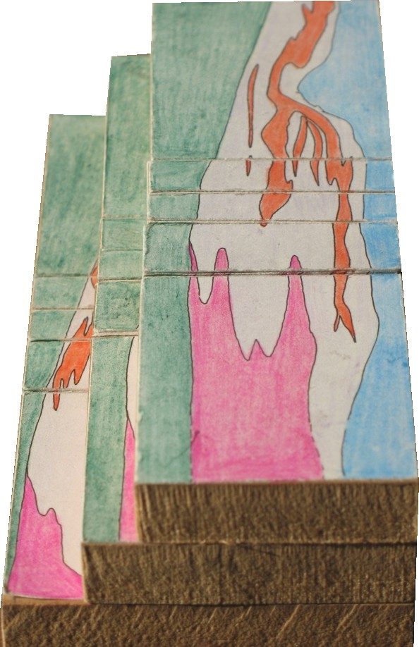
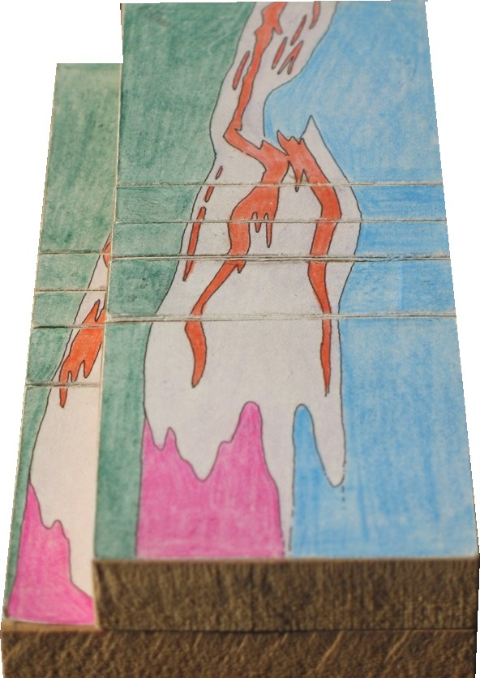
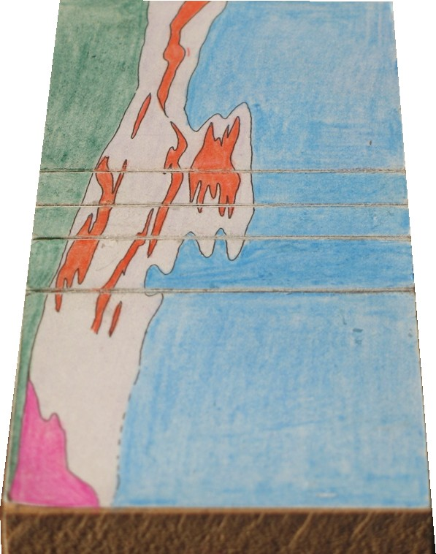
100m
WOODEN BLOCKS MODEL

Slide 4
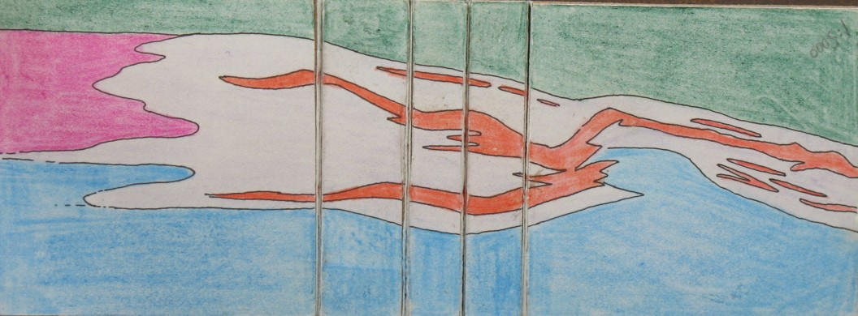
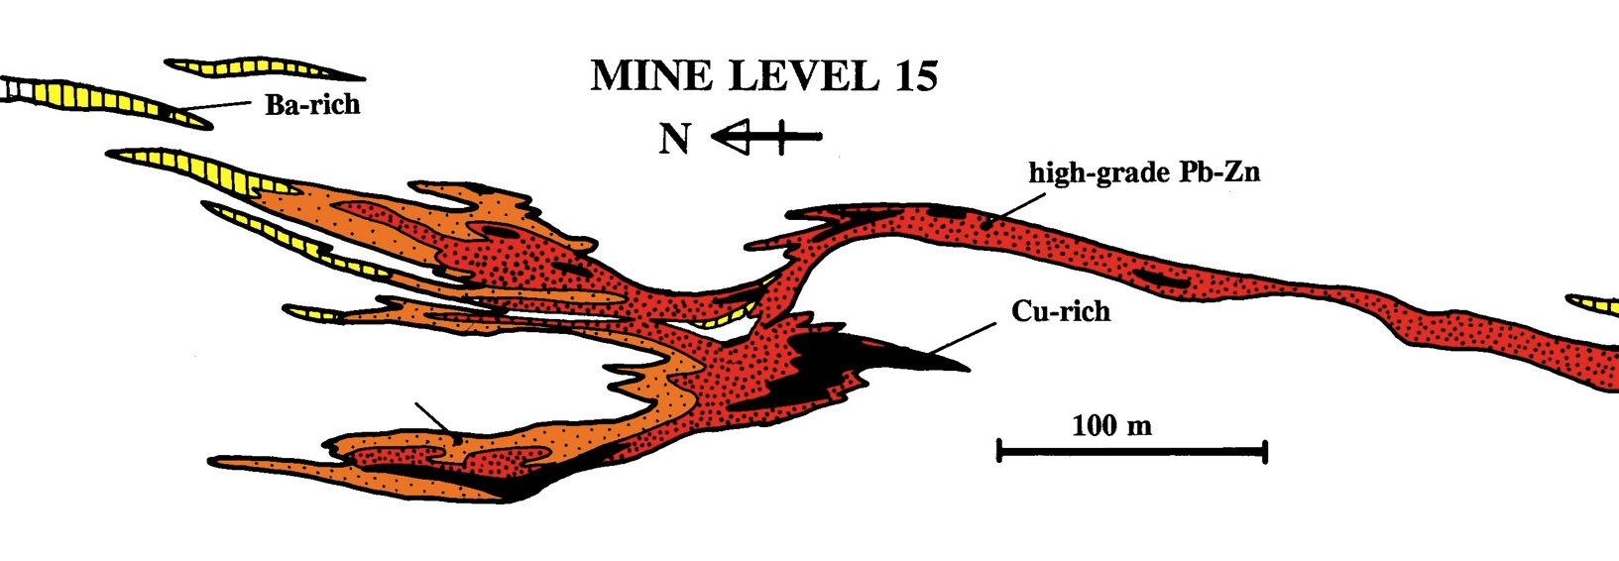
Fold interpretation of Brathwaite, 1970
ORE LENS E
ORE LENS F
ORE LENS G
45

Slide 5
Fold interpretation of Green, 1981
ORE LENS E
ORE LENS F
ORE LENS G
45

Slide 6
Fold interpretation of Huston & Zaw 1988
consistent eastward vergence of parasitic folds in host rock conflicts with previous fold interpretation of the orebody
ORE LENS E
ORE LENS F
longitudinal cross-section line (next slide)
ORE LENS G
45

Slide 7
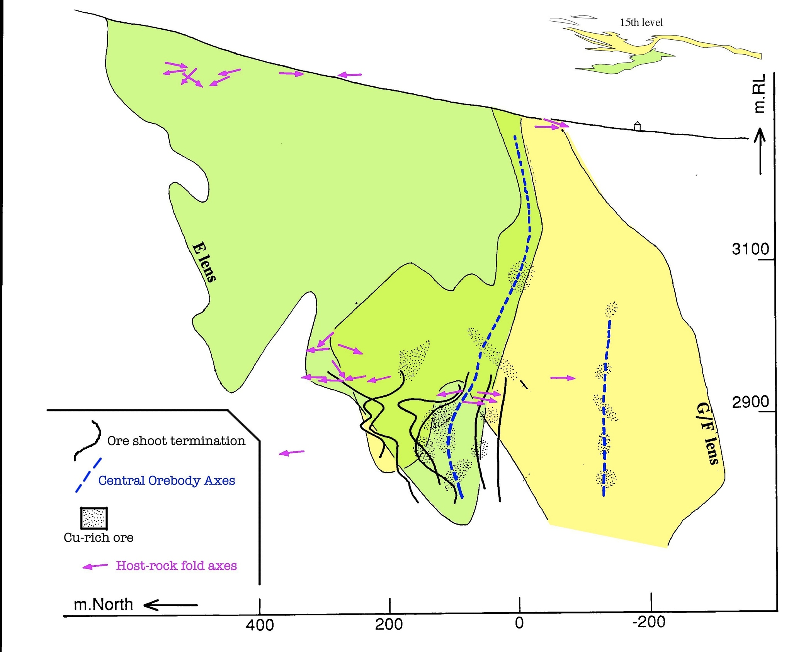
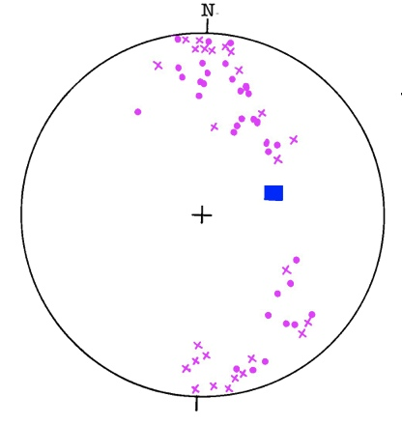
longitudinal cross-section
15 level
17 level
200m
modified after Aerden 1991

Slide 8
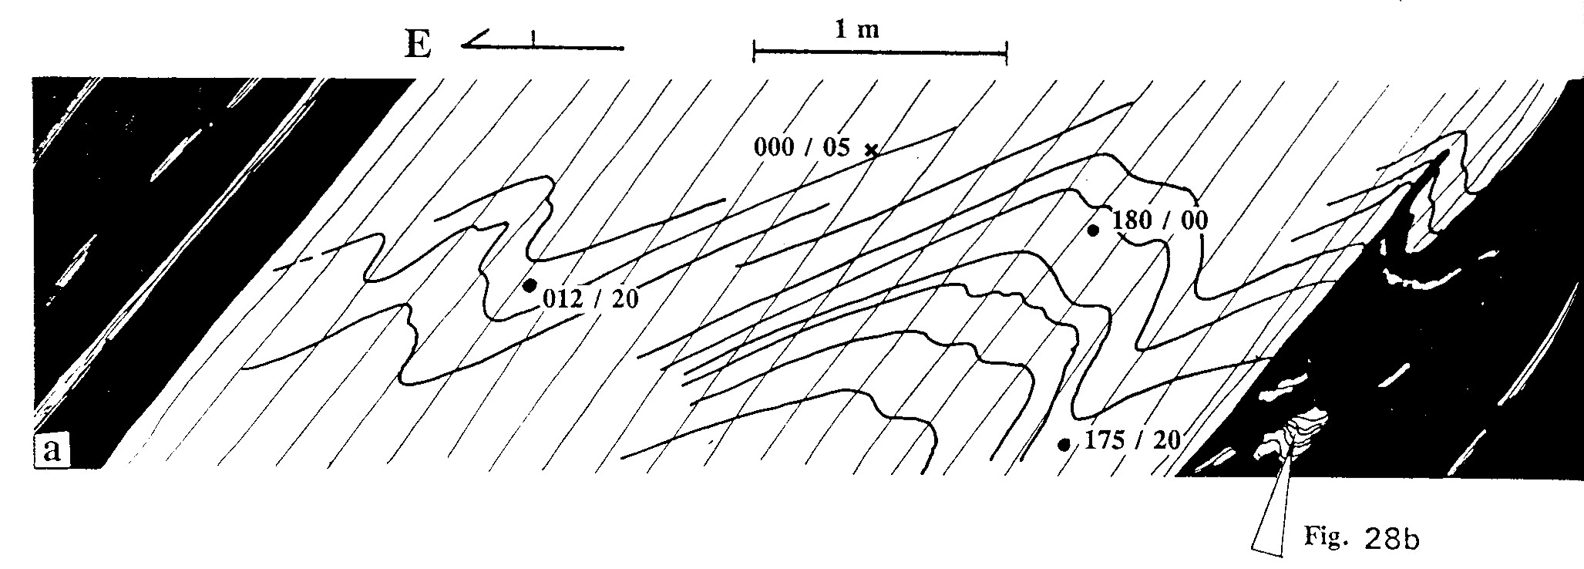
sulfuros
masivos
sulfuros
masivos
ore lenses cut folded bedding in host rock
and are parallel to foliation
Aerden – J. Struct. Geol. 1991

Slide 9
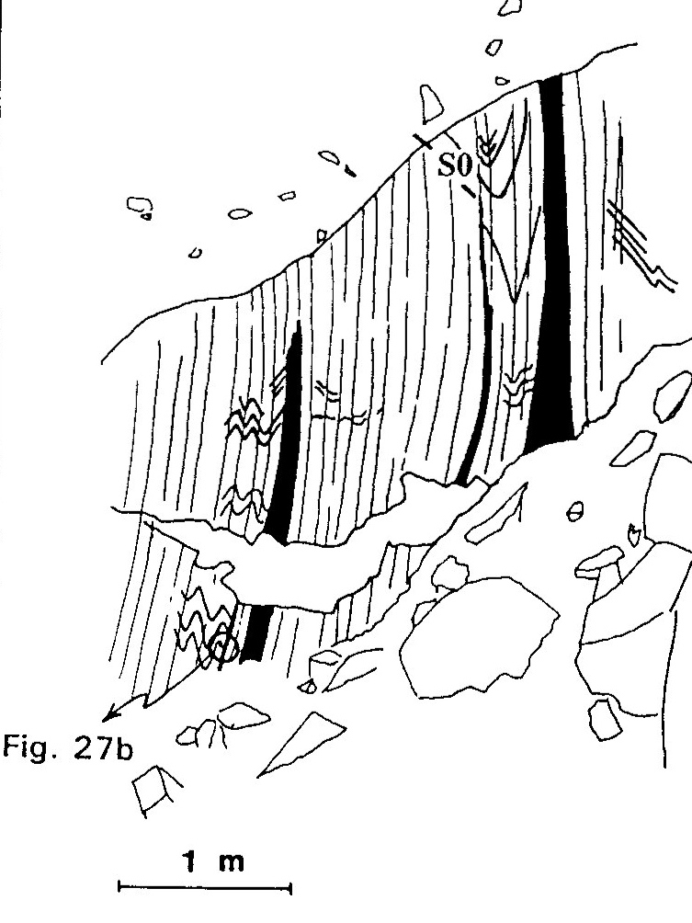
Aerden – J. Struct. Geol. 1991

Slide 10
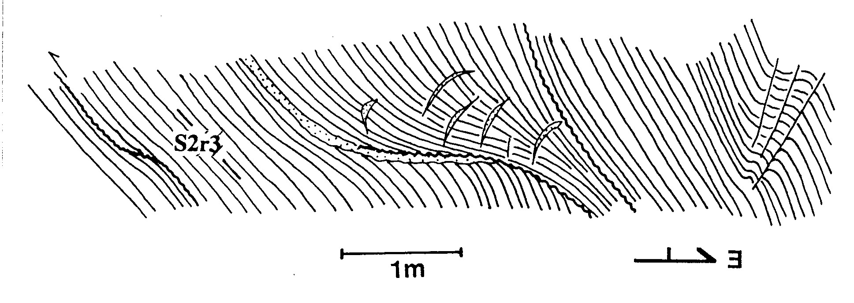
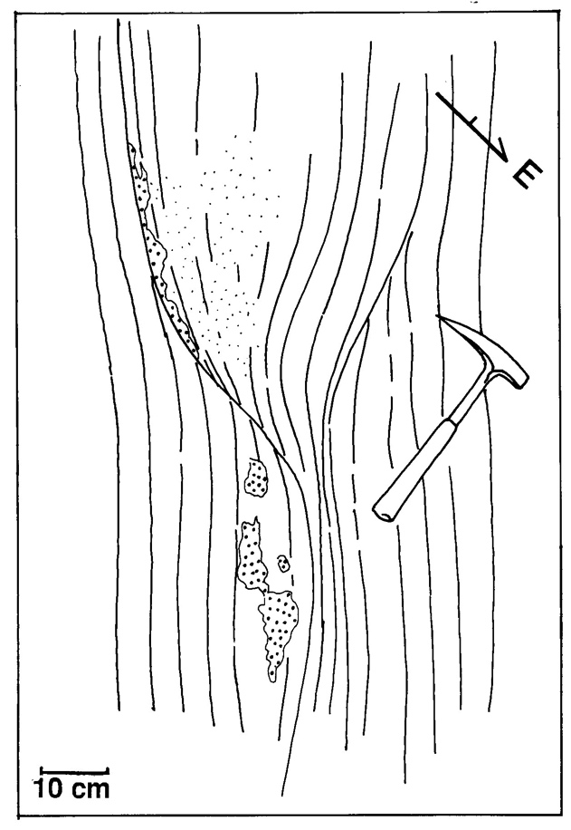
Extensional ramp
FOLIATION BOUDINAGE
modified after Aerden 1991

Slide 11
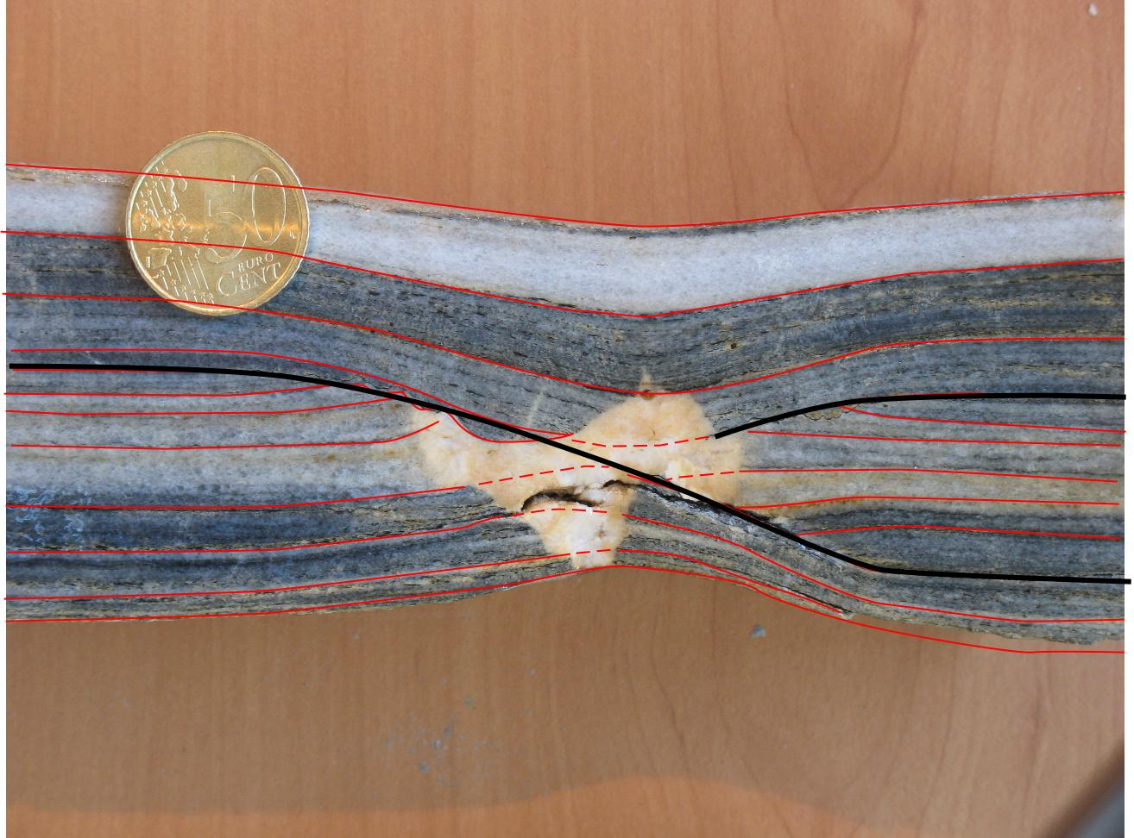
similar foliation boudinage geometries in marbles of the Nevado-Filabride Complex, Betic Cordillera

Slide 12
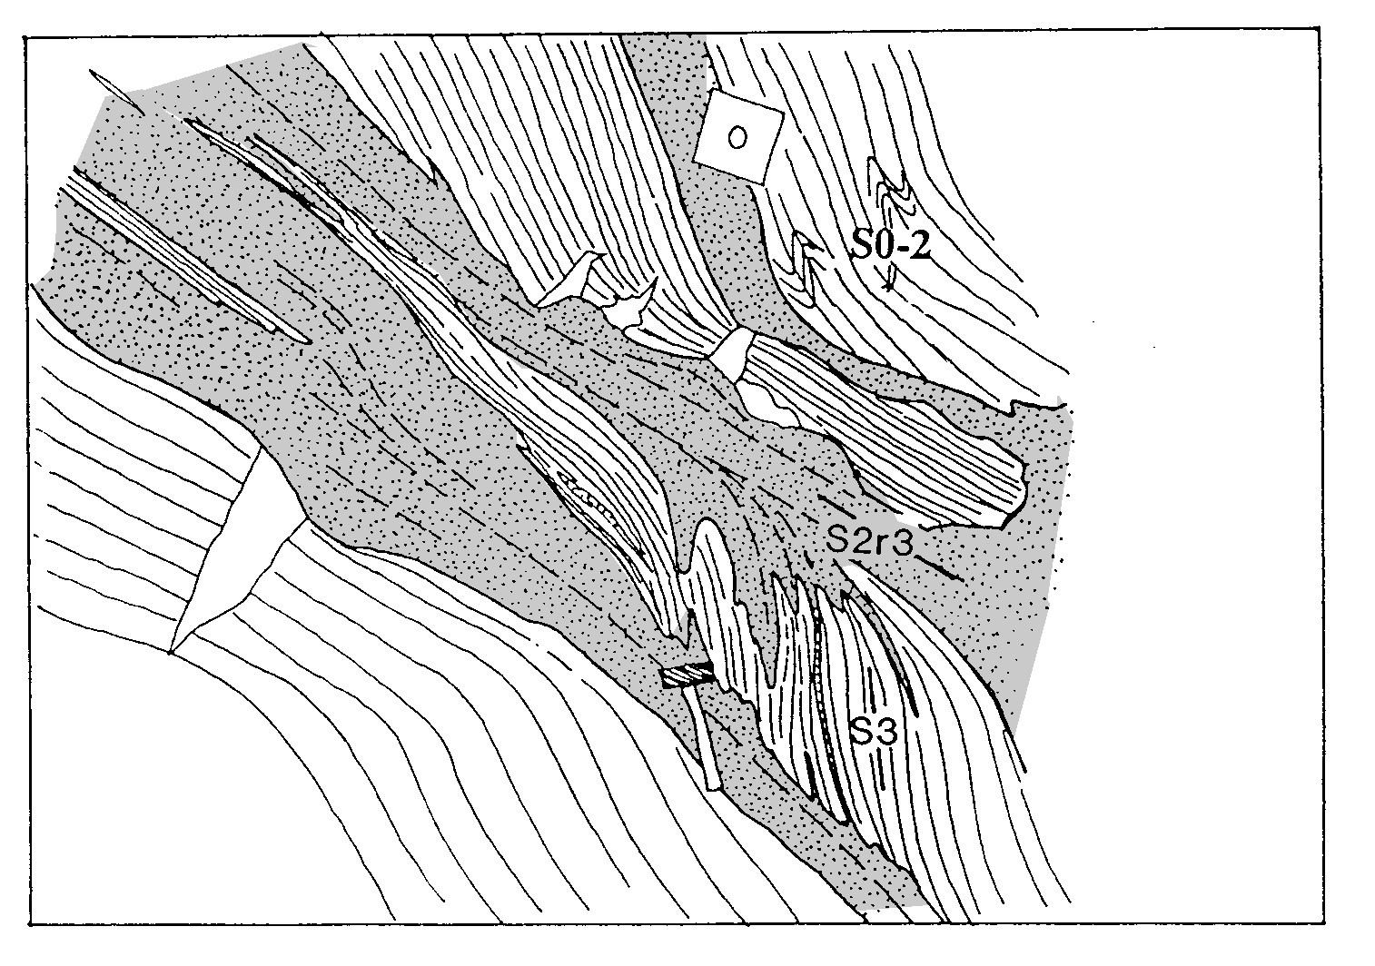
barite-rich
massive sulphides
replacing shear zone
Aerden JSG 1991 (Fig. 17)

Slide 13
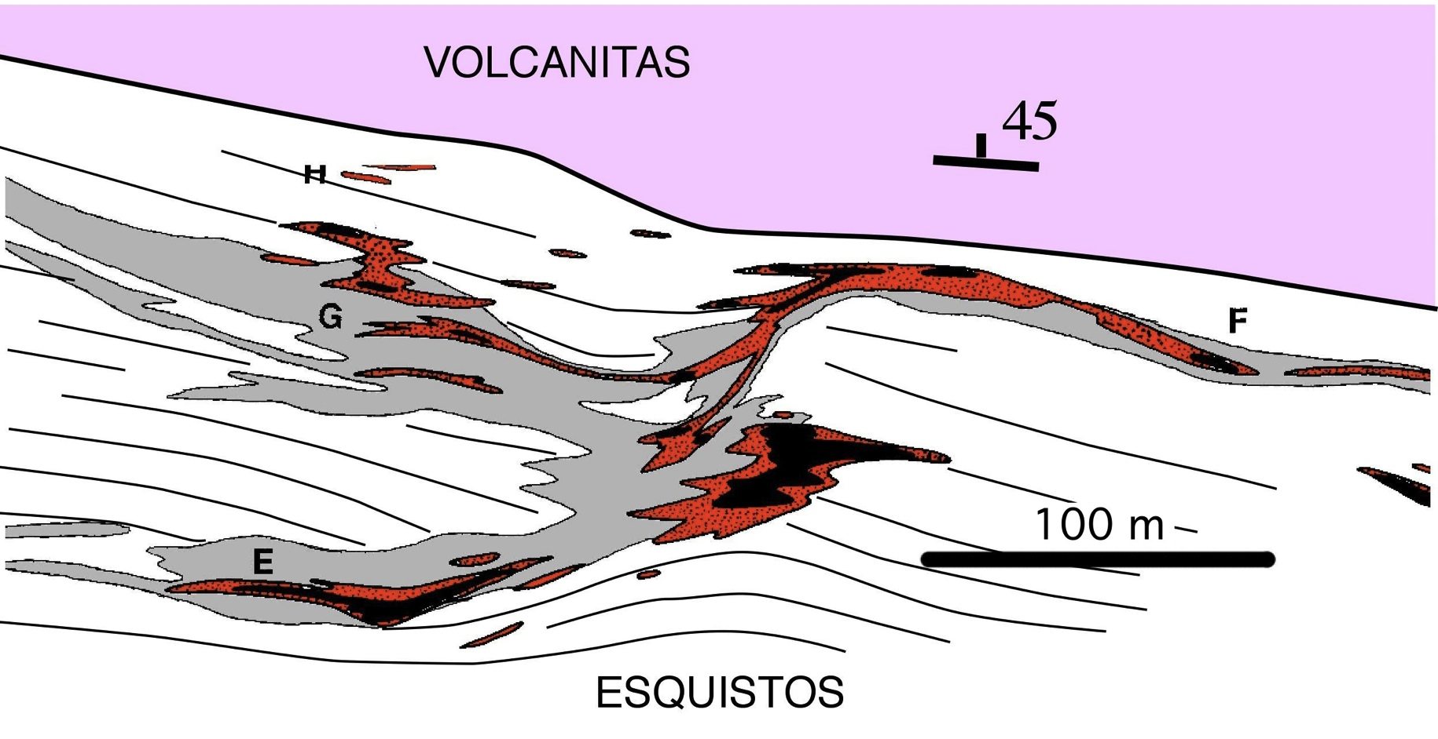
Sph-Gal-Py ore (Pb-Zn-rich)
Py-Cpy ore (Cu-rich)
modified after Aerden 1991

Slide 14
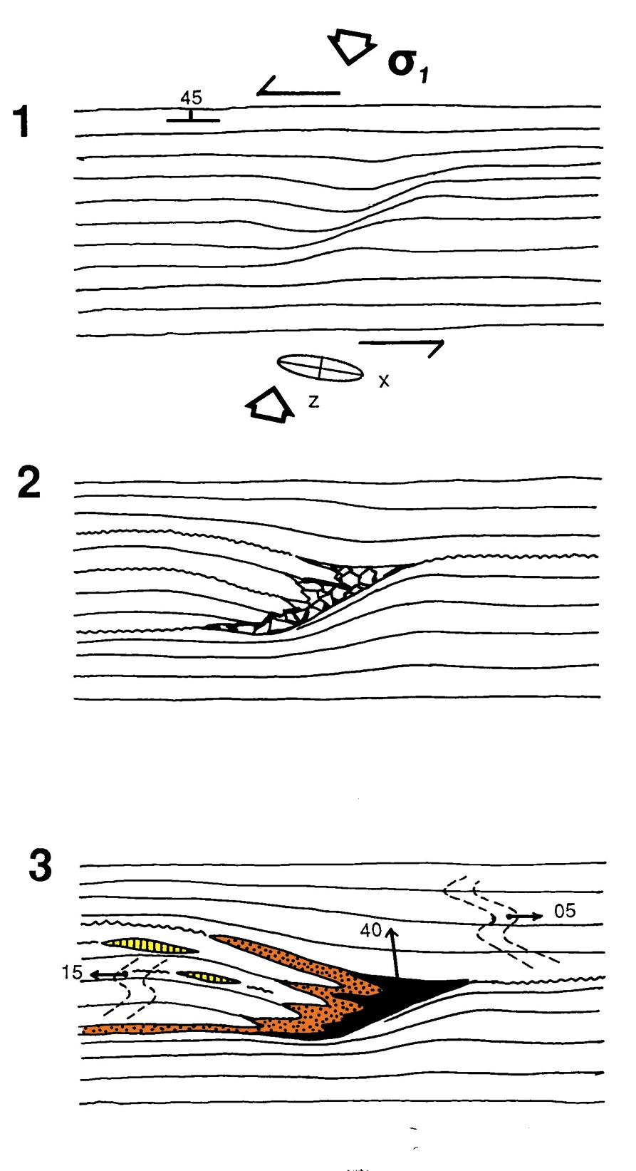
genetic model
Aerden JSG 1991

Slide 15
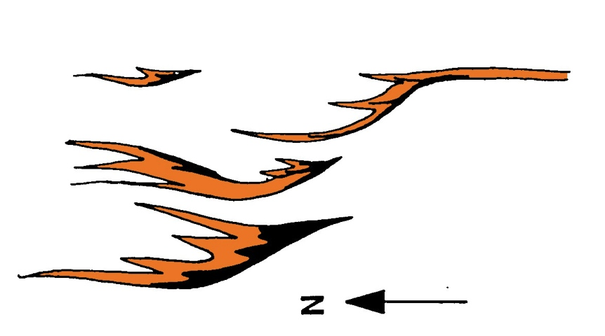
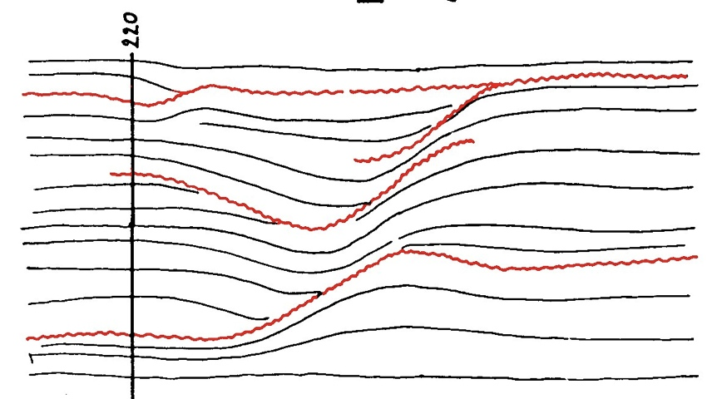
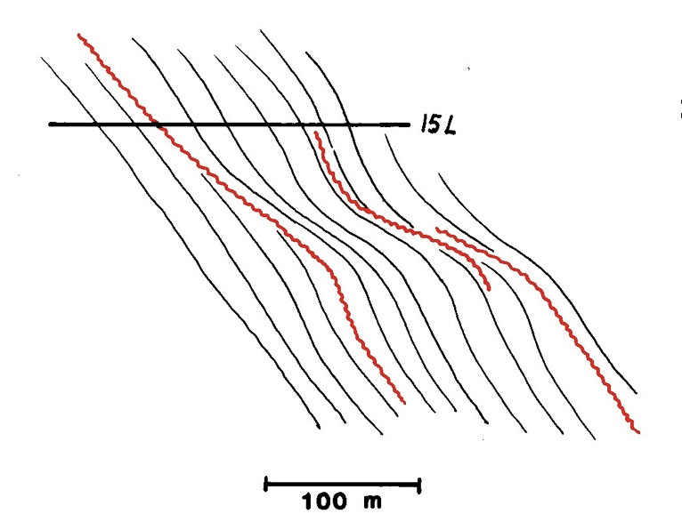
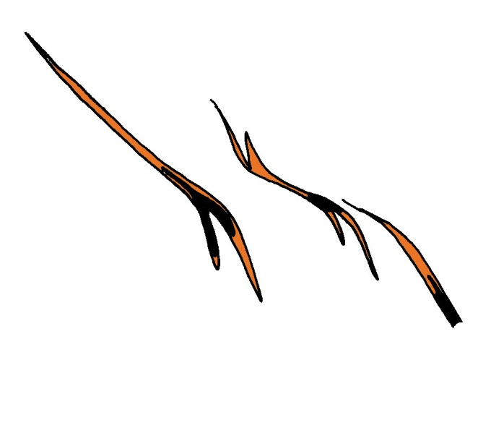
MAP
CROSS-SECTION
Aerden – J. Metamorphic Geol. 1994 FIGURE 2

Slide 16
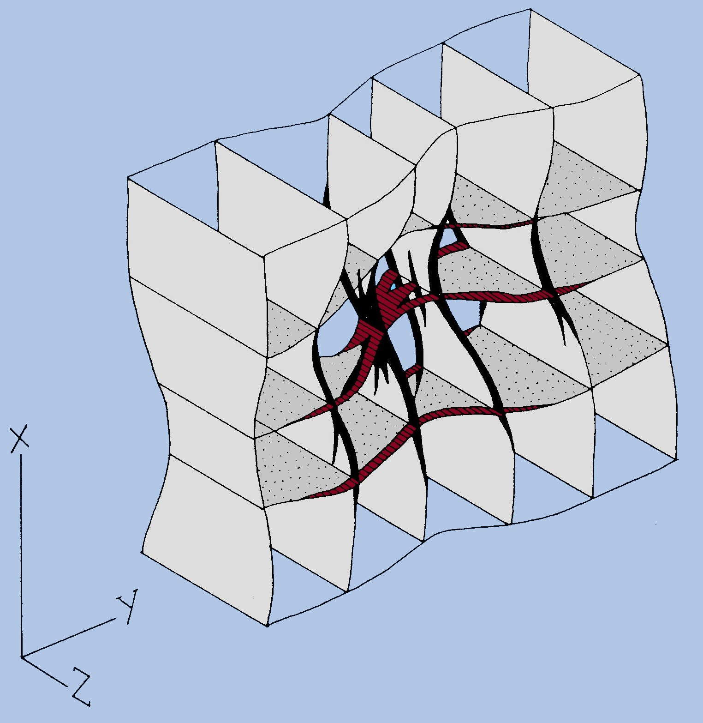
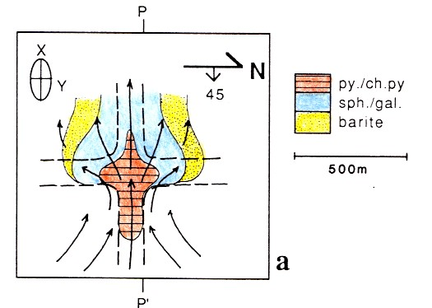
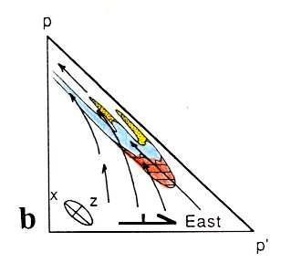
modified after Aerden 1991

Slide 17
REPLACEMENT TEXTURES

Slide 18
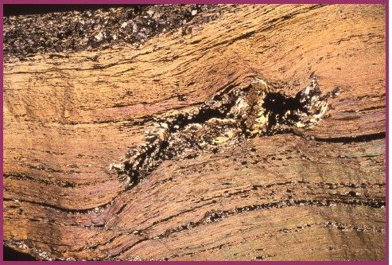
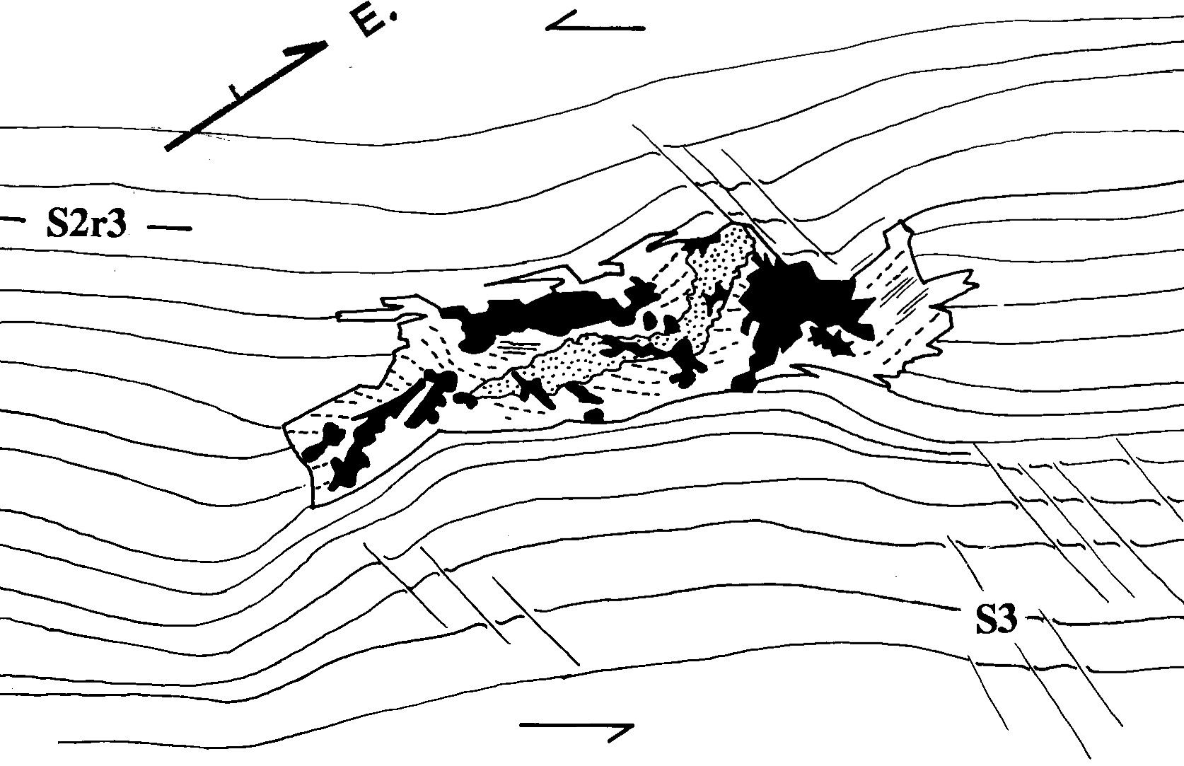
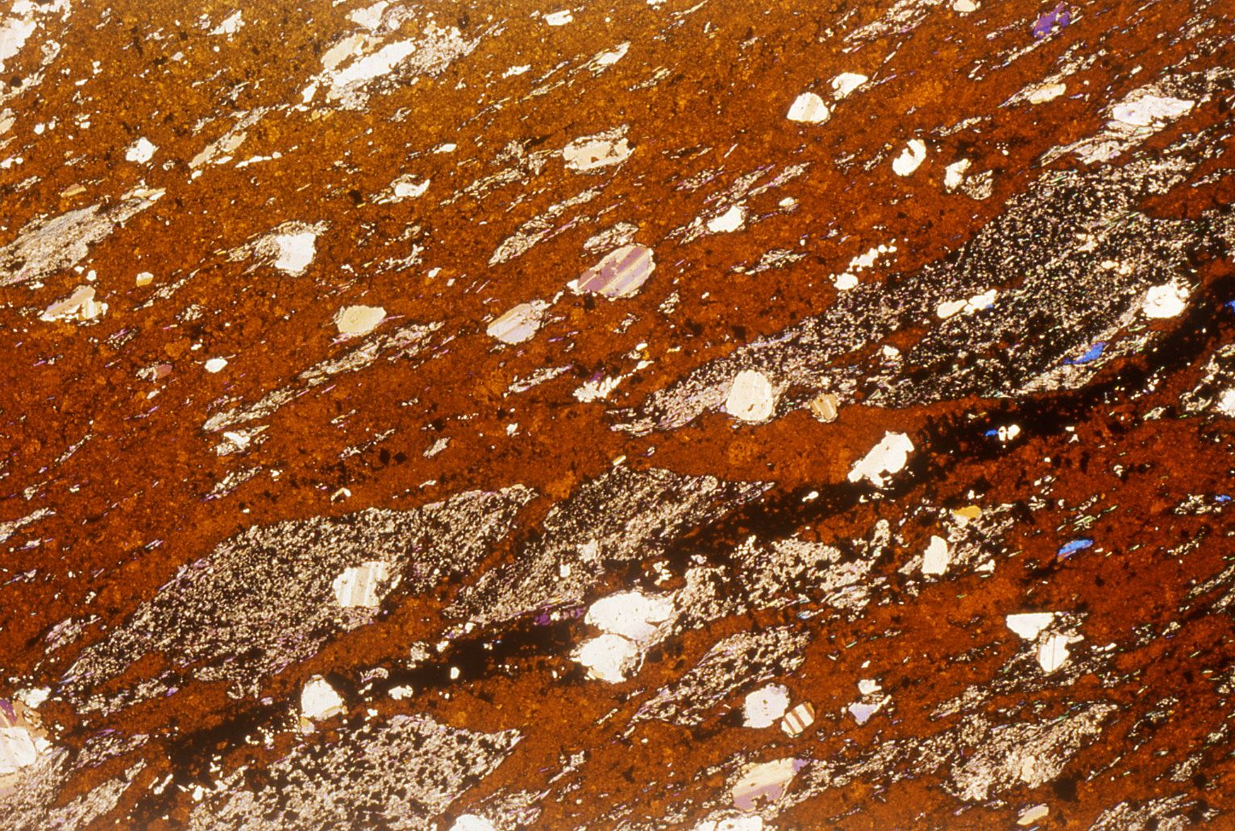
miniature of Rosebery ore body
(Aerden 1991)
Sphalerite-rich massive sulphides containing numerous fragments of schistose host rock

Slide 19
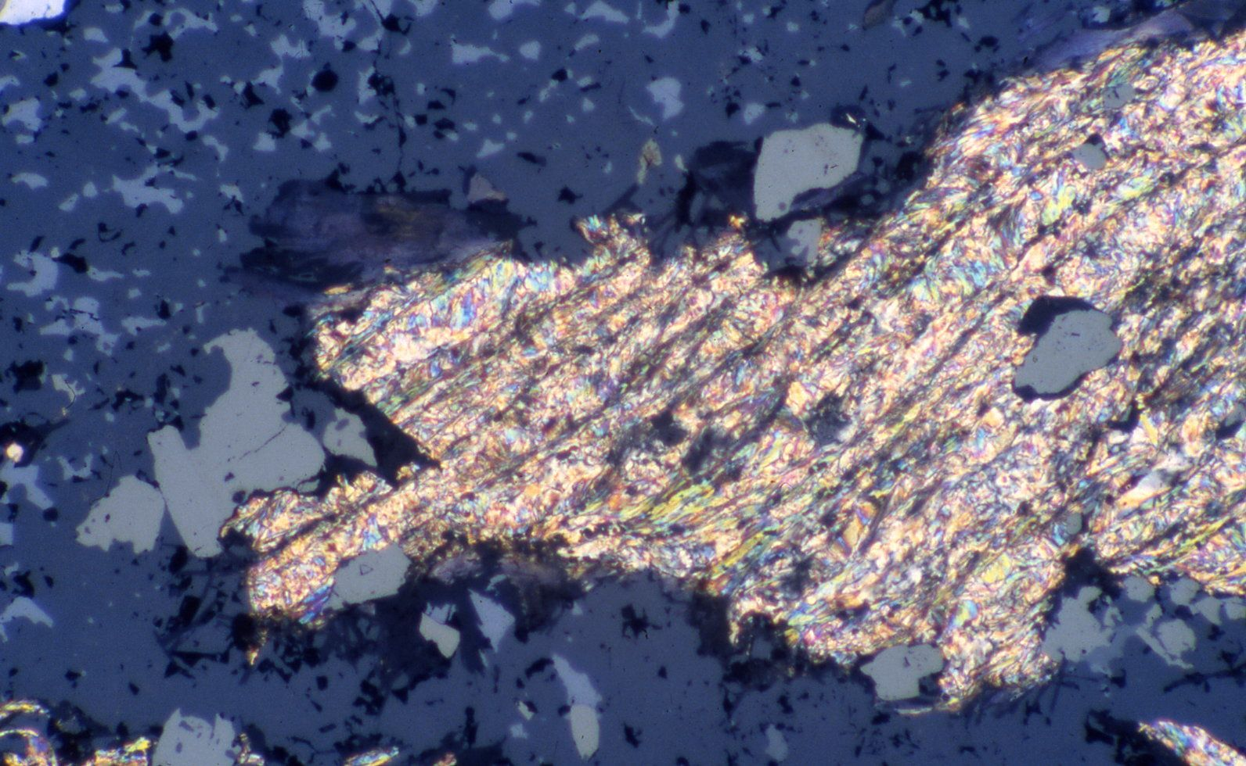
FeS₂
PbS
host-rock fragment containing S3 crenulation cleavage sharply truncated by massive sulphides. The sulphides post-date the cleavage (from Aerden 1994).
Aerden – J. Metamorphic Geol. 1994 FIGURE 12

Slide 20
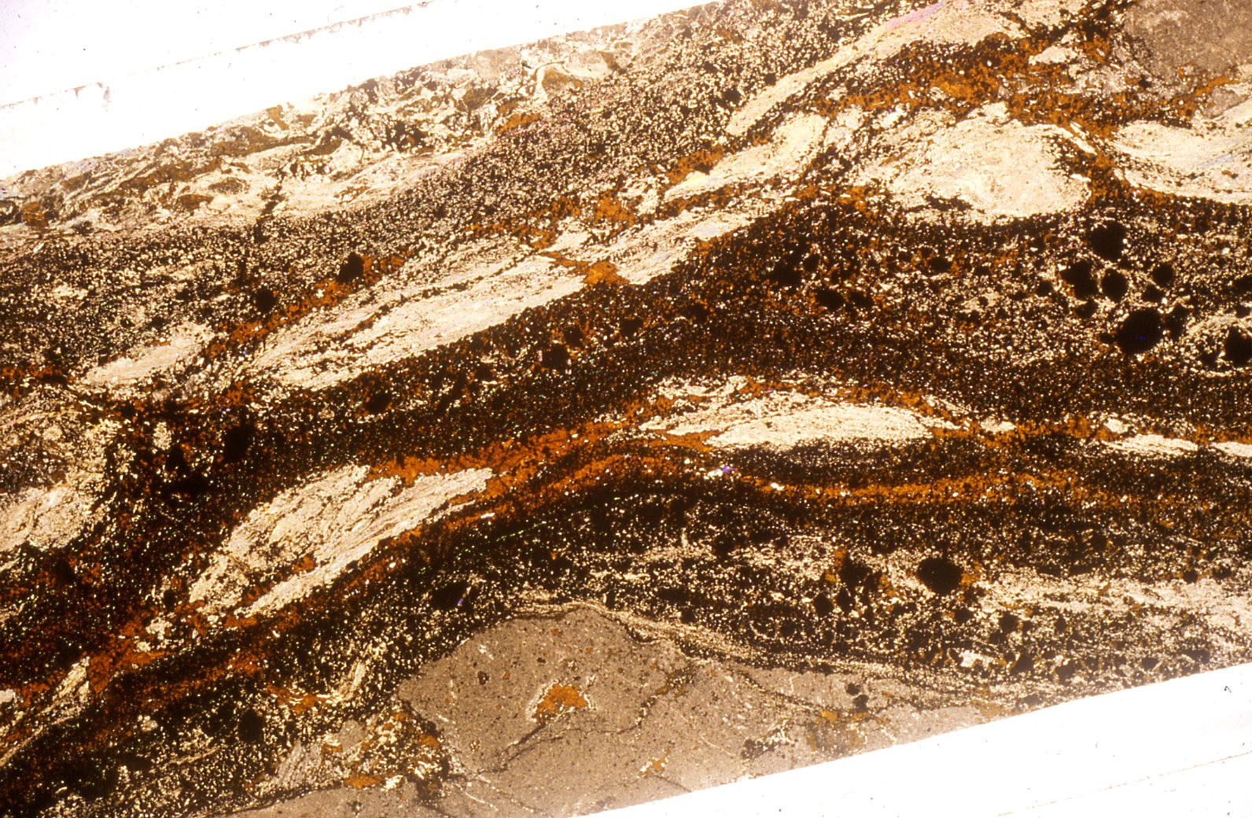
Sphalerite replacing host rock controlled by microboudinage
Aerden – J. Metamorphic Geol. 1994 FIGURE 17

Slide 21
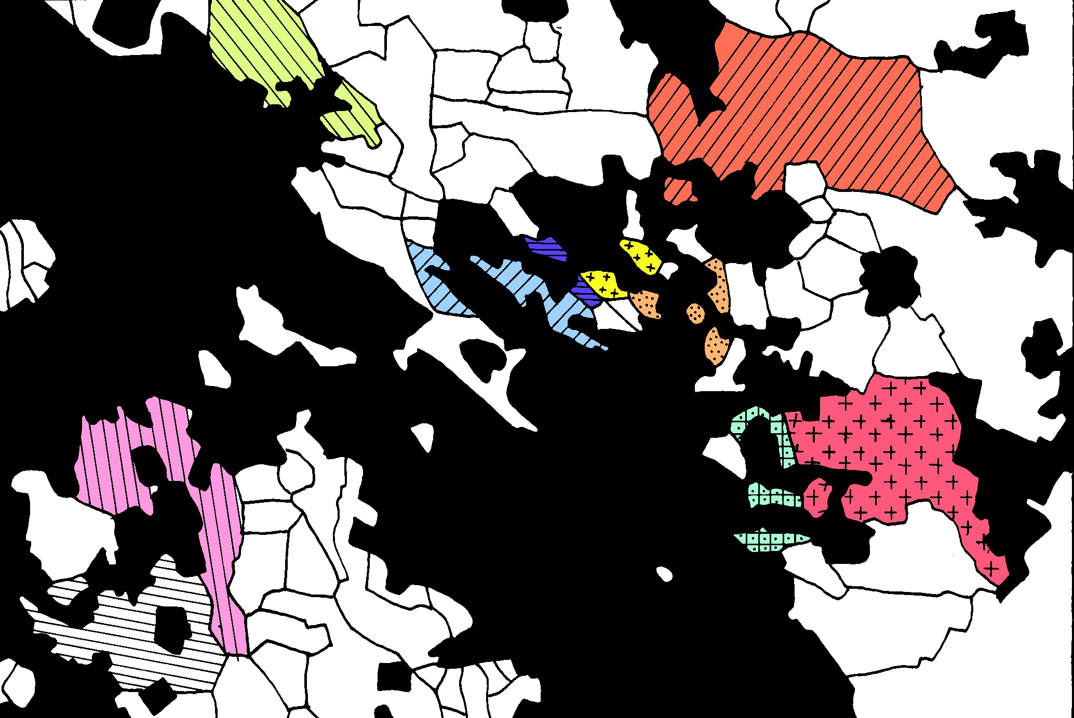
Massive Galena-Sphalerite-Pyrite ore (BLACK) replacing quartz. Quartz grains with identical optical orientations have been given the same coloured ornament pattern.
Aerden – J. Metamorphic Geol. 1994 FIGURE 8

Slide 22
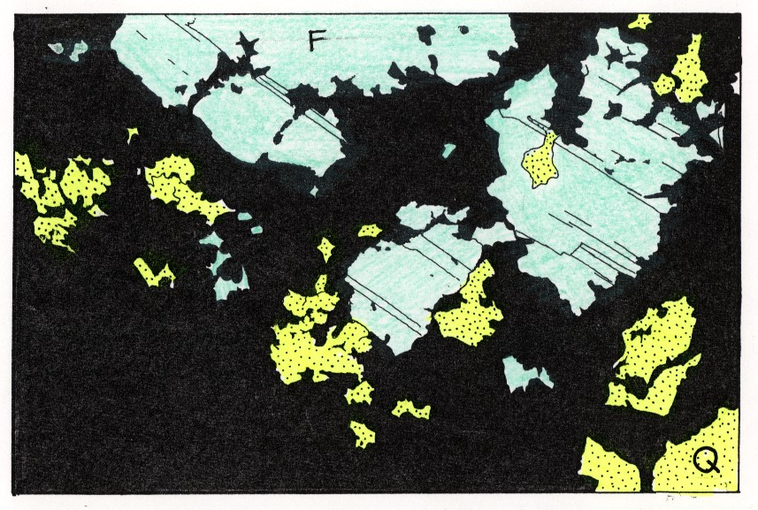
Massive Galena-Sphalerite-Pyrite ore (BLACK) replacing quartz end large feldspar crystal.
Aerden – J. Metamorphic Geol. 1994 FIGURE 10

Slide 23
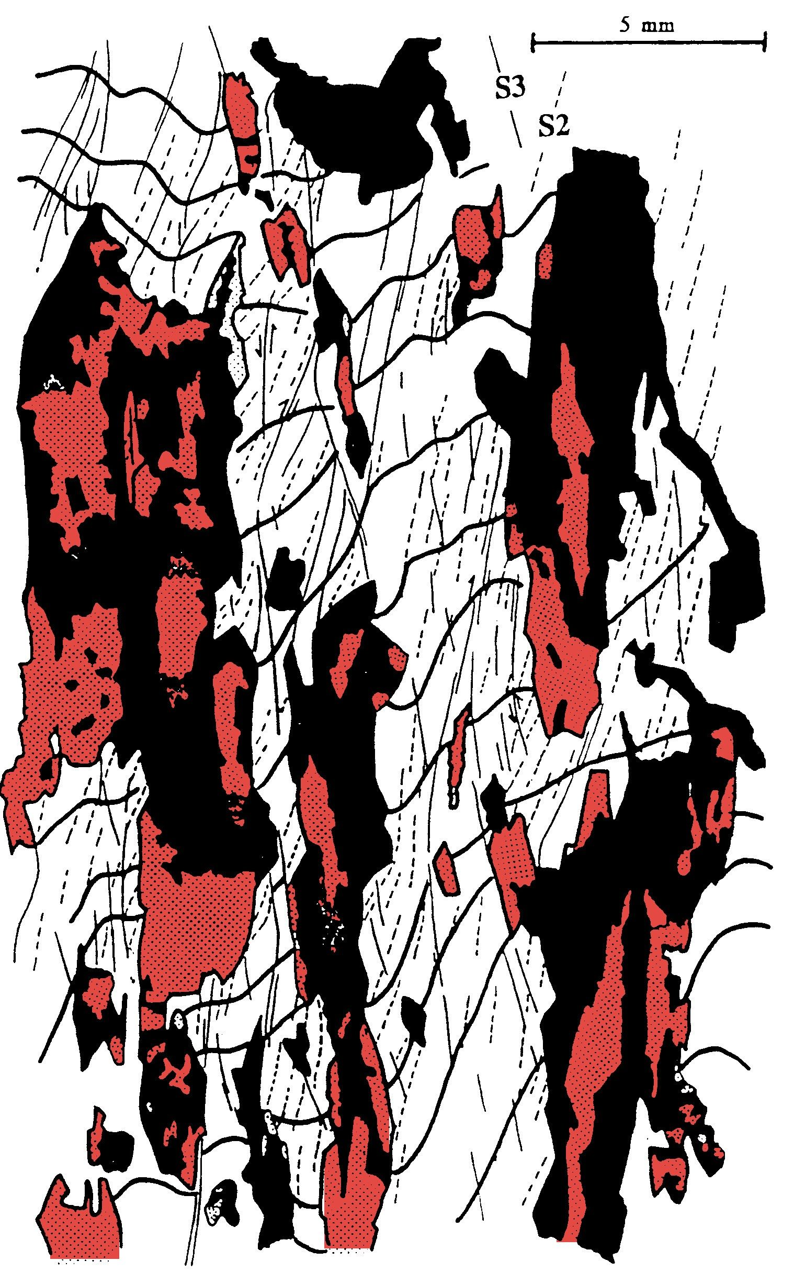
Hercules Mine
Aerden - Econ. Geol. 1993
S2
(main cleavage)
S3
(crenualation cleavage)
S0
(folded bedding)
Sphalerite
Chlorite
ther geometries of replaced host-rock domains are controlled
by S3 and S2 cleavages. The ore appears preferentially located in short-limb domains of folds (yellow line)

Slide 25
pyrite I
chlorite- quartz-carbonate-barite
pyrite II
Chalcopyrite, Galena, Sphalerite
time
observed mineral zoning from structural trap outward
sericite-carbonate-quartz-chlorite alteration
Ca-Feld-Ba (+Sph, Ga)
Sph-Ga-Py-Q
Py-Cpy-Chl-Q

Slide 26
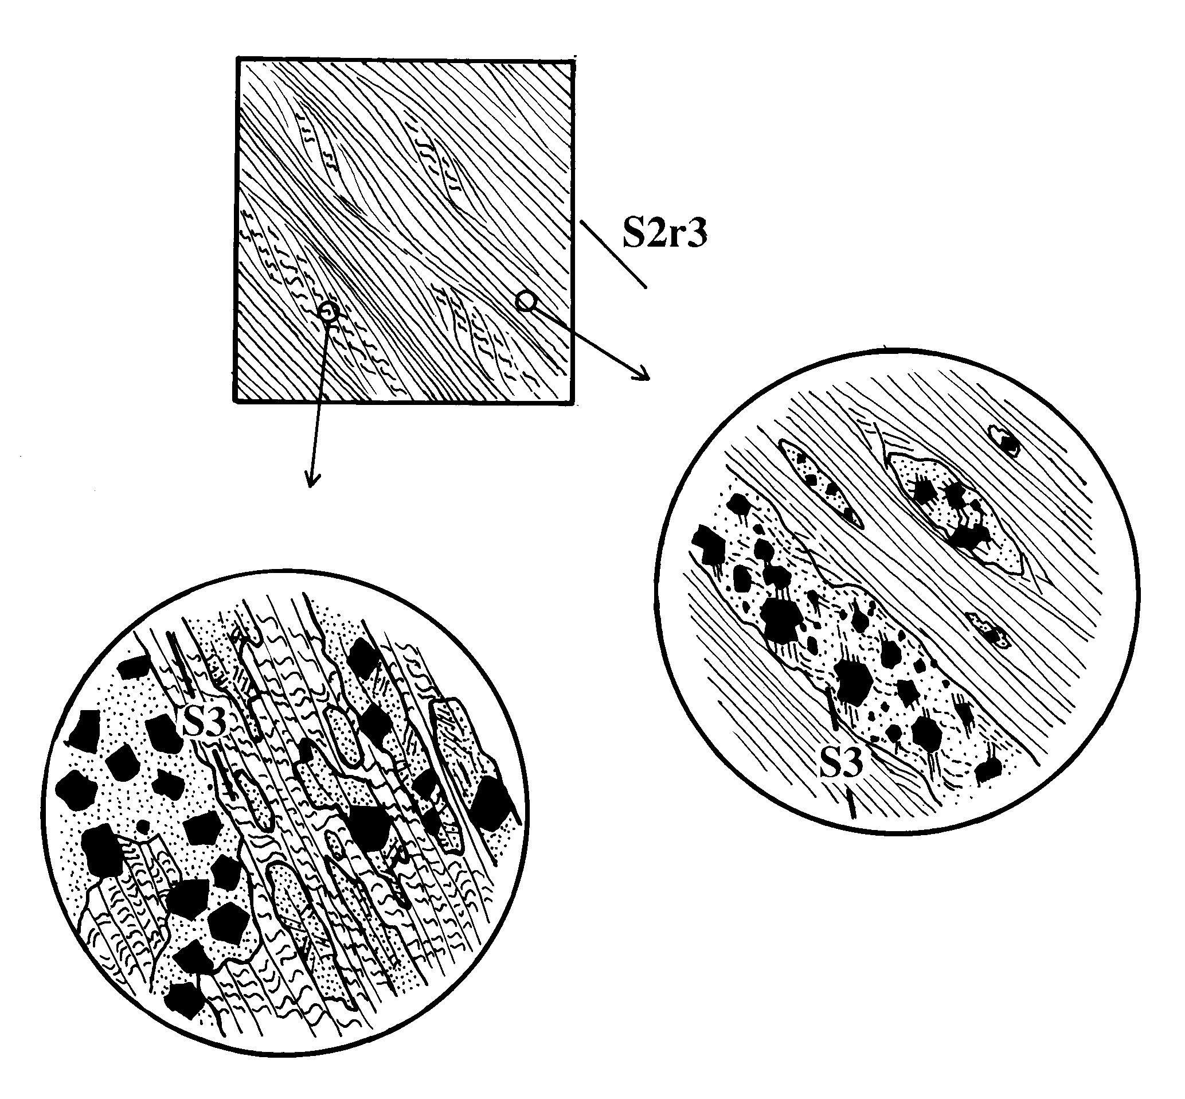
(S2 reactivated during D3)
syn-D3 replacement of host rock by pyrite-quartz gangue
S3

Slide 27
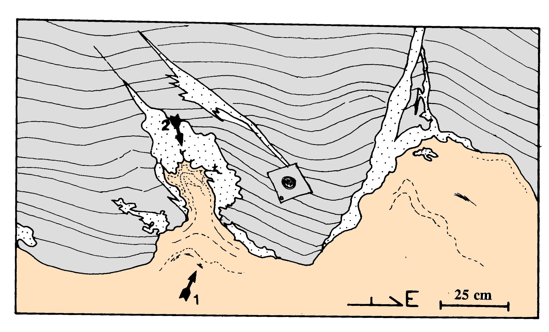
host-rock
banded
massive sulphides
mechanical remobilization of sulphides into late fractures formed at the sulphide (soft) - hostrock interface (piercement structures)

Slide 28
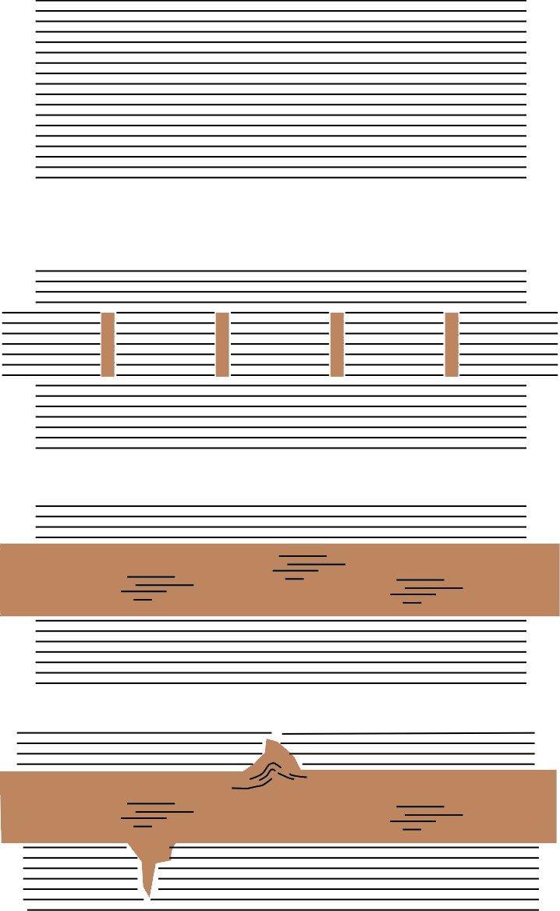
1
2
3
4

