Slide 1
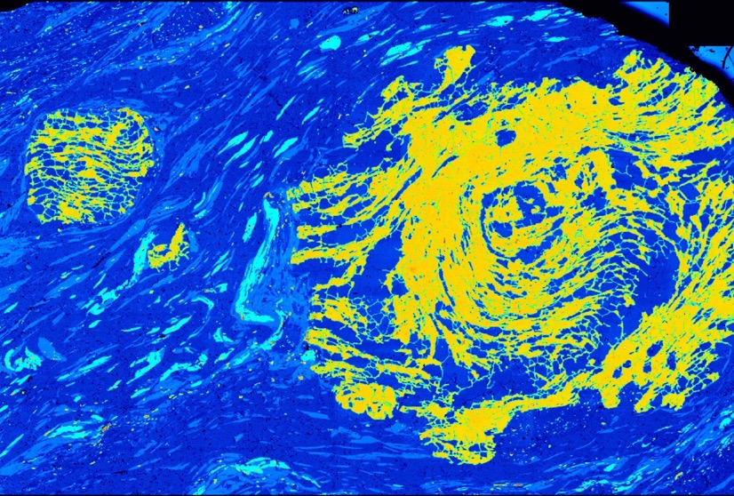
How porphyroblasts record deformation and orogenesis
Some key concepts and examples
Domingo Aerden
Universidad de Granada, Spain

Slide 2
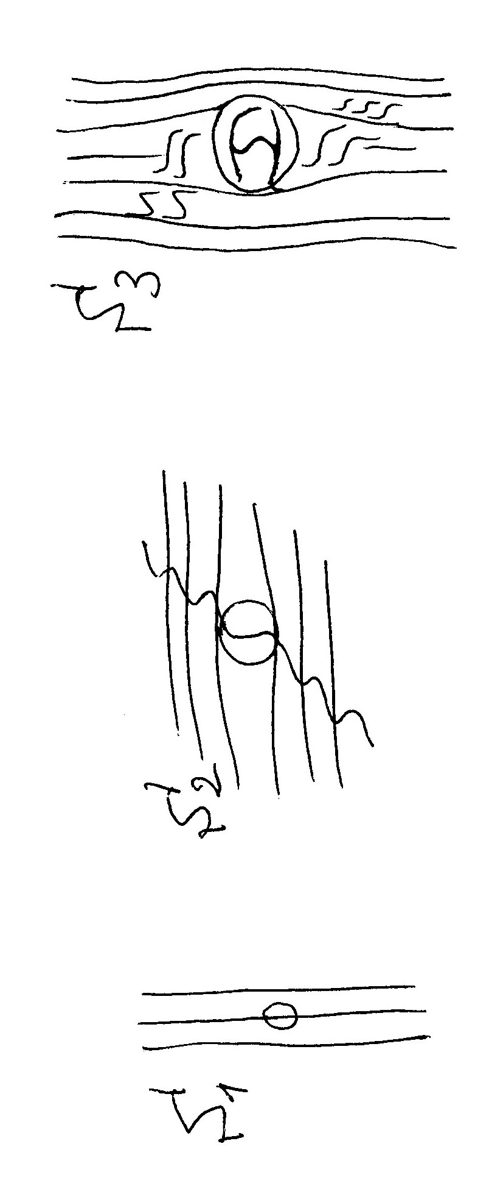
Traditional ‘snowball’ model
the spiral axis lies
perpendicular to the
dextral shearing direction
the spiral axis lies
perpendicular to
the shortening direction with a component of sinistral shearing
S1
S2
S3
New model: polyphase deformation

Slide 3
my Ph.D. supervisor
1985
1989
my M.Sc. supervisors
1992
1992

Slide 4
Articles dealing with the kinematics of inclusion trails (1980-2022) favoring either porphyroblast rotation or porphyroblast non-rotation, or inconclusive
Web of Knowledge key word search:
porphyroblast rotation, inclusion trails
150 papers since 1980

Slide 5
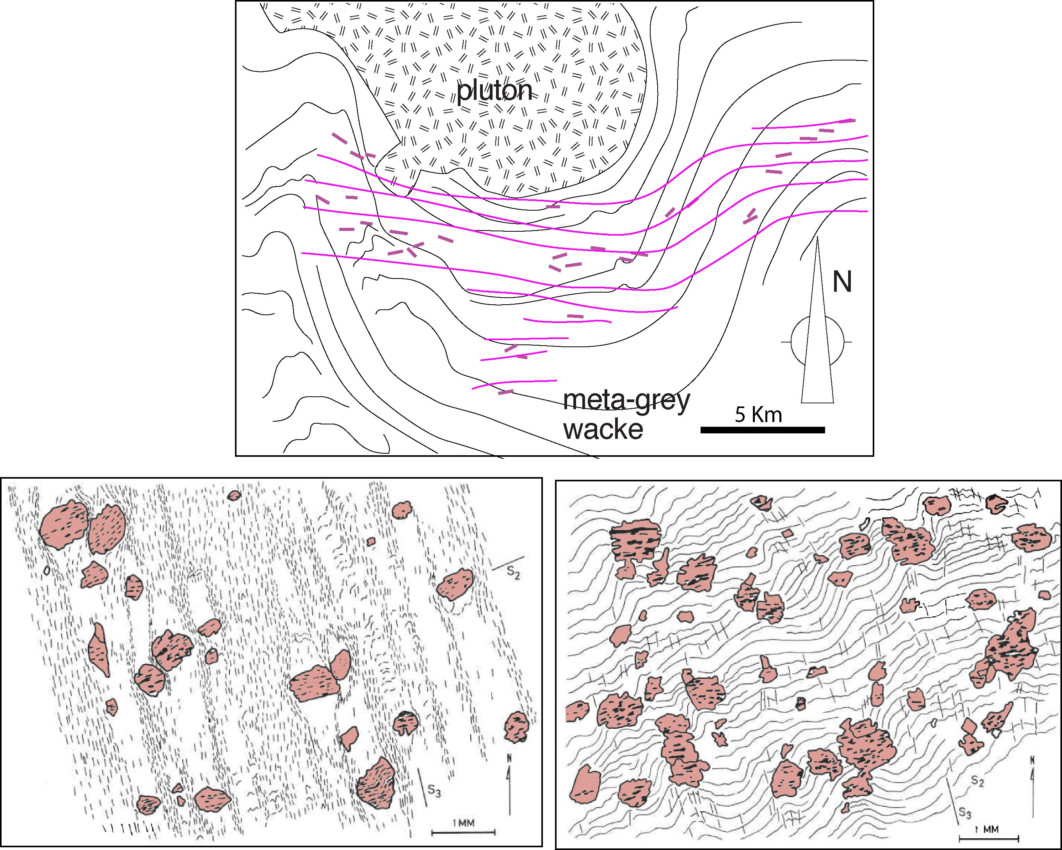
Fyson (1980), the first to report regionally consistent inclusion trails
Slave Province, Canadian Shield
S1-e
Inclusion-trail
trajectories
S2
S1
S1
N
1mm
1mm

Slide 6
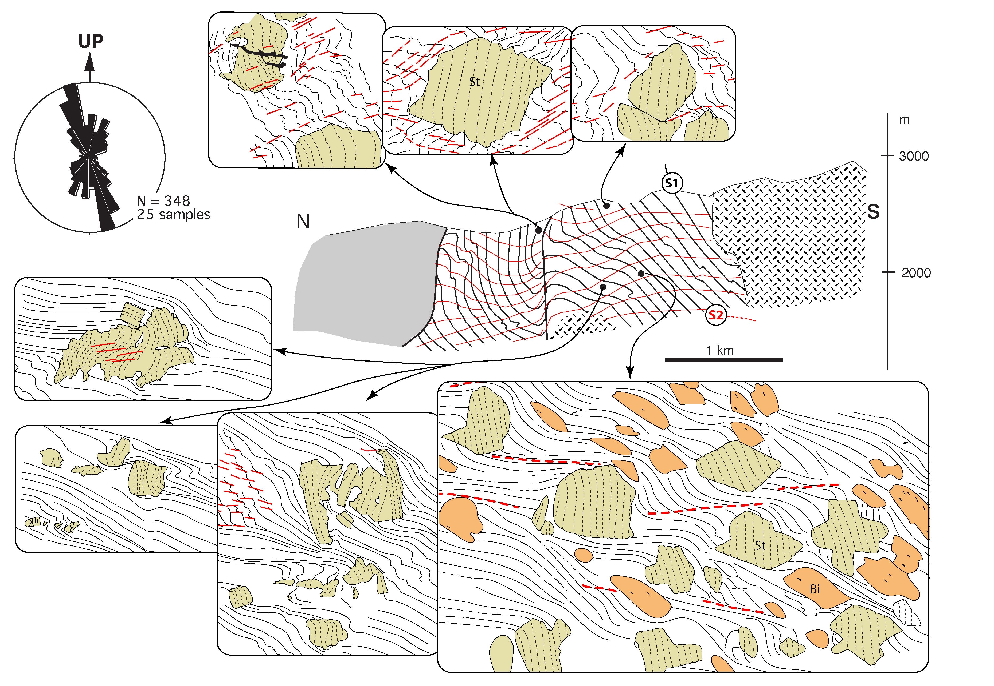
Aerden, 1995 finds the same in the
Lys-Caillaouas Massif

Slide 7
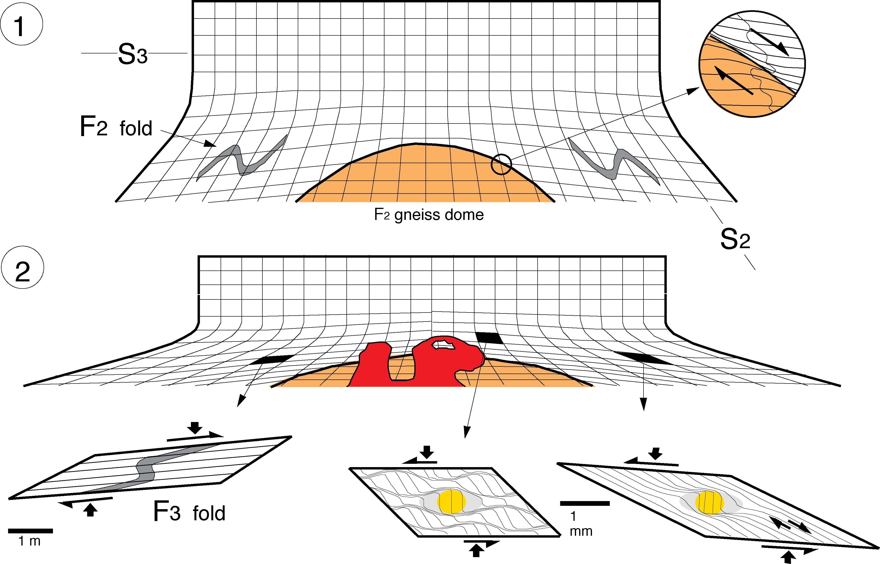
Aerden’s, 1994 tectonic interpretation of the Lys-Caillaouas Massif

Slide 8
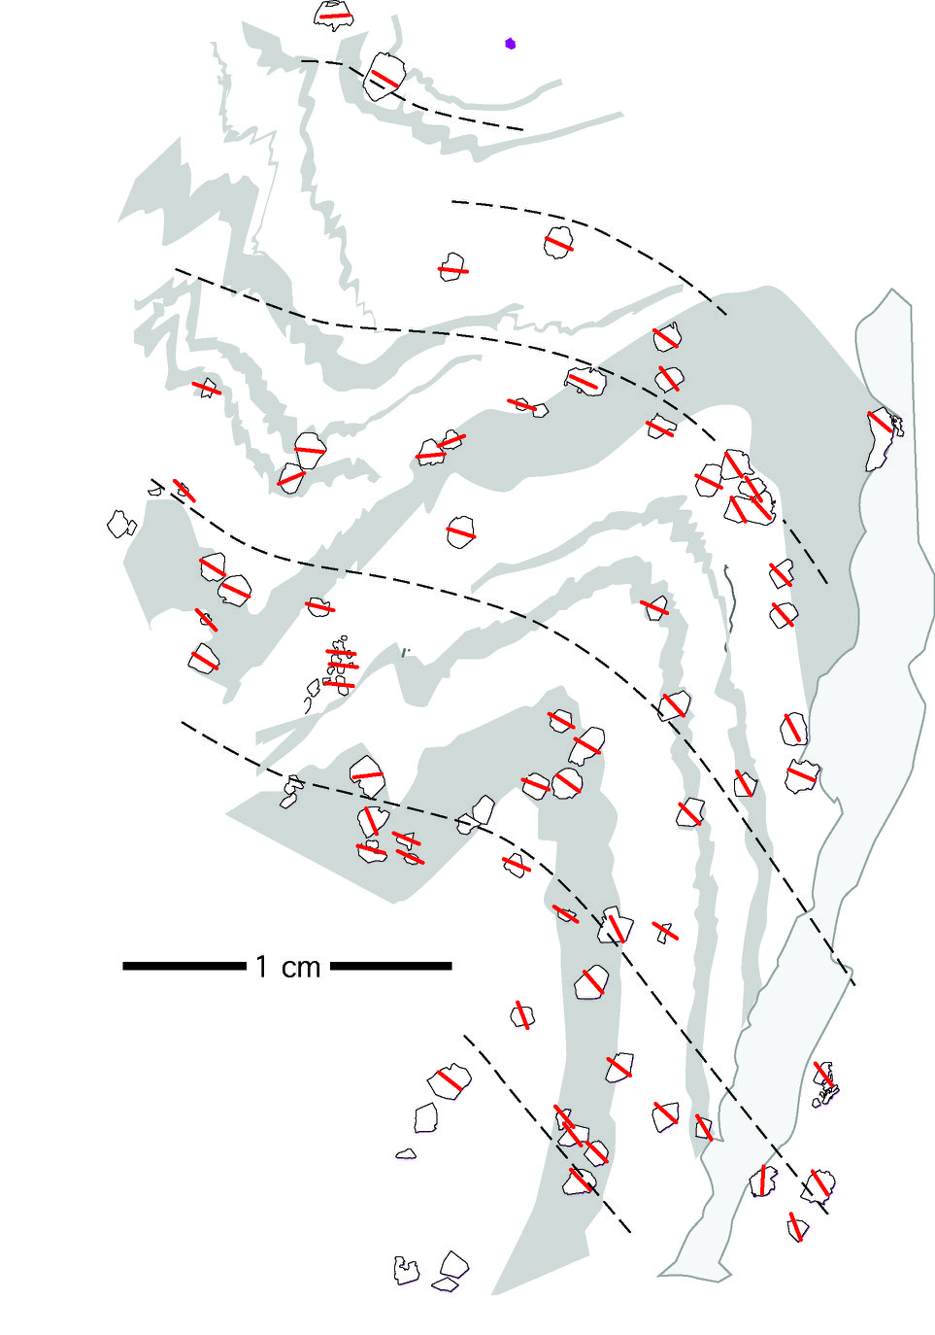
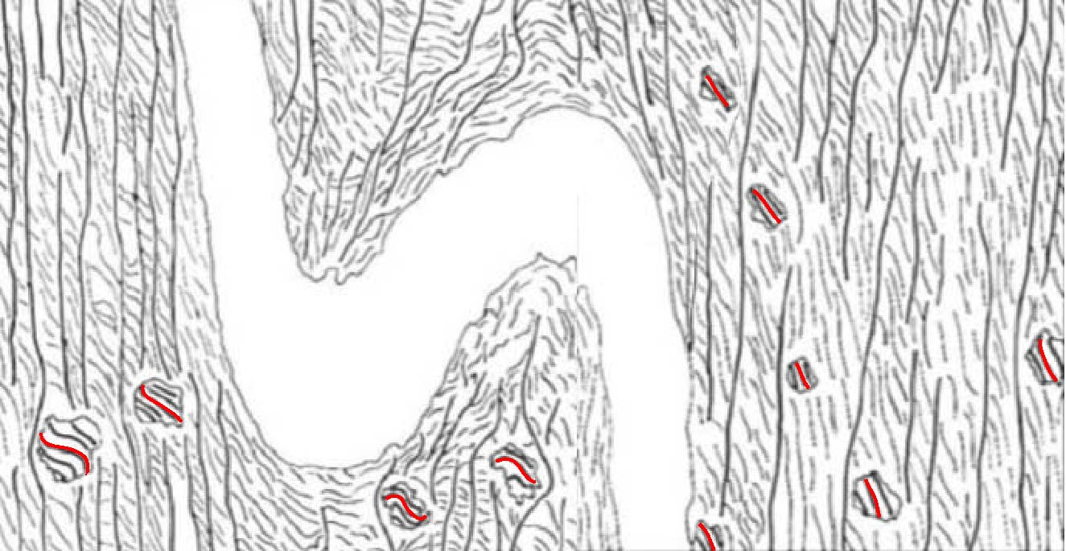
Two examples of relatively constant inclusion trails despite later folding
Bell et al. Geology 1992
Aerden et al., JSG 2010

Slide 9
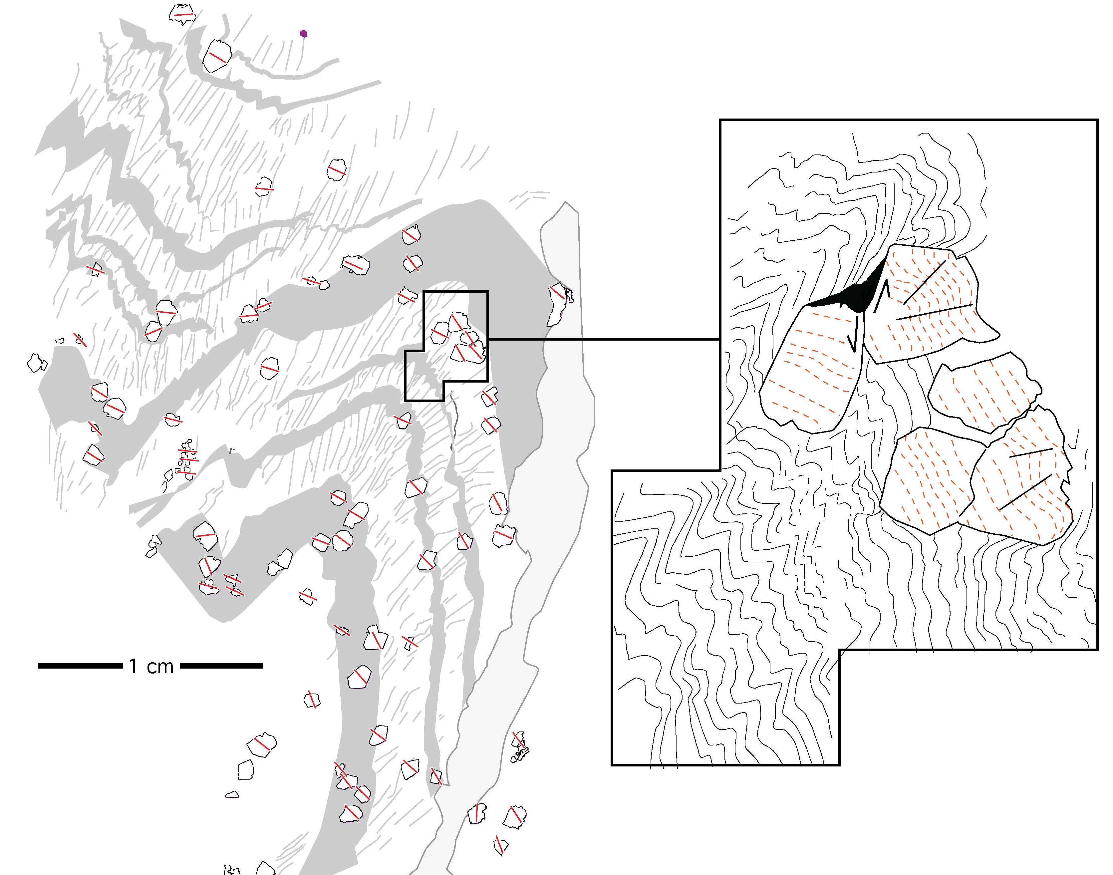
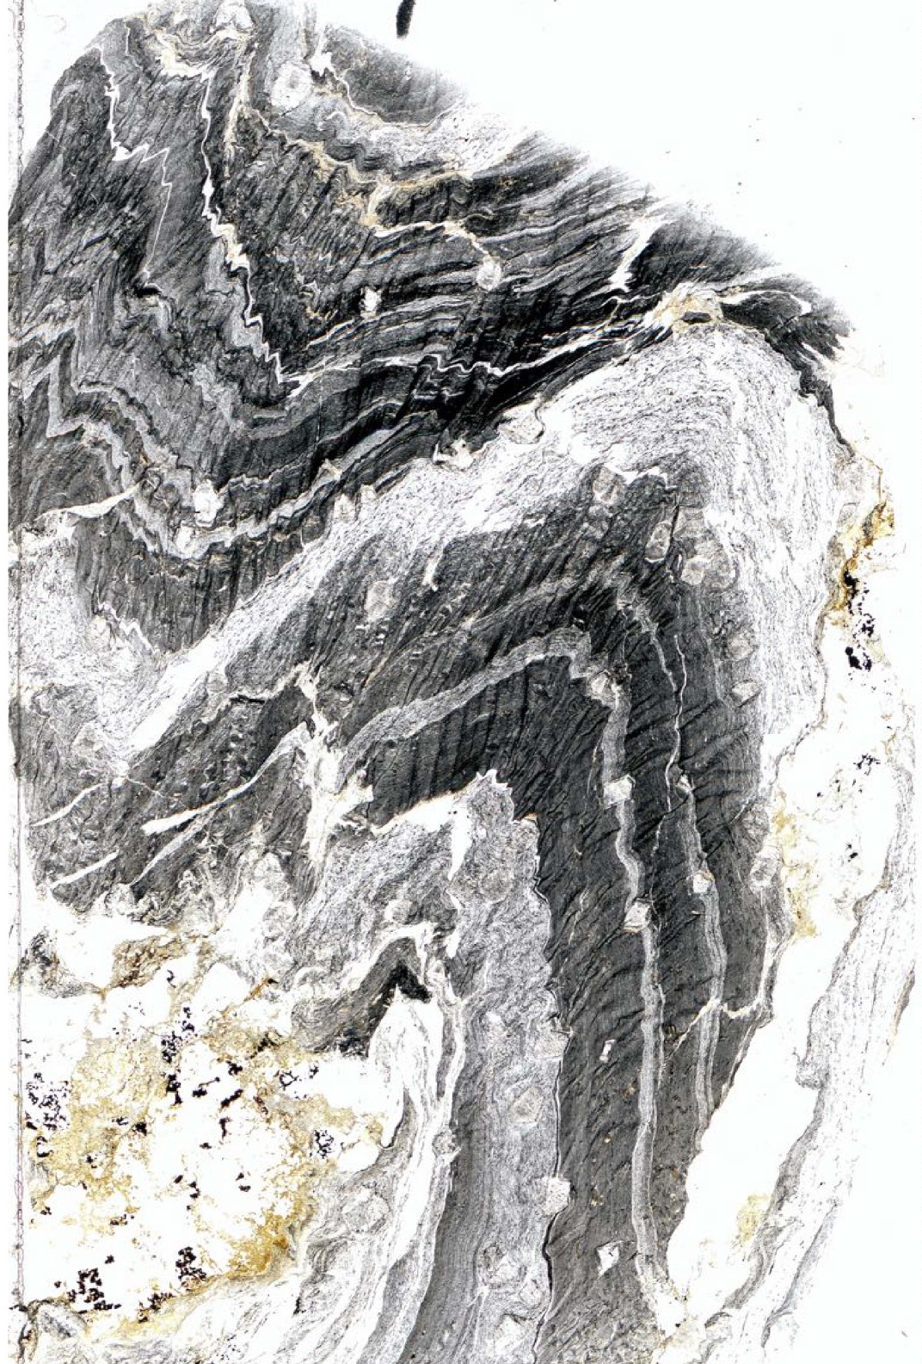
This one rotate ca. 45° anticlockwise

Slide 10
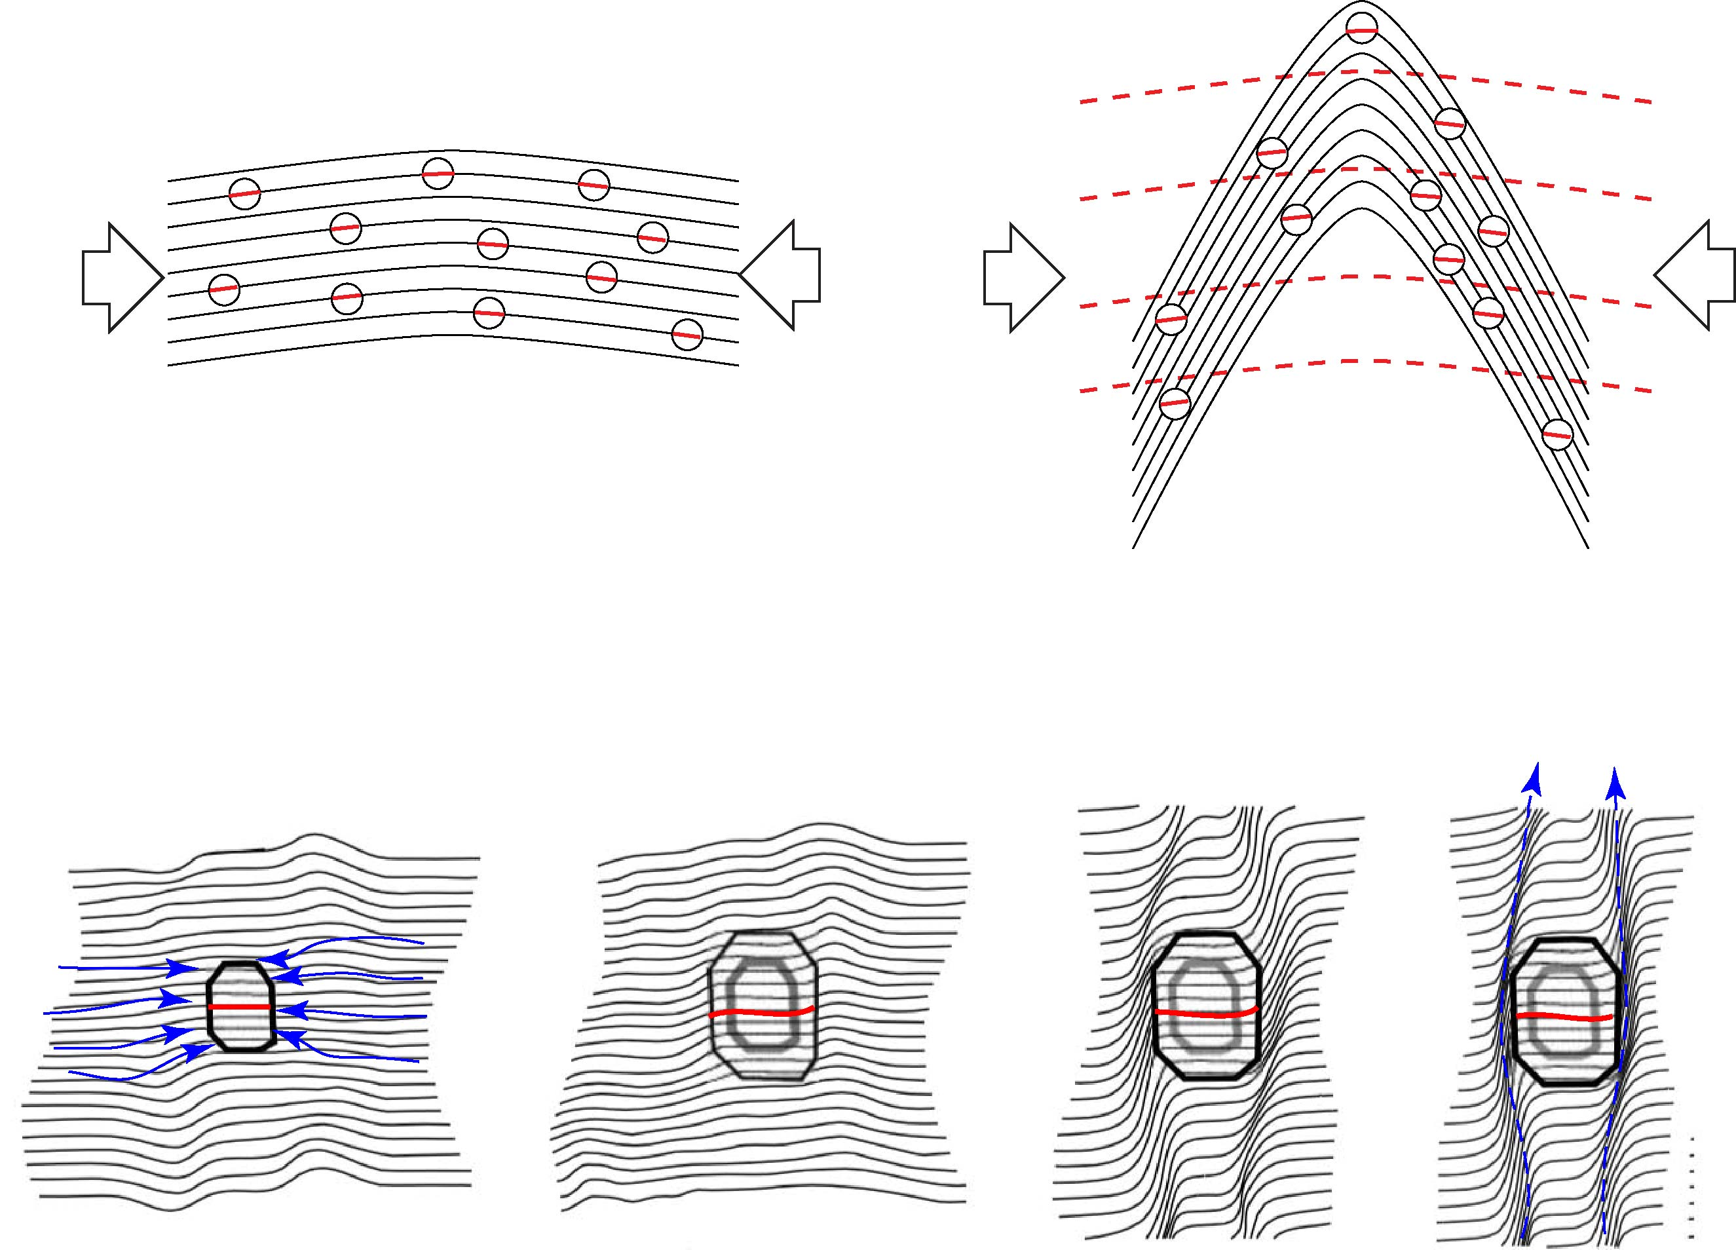
EXPLANATION
porphyroblast grow during early fold stage
growth ceases when a new foliation
intensifies against porphyroblast margins
microfracturing
enhances difusion
Bell & Bruce, 2007

Slide 11
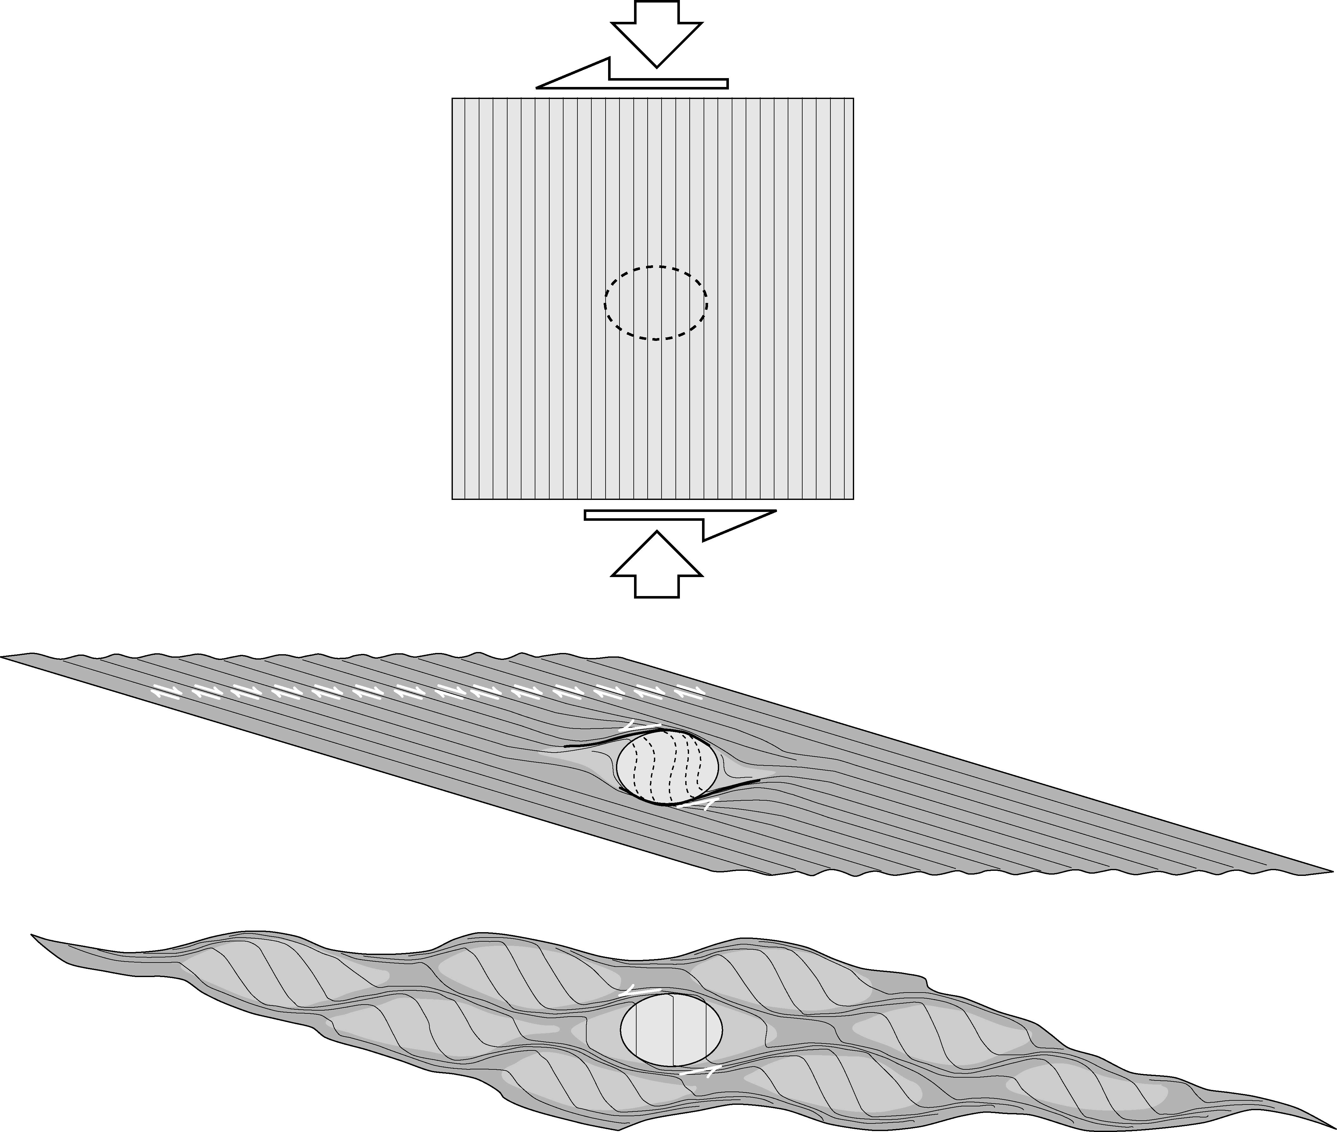
Lack of porphyroblast rotation results from 2 modes of deformation partitioning. Both modes can operate simultaneously even at the scale of a thin section. Mode-1 commonly transitions to Mode-2 with increasing strain as the original foliation enters the extensional field.
Modified after
Bell 1985 and
Aerden 1995
MODE-2
antithetic reactivation of
pre-existing foliation
synthetic shear against rigid object
MODE-1
crenulation cleavage
development
= synthetic shear only

Slide 12
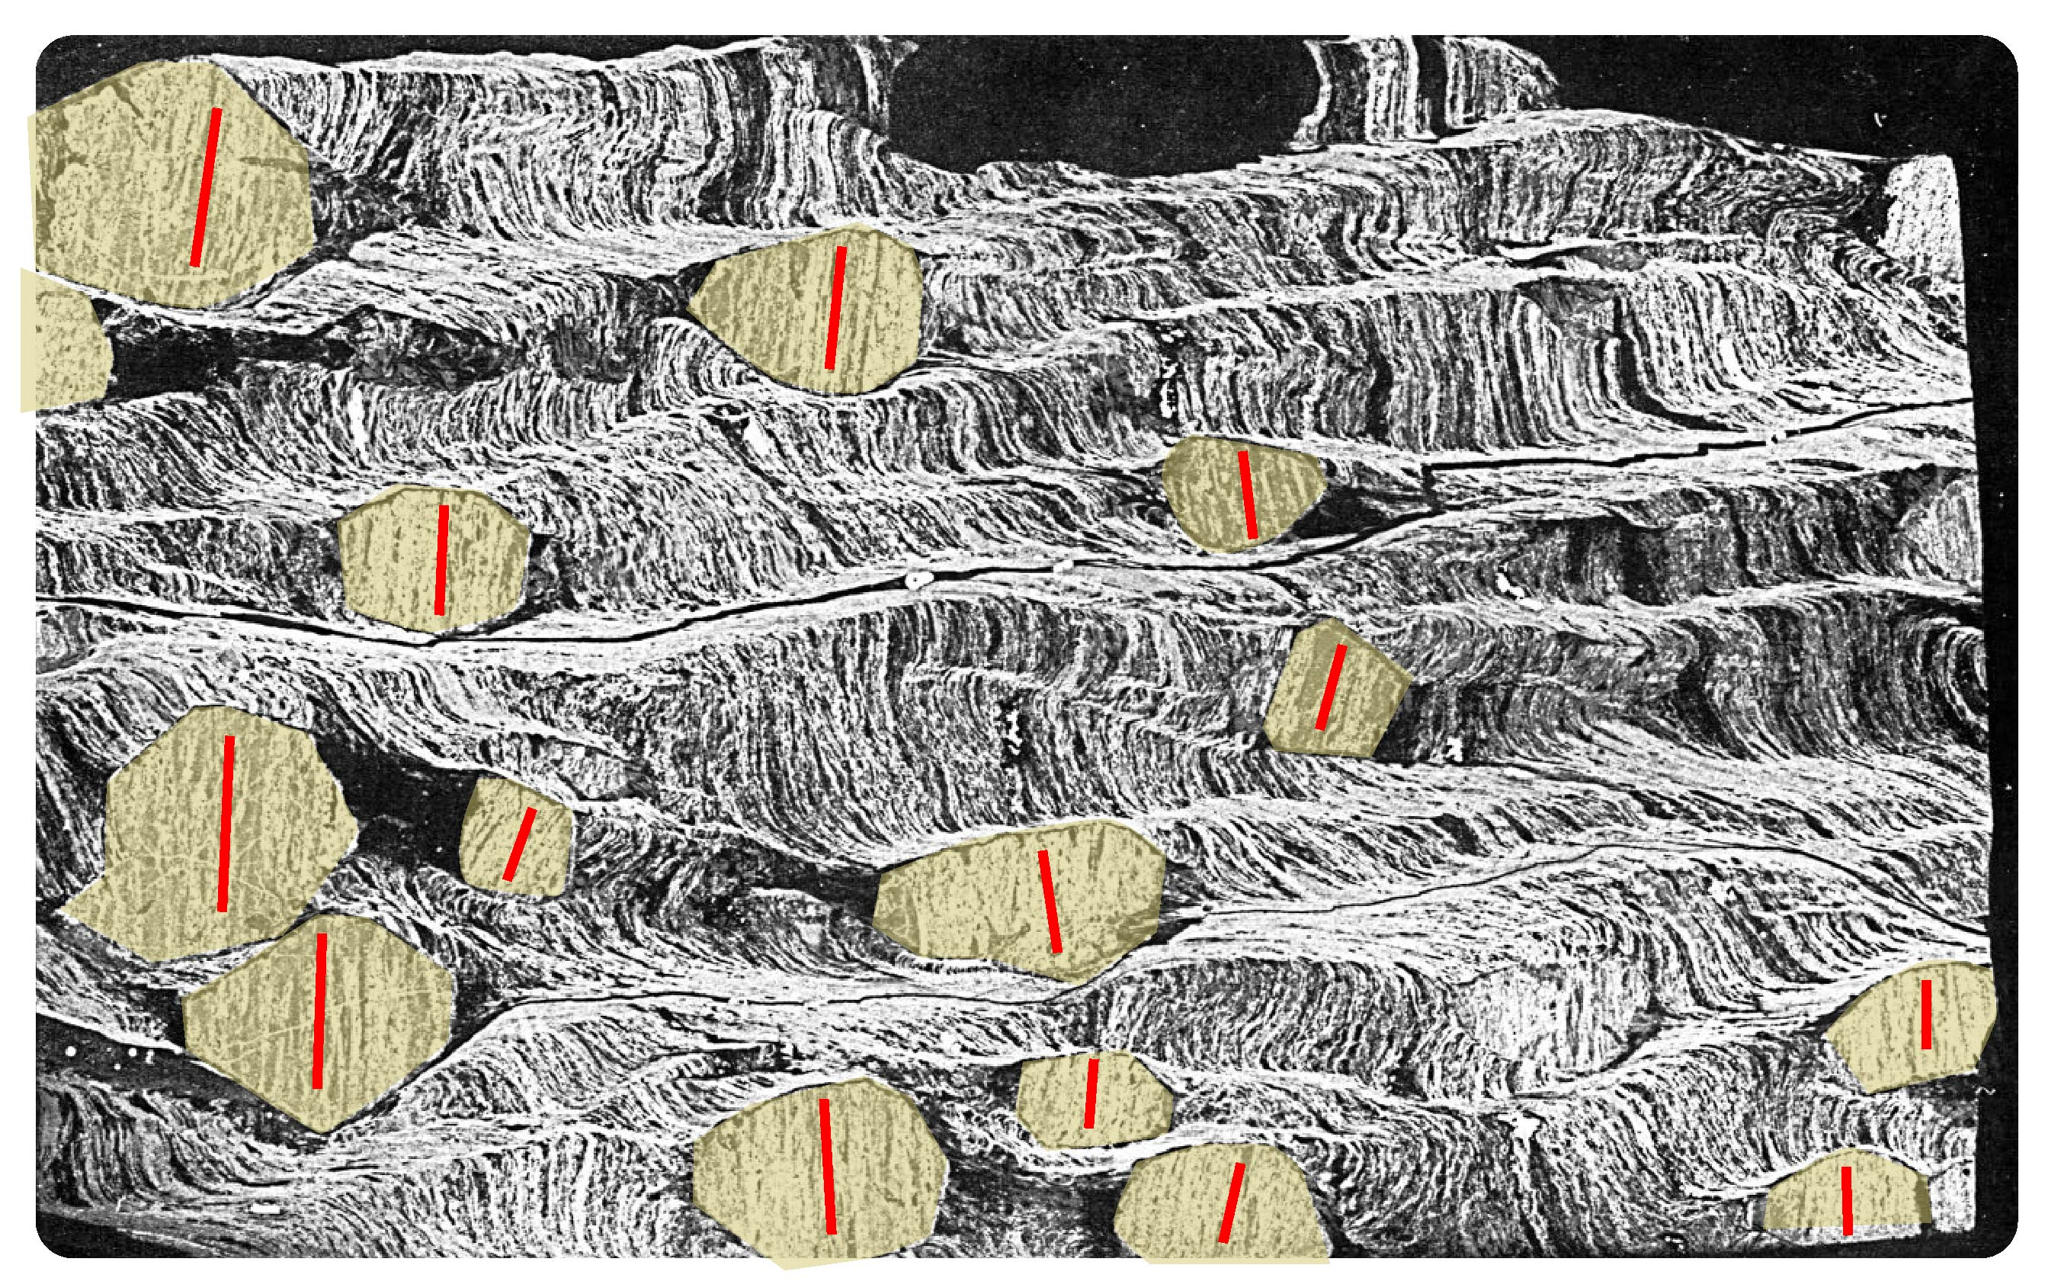
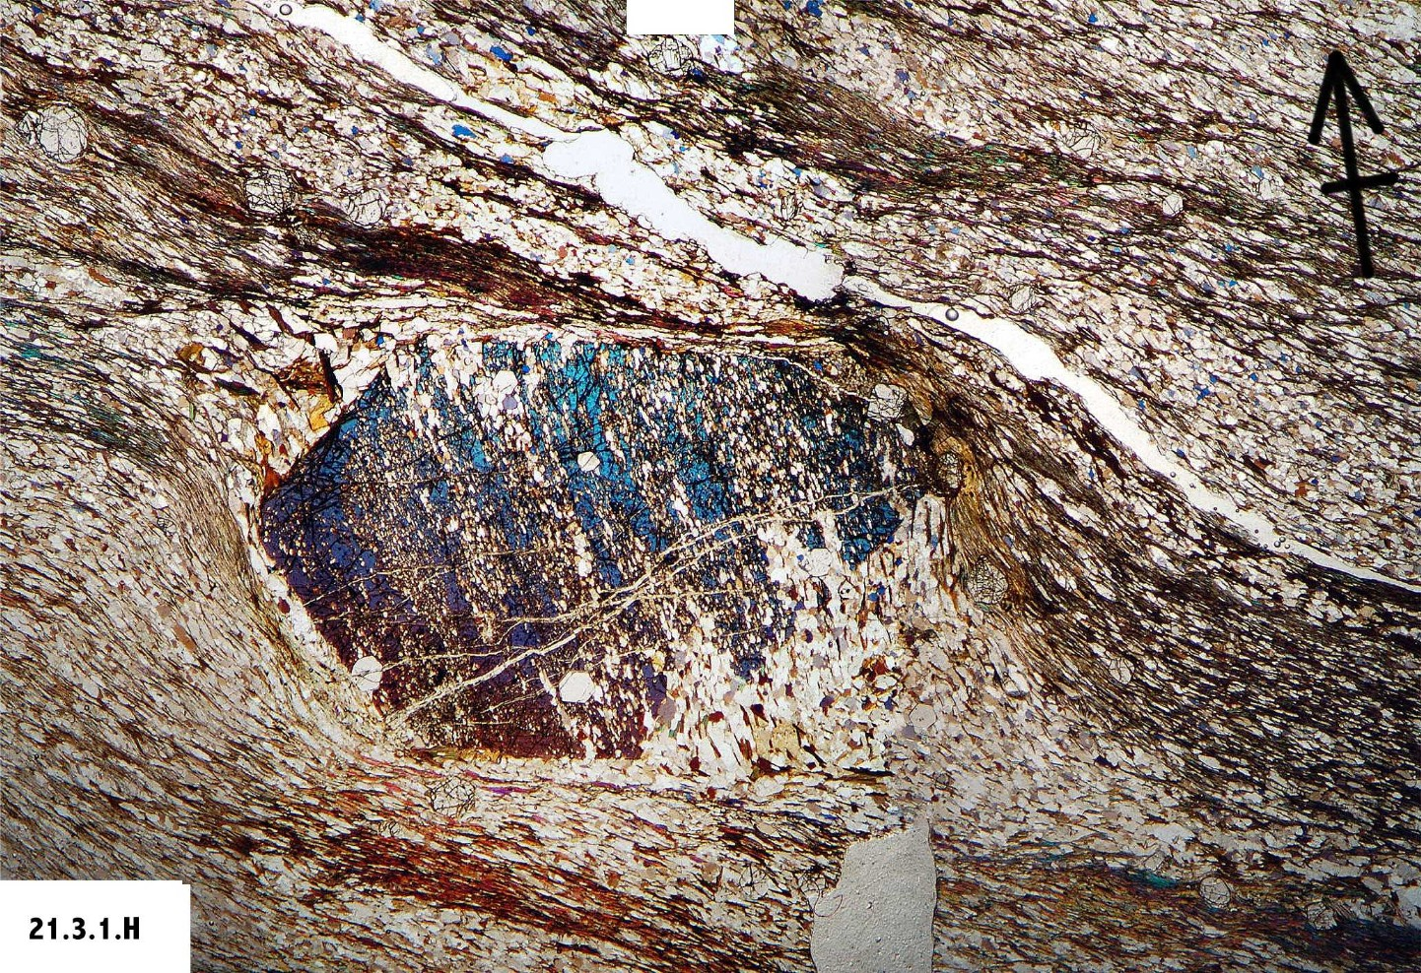
MODE-1
Lack of porphyroblast rotation is due to deformation partitioning
2 possible modes:
MODE-2
Bell & Johnson, 1992
antithetic reactivation of
pre-existing foliation
synthetic shear against rigid object
crenulation cleavage
development
= synthetic shear only

Slide 13
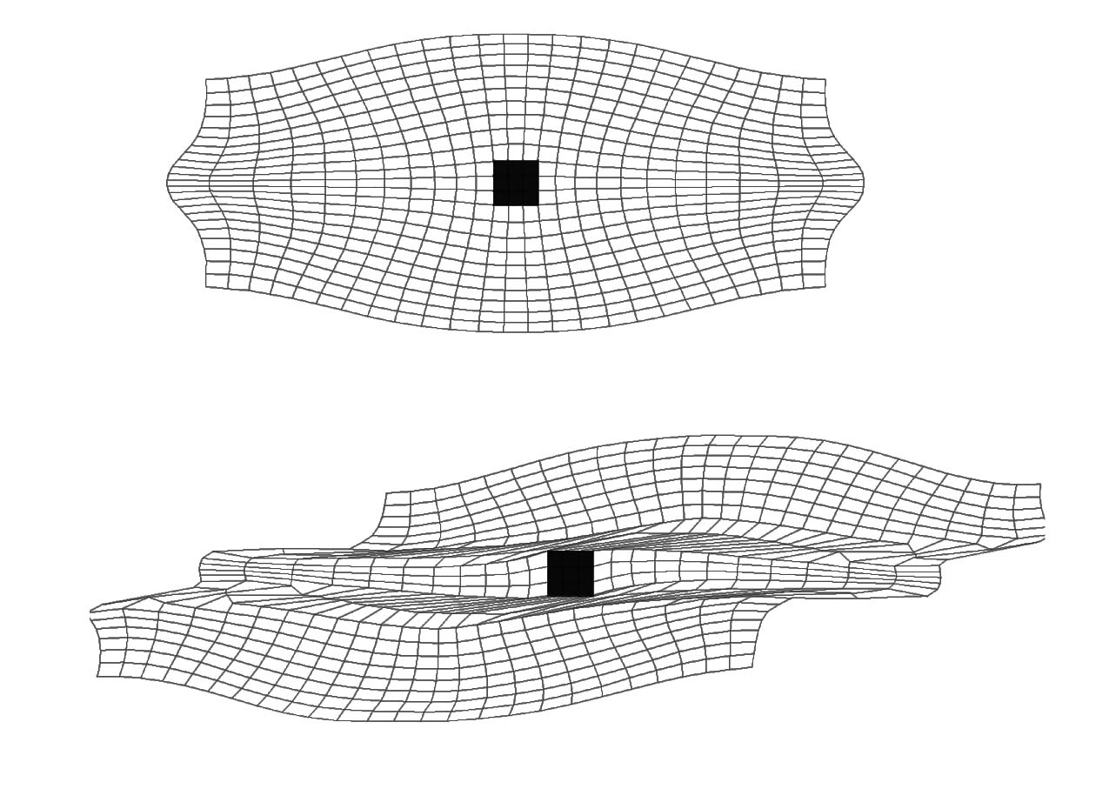
numerical model of pure shear followed by simple shear
Fay et al. 2008

Slide 14
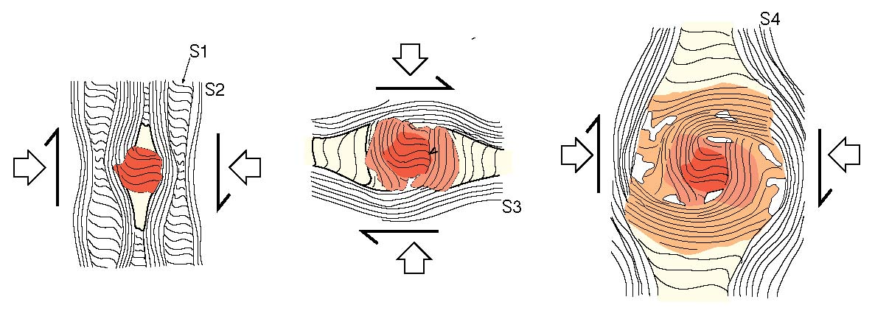
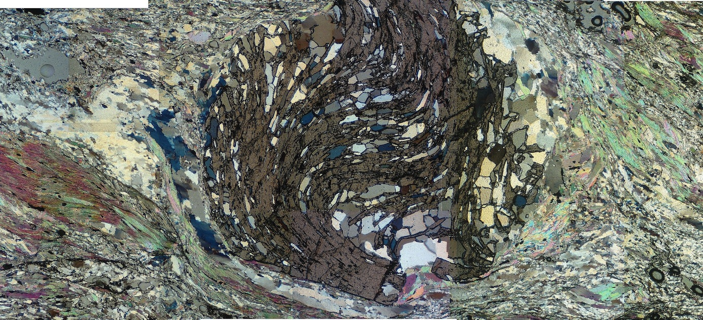
Bell et al. 1992. Geology
D3
D4
D2
Aerden and Sayab, 2008
Notes:
MULTIPLE DEFORMATIONS PRODUCING A SEQUENCE OF ORTHOGONAL FOLIATIONS

Slide 15
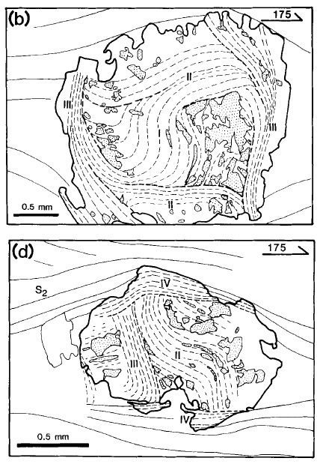
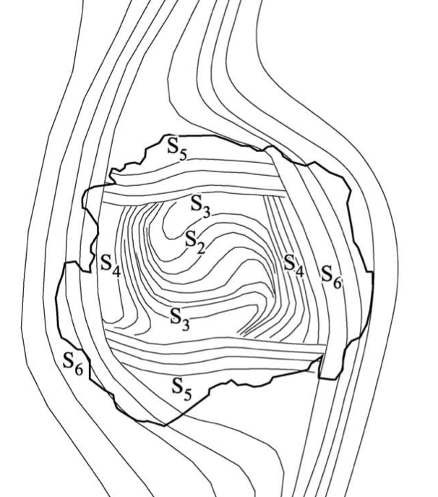
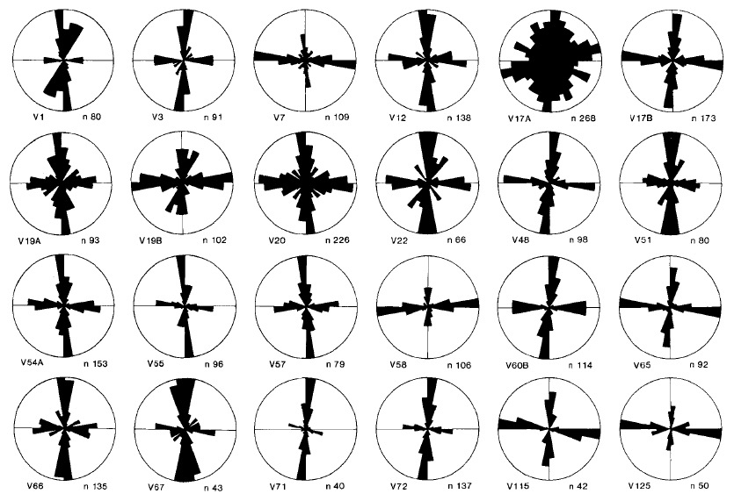
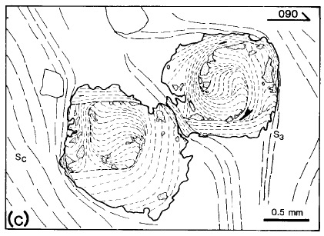
Hayward, JMG 1992:
Vertical and horizontal preferred orientations of internal truncations in the classic spiral garnets of Vermont studied by Roosenfeld. This data slam dunks the ‘snowball’ mechanism.
(24 samples, 2611 data)

Slide 16
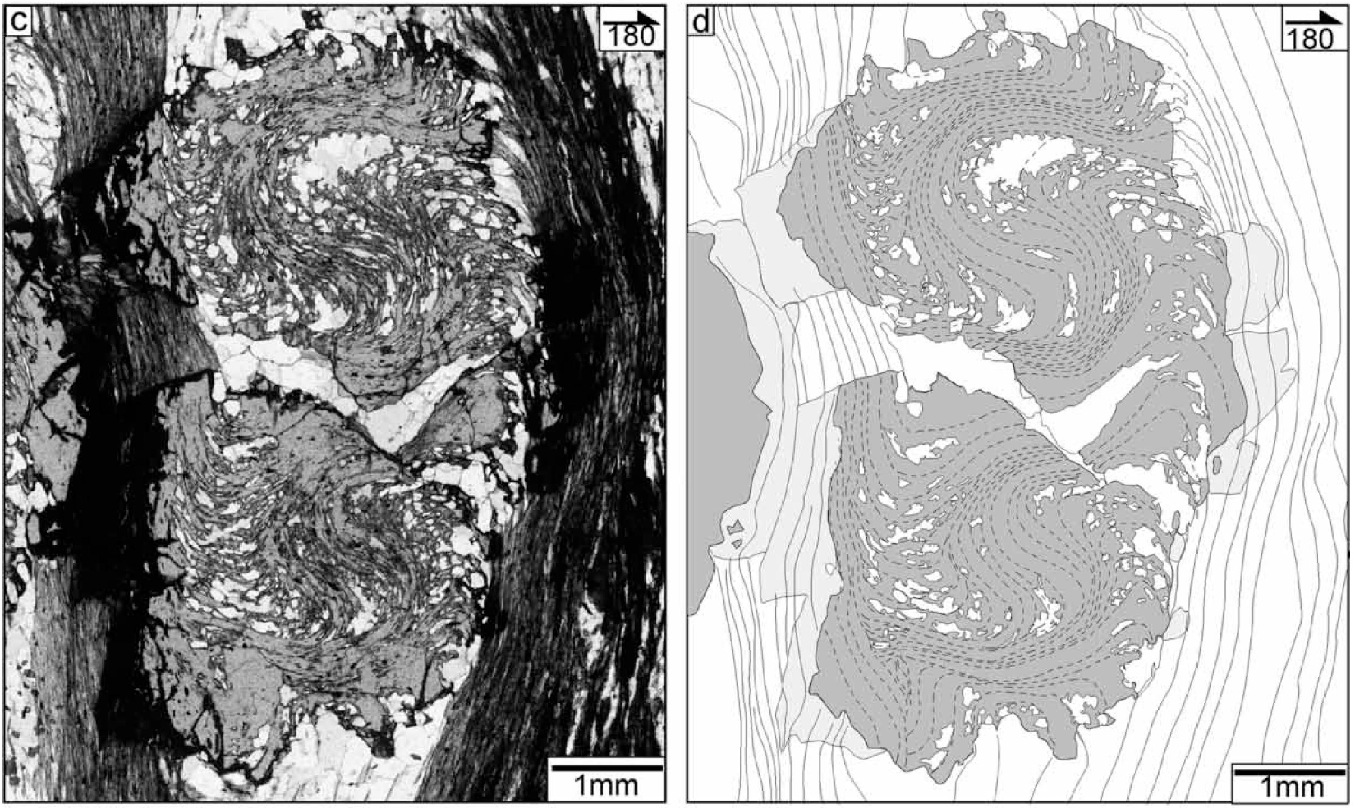
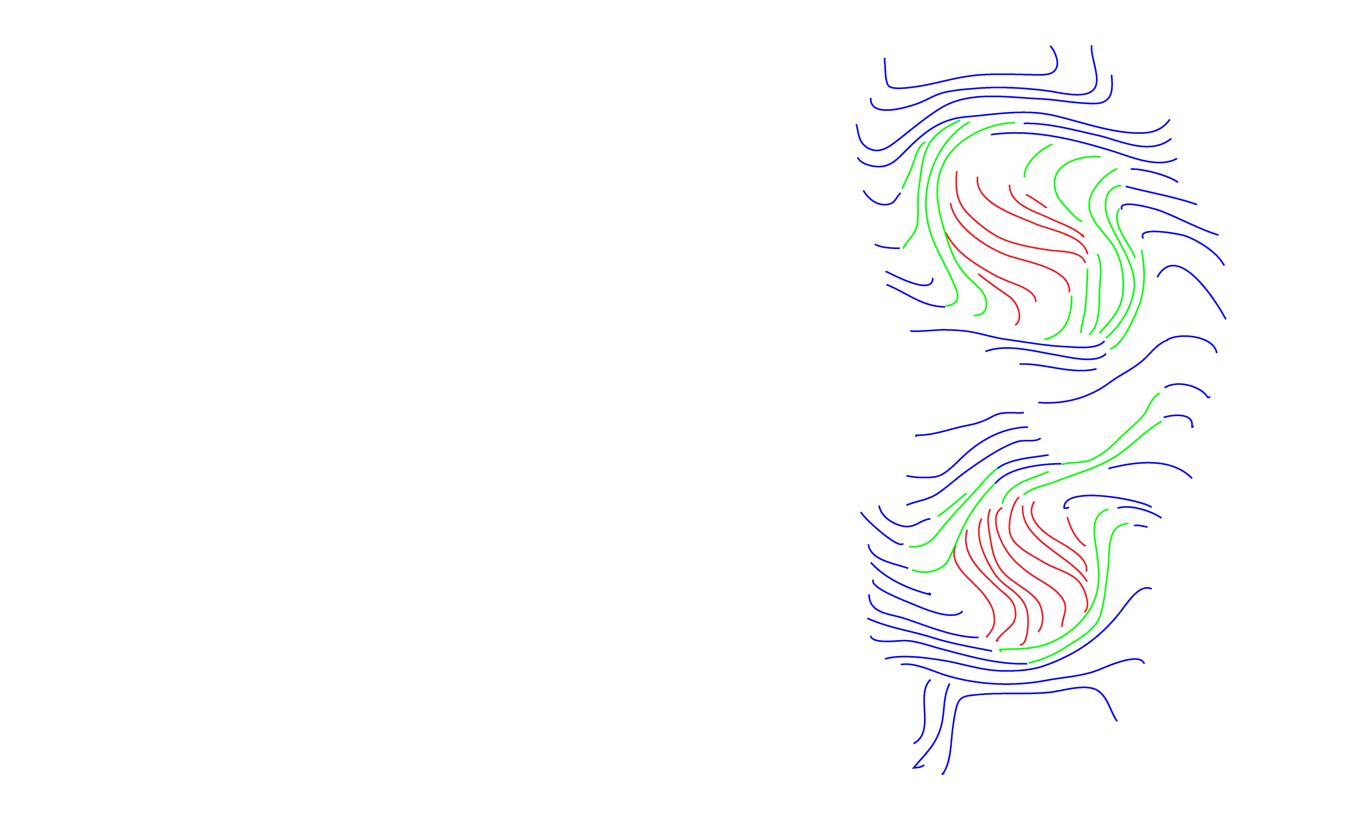
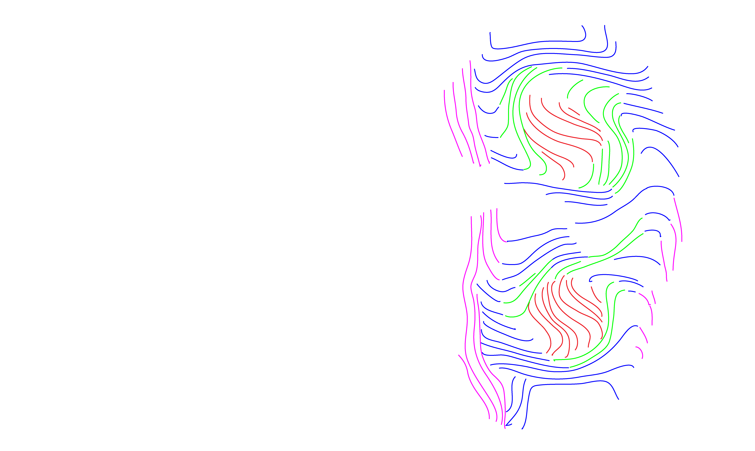
Bell et al. 2005, Australian J. Earth Sc.
S1-S2-S3-S4

Slide 17
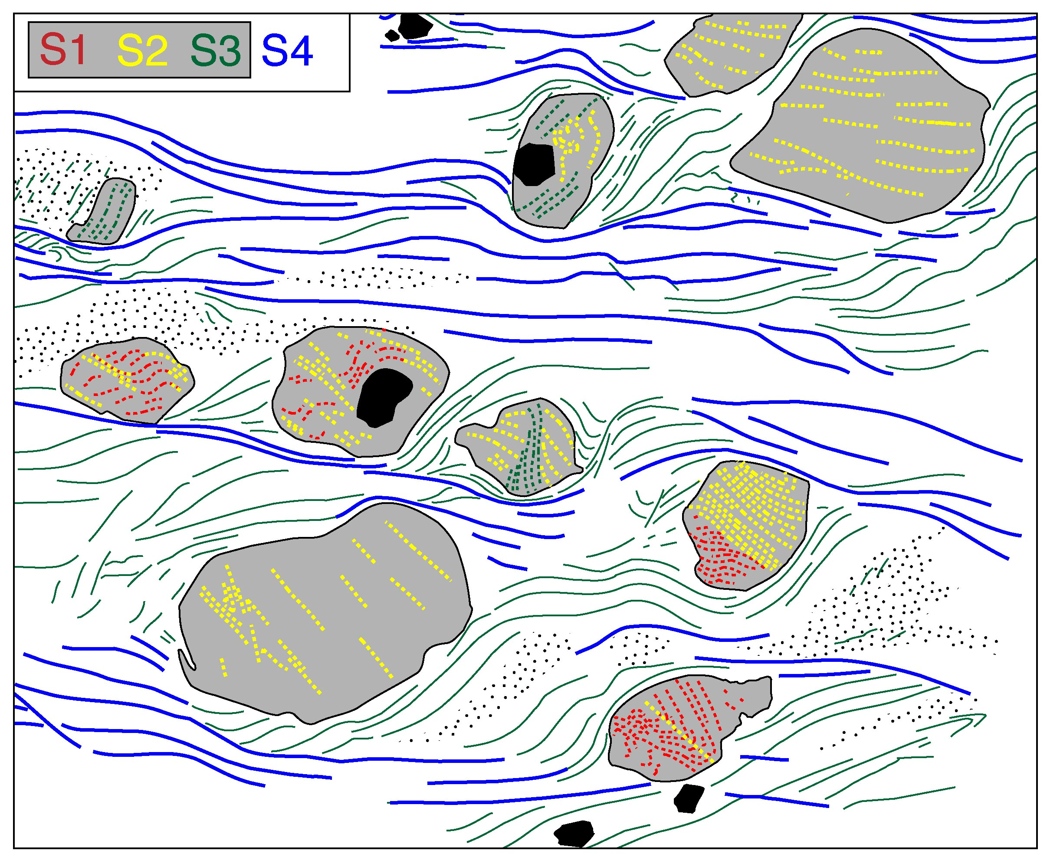
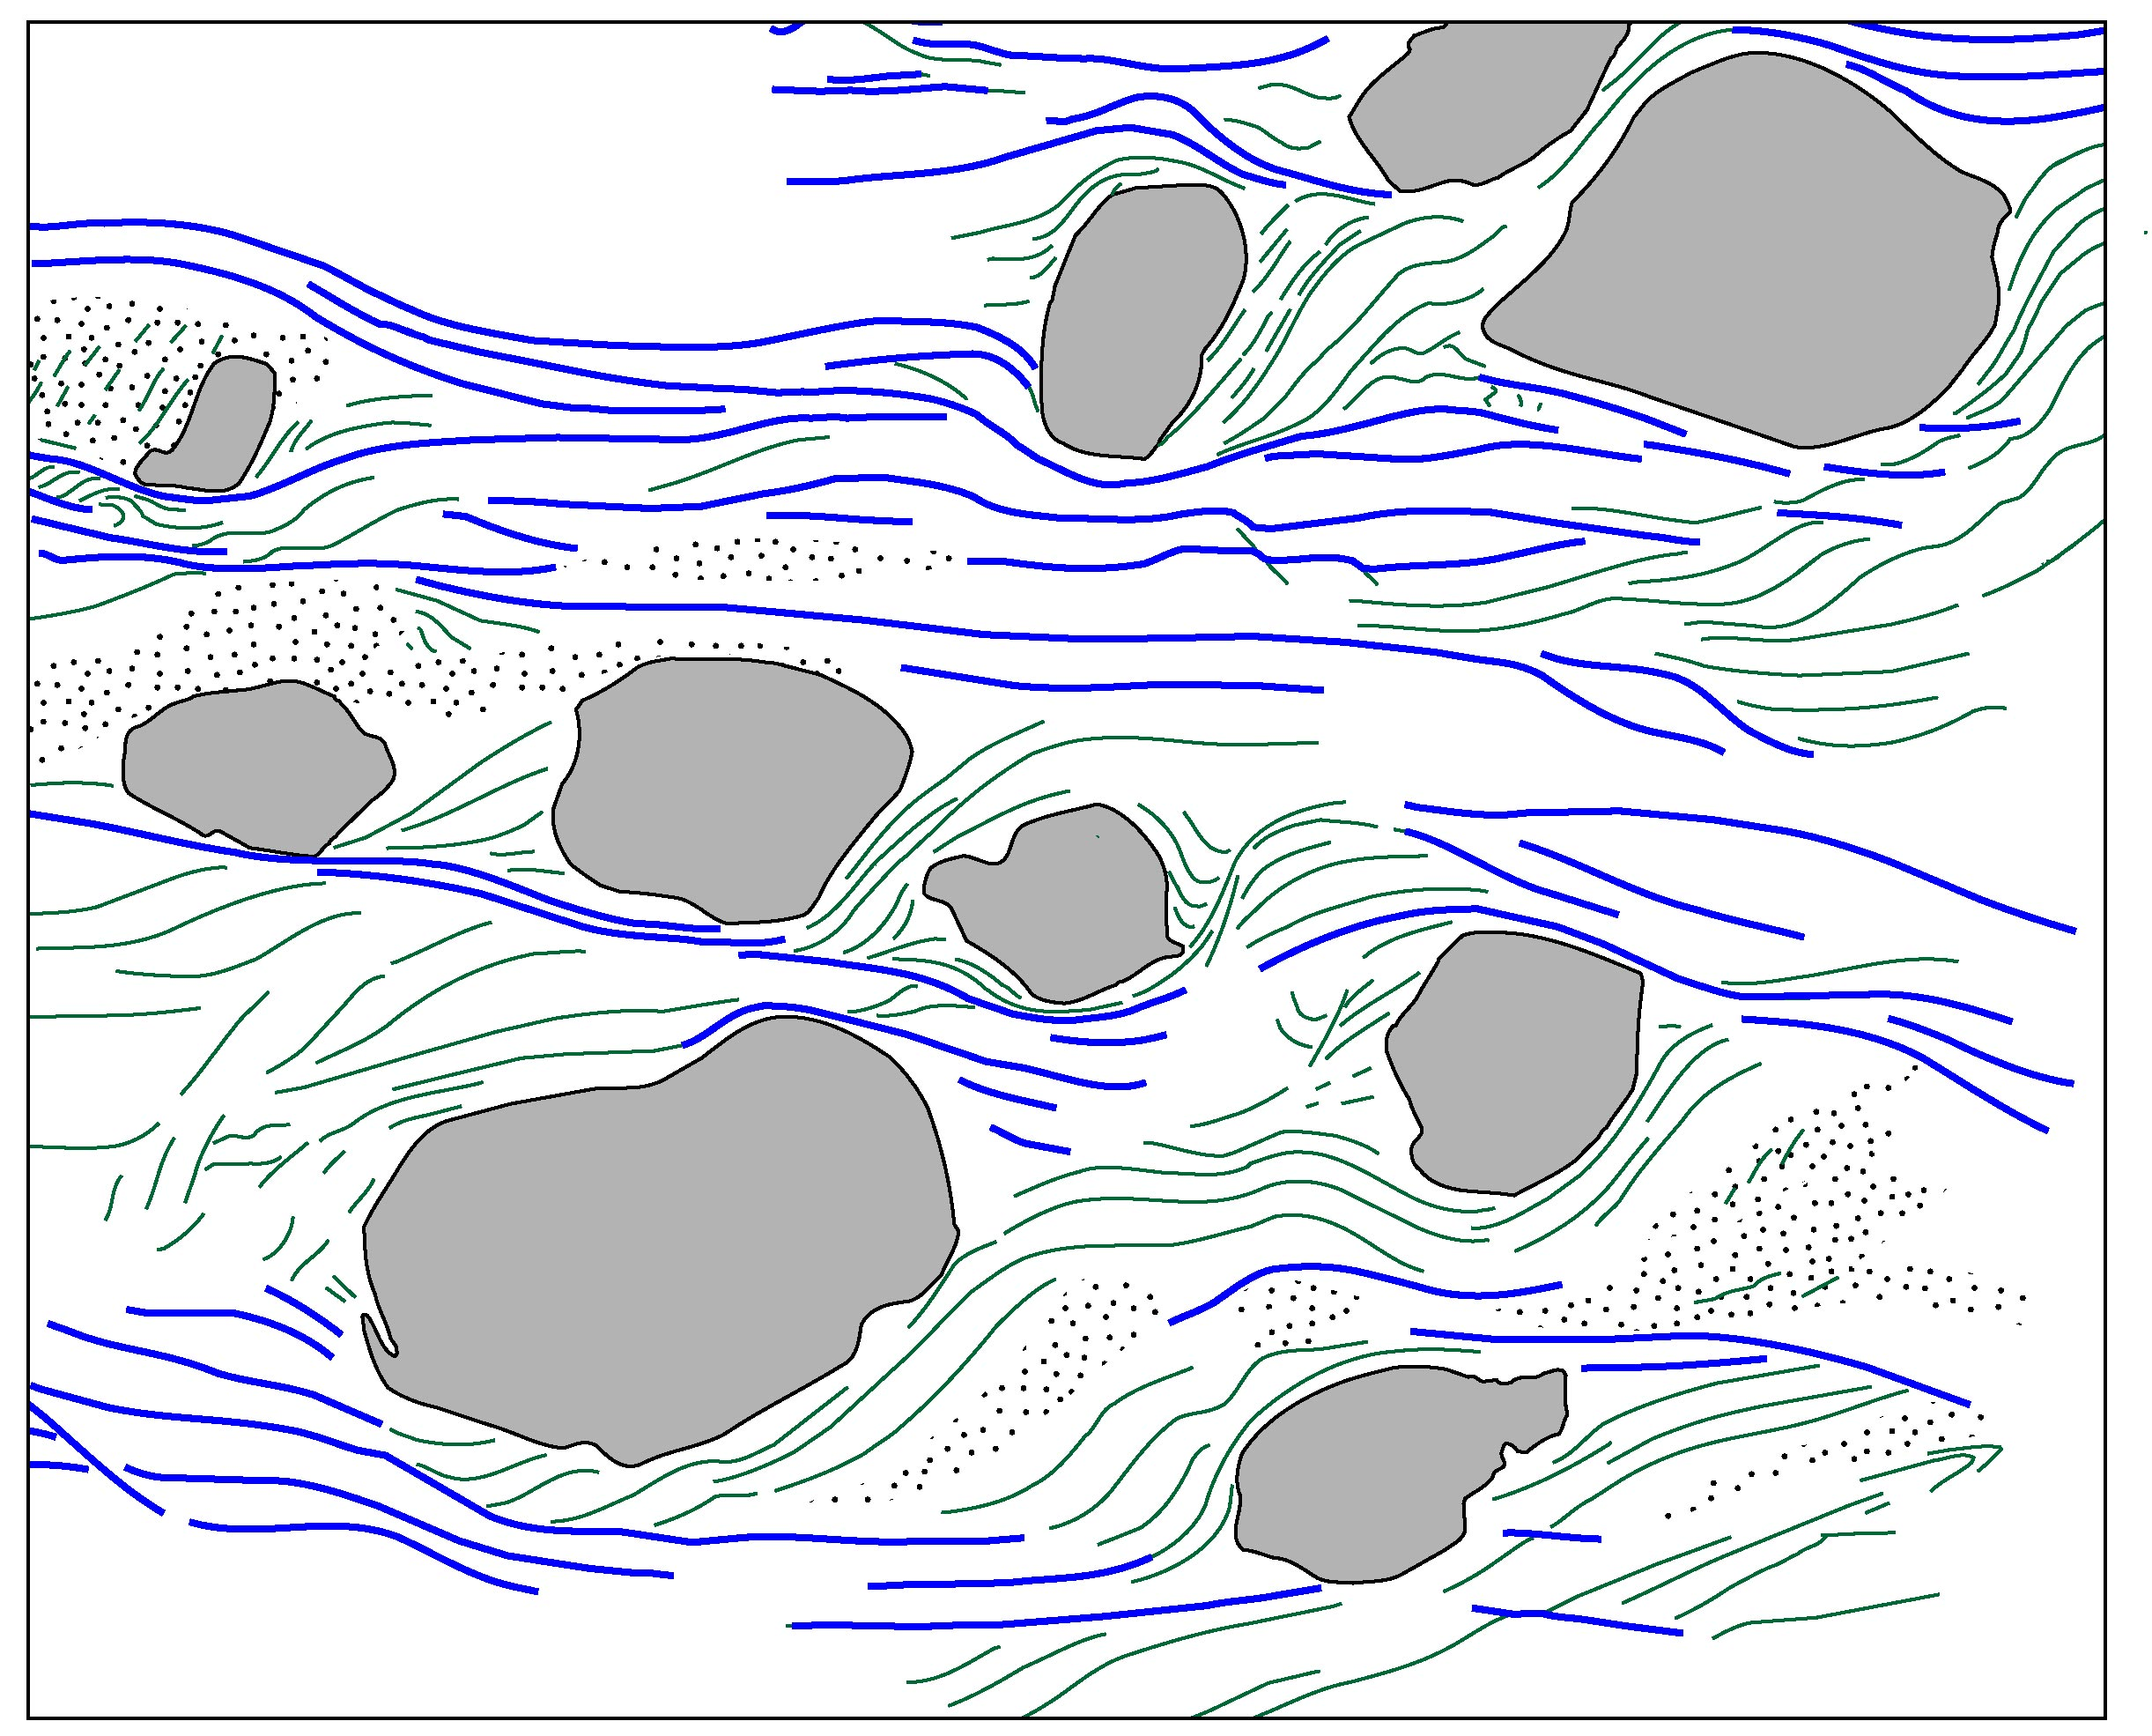
Pseudo S-C fabric that could be mis-interpreted in terms of dextral simple shear, but this rock experienced 4 deformation phases
N120
Aerden, JSG, 2004

Slide 18
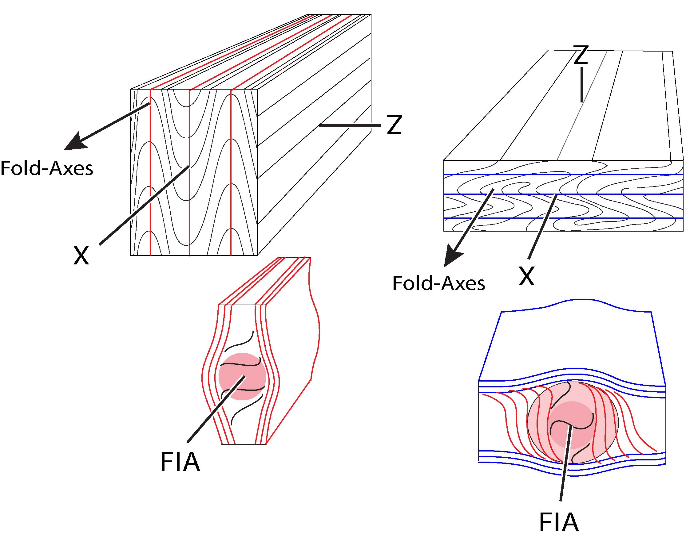
FIA = Foliation Intersection/Inflexion Axes
D2
D3
Folded S1

Slide 19
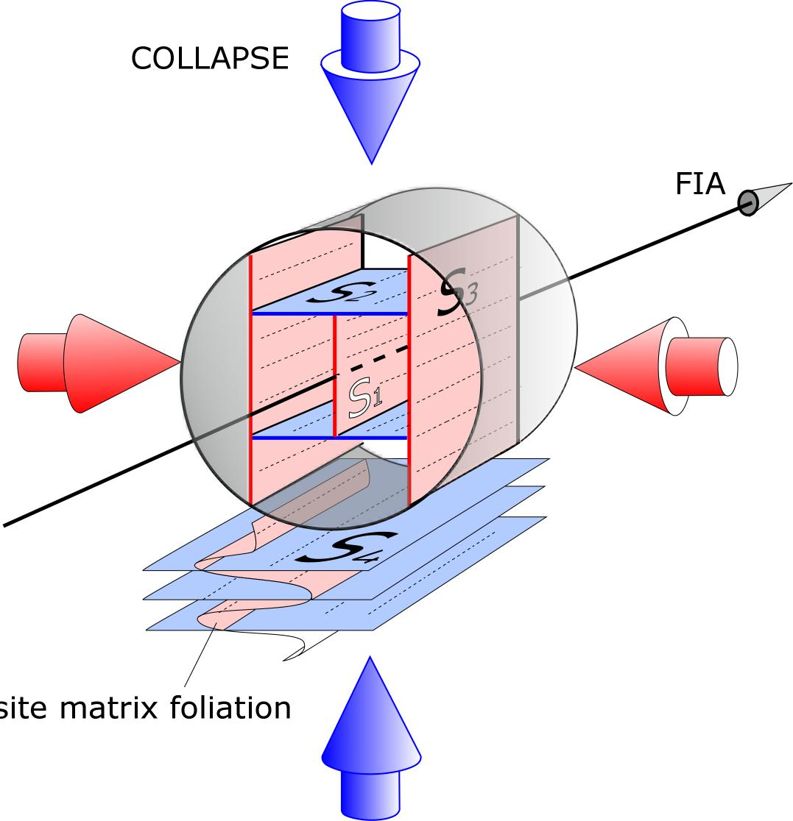
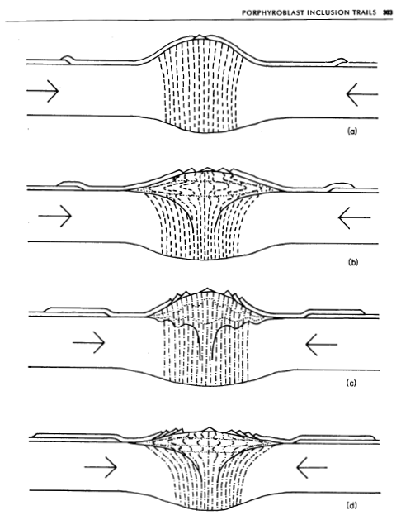
contraction-collapse cycles
MODEL PREDICTIONS:
FIAs form perpendicular to the shortening direction.
The strike of inclusion trails is also perpendicular to the shortening direction.
Bell & Johnson 1989

Slide 20
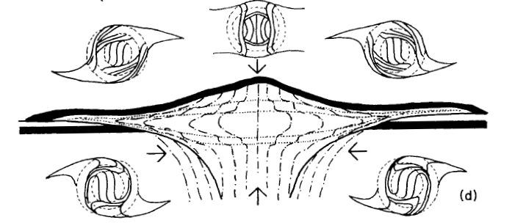
inclusion-trail curvature sense
versus tectonic transport direction
gravitational spreading
thrusting
thrusting
shortening
and uplift
Anticlockwise spiral Grt
Clockwise spiral Grt
Bell & Johnson 1989
Notes:
INDICATES A FUNDAMENTAL CHARACTERISTIC OF THE DYNAMICS OF OROGENIC WEDGES / DOUBE WEDGES
ALTERNATION OF COMPRESION AND COLLAPSE

Slide 21
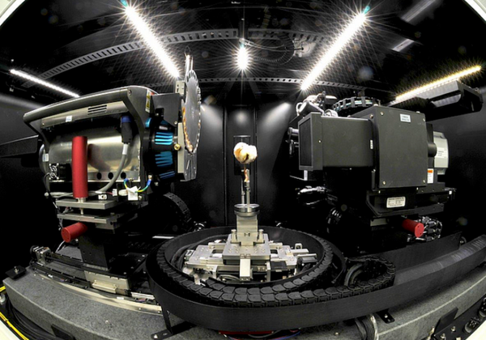
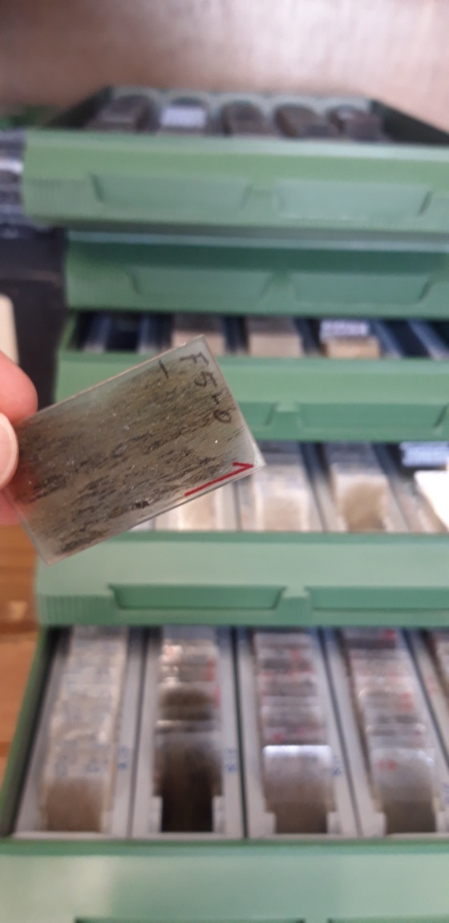
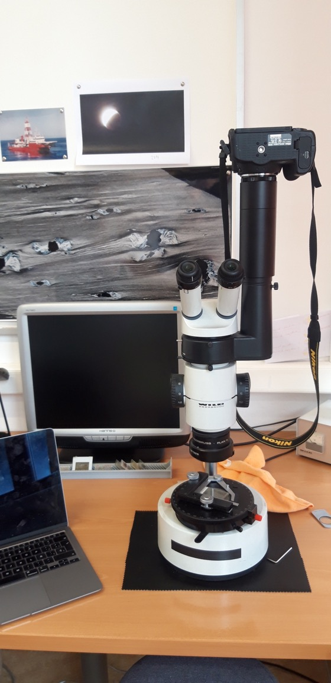
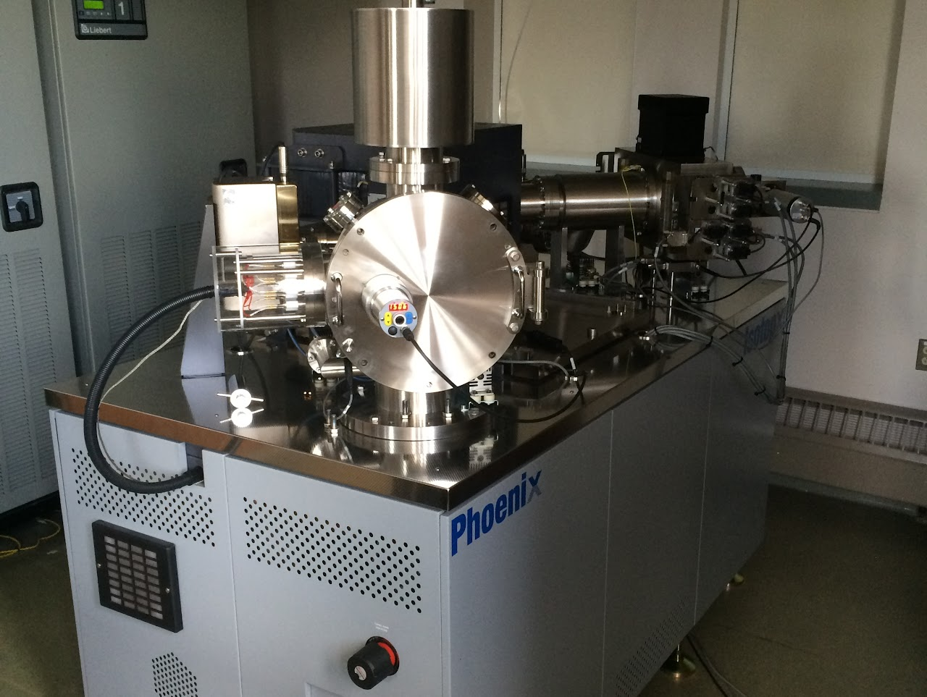
microstructural techniques
Laminas delgadas
orientadas (muchas)
Micro-tomografía
Spectrómetro de Masa (TIMS)
microscopía óptica

Slide 22
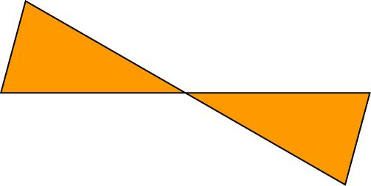
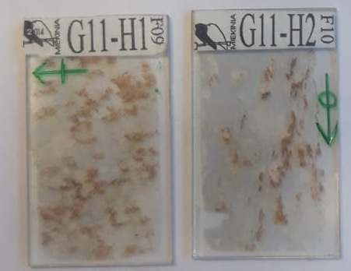
Asymmetry technique for determining an average FIA trend in a single sample
Strike of inclusion trails
N
N
six vertical thin sections spaced 30°
2 horizontal thin sections

Slide 23
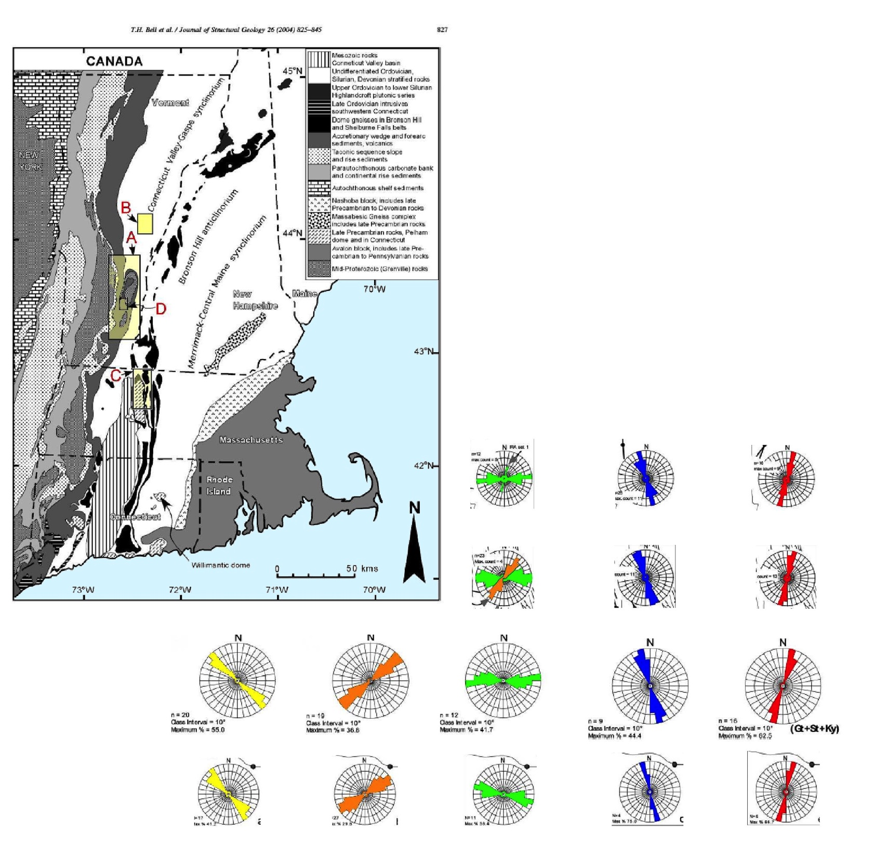
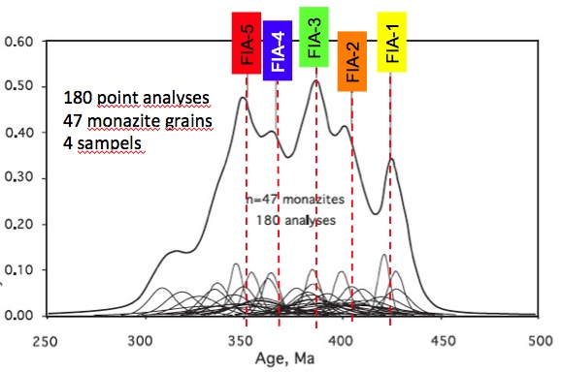
Bell & Newman, 2006
Monazite U-Pb microprobe ages correlated with 5 FIAs
Bell & Welch, 2002
Boston
A
Five FIA sets
in the Northern Apallachians
B
n=12
n=25
n=16
50 km
n=23
n=29
n=25
C
n=20
n=19
n=12
n=9
n=16
D
n=17
n=27
n=11
n=4
n=6
Notes:
5 SETS OF FIA
420-340MA CONTINUOUS OROGENY – NOT DISTINCT EVENTS (TACONIC ACADIAN)

Slide 24
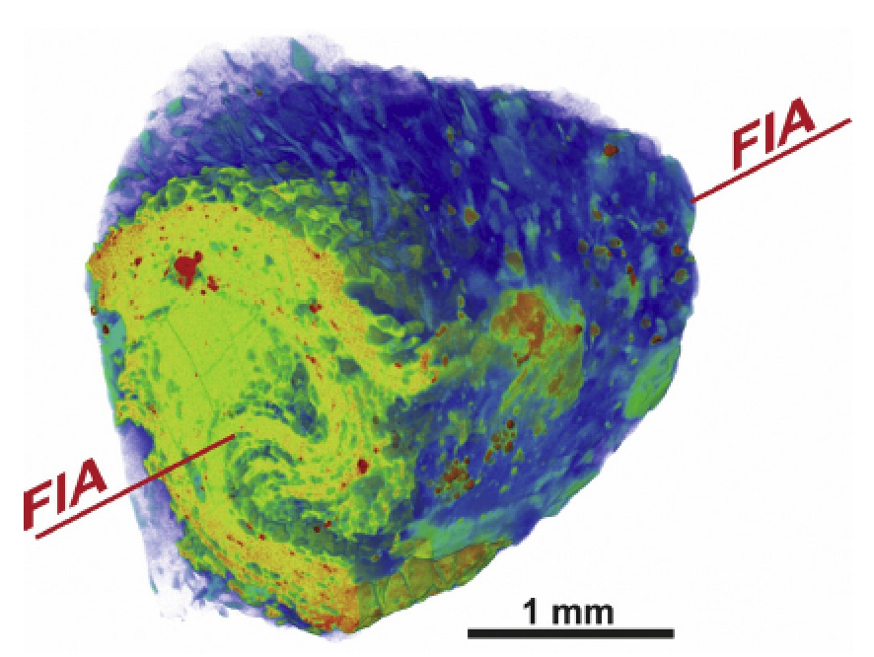
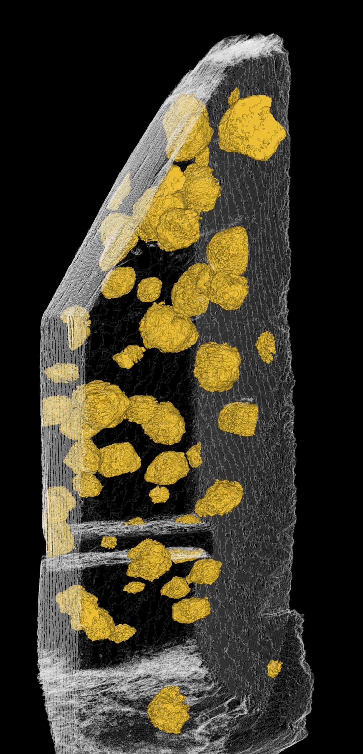
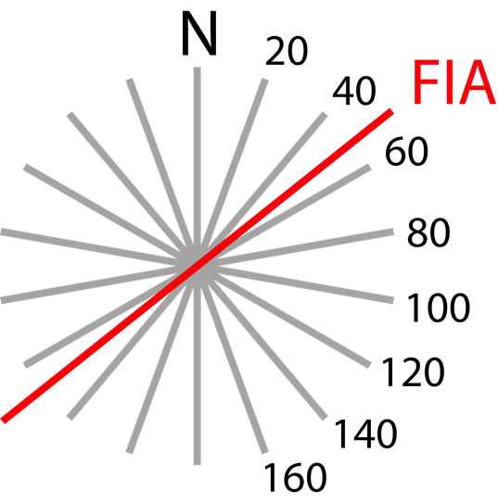
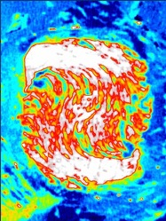
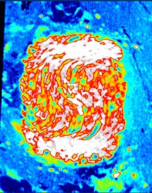
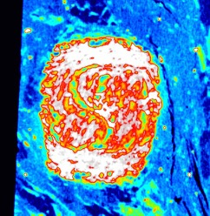
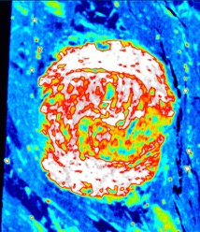
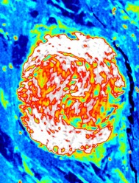
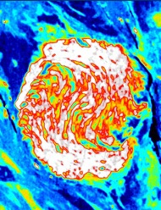
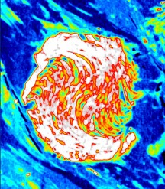
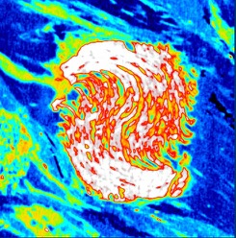
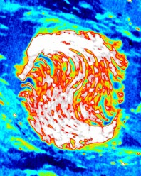
Aerden & Ruiz-Fuentes, 2020
X-ray tomography
Sayab et al. 2021
asymmetry switch
N-0
N20
N40
N60
N80
N100
N120
N140
N160
N180
Notes:
SINGLE GARNET PORPHYROBLAST –SECTIONS MADE WITH X-RAY TOMOMGRAPHY
FIA N045

Slide 25
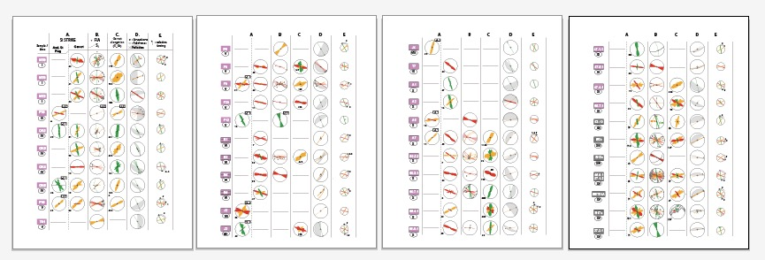
Aerden et al. 2022

Slide 26
3 main microstructural
trends preserved by porphyroblasts around
the Gibraltar Arc
Data from
Aerden et al. 2022 and
Ruiz-Fuentes & Aerden 2023

Slide 27
RELATIVE TIMING OF THE 3 FIA SETS
Younger
Older
Older
Younger

Slide 28
Two examples of relative timing criteria for differently oriented inclusion trail sets
Aerden et al., Tectonics 2022

Slide 29
FIA versus plate motions reconstructed from paleomagnetism
Sm-Nd garnet
ages
Aerden et al. Tectonics, 2022

Slide 30
FIA versus subduction polarity
The dominant curvature sense of inclusion trails indicates top SSE to SE thrusting according to the non-rotational model. This is consistenmt with widely assumed NNW to NW directed subduction.
A similar relationship beyween subduction polarity and spiral garnet asymmetry is shown in Aerden et al. (2021) for Variscan blueschists.
Inclusion trail asymmetry in 58 samples

Slide 31
Aerden & Sayab 2017
2 cm

Slide 32
1.
2.
3.
Aerden & Sayab 2017

Slide 33
Aerden & Sayab 2017
These pyrite porphyroblasts did rotate!
although much of the total amount if fiber curvature is due to a change in stress field

Slide 34
Discovery of the Central Iberian Arc thanks to porphyroblasts
Aerden, 2004, Martínez Catalán, 2011

