Slide 1
TECTONIC FOLIATIONS
Domingo Aerden (2010)

Slide 2
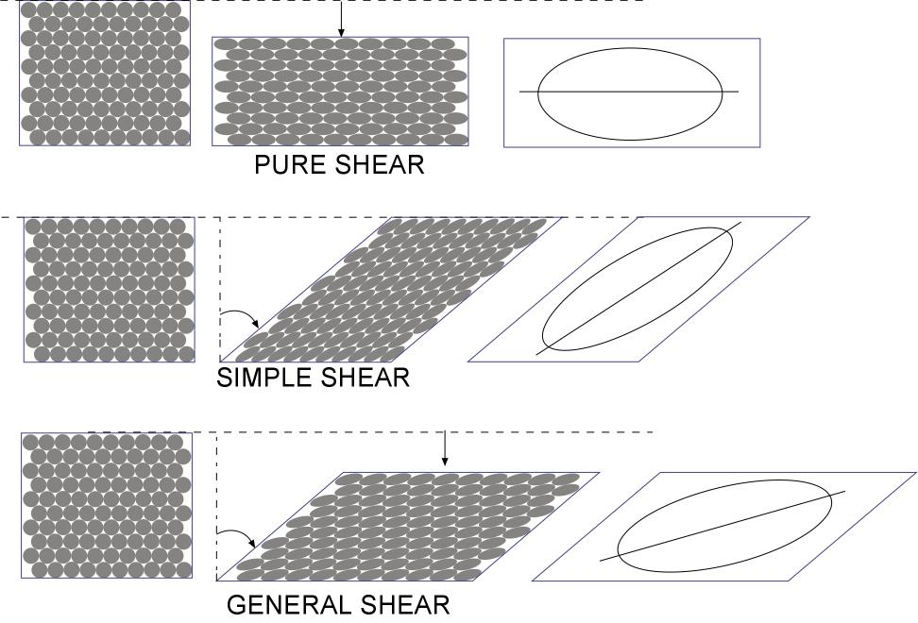
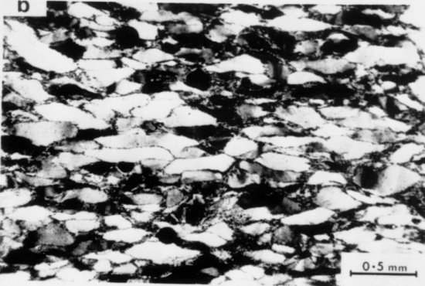
“Continuous” foliations:
Defined by elongate mineral shapes
cuarcita deformada
Most common types of foliations are "discontinuous” foliations characterized by regularly spaced cleavage planes (septae) separating "microlithons”

Slide 3
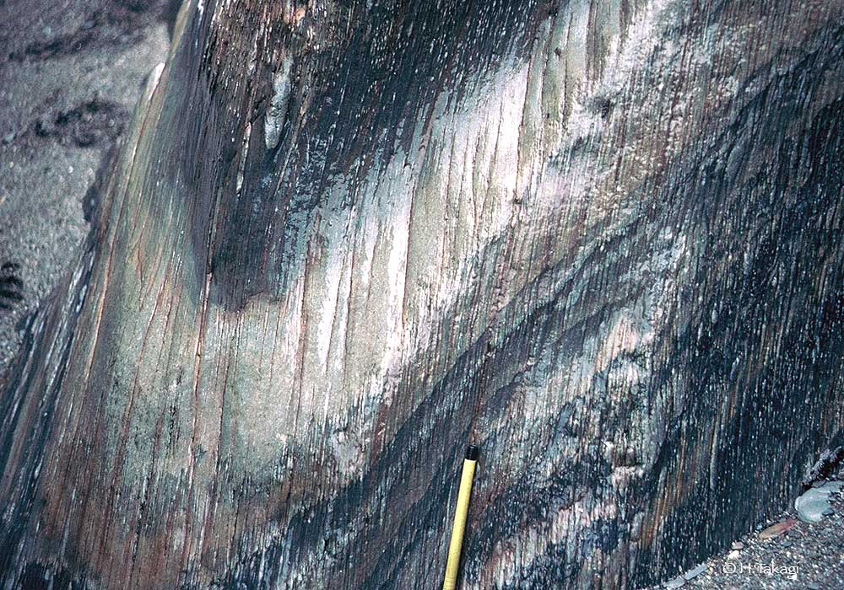
SLATY CLEAVAGE

Slide 4
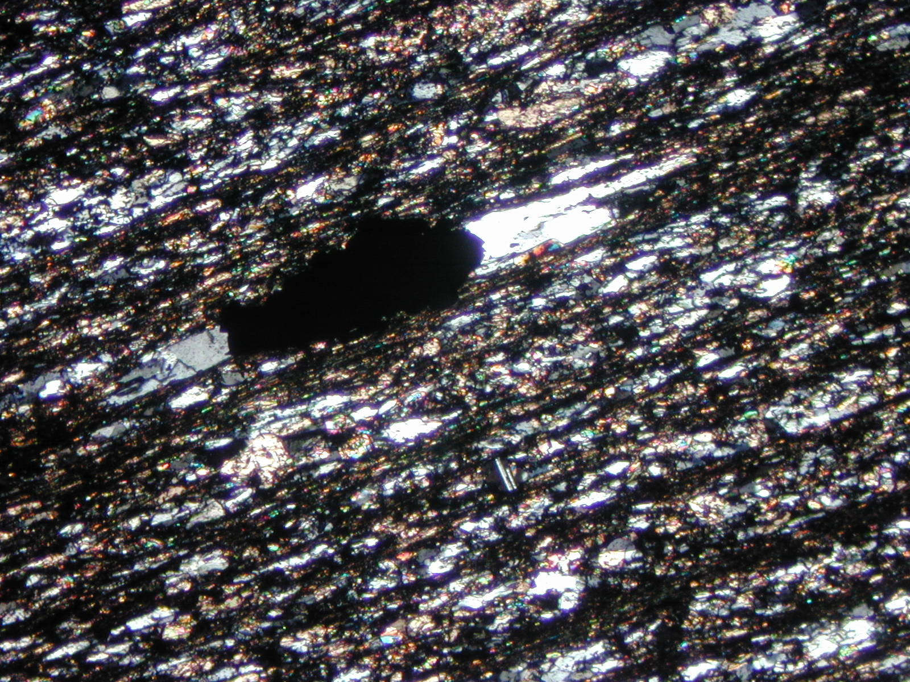

Slide 5
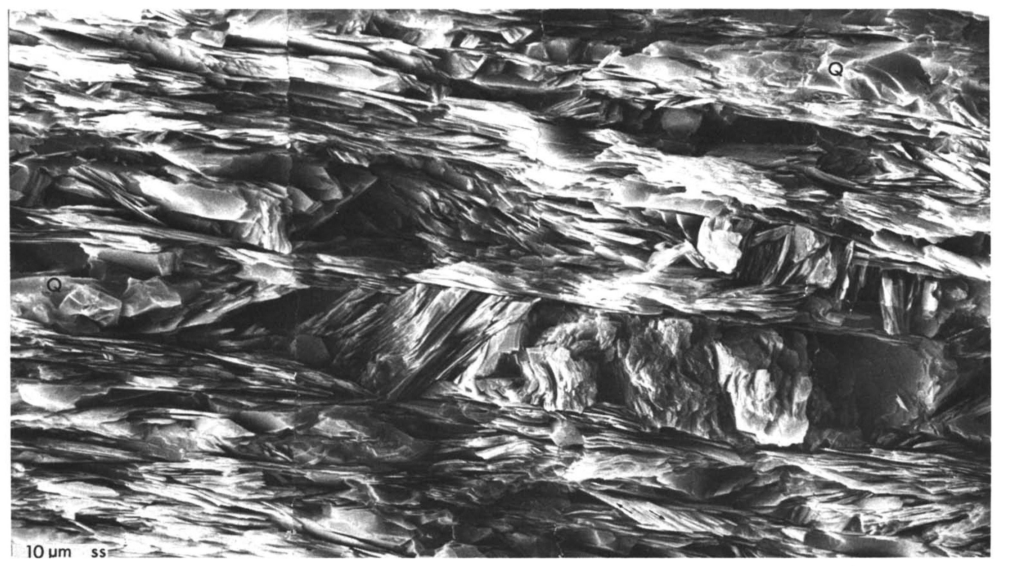
SLATY CLEAVAGE
note spaced character
SEM image (Weber, 1986)
100μm
microlitón
10μm
microlitón

Slide 6
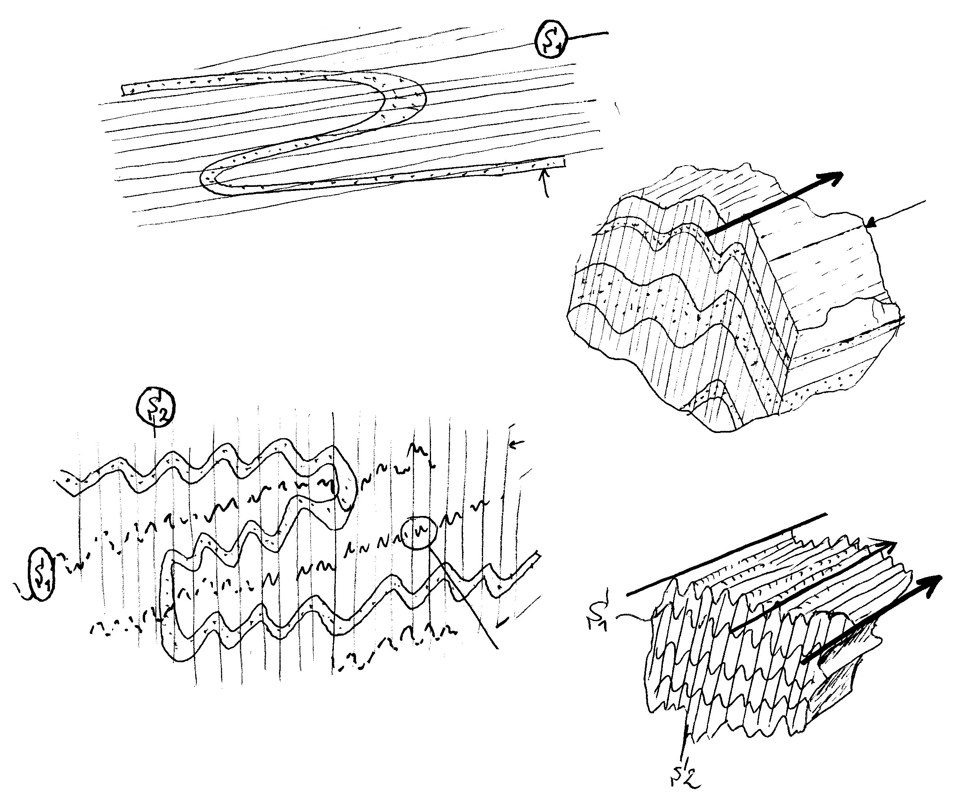
S1 foliation (schistosity)
L1 intersection lineation
D1 deformation phase
D2 defromation phase
causing refolding
S2 crenulation cleavage
L2 cren. lineation

Slide 7
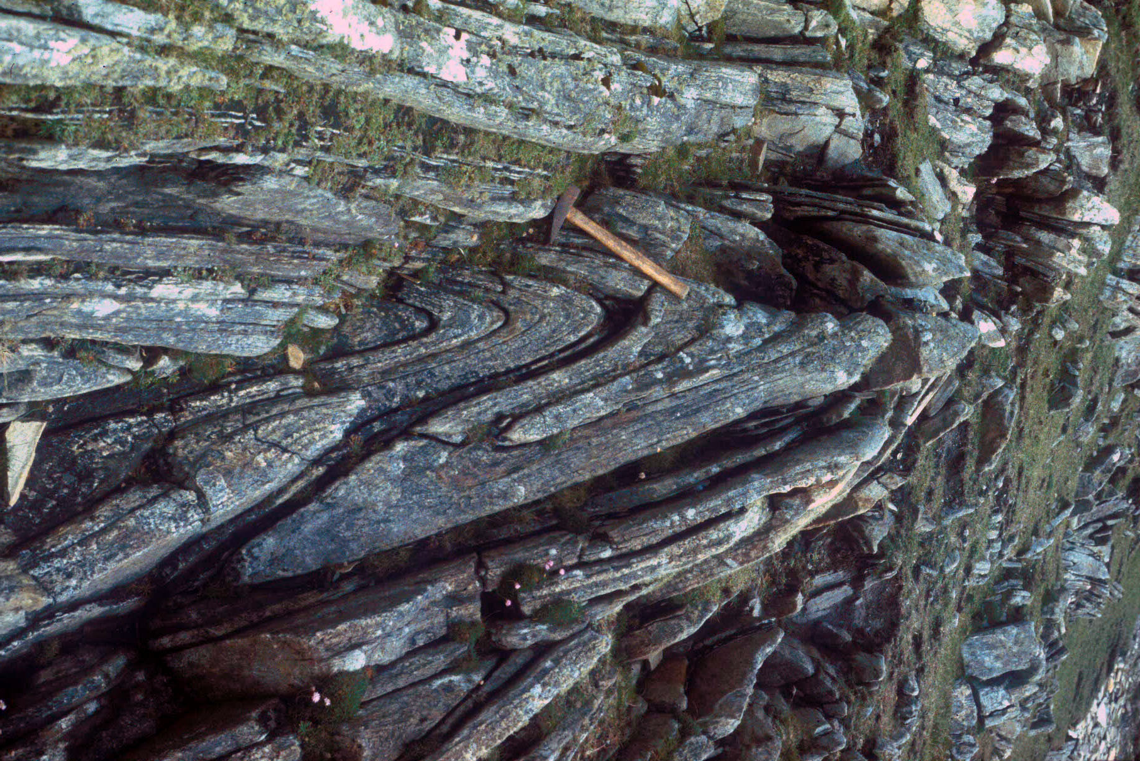

Slide 8
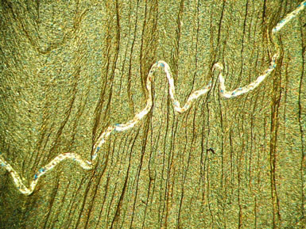
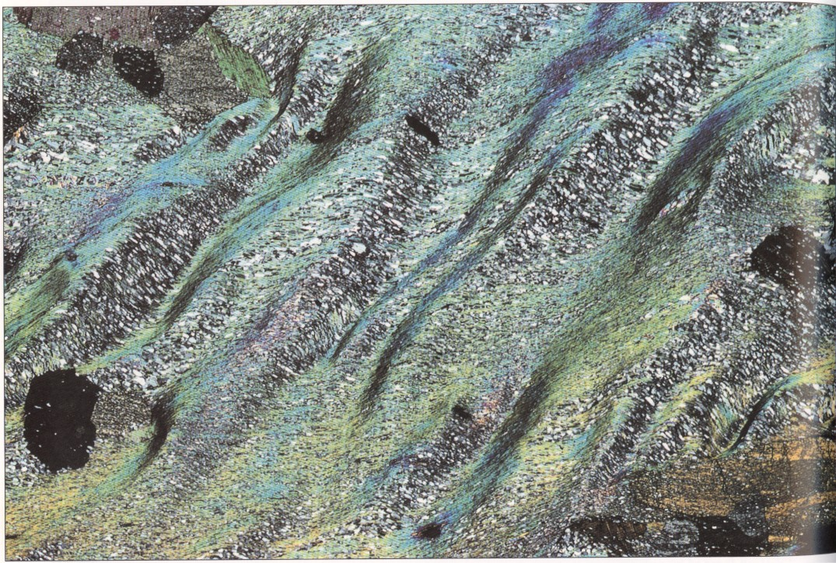
S2 crenulation cleavage
garnet porphyroblast
quartz dissolution in cleavage planes (septae) but not in microlithons
1mm
ca. 1mm
Vernon, 2002

Slide 9
What is the mechanical significance of foliation planes? What is their relationship to folds and shear zones, stress and strain?

Slide 10
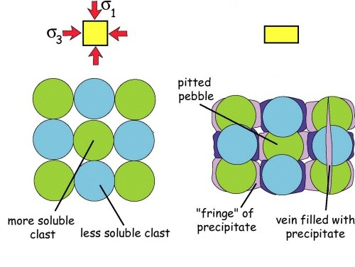
PRESSURE SOLUTION CLEAVAGE
Disolved material can move out of the syste (volume reduction) or reprecipitate locally in sites of fracturing and dilation (veins)
VOLUME LOSS
y
x
z
NO VOLUME LOSS

Slide 11
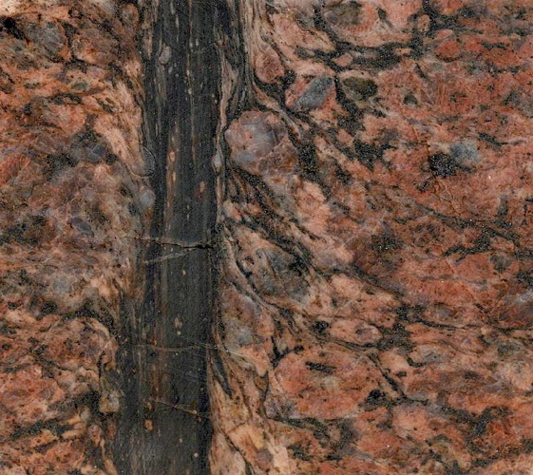
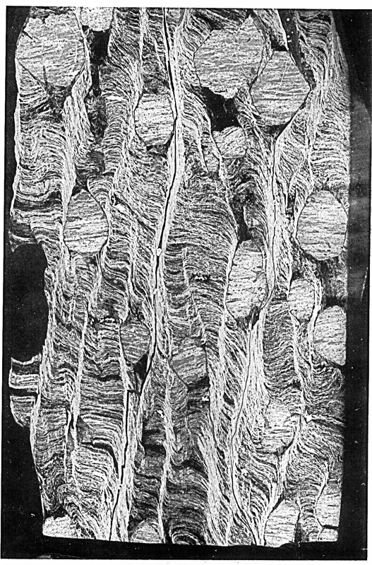
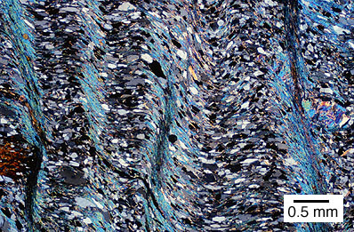
Often shear components along cleavage planes are suggested by deflection of S1 into S2 cleavage planes, similar as in macroscopic shear zones.
Mylonite band in granite

Slide 12
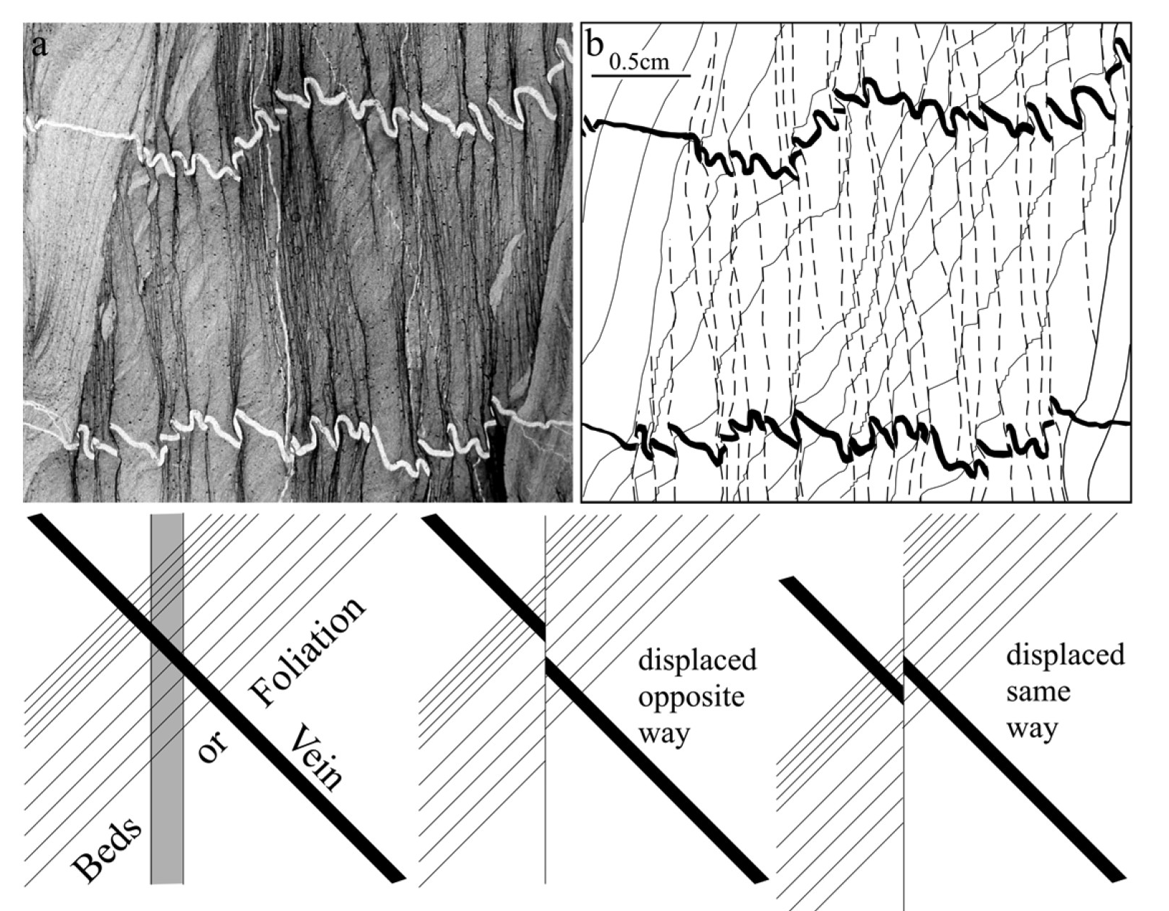
In this example (Bell & Cuff, 1989), veins and bedding are displaced along crenulation cleavage planes in the same sense. This geometry proves shearing components along foliations
prior to cleavage formation
if only dissolution
If combination of dissolution and shearing

Slide 13
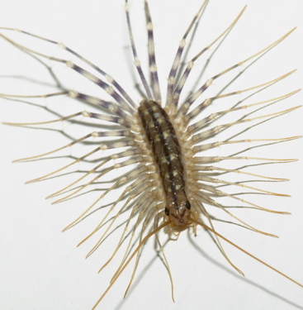
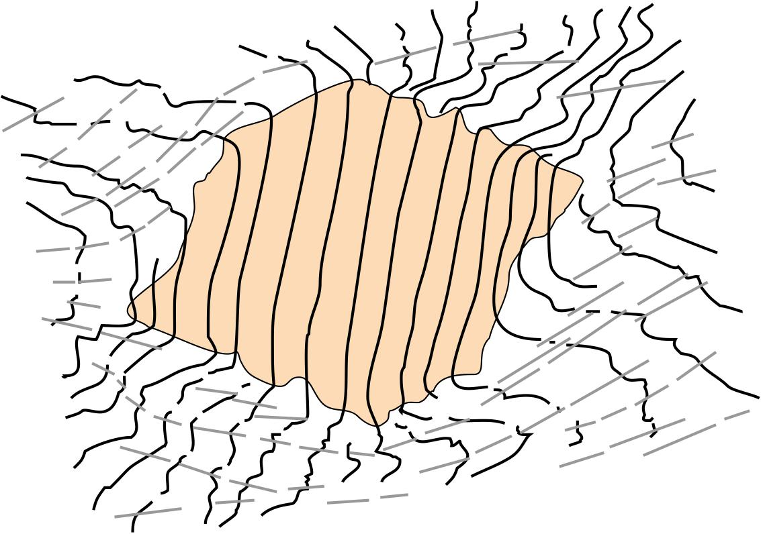
S1
S2
Millipede microstructures
Bell & Rubenach (1980)
staurolita
(rigido)
note opposite curvature of S1 as it exits the staurolite porphyroblast
Bell 1981

Slide 14
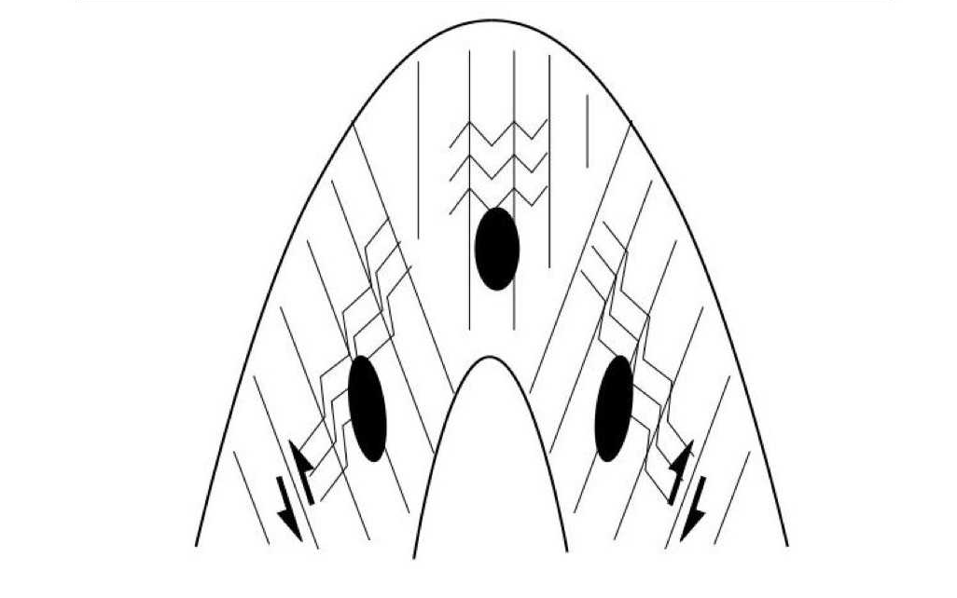
Aerden et al., 2010
abanico de foliación
Fold model of Aerden et al. 2010 inspired on the millipede strain geometry
Foliations can be interpreted as planes of shearing with also a component of shortening perpendicular to them (pressure solution)

Slide 15
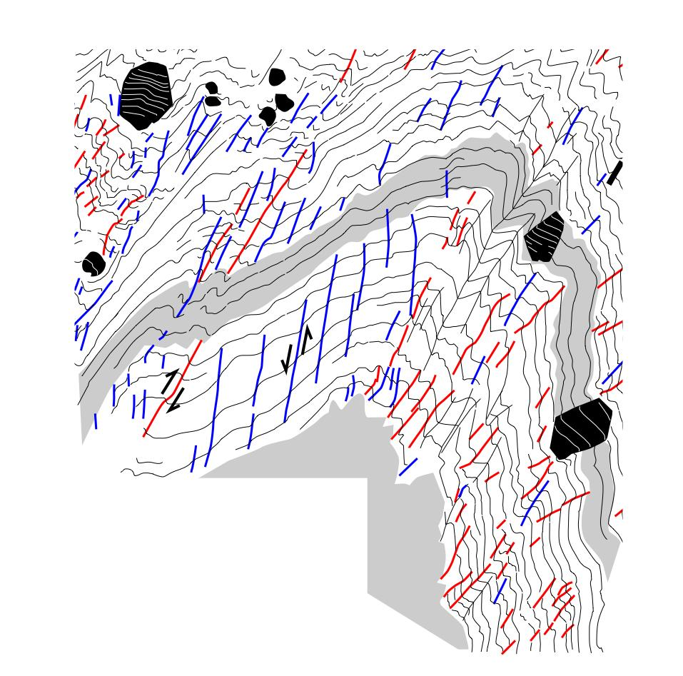
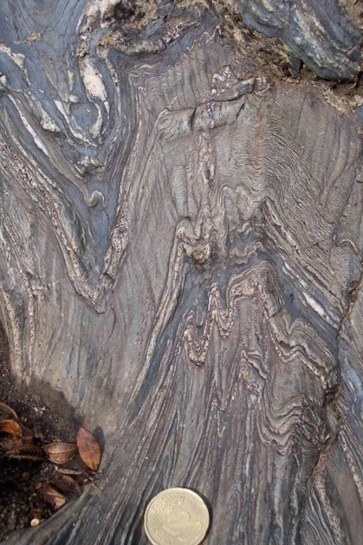
CLEAVAGE FANNING

Slide 16
Deformation partitioning control on porphyroblast growth

Slide 17
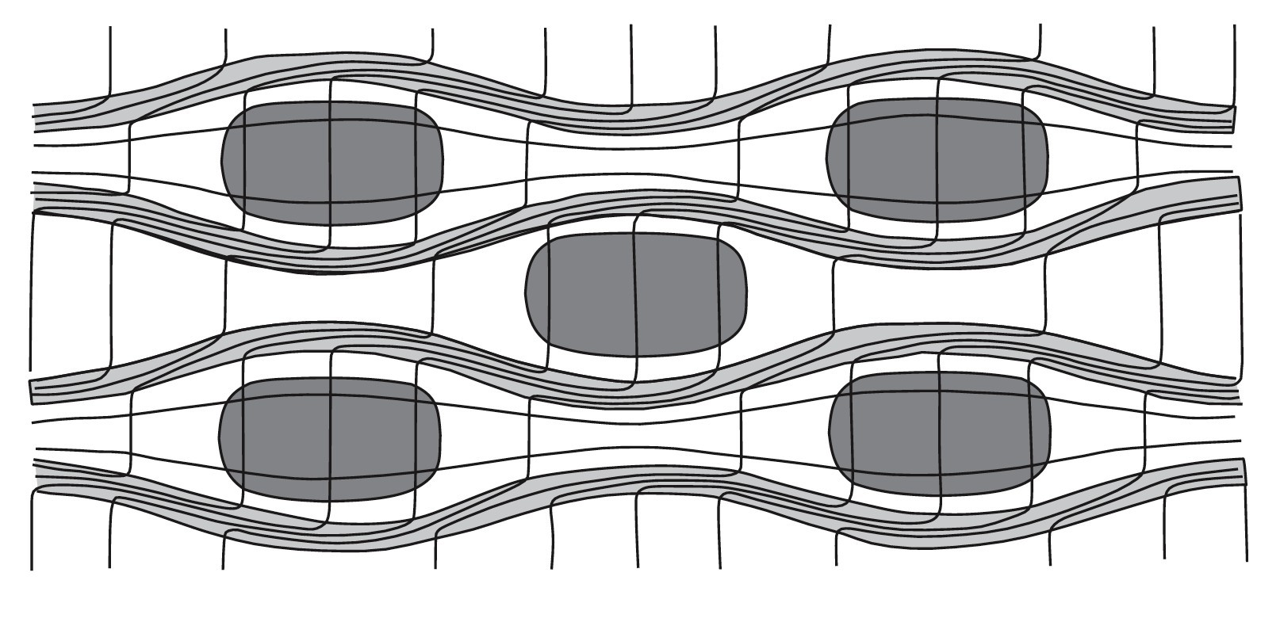
Porphyroblasts nucleate ans grow in zones of low or zero strain. They do not rotate even when tthe bulk deformation is non-coaxial. Sshearing components are accommodated in cleavage planes surrounding low-strain lenses hoting the porphyroblasts
shortening
shearing
No strain

Slide 18
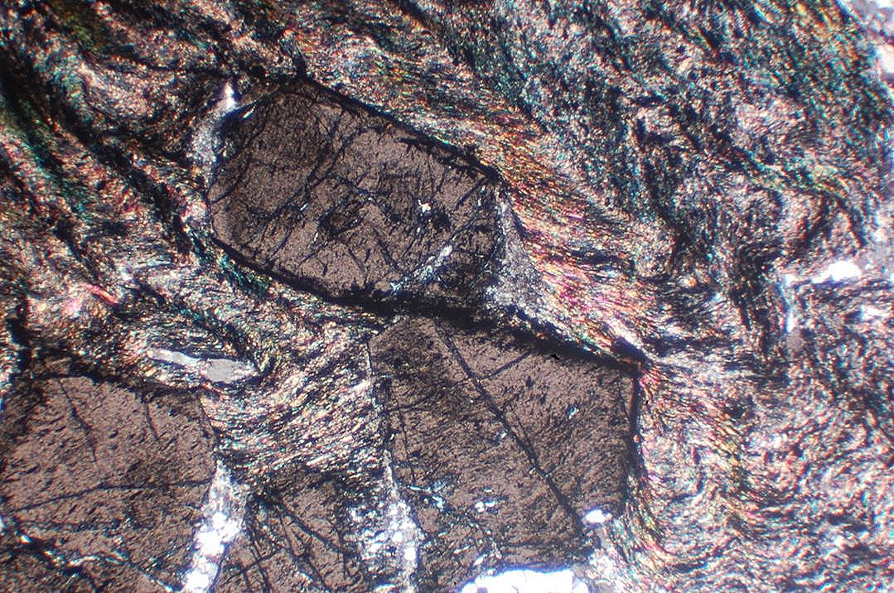
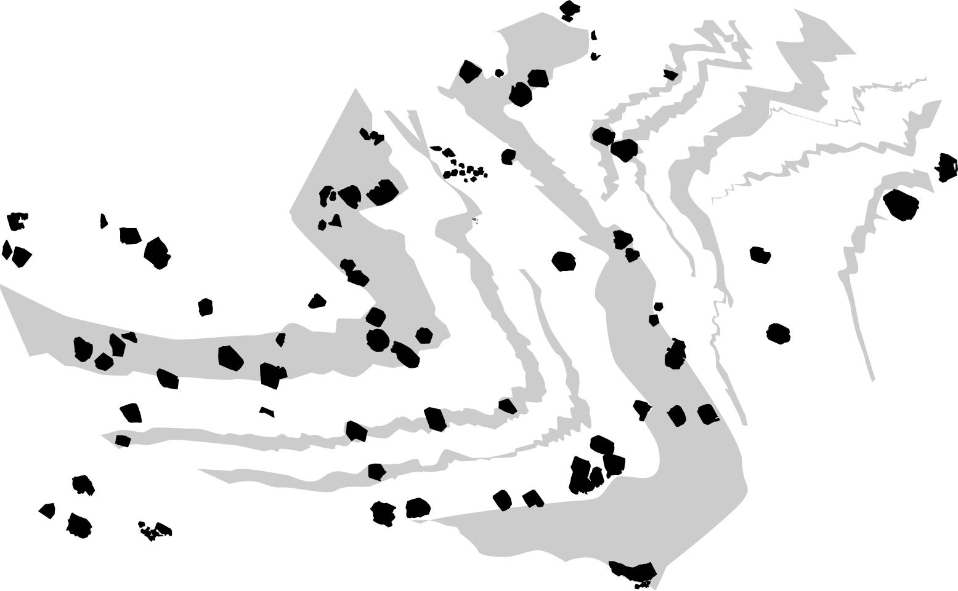
Garnet porphyroblasts with consistent inclusion trail orientations in a cm-scale fold (Aerden et al., 2010)
1 CM

Slide 19
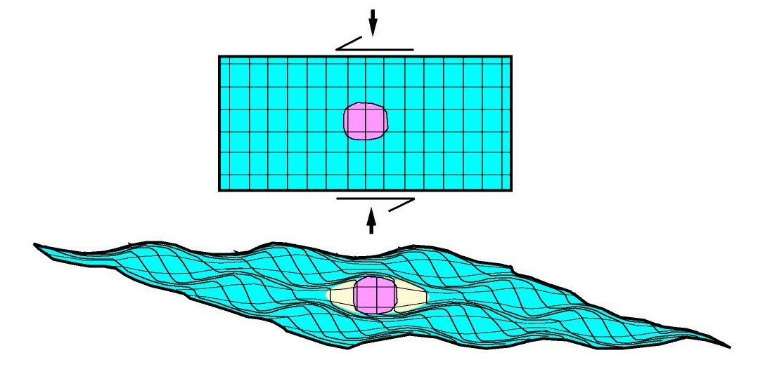
Deformation partitioning and porphyroblast rotation
Homogeneous flow induces rotation of
A rigid object
rotación de objetos rígidos
deformación homogenea
antes de deformación
rocas metamorficas reales
no rotación de objetos rígidos
deformación altamente heterogenea

Slide 20
Control of deformation on the timing and sites of porphyroblast growth
Porphyroblast growth starts when stress is orineted parallel to pre-existing S1 cleavage and induces dilation (microfracturing) between cleavage planes
porphyroblast growth ceases when fluid access is cut off by newly formed continuous S2 cleavage planes
Bell & Bruce, 2007

Slide 21
Reactivation of foliations

Slide 22
EVOLUCION DE UNA FOLIACION DE CRENULACIÓN DURANTE DEFORMACION NO-COAXIAL
(Aerden, 1994)
Dextral shearing on S2
S2
S1
Antithetic shearing on S1
S1 is being shortened and
crenulated
crenulations start opening up.
They “un-crenulate”
S1 is now being extended and reactivated

Slide 23
strain field around a rigid porphyroblast. The blue lines (S2) correspond to high-strain zones that form against the margin of the rigid object to solve the strain incompatibility between the (undeformed) rigid object and the matrix

Slide 24
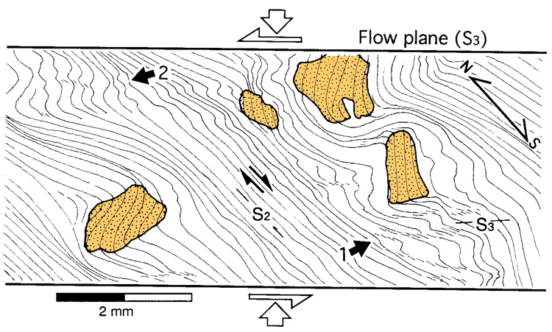
bulk strain ellipse
S2
S1
Pseudo-SC fabric
reacrtivation
Aerden, 1994

Slide 25
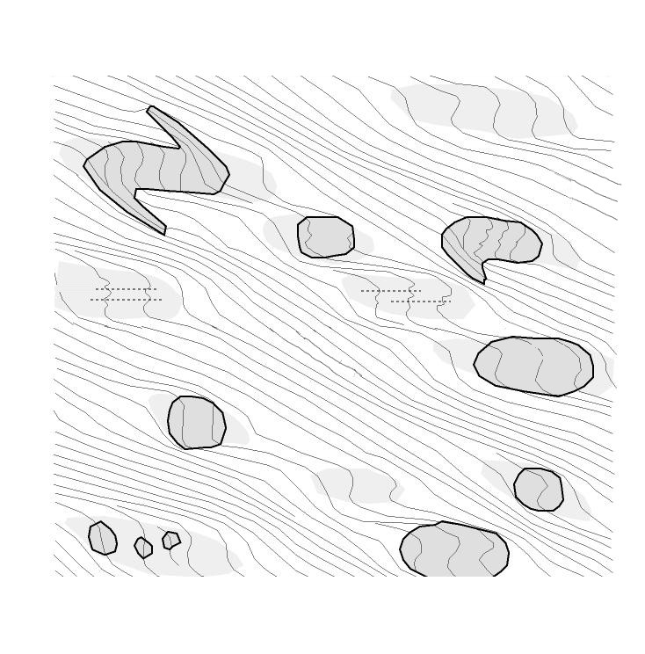
So how would you interpret this diagram….?
How many deformtaion phases? What is the bulk shear sense and the local shear sense

Slide 26
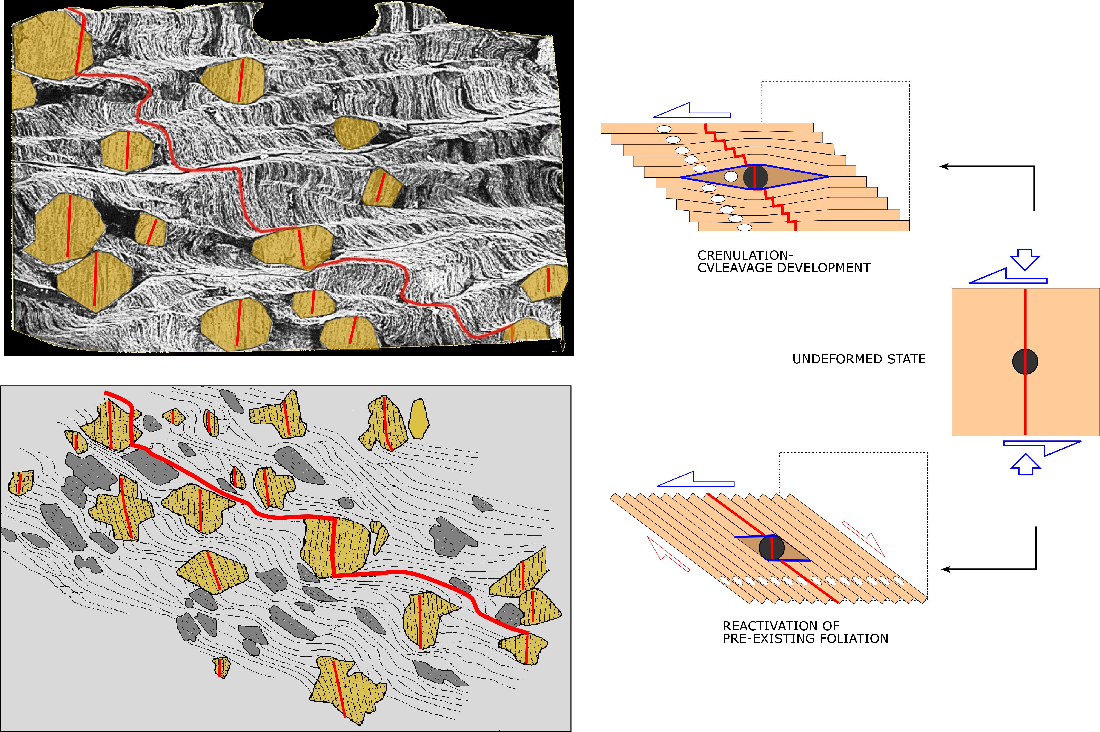
(a)
Both microstructures can form simultaneously in the same stress field. The upper diagram iis more coaxial and has not reached the reactivation stage
(b)
new foliation only developed
against edges of rigid heterogeneities

Slide 27
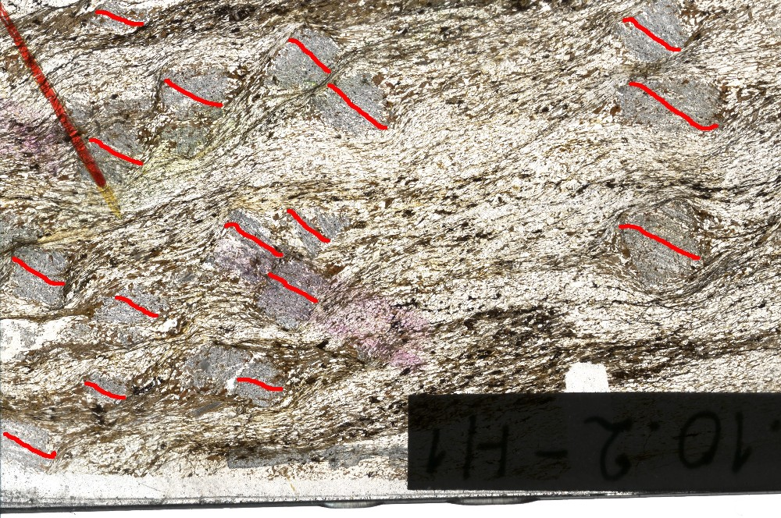
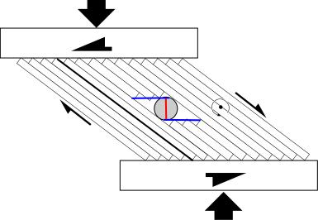
interpretar

Slide 28
