Slide 1
Stellar Structure
Fundamental Astrophysics

Slide 2
Stars
A star is a giant gas ball at very high temperature.
The stellar energy is generated in its interior.
Th pressure produced by the energy released in the inner regions pushes the gas outwards.
Gravity pulls gas towards the centre.
Let’s calculate the equations goverging this equilibrium of forces:

Slide 3
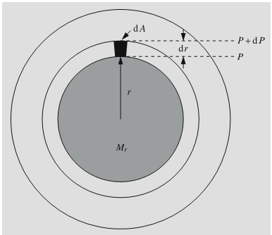
Hydrostatic equilibrium

Slide 4
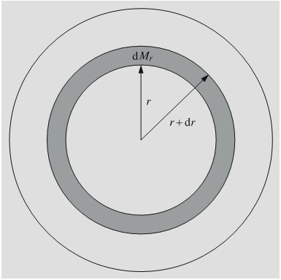
Equation of continuity

Slide 5
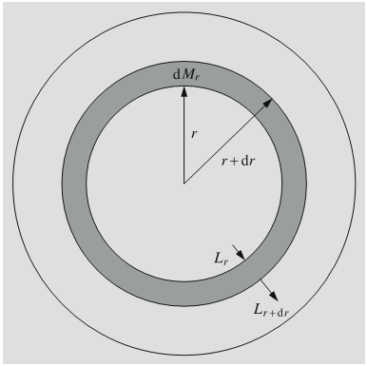
Conservation of energy

Slide 6
Temperature gradient - Energy transport
Energy transport can take place by conduction, radiation or convection.
Conduction es usually negligible.
Pure radiation:
Convection:

Slide 7
Boundary conditions
At the star’s centre:
M(0)=0 P(0)=P₀
L(0)=0 ρ(0)= ρ₀
T(0)=T_{c}
At the surface:
M(R)=M P(R)=0
L(R)=L ρ(R)=0
T(R)=0

Slide 8
Equation of state
Gas pressure:
Radiation pressure:

Slide 9
Equation of state for a degenerate gas
Non relativistic (10⁷ kg/m³)
Relativistic (10⁹ kg/m³)

Slide 10
Energy production in stars
Gravitational contraction was originally proposed as the energy source →It would not last enough at the necessary rate.
Earl universe was composed mostly of H, some He, and traces of light elements (Li, Be, …).
Heavier elements originate in stellar interiors → Thermonuclear fusion.

Slide 11
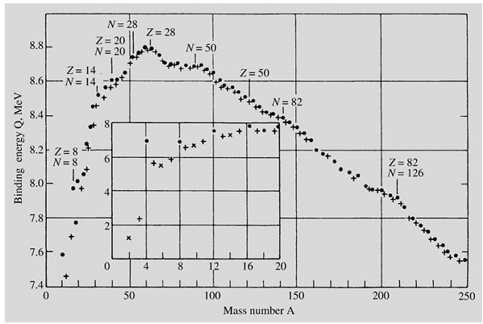
Binding energy

Slide 12
Nuclear reactions inside stars
The mass of a He atom is 0.7% smaller than the mass of four H atoms →
Energy production is roughly
per kg of H.
In 1938 Hans Bethe proposed the CNO chain as the main energy source within stars.
There are also other reactions

Slide 13
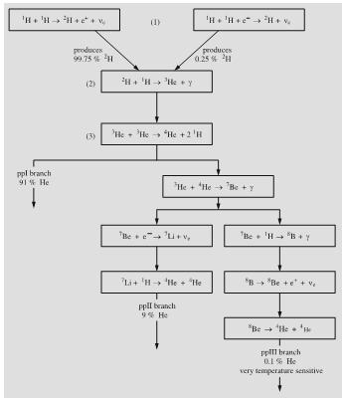
p-p reaction
It is the dominant mechanism of energy production for temperatures below 20 millon K.
The first reaction is very improbable, with a characteristic time of 10¹⁰ years for the conditions in the sun.

Slide 14
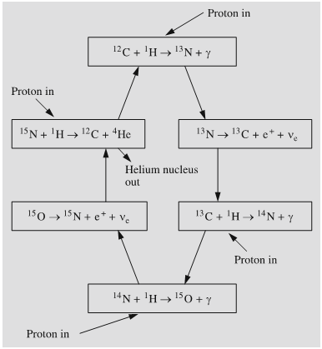
CON Cycle
Between 20 and 100 mill. K, the dominant reaction is the CNO cycle proposed by Bethe y Weizsacker.
C, N y O appear as catalysts in the reaction.
Formation of ¹⁵O is the slowest reaction (t~1 mill years) and controls the rate of the whole reaction.
It is energetically less efficient tha the p-p chain.

Slide 15
Triple-alpha reaction
As hydrogen burns, the amount of helium increases.
Over 100 mill K, hellium can also fuse to produce ¹²C.
At even higher temperature, other reactions are also possible producing elements as heavy as Fe o Ni.

Slide 16
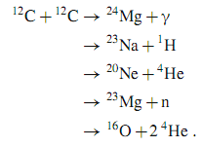
Other reactions
Alpha reactions
C fusion (T~5-8 10⁸ K)

Slide 17
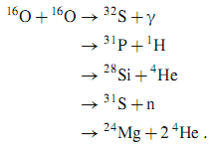
Other reactions (II)
O fusion (T~10⁹ K)
Si fusion
Elementos heavier than Fe are usually generated by neutron captures in endoenergetic reactions ocurring during SN explosions.

Slide 18
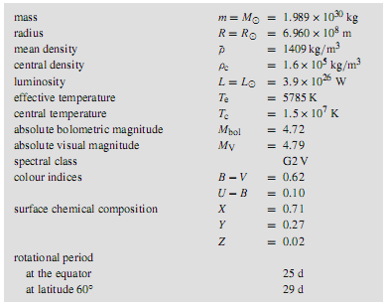
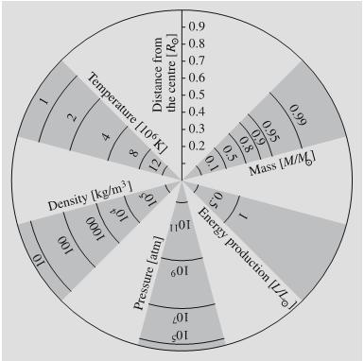
The sun
Notes:
Cutaway picture of the Sun, showing its interior and atmosphere.

Slide 19
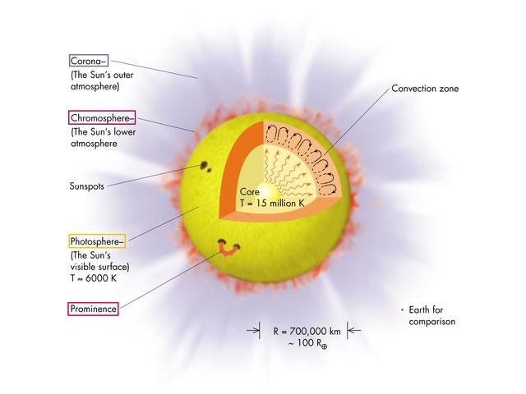

Slide 20
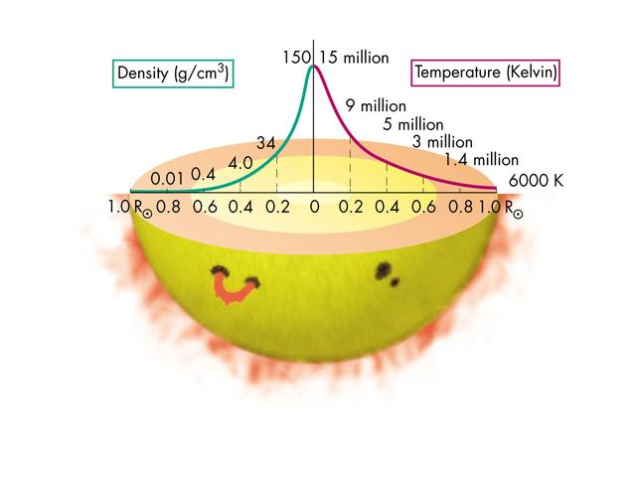
Notes:
Plots of how density and temperature change through the Sun.

Slide 21
Sun’s Surface
Photosphere:
The visible part of Sun (we cannot see the interior, because it is optically thick)
It is 300-500 km thick
Temperature of 8000 to 4500 K (decerasing outwards)
Continuum and absorption lines (Why absorption and not emission lines?)
Granulation in the surface indicates convection zones (size of ~1000 km) . Convection is necessary because radiative transport is not enough.
Notes:
Es la zona de transicion del interior donde los fotones “andan” (opctiamente grueso) a la zona exterior donde “vuelan” (opticamente delgado) (Shu)
En las zonas exteriores del sol la temperatura ya es tan bajo que H no es ionizado --> opacidad alta > se necesita conveccion en adicion de radiacion para transportar toda la energia hacia fuera.

Slide 22
Granulation at the surface of the sun,and a sunspot
Typical size of granulation: 1000 km
Notes:
Photograph of solar granulation near a sunspot. The bright patches are immense bubbles of hot gas rising from deep within the Sun. The darker areas around them are cooler gas sinking back into the Sun's interior. The sunspot is about 23,000 kilometers in diameter. (Courtesy William Livingston/NOAO.)

Slide 23
Limb darkening
Cause:
Limbs are darker (and redder) because we only see an upper (colder) shell
Sun at visible wavelengths

Slide 24
Sun’s Atmosphere
Cromosphere:
Above the photosphere, some 500 - 2000 km thick
Temperature of 4500 to 7000 K
Cannot see its continuum emission because it is much dimmer than photosphere in the background (it is much lower density).
Produces emission lines (H, He and metals). Strongest line is Hα.

Slide 25
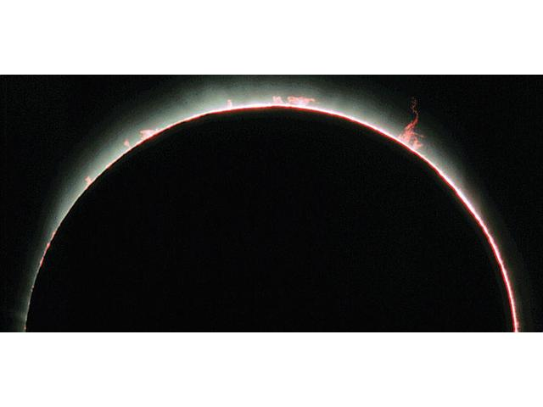
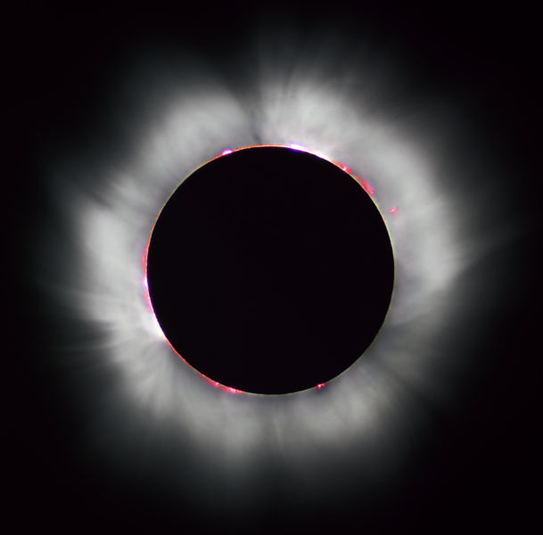
Cromosphere observed during a total eclipse (thin red and white region)
Cromosphere and Corona (seeing during a solar eclipse)
Notes:
Photograph of a portion of the solar chromosphere at a total solar eclipse. (Courtesy Jacques Guertin, Ph.D.)

Slide 26
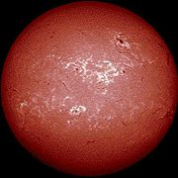
Cromosphere in Halpha
We see the cromosphere in emission (Hα from the photosphere is in absorption)
Ondulations
Notes:
Imagen de Halpha de Wikipedia
Linaemas negras son proturberancias

Slide 27
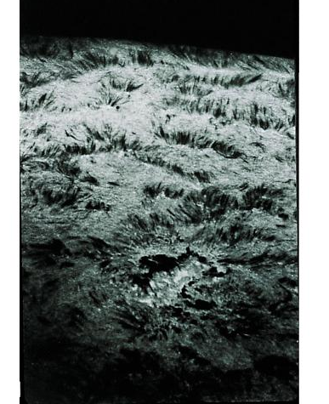
Spiculae in the cromosphere:
Gas filaments ascending some 10000 km lasting serveral minutes
Notes:
Photograph of spicules in the chromosphere. The spicules are the thin, stringy features that look like tufts of grass. (Courtesy NOAO.)
Eso tiene que ser una imagen en una linea de emision, pe. Halpha, para ver la cromosfera. Demuestra el aspecto
Ondulado como en la imagen anterior, pero en mas detalle.

Slide 28
The Corona
Corona:
Temperatures of a few million degrees (heated by magnetic fields and sound waves – the details of the mechanism still not fully understood)
Emits in X-rays
Emission lines of very high excitaion, originated in the outer region: Coronal lines. Unknown origin until 1941, they where thought as coming from new chemical elements!!.
Gas in the corona is being pushed towards interplanetary space, forming the solar wind.
Sun loses some 10⁻¹³ solar mass per year in this wind.
Solar wind at the surface of Earth has 5-10 part/cm³ and speeds of 500km/s.
Notes:
La corona no se suele considerar como parte de la atmosfera.

Slide 29
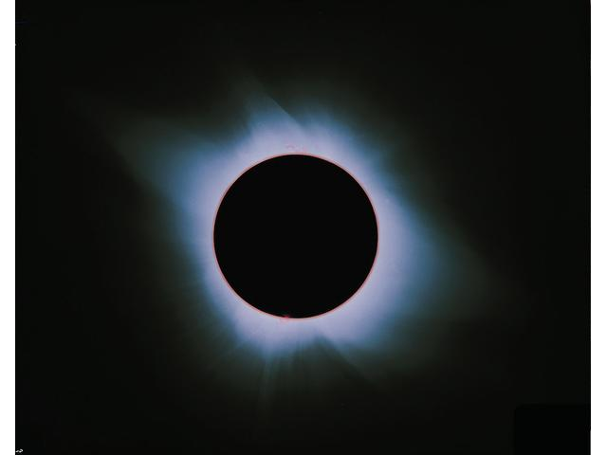
Corona during a solar eclipse
Notes:
Photograph of the corona at a total eclipse of the Sun. (Courtesy Dennis di Cicco.)

Slide 30
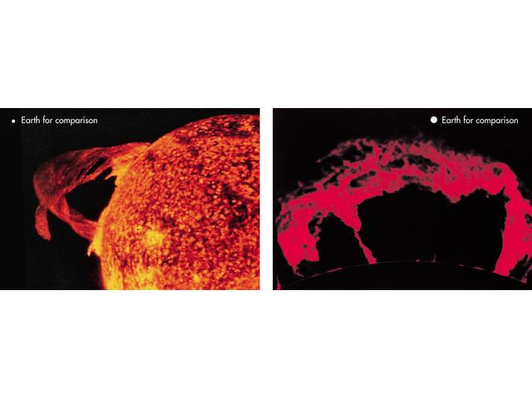
Protuberancias solares
Notes:
Photographs of some solar prominences. (Courtesy NOAO/NRL.)

Slide 31
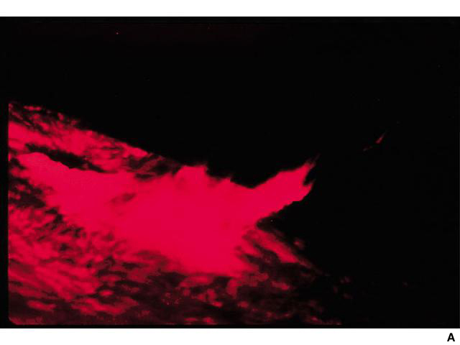
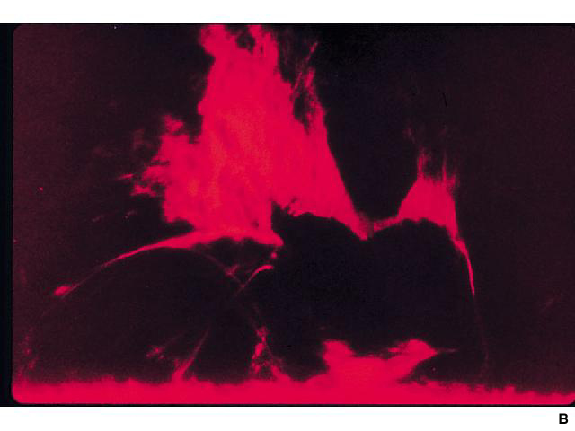
Solar flares:
They can last from seconds to nearly an hour.
Magnetic energy is suddenly and violently released
Notes:
A) Photographs of solar flares. In (B), the flare has erupted below a prominence and is blasting the prominence gas outward. (Courtesy NOAO.)

Slide 32
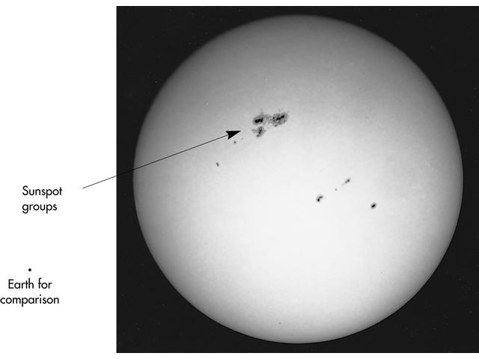
Solar activity
Sunspots
Notes:
White-light photograph of photosphere with sunspots. (Courtesy NOAO.)

Slide 33
Sunspots:
Known for over 400 years, Galileo already observed them.
Two different regions: Umbra, surrounded by Penumbra
Lower temperature (some 1500 K) than surroundings
Diameter: some 10000 km
Duration: days to months (even longer!)
Number of spots follows a cycle with period of between 7 to 17 years (average of 11 years)
High magnetic field up to 0.45 Tesla (aprox. 10000 stronger than earth’s mag. Field!!)

Slide 34
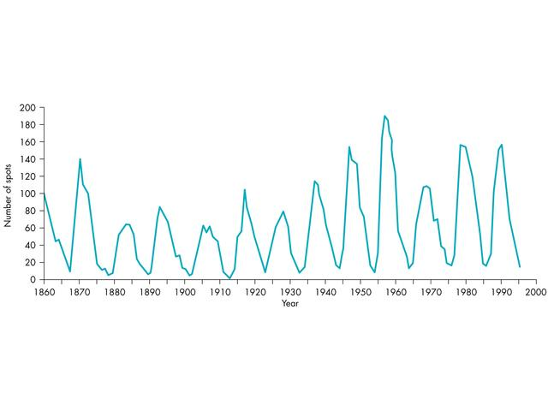
Sunspot cycle → known since a long time !!
Notes:
Plot of sunspot numbers showing solar cycle. (Courtesy John A. Eddy.)

Slide 35
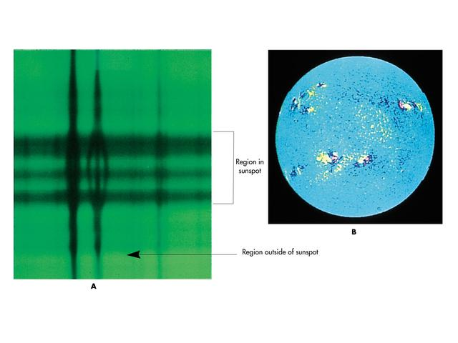
Efecto Zeeman midiendo campo magnético en las manchas solares
distance
Magnetogram.
Regiones amarillas: Orientación norte magnético
Regiones submarino: Orientación sur magnético
La orientación Norte-Sur está invertido en la hemisferia sur-norte.
frecuencia
Intensidad de la emisión: escala gris
Notes:
(A) Photograph of the Zeeman effect in a sunspot. Notice that the line is split over the spot where the magnetic field is strong but that the line is unsplit outside the spot where the field is weak or absent. (B) Magnetogram of the Sun. Yellow indicates regions with north polarity and dark blue indicates regions with south polarity. Notice that the polarity pattern of spot pairs is reversed between the top and bottom hemispheres of the Sun. That is, in the upper hemisphere, blue tends to be on the left and yellow on the right. In the lower hemisphere, blue tends to be on the right and yellow on the left. (Courtesy NOAO.)

Slide 36
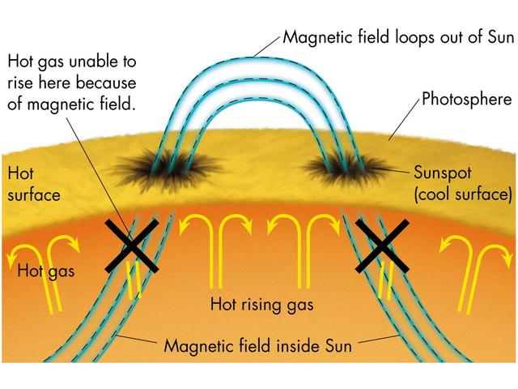
Magnetic fields involved in sunspots: regions where magnetic files come out of the surface.
Hot gas cannot reach the surface →Lower temperature
Spots come in pairs with opposite polarity.
Notes:
Sketch of how magnetic fields cause sunspots

Slide 37
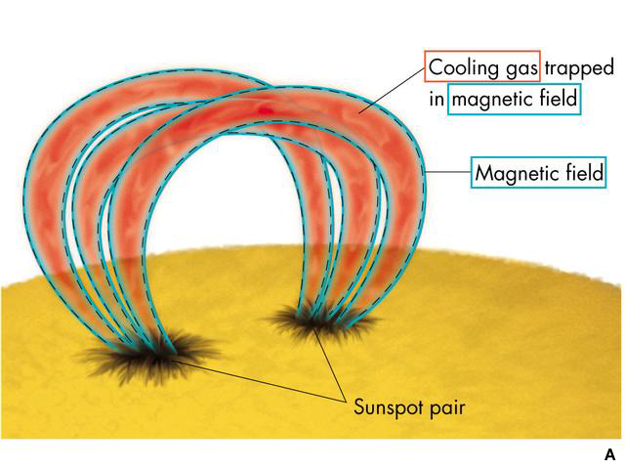
Loops:
Ionized gas moving along the magnetic field
Prominences can be:
Quiet
Loop (figure)
Eruptive
Notes:
(A) Sketch illustrating how magnetic fields support a prominence. (B) Photograph of a prominence. (Courtesy NOAO.)
Approximately how big is the prominence in (B)? Use the fact that the Sun's diameter is about 100 times the Earth's.

Slide 38
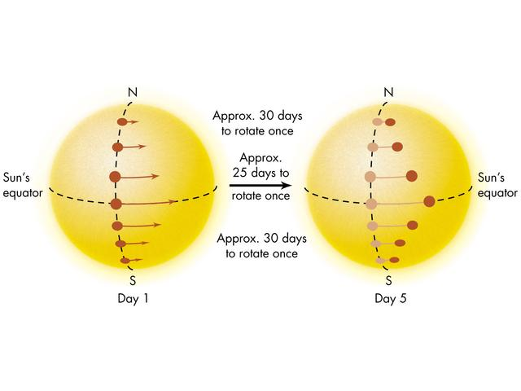
Rotación diferencial del Sol (descubierto en 1630 por Christoph Schneider)
Notes:
Sketch showing solar differential rotation. Points near the Sun's equator rotate faster than points near the poles

Slide 39
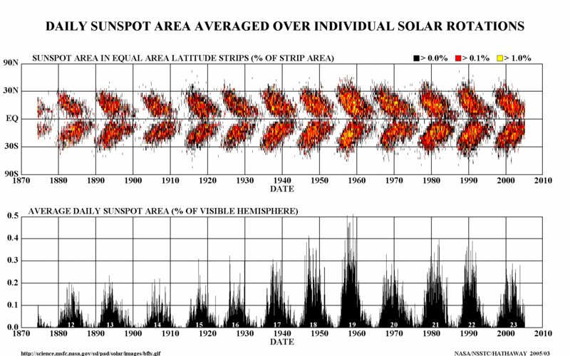
Top: Variation in sunspot distribution → related to diferential rotation.
Bottom: Evolution of number of sunspots
Notes:
Además:
Las manchas empiezan a aparecer a latidudes de 40 grados y mueven hacia el ecuador
Las manchas de ciclos sucesivos tienen polaridad opuesto.

Slide 40
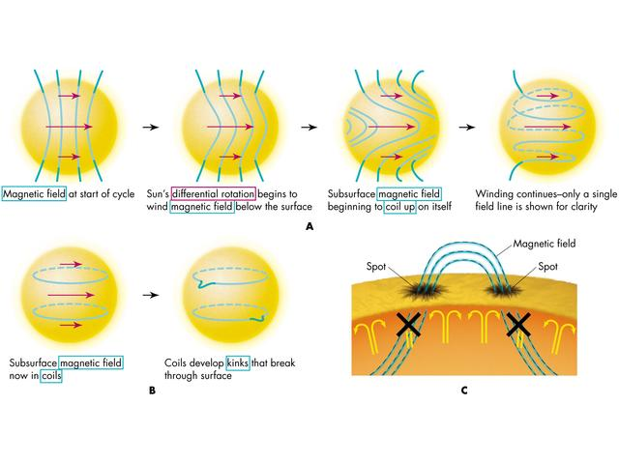
Creación del campo magnético a través del efecto dinamo
Necesario: Medio conductor, rotación diferencial
Actividad solar máximo cuando enredo de las líneas del campo magnético es máximo
Detalles del proceso son complejos.
Notes:
Sketch showing, (A), the possible winding up of the subsurface magnetic field. (B) Fields penetrating the Sun's surface. (C) Formation of a spot pair
Teoria dinamo para creacion del campo magnetico: necesita rotacion diferencial y conveccion en un medio conductor.
Se lo puede imaginar como una goma que al tirarla va cargada cada vez de mas energia. Esta energia despues se libera en las actividad solar.

