Slide 1
University of Granada
UGR
Methodology: saliency-based, low-level vision approaches, image-to-structured-data methods, 3D motion, classification
Design: local (system or device) embedded processing
Optimization: Real-time image processing, pipelined architectures (low-latency)
Previous EU-projects (robotics and vision): SpikeFORCE (IST-2001-35271), ECOVISION (IST-2001-32114), DRIVSCO (IST-016276-2), SENSOPAC (IST-028056), REALNET (FP7-270434), TOMSY (FP7-270436), Human Brain Project (HBP).

Slide 2
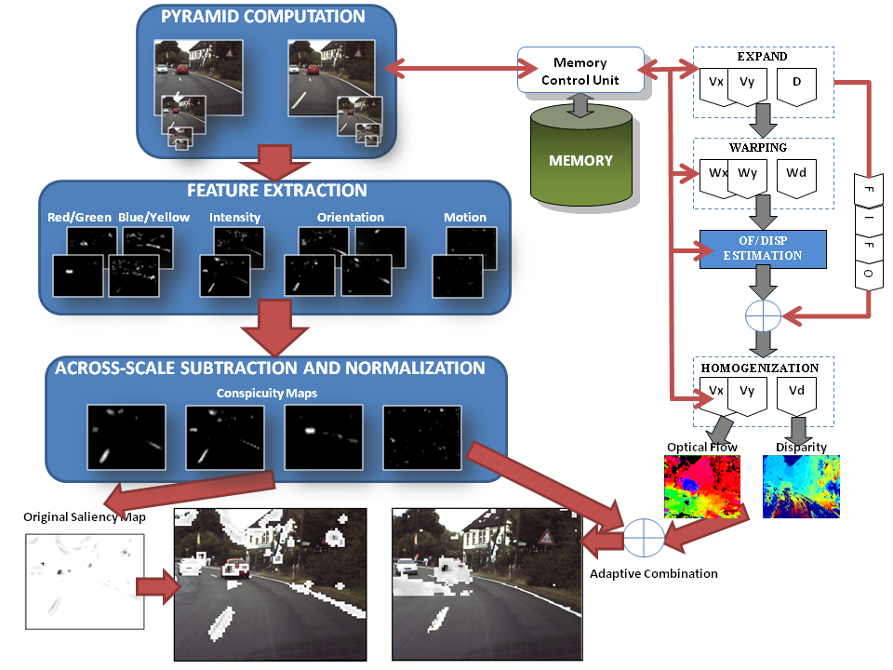
Embedded Engines for Image Processing
Low latency
Low computational power
Embedded processing
Real-time (~30 fps)
FPGA system | Fps | Frequency (MHz)
Disparity Mono | 355 | 109
Disparity Multi | 36 | 49
Optical flow Mono | 270 | 83
Optical flow Multi | 32 | 44
Saliency System | 32 | 50
Saliency System | 32 | 72
Complete System | 32 | 55
Virtex 4 FX100
Virtex 5 LX330T
VGA res. (640x480)
Saliency pow. Consum: 2.64w (Xpower)
Barranco et al., IEEE Trans. Industrial Informatics, 2014.

Slide 3
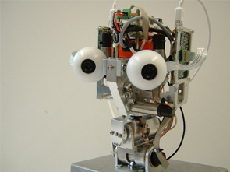
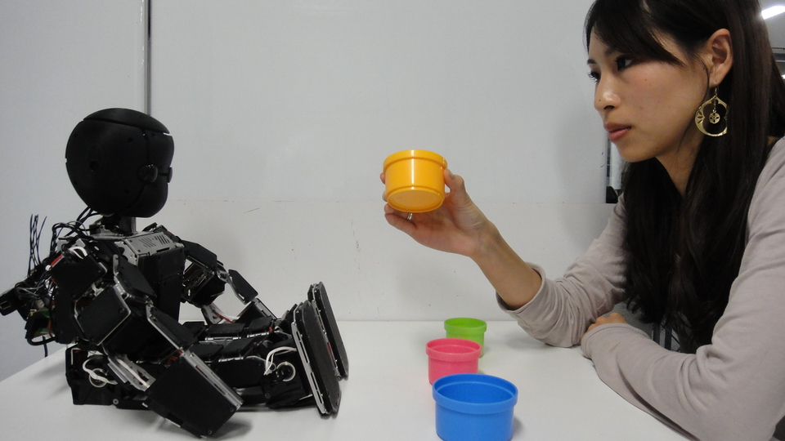
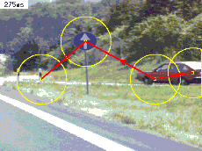
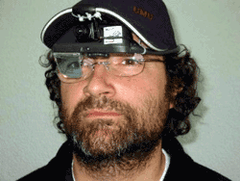
Embedded Engines for Image Processing: Applications
Pasive vision
Active vision
Active vision:
Dynamic filter modul.
Gazing control, vergence.
Active selection (& compression)
Robotics (low latency, real time): closing Percpetion-Action loop.
Autonomous navigation
Low-vision aid devices:
Cue highlighting
Selective vision
User-selection action

Slide 4
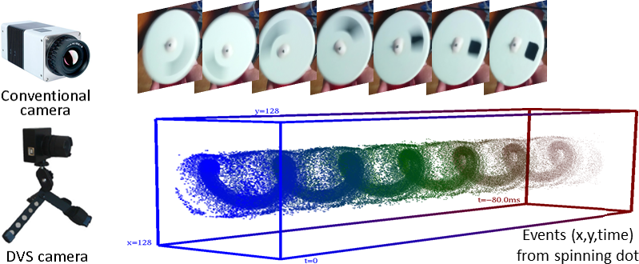
Low-latency sensors
No blurring
Fast motion
No occlusions
Real-time
Dynamic range
Asynchronous sensor: A new event every ~ 15 us
Very accurate and sparse optical flow
OF cues for motion segmentation and classification

Slide 5
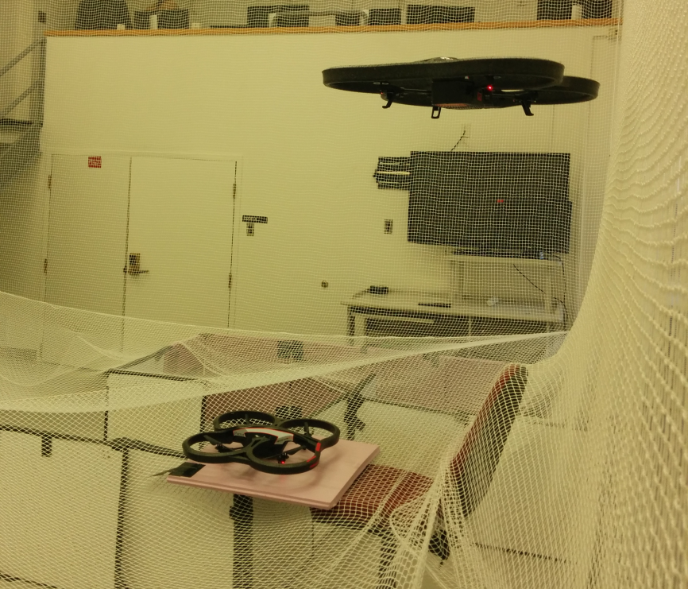
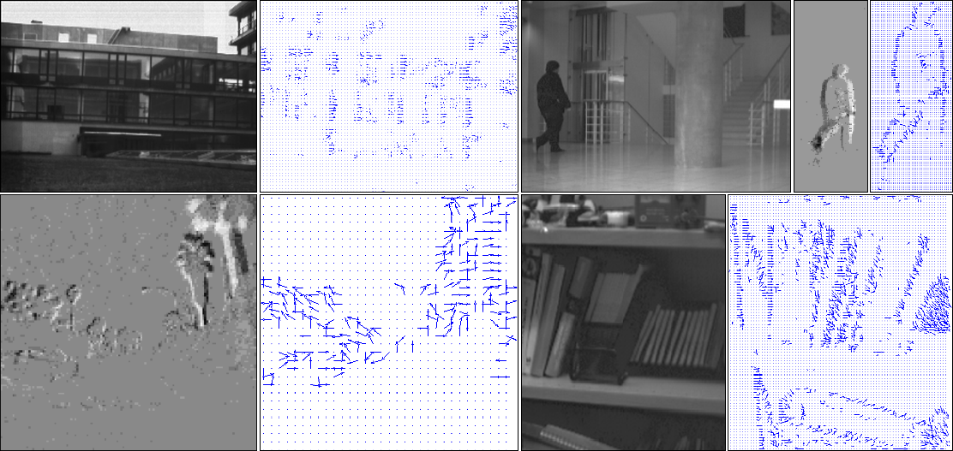
Applications
Autonomous Navigation: UAVs
Low computational load
Low processing
Limited resources and BW
Challenge: GPS denied environments

Slide 6
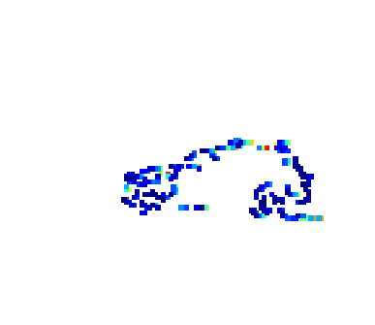
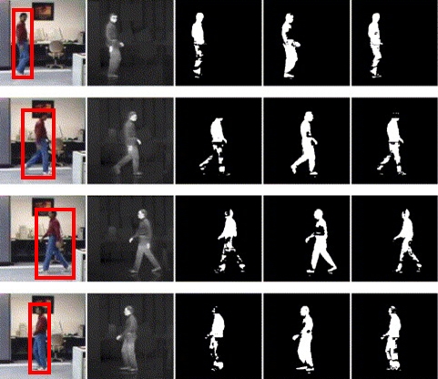
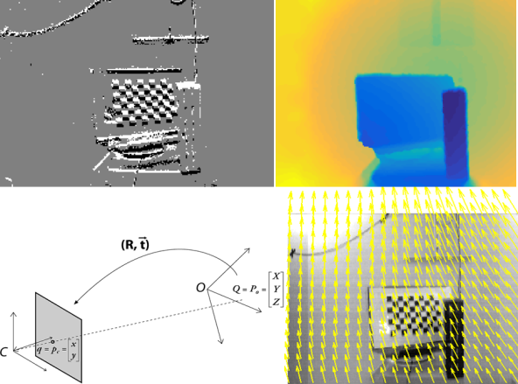
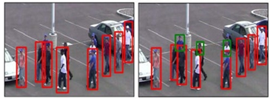
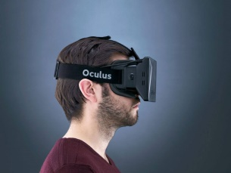
Applications
Foreground
Background
Real-time segmentation with low local processing sensors
Heterogenous cues
Boundary
Segmentation from motion, ego-motion estimation, 3D motion and pose estimation, SLAM
Video-surveillance
BG subtraction
Navigation
Tracking and mapping
AR and VR
IMOs detection: e.g. pedestrian
F. Barranco, C.L. Teo, C. Fermuller, Y. Aloimonos. Contour detection and characterization for asynchronous event sensors. ICCV, 2015.

