Slide 1
Francisco Barranco Cornelia Fermüller Yiannis Aloimonos
Event-based contour motion estimation

Slide 2
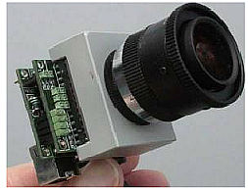
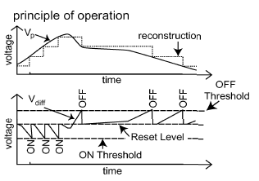
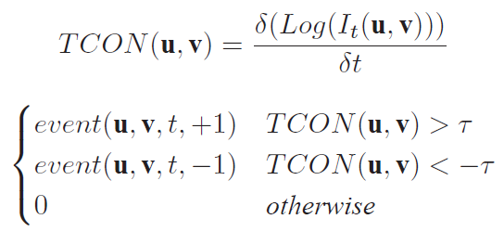
Asynchronous Event-based Dynamic Visual Sensor
[1]
No blurring, no artifacts
Accurate fast motion estimation
No occlusions
Real-time performance
DVS output → asynchronous AER
At point P(u,v), at time t an event event(u,v,t) of value either +1 or -1 is fired if the logarithm is greater than T
DAVIS/ApsDVS or ATIS:
Dynamic + static scene information
Provide absolute scene-reflectance values
[1] P. Lichtsteiner, C. Posch, and T. Delbruck, A 128×128 120dB 15μs latency asynchronous temporal contrast vision sensor, IEEE J. Solid State Circuits, 43(2), 566–576, 2008.

Slide 3
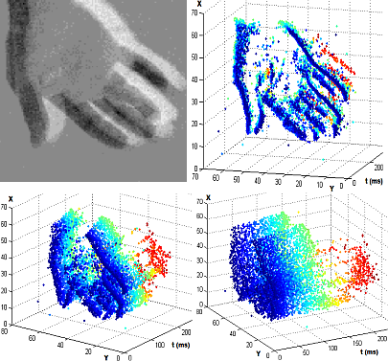
Motion pathway with Dynamic Visual Sensor
Early contour boundaries
Rough motion estimation
Early segmentation
Refined motion estimation
3D pose estimation
- Accurate motion estimation
No additional assumptions
Only estimates in the contours
High temporal resolution

Slide 4
Event-based contour motion estimation
Problems of current approaches | DVS Camera solution
Handle fast motion Solution: Multiresolution techniques 3D motion from matching interest points not from motion | High temporal resolution
Depth discontinuities | Early extraction of contours
Separate different 3D motions | The high temporal information allows separating two different rigid motions superimposed
Computational cost | Compute normal flow only when there is a change in time
Motion blur, light artifacts | Dynamic range (log)

Slide 5
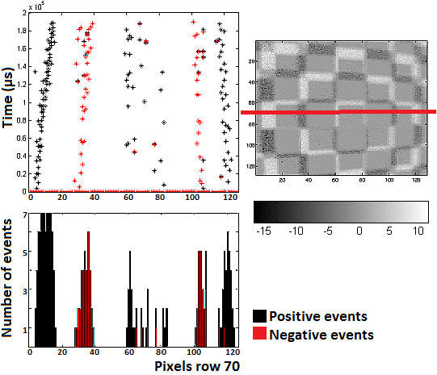
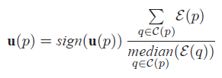
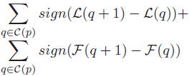
Contour motion estimation
Speed ←→local bar width
With:
→ #events of pixel p
→ Set of connected pixels
→ speed for pixel p
Robust function for the sign estimation
Fusing DVS and Intensity data:
Accurate intensity reconstruction for every event
Figure. Events collected with the DVS camera zooming in a chessboard pattern. The first row show the collected positive (black) and negative (red) events for the row 70, and an example of the output of the DVS.

Slide 6
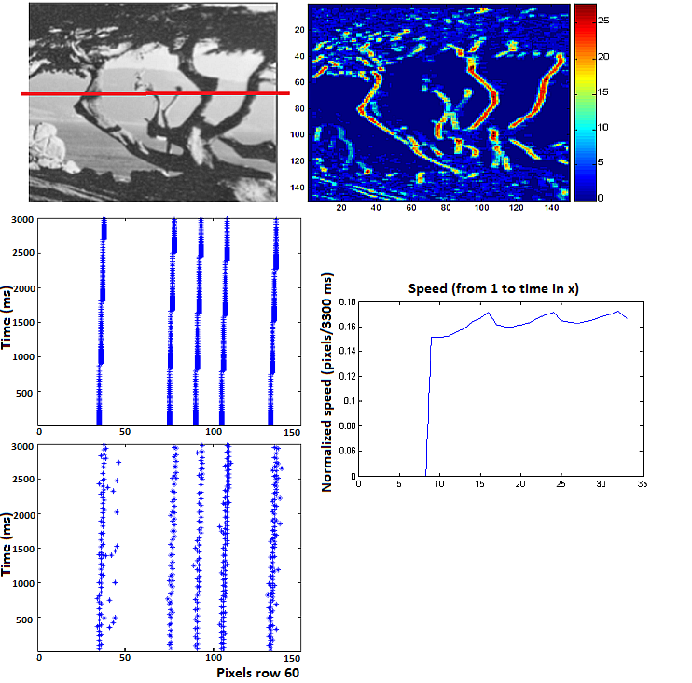
Contour motion estimation
Speed ←→local bar width
+ multi-temporal approach
Early segmentation
Figure. Events collected for “Translation Tree” sequence The first row shows the image and the accumulated positive events. The second and third row show the positive events collected for row 80 of the image. The last row shows the speed estimated for pixel (80, 40) for different time intervals (over 3300ms at a step size of 100ms).
Refined motion estimation

Slide 7
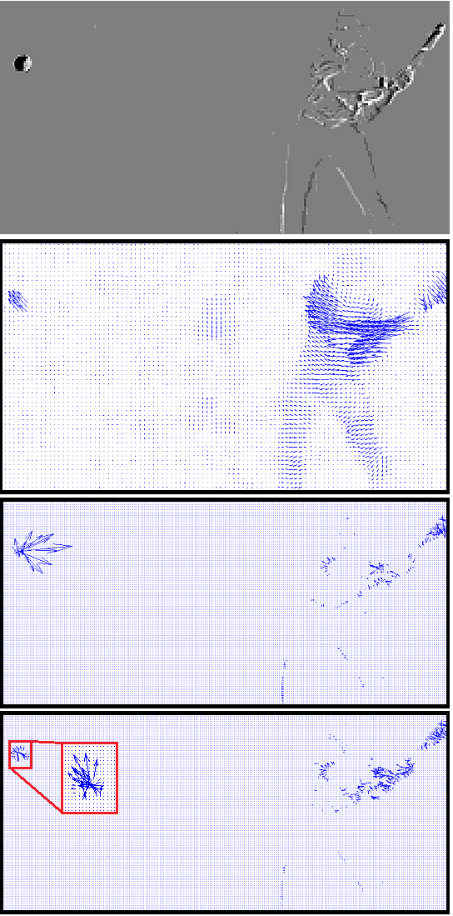
Problem I: Fast speed estimation
Video source: http://www.youtube.com/watch?v=arlWwQsmnM
Handle fast motion→ multiresolution techniques
Time performance
Computational complexity
Not very accurate:
- Scale-to-scale error propagation
- Outliers suppression
Small objects moving fast
Solution: High temporal resolution (DVS)
classic+NL-fast
[2] D. Sun, S. Roth, and M. Black, A quantitative analysis of current practices in optical flow estimation and the principles behind them, IJCV, 106 (2), 115–137, 2014

Slide 8
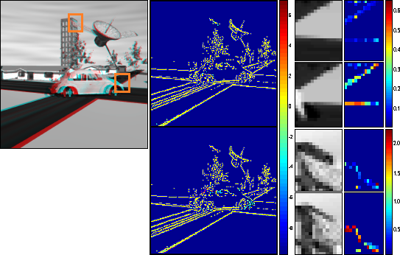
Problem II: Occlusions
Occluded regions + smoothing constraint →
Error propagation
Detect and prevent:
- Reprojection
- Flow divergence
Flow available → ++ Error
Figure. Satellite sequence [3]. Occlusion results for event-based and Classic+NL-fast[2] algortithm.
Solution: with DVS occlusions do not make sense
 | AEPE rel (%) | AEPE rel (%) [2] | Density (%)
Classic+NL-fast [2] | 0.619 | 26.1 | 4.165
Event-based | 0.261 | 9.6 | 4.165
[3] B. McCane, K. Novins, D. Crannitch, and B. Galvin, On benchmarking optical flow, Computer Vision and Image Understanding, 84 (1), 126 – 143, 2001.

Slide 9
Problem III: Performance
Conventional sophisticated methods:
Texture decomposition
Multiresolution schemes
Nonconvexity weighing functions
Spline-based bicubic interpolation
Global smoothing terms
Non-local regularization terms
Actual framework seems to be exahusted
- Without an early motion boundary segmentation obtaining more accurate methods is very hard
Real-time performance with DVS
 | Frame rate | Frame rate [2] | Events
Satellite 200x200 | 31.6 fps | 0.07 fps | ~15000
Computationally very expensive
It might take even minutes
 | AEPE rel (%) | AEPE rel (%) [2] | Density (%)
Trans | 0.003 | 7.5 | 9.72
Diver | 15.4 | 19.4 | 5.4
Yosemite | 12.8 | 11.7 | 1.37
Rubberwhale | 25.2 | 40.1 | 0.53
Dimetrodon | 7.2 | 9.1 | 0.78
Satellite | 9.6 | 26.1 | 4.17
Our contour motion estimation is more accurate than [2], algorithm ranked in Middlebury [4] as one of the first ones in December 2013!!

Slide 10
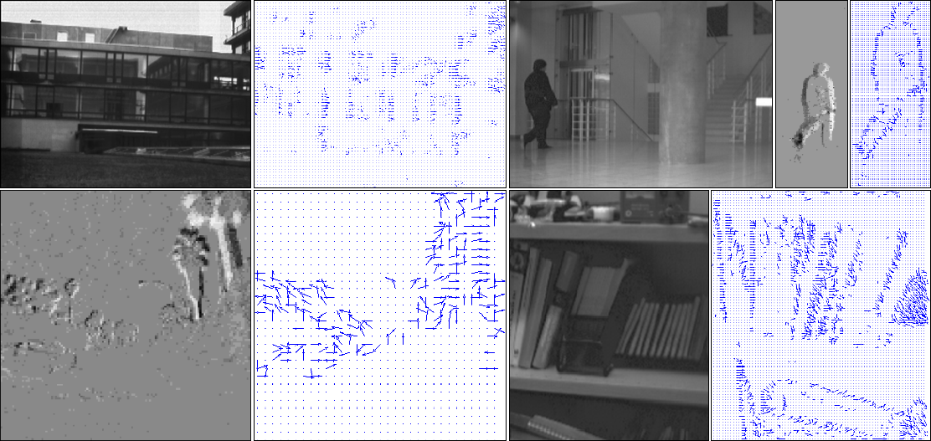
Event-based contour motion results
 | AEPE rel (%) | AEPE rel (%) [2] | Density (%)
Trans | 0.003 | 7.5 | 9.72
Diver | 15.4 | 19.4 | 5.4
Yosemite | 12.8 | 11.7 | 1.37
Rubberwhale | 25.2 | 40.1 | 0.53
Dimetrodon | 7.2 | 9.1 | 0.78
Satellite | 9.6 | 26.1 | 4.17
Our contour motion estimation is more accurate than [2], algorithm ranked in Middlebury [4] as one of the first ones in December 2013!!
[4] S. Baker, D. Scharstein, J. P. Lewis, S. Roth, M. J. Black, and R. Szeliski, A database and evaluation methodology for optical flow, Int. J.
Comput. Vision, 92 (1), 1 – 31, 2011

Slide 11
Take-home message
Current framework seems exahusted → DVS
Asynchronous event-based data
Multi-temporal biologically inspired approach
Accurate motion estimation
Real-time performance / less resources
No occlusions
Fusion with current frame-based technique

