Slide 1
Opinion Retrieval: Looking for opinions in the wild
Dr. Georgios Paltoglou
Senior Lecturer at Faculty of Science and Engineering
University of Wolverhampton, UK
email: g.paltoglou@wlv.ac.uk
website: www.wlv.ac.uk/~in0948

Slide 2
First things first!
You’ll notice the slides aren’t present in your ESSIR USB stick!
They can be found and downloaded online from this url!
Don’t worry, the address will remain visible throughout the session

Slide 3
Overview
Academic Background
Opinion Retrieval
Definition and motivation
Applications and challenges
Opinion Analysis
Relevant Benchmarking activities
TREC Blog/Microblog Tracks
NTCIR-6 Opinion Analysis
Bringing it all together
Opinion Retrieval
Summary and conclusions

Slide 4
Academic Background
2002: Bachelor in Mathematics
Aristotle University of Thessaloniki, Greece
2003-05: M.Sc. in Advanced Informatics and Communication Systems
Aristotle University of Thessaloniki, Greece
2005-08: Ph.D. in Information Retrieval
Department of Applied Informatics, University of Macedonia, Greece
2009-11: Post-doctoral Research Fellow
Statistical Cybermetrics Research Group, University of Wolverhampton, UK
2011-13: Lecturer in Computer Science
School of Technology, University of Wolverhampton, UK
2013-present: Senior Lecturer in Computer Science
Faculty of Science and Engineering, University of Wolverhampton, UK

Slide 5
Overview
Academic Background
Opinion Retrieval
Definition and motivation
Applications and challenges
Opinion Analysis
Relevant Benchmarking activities
TREC Blog/Microblog Tracks
NTCIR-6 Opinion Analysis
Bringing it all together
Opinion Retrieval
Summary and conclusions

Slide 6
Definitions
Opinion Retrieval 2 constituent parts
Information Retrieval (IR)
with a particular focus on IR in social media (e.g., blogs, forums, Twitter)
Opinion Analysis (OA)
also known as Sentiment Analysis or Opinion Mining.
Opinion Retrieval refers to the ranking of documents on relevance and opinionatedness
The user’s aim is to find relevant content that contains opinions.
e.g., “What is Obama’s opinion on the recent events in Egypt?”, “What do people think about the new iphone?”
IR has and will been discussed in great depth in this Summer School
We’ll focus on the novel aspects that are relevant to Opinion Retrieval
IR in social media, with a focus on Twitter (as one of the most prevalent platforms)
Opinion Analysis
…and importantly, bringing the two together!

Slide 7
IR in Social Media
For a thorough discussion, refer to yesterday’s session by Arjen de Vries
In summary, Social Search has a number of distinct features, different from general web search:
Content is ephemeral
Timeliness is vital
Document length significantly varies
Think Twitter’s 140 character limit
Authorship is important
Look for trend setters
Unique syntax
Abbreviations, hashtags, mentions
Often main content is linked to, rather than present in the document

Slide 8
Opinion Analysis
The computational treatment of subjectivity in text
Subjectivity:
The linguistic expression of somebody’s opinions, sentiments, emotions, evaluations, beliefs, speculations (i.e., private states)
States that are not open to objective observation or verification.
A sub-discipline within Natural Language Processing (NLP), heavily influenced by Machine Learning and Psychology.
Aim: design and implement algorithms that can automatically detect and analyse expressions of private states in text
Who thinks/feels how about what?

Slide 9
Who thinks how about what? - the Opinion Holder
The entity that holds the particular opinion about another entity
Can be person, organisation, group, etc.
The owner of the private state
Direct opinion holders
Authors of forum posts, tweets
Indirect opinion holders
When a third party (e.g., reporter) presents the opinion of other entities
“The Parliament exploded into fury against the government when…”

Slide 10
Who thinks how about what? - the Opinion Holder
Extracting the Opinion Holder in practise [12, 14]:
Identify the entities in the text
e.g., persons, dates, organisations, locations
Can use toolkits like Gate, IdentiFinder
Limit the pool to entities that can hold opinions (e.g., persons not dates)
Parse text to extract relationships between potential holders and opinion segments
Or simply consider the closest entity to opinion segment
More about detecting opinion segments later…
Of course, in review-related content, the Holder is typically the author!
Anaphora resolution can help increase coverage [13]:
… In a Washington Post interview, Romney stated that he believes Prime Minister Putin is currently “rebuilding the Russian empire.” He stated that reset “has to end,” and “We have to show strength.” …
Not always easy!
Toolkits: OpenNLP, CogNIAC [16]

Slide 11
Who thinks how about what? - the Opinion Object
The entity about which an opinion is being expressed
The object of the private state
Often, not monolithic entity, but comprising of hierarchy of components and attributes (aspects)
e.g., cell phone: design, reception, voice quality, features, weight, etc.
For each aspect, many synonyms may exist:
e.g., design can be described by good-looking, classy, modern, etc.
Often, it is imperative to be able to detect the relevant aspects of an entity to be able to analyse how its is being discussed
e.g., “good reception, but quite heavy”

Slide 12
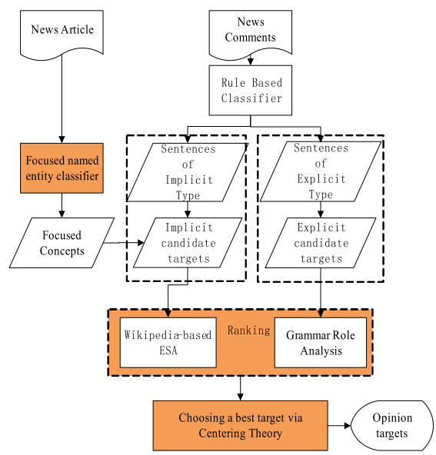
Who thinks how about what? - the Opinion Object
Extracting the Opinion Object in practise [17,18]:
A lot of heuristics come into play
As before, detect entities and analyse their relationship to the opinion segment
e.g., “Obama approved intelligence leaks… “
Depending on domain, limit entities to persons, organisations
Typically, nouns or phrases
If applying on Twitter, hashtags come very handy
Identify entities through colocations with hashtags
Often, the target is implicit (e.g., in comments, reviews)
Not directly mentioned in text or synonyms used
Need to cluster different nouns under the same entity
e.g., via explicit semantic analysis (ESA) [19]
image taken from [18]

Slide 13
Who thinks HOW about what? - the Opinion
The content of the private state
Multiple types of analyses are possible:
Basic ternary: {positive, negative, objective}
e.g., thumbs up/down, in favour/against
Scaled: positive and/or negative of a predetermined scale
e.g., 1-5 stars
Universal emotions: fear, love, happiness, sadness, anger, disgust, surprise
Russell’s circumplex model …

Slide 14
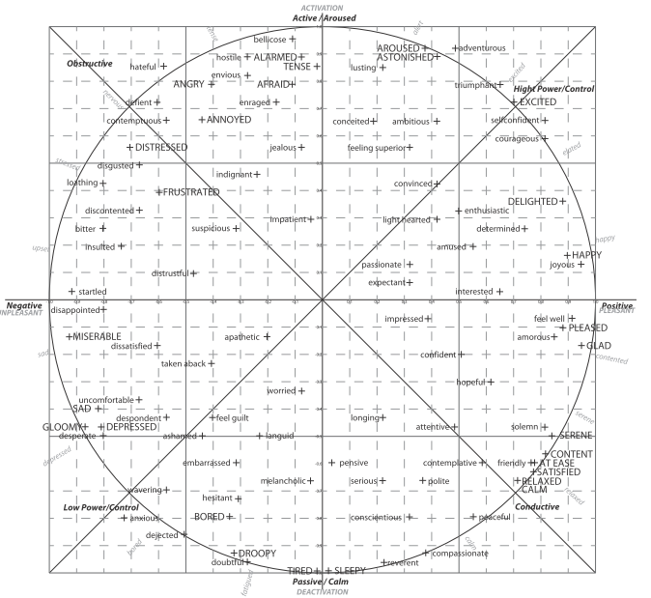

Slide 15
Who thinks HOW about what? - the Opinion
Depending on the:
environment
short vs. long text spans
twitter vs. blog posts
application requirements
How will the output be used:
Public Opinion analysis
Product benchmarking
Social studies, etc.
a type of analysis has to be selected. For example:
Ternary analysis is most common for short exchanges
Circumplex model has been successfully applied to forum threads
Basic emotions may be inappropriate for social studies analysis
Scaled analysis has been applied to reviews, but only for individual reviewers!

Slide 16
Why is this relevant and important? - Academia
Enhance Question Answering (QA) systems
Separate facts from opinions
Question: What is the international reaction to the re-election of Robert Mogabe as President of Zimbabwe?
Answer: African observers generally approved of his victory while Western Governments strongly denounced it.
Opinion QA is more complex the fact-based QA
Opinion Retrieval for search engines
Especially useful for transactional queries - ecommerce
81% of internet users have done an online product research at least once (20% do daily!)
“Opinion: iPhone”
Comparison: iPhone vs. HTC”
Whole range of new problems/challenges
HCI: single/multiple rankings?
Summarising of results? Authoritative reviewers? etc.

Slide 17
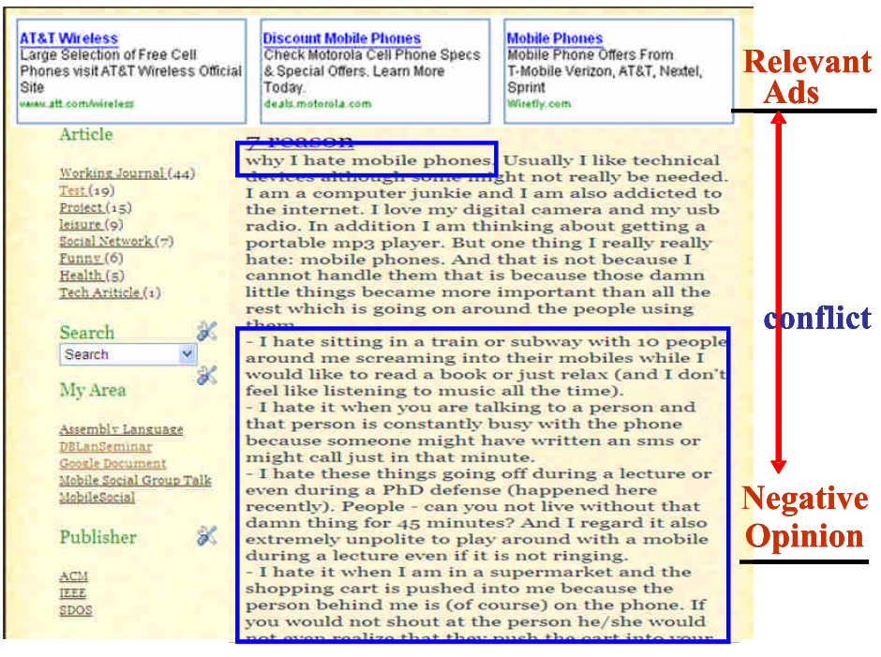
Why is this relevant and important? - Industry
Phenomenal increase of user-generated content
Twitter: 1B tweets/week, 140M tweets/day
Tumblr: 100M blogs, 72M posts/day
Businesses and organisations
Product and services benchmarking
Market intelligence
Businesses spend vast amounts of money to understand consumer sentiments/opinion
Consultants, surveys, focus groups, etc.
Ad placement: Placing ads in user-generated content
Place an ad when one praises a product. Avoid bad PR. [30]
Expressive text-to-speed synthesis/analysis
Prediction (election outcomes, market trends)

Slide 18
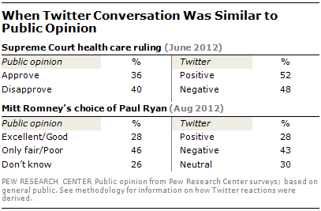
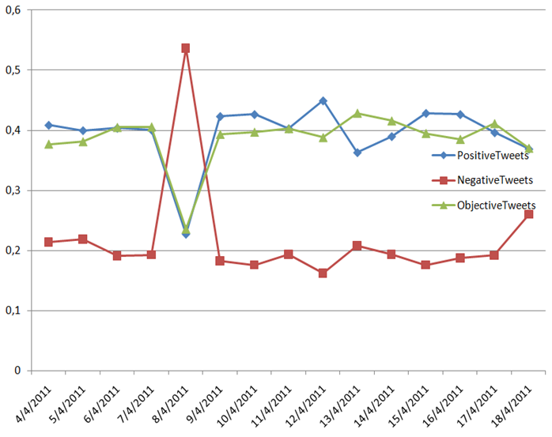
Public Opinion Tracking
Politics
Market
Monitoring of public opinion on Twitter for the keyword “milk”.
Spike occurs on 8/4/2011 after a series of deaths in China relating to bad quality milk (source)

Slide 19
Challenges (I)
Subtle ways of expressing private states
“If you are reading this because it is your darling fragrance, please wear it at home exclusively and tape the windows shut” No negative words
“Miss Austen is not a poetess” Fact or opinion?
“Go read the book” Context
“Yeah, sure!” Irony
“I feel blue” vs “The sky is blue” Idioms
“If you thought this was going to be a good movie, this isn’t your day” Negation
Informal language
90+% of language used in some social platforms deviates from standard English [3]
“wuddup doe mah nigga juz droppin sum cuzz luv on u DeUcEz”
As a result, even standard NLP processes need revisiting:
Part-of-speech tagging in Twitter [4]

Slide 20
Challenges (II)
“This film should be brilliant. It sounds like a great plot, the actors are first grade, and the supporting cast is good as well, and Stallone is attempting to deliver a good performance. However, it can’t hold up” Opinion reversal
“I bought an iPhone a few days ago. It was such a nice phone. The touch screen was really cool. The voice quality was clear too. Although the battery life was not long, that is ok for me. However, my mother was mad with me… ” Topic drift
Lastly, in contrast to IR which is typically based on keywords, opinions are NOT easily conveyed by keywords.
e.g. “unpredictable plot” vs. “unpredictable steering”
Example from [5]:

Slide 21
Overview
Academic Background
Opinion Retrieval
Definition and motivation
Applications and challenges
Opinion Analysis
Relevant Benchmarking activities
TREC Blog/Microblog Tracks
NTCIR-6 Opinion Analysis
Bringing it all together
Opinion Retrieval
Summary and conclusions

Slide 22
Opinion Analysis
Two approaches to the problem:
Machine-Learning (ML) solutions
Lexicon-based solutions
Hybrid solutions
Each has advantages and disadvantages…

Slide 23
Machine-Learning (ML) solutions
‘Learn by example’ paradigm
Provide an algorithm with lots of examples
Documents that have been manually/semi-automatically annotated with a category
Supervised learning
In our case: e.g., positive/negative reviews
Algorithm extracts characteristic patterns for each category and builds a predictive model
Apply model to new text -> get prediction
Things to note:
Typical machine-learning algorithms are typically used
SVMs, Naïve Bayes, Maximum Entropy
Focus is mostly on better modelling the documents -> design better features!
Enhance/replace standard bag-of-words approach
The aim is to address the challenges we saw before

Slide 24
Crash-course on ML for document classification
Bag-of-words document representation: document -> vector
Example:
d₁=“good average excellent good”
d₂=“okay good average fine”
d₃=“good okay okay”
Then Vocabulary={“good”, “average”, “excellent”, “fine”, “okay”} and d₁ will be represented as:
d₁={2,1,1,0,0} if features are frequently-based or
d₁={1,1,1,0,0} if boolean-based
Problems:
Order of tokens is lost
Long-distance relationships are lost
“Avengers was a good movie, but Iron Man sucked!”

Slide 25
Documents in a Vector Space - Classification
Sec.14.1
negative
Test document; which category?
positive
For an in-depth analysis, see any of these books [22,23,24]

Slide 26
Documents in a Vector Space - Classification
Sec.14.1
Example: k-Nearest Neighbours
Example: Support Vector Machines
For an in-depth analysis, see any of these books [22,23,24]

Slide 27
Machine-Learning solutions
Basic approach:
Get manually annotated documents from the domain you are interested in.
e.g., positive and negative reviews of electronics products
This will be your training corpus
Train any standard classifier using bag-of-words as features
Typical classifiers: Support Vector Machines (SVMs), Naïve Bayes, Maximum Entropy
Naïve Bayes are super-easy to implement from scratch
Don’t try to implement SVMs yourself! Use existing implementations: SVM^{light}, LibSVM or LibLinear (for larger datasets). Use linear kernels
Use boolean features not frequency-based
Apply trained classifier to test corpus or application
If you want to predict a rating, e.g., 1-5 stars [20]
Same as above, but use multi-class classification or regression:
Linear Regression, Support Vector Regression

Slide 28
Machine-Learning solutions
Typical extensions, focus on extending/enhancing the document representation. Instead of/in addition to bag-of-words features, they use [5]:
Extra features for emphasised words, special symbols, document length [21]
Higher order n-grams (e.g., bi-grams)
“The movie was not very good, actually”
“The_movie movie_was was_not not_very very_good good_actually.”
Helps capture features like: was_not (negation), very_good (intensifiers)
Part-of-speech (pos) tags
“This is a love movie.”
“This_DT is_VBZ a_DT love_NN movie_NN.”
Why?
Position
“I loved this movie...... not so bad.... go see it.”
“I_1 loved_1 this_1 movie_1...... not_2 so_2 bad_2.... go_2 see_3 it_3.”

Slide 29
Aspect-based Opinion Analysis
As discussed, often the Opinion Object comprises of different aspects
e.g., camera: lens, quality, weight.
Often, such an aspect-based analysis is more valuable than a general +/-
Automatic extraction of those features is possible by:
Building Ontology Trees [25]

Slide 30
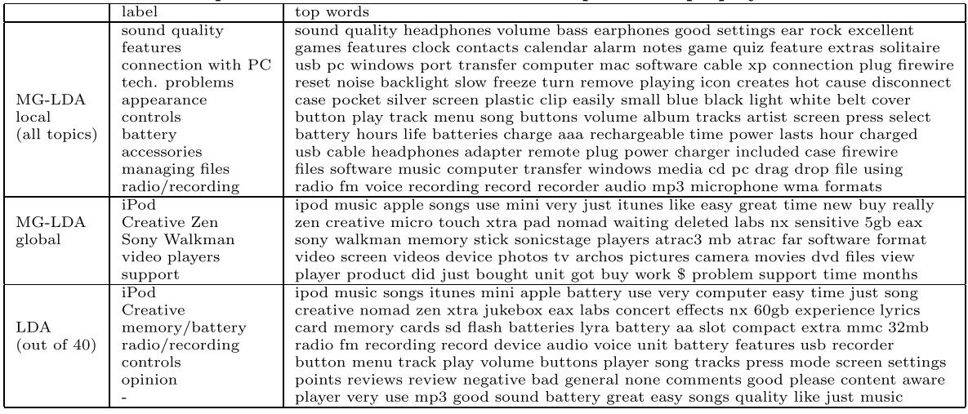
Aspect-based Opinion Analysis
Or by viewing reviews as mixtures of topics relating to different aspects of the product [26]

Slide 31
Pros/Cons of the approach
Advantages:
Tend to attain good predictive accuracy
Assuming you avoid the typical ML mishaps (e.g., over/under-fitting)
Disadvantages:
Need for training corpus
Solution: automated extraction (e.g., Amazon reviews, Rotten Tomatoes) or crowdsourcing the annotation process (e.g., Mechanical Turk)
Domain sensitivity
Trained models are well-fitted to particular product category (e.g., electronics) but underperform if applied to other categories (e.g., movies)
Solution: train a lot of domain-specific models or apply domain-adaptation techniques
Particularly for Opinion Retrieval, you’ll also need to identify the domain of the query!
Often difficult/impossible to rationalise prediction output

Slide 32
Lexicon-based solutions
Detect/extract the polarity of opinions, based on affective dictionaries [7,8]
Word-lists where each token is annotated with an ‘emotional’ value
e.g., positive/negative words or words that express anger, fear, happiness, etc.
More to follow…
Add syntactic and prose rules to estimate the overall polarity of text:
Negation detection: “the movie wasn’t good”
Exclamation detection: “great show!!”
Emoticon detection: “went to the movies ☺”
Emphasis detection: “You are gooooood”
Intensifier, diminisher word detection: “Very good movie” vs. “good movie”
Example of simplified process in next page…

Slide 33
(Basic) lexicon-based approach
Detect emotion in two independent dimensions:
Positive: D_{pos}: {1, 2,… 5}
Negative: D_{neg}: {-5, -4,… -1}
(optional) Predict overall polarity by comparing them :
If D_{pos} > |D_{neg}| then positive
Example: “He is brilliant but boring”
Emotion(‘brilliant’)=+3
Emotion(‘boring’)=-2
Negation detection: “He isn’t brilliant and he is boring”
Emotion(NOT ‘brilliant’) = -2
Decreased by 1 and sign reversed
Exclamation detection: “He is brilliant but boring!!”
D_{pos} =+3, D_{neg}=-2 => positive
D_{pos} =+1 (default), D_{neg}=-3 => negative

Slide 34
Extensions
Naturally, this is a very simplified description
Typical extensions include:
Ability to optimize affective lexicon
Add / remove words on-the-fly
Manipulate affective weight based on training data
We’ll see examples of both later…
Proper syntax analysis
To locate the interdependencies between affective words and modifiers
Detection of user-defined keywords and their relation to affective text spans:
“ESSIR rocks, but the weather is too hot”
Demo:
SentiStrength: http://sentistrength.wlv.ac.uk/
TweetMiner: http://mi-linux.wlv.ac.uk/~0920433/project/tweetmining.html

Slide 35
Pros/Cons of the approach
Advantages:
Can be fairly accurate independent of environment
No need for training corpus
Can be easily extended to new domains with additional affective words
e.g., “amazeballs”
Can be easy to rationalise prediction output
More often used in Opinion Retrieval (in TREC, at least!)
Disadvantages:
Compared to a well-trained, in-domain ML model they typically underperform
Sensitive to affective dictionary coverage

Slide 36
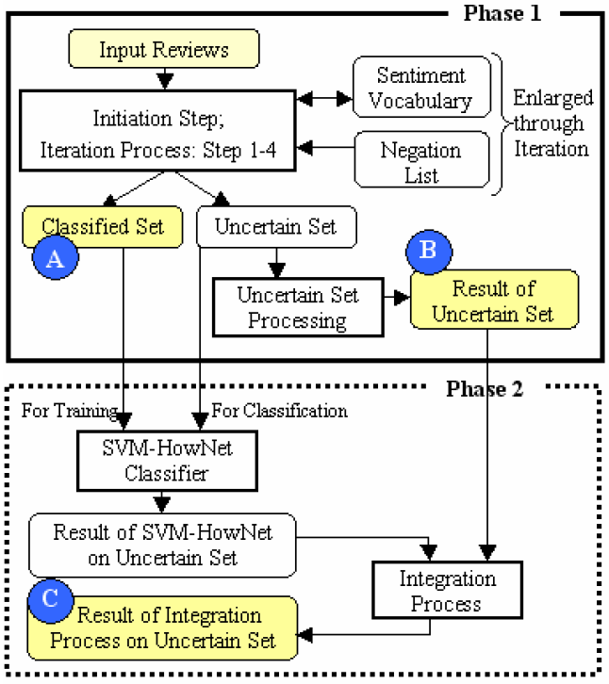
Hybrid solutions
Lexicons + Machine-Learning, e.g., SELC (SElf-Supervised, Lexicon-based and Corpus-based) [11]

Slide 37
Affective Lexicons
They have been extensively used in the field either for lexicon-based approaches or in machine-learning solutions
Additional features
Bootstrapping: unsupervised solutions (see previous)
Can be created manually, automatically or semi-automatically
Can be domain-dependent or independent
A lot of them are already available:
Manual
LIWC: Linguistic Inquiry and Word Count [10]
ANEW: Affective norms for English words [11]
Automatic:
WordNet-Affect [9]
SentiWordNet [31] …

Slide 38
LIWC: Linguistic Inquiry and Word Count

Slide 39
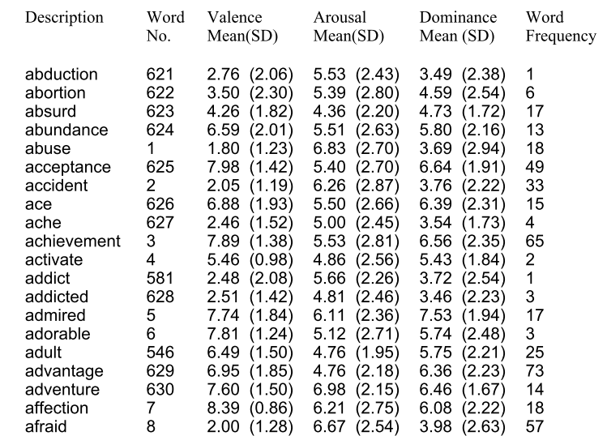
ANEW: Affective norms for English words

Slide 40
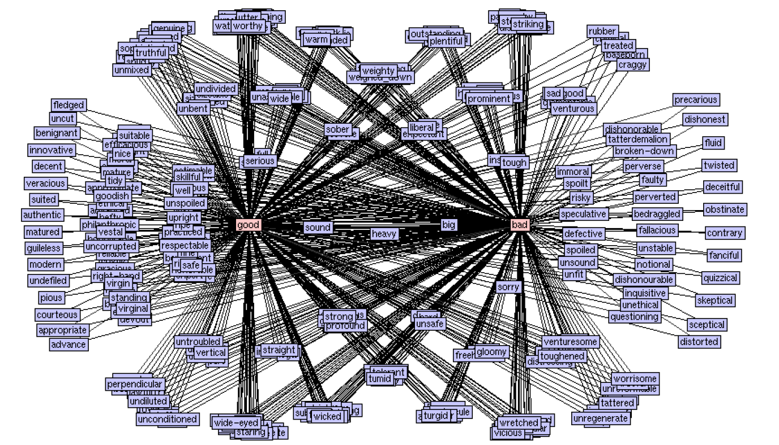
Creating affective lexicons: using WordNet
WordNet: A lexical database for the English language, that provides various semantic relations between tokens (e.g., synonyms, antonyms)
Can be used to classify positive/negative tokens, based on distance from seed words
Links between ‘good’
and ‘bad’ in WordNet
image taken from [5]

Slide 41
Creating affective lexicons: using conjunction

Slide 42
Overview
Academic Background
Opinion Retrieval
Definition and motivation
Applications and challenges
Opinion Analysis
Relevant Benchmarking activities
TREC Blog/Microblog Tracks
NTCIR-6 Opinion Analysis
Bringing it all together
Opinion Retrieval
Summary and conclusions

Slide 43
TREC Blog Track: Opinion Retrieval task (2006 – 2008)
Task: locate blog posts that express an opinion about a given target
target: any named entity, e.g., person, location, organisation, concept, event
“What do people think about X?”
Topic example:
<top>
<num> Number: 930 </num>
<title> ikea </title>
<desc> Description: Find opinions on Ikea or its products </desc>
<narr> Narrative: Recommendations to shop at Ikea are relevant opinions. Recommendations of Ikea products are relevant opinions. Pictures on an Ikea-related site that are not related to the store or its products are not relevant. </narr>
</top>

Slide 44
TREC Blog Track: Opinion Retrieval task
Assessment in 2 levels:
relevant vs. non-relevant (-1, 0, 1)
-1: not-judged
0: not-relevant
1: relevant, but non-opinionated
opinionated vs. non-opinionated (2, 3, 4)
2: opinion expressed explicitly negative/against target
3: opinion expressed both positive and negative towards target (i.e., mixed)
4: opinion expressed explicitly positive/supporting target
Dataset: Blog06 collection
Property | Value
# unique blogs | 100K
Uncompressed size | 148GB
Crawling period | 11/2005 – 2/2006
# homepages | 324K
# permalinks | 3M
Selection of “top blogs”
by Nielsen BuzzMetrics

Slide 45
Examples of posts
relevant, negative blog post [1]:
relevant, non-opinionated blog post [1]:

Slide 46
TREC Blog Track: Polarity subtask (2007-8)
Detect the polarity of the expressed opinion
positive vs. negative
Main Metric:
R-accuracy = $\frac{\# opionionated documents above rank R that are correctly classified}{\# opinionated documents above rank R}$
R=opinionated documents for particular query
Alternative metrics:
R-Accuracy at specific rank cut-offs (A@10 and A@1000)
In contrast, Opinion Retrieval uses standard IR metrics, such as MAP, P@10, etc.
Using opinionated-only documents as relevant.
i.e., 1 documents are considered as 0

Slide 47
TREC Microblog Track (2011-12)
Focus on search tasks in microblogging environments (i.e., Twitter)
Tweets11 corpus [38]
16M tweets
23 Jan 2011 – 7 Feb 2011
Sample of Twitter firehose (1%)
Real-time Task
“At time t, find tweets about topic X”
Rank tweets by relevancy and time!
Newer posts should be higher than older
Both tweet and linked content were judged for relevancy
No opinion component in TREC tasks
Opinion judgements have been made available for 2011 qrels [39]
Some work on opinion retrieval on Twitter exists [40]
image from [38]

Slide 48
NTCIR-6 Opinion Analysis Pilot Task
NTCIR: NII Testbeds and Community for Information access Research
Series of evaluation workshops (think TREC)
Themes: IE, QA, text summarisation, extraction, IR, etc.
Opinion Analysis [15] task’s aim was for participants to detect:
Opinionated sentences
Opinion holders
Relevant sentences
To the predefined topic
Opinion polarities
In dataset comprising of Japanese, Chinese and English news articles

Slide 49
NTCIR-6 Topic example

Slide 50
Overview
Academic Background
Opinion Retrieval
Definition and motivation
Applications and challenges
Opinion Analysis
Relevant Benchmarking activities
TREC Blog/Microblog Tracks
NTCIR-6 Opinion Analysis
Bringing it all together
Opinion Retrieval
Summary and conclusions

Slide 51
Opinion Retrieval
Typical approaches:
Standard topical retrieval
tf*idf, off-the-self retrieval systems
Opinion Analysis on top-retrieved results and filtering/re-ranking
Filtering: removing non-opinionated retrieved documents
Re-ranking: opinionated documents are “moved up” the rankings
Lexicon-based or machine-learning approaches (see previous)
Or combine two independent scores:
where relevance_score can be estimated by standard IR algorithms (LM,BM25,DFR).
Subsequently, the issue is how to estimate opinion_score.
Initial approach: again, lexicon-based or machine-learning solutions (see previous)

Slide 52
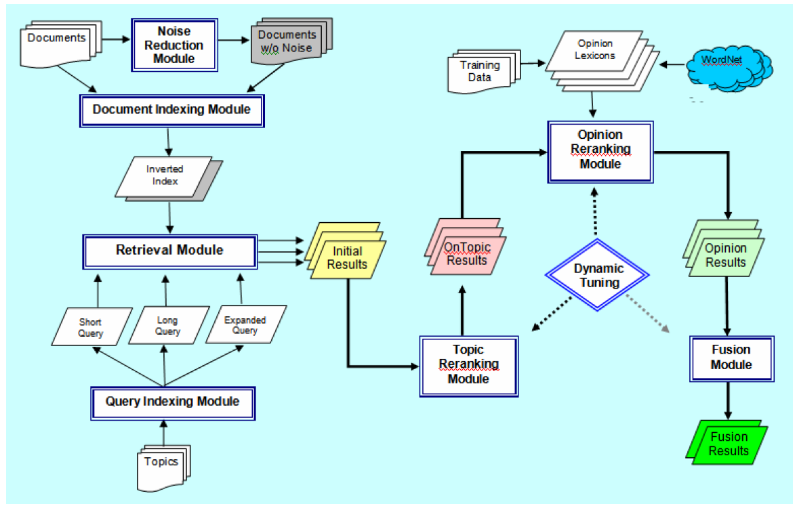
Example of 2-stage retrieval: Indiana University, USA [2, 32]

Slide 53
Language models for opinion retrieval [29]
Let’s see some more approaches for estimating opinion_score(Q,D)
Formally, under the LM approach:
where OV=opinion word vocabulary
= probability the opinion model for the query (R) generated the opinion words w
Can be viewed as a special case of query expansion
Find the most relevant opinion terms and add them to query
Query-independent:
Seed words from affective lexicons (e.g., good, bad)
Learning to Rank: find the opinion words that maximise MAP on training data
Query-dependent:
Through pseudo-relevant feedback, locate the most probable opinion terms that co-occur with query terms.
Mixture

Slide 54
Integrating IR and OA tools
OpinionFinder (OF) [33]
Freely available toolkit for identifying subj/obj sentences
Comes with trained models, rules, affective lexicons
Can be used off-the-shelf
The opinion_score can be estimated as [34]:
where
sum(diff) = sum of the diff values that OF outputs (i.e., confidence in prediction)
Scores are combined slightly different in this case:
Because OF is slow to analyse text, we only apply it to top k-ranked documents
That is, in practise, we apply re-ranking.

Slide 55
Query-dependent opinion lexicons [28]
Assume initial affective weight is given: (e.g., by SentiWordNet [31])
Then:
where:
Practically, we are updating token affective weights in real-time

Slide 56
Query-independent opinion lexicons [27]
Basic idea:
Compare the different patterns of term occurrence between:
objective and
non-objective documents
Terms that occur mostly in objective documents are non-opinionated
Terms that occur mostly in subjective documents are opinionated
“Normalize” by considering the occurrence of terms in the general collection
Add the extracted terms to the original query
Notes:
po=relative freq in set O of relevant and opinionated documents
pr = relative freq in set R of relevant and objective documents
pd = relative frequency in document d
po = relative frequency in set D of all documents

Slide 57
What about proximity?
All opinions expressed in a document don’t necessarily refer to the entity in the query.
e.g., a blog post may refer to multiple entities
a review may compare multiple products
How can we capture relatedness between query terms and opinionatedness?
One solution:
Use query-dependent affective lexicons
We discussed such solutions previously (e.g., [28])
Better solution:
Is the distance between query terms and affective words important?
i.e., should we consider the proximity as a factor?
YES!

Slide 58
What about proximity?
The closer the query terms are to subjective sentences, the higher the score [35]:
where S_{d} = set of subjective sentences
prox(t,s) is estimated in a similar way to estimating proximity of query terms in the DFR framework
Calculate the probability of opinion at each point in the document [36]:
Locate the affective words in the document (e.g., using SentiWordNet)
Assume that their opinionatedness, slowly diffuses the further a query term from them.
e.g., “ESSIR is great, but the weather sucks!”: ‘great’ is close to ESSIR, so it would apply more weight to ‘ESSIR’ than ‘sucks’.
calculate p(opinion|i,d), the probability that there is an opinion expressed at position i
Calculate the overall opinionatedness of the document in relation to the query:
Combine opinion_score with relevance_score

Slide 59
Polarity identification in Opinion Retrieval
In the solutions we discussed so far, the focus was to find relevant and opinionated documents in relation to the user’s information needs.
We often want to distil them by their polarity
i.e., relevant positive and relevant negative
We might want to produce two different rankings (aka, TREC-style) or, for practical applications, mix them.
e.g., one column for positive, one column for negative
provide summary statistics based on number of positive/negative reviews

Slide 60
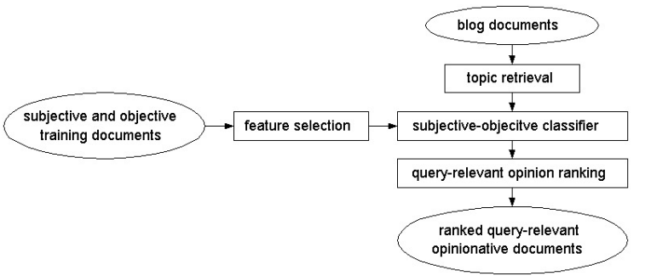
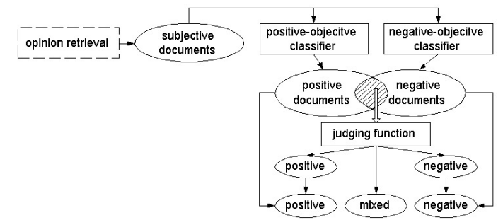
University of Illinois at Chicago [37]
Opinion Retrieval
Polarity Classification

Slide 61
Polarity identification using query expansion
Add affective words to the original query and search index with expanded query [38]
i.e., if original query is “iphone”, create two new versions for pos/neg:
Negative: “iphone bad terrible awful…”
Positive: “iphone good excellent superb…”
Off-the-shelf affective lexicons
Machine-learning approach
Crawl positive/negative reviews from product-review website (e.g., Amazon)
Distil positive/negative terms based on some measure (EM, chi-square)
By comparing the frequency of terms in documents of different polarity
Same technique can be used for basic Opinion Retrieval
Using obj/subj documents (e.g., reviews vs. Wikipedia pages)
Of course, having a lot of query terms typically results in decreased efficiency.

Slide 62
Overview
Academic Background
Opinion Retrieval
Definition and motivation
Applications and challenges
Opinion Analysis
Relevant Benchmarking activities
TREC Blog/Microblog Tracks
NTCIR-6 Opinion Analysis
Bringing it all together
Opinion Retrieval
Summary and conclusions

Slide 63
Summary
In this session, we focused on Opinion Retrieval
Its aims are to study relevancy and opinionatedness, focusing on social media
We saw why this is an important area of research, both for academia and industry
We presented a quick introduction to Opinion Analysis
And we discussed its challenges in social media
We also saw how some of those issues can be solved
Lastly, we saw different approaches on combining standard IR techniques with opinion analysis methods for Opinion Retrieval
Importantly, we discussed a number of benchmarks that you can use/utilize to explore new methods of tackling the problem.
A list of references follows…

Slide 64
References
Iadh Ounis, Craig Macdonald, Maarten de Rijke, Gilad Mishne, Ian Soboroff. 2009. Overview of the TREC 2006 Blog Track. TREC 2006
Kiduk Yang, Ning Yu, Alejandro Valerio, Hui Zhang. 2009. WIDIT in TREC 2006 Blog Track. TREC 2006
Thelwall, M. 2009. MySpace comments. Online Information Review, 33(1), 58–76
Kevin Gimpel, Nathan Schneider, Brendan O'Connor, Dipanjan Das, Daniel Mills, Jacob Eisenstein, Michael Heilman, Dani Yogatama, Jeffrey Flanigan, and Noah A. Smith. 2011. Part-of-speech tagging for Twitter: annotation, features, and experiments. In Proceedings of HLT '11, 42-47.
Bo Pang, Lillian Lee, and Shivakumar Vaithyanathan. 2002. Thumbs up?: sentiment classification using machine learning techniques. In Proceedings of EMNLP '02, 79-86
Jaap Kamps, Robert J. Mokken, Maarten Marx, and Maarten de Rijke. Proceedings of the 4th International Conference on Language Resources and Evaluation LREC 2004, IV, page 1115-1118. Paris, France, European Language Resources Association, (2004)
Georgios Paltoglou and Mike Thelwall. 2012. Twitter, MySpace, Digg: Unsupervised Sentiment Analysis in Social Media. ACM Trans. Intell. Syst. Technol. 3, 4, Article 66 (September 2012)
Thelwall, M., Buckley, K., Paltoglou, G. Cai, D., & Kappas, A. (2010). Sentiment strength detection in short informal text. Journal of the American Society for Information Science and Technology, 61(12), 2544–2558.
Strapparava, C., & Valitutti, A. (2004). WordNet-Affect: an affective extension of WordNet. Proceedings of the 4th International Conference on Language Resources and Evaluation, 1083–1086.
James W. Pennebaker, Martha E. Francis, and Roger J. Booth. Lawerence Erlbaum Associates, Mahwah, NJ, (2001)
Bradley, M. M., & Lang, P. J. (1999). Affective norms for English words (ANEW): Instruction manual and affective ratings. University of Florida: The Center for Research in Psychophysiology.

Slide 65
References
Likun Qiu, Weishi Zhang, Changjian Hu, and Kai Zhao. 2009. SELC: a self-supervised model for sentiment classification. In Proceedings of the 18th ACM conference on Information and knowledge management (CIKM '09).
Soo-Min Kim and Eduard Hovy. 2004. Determining the sentiment of opinions. In Proceedings of the 20th international conference on Computational Linguistics (COLING '04). Association for Computational Linguistics, Stroudsburg, PA, USA, , Article 1367.
Niklas Jakob and Iryna Gurevych. 2010. Using anaphora resolution to improve opinion target identification in movie reviews. In Proceedings of the ACL 2010 Conference Short Papers(ACL Short '10).
Yohei Seki, Noriko Kando, and Masaki Aono. 2009. Multilingual opinion holder identification using author and authority viewpoints. Inf. Process. Manage. 45, 2 (March 2009), 189-199.
Yohei Seki, David Kirk Evans, Lun-Wei Ku, Hsin-Hsi Chen, Noriko Kando, and Chin-Yew Lin. Proceedings of the Workshop Meeting of the National Institute of Informatics NII Test Collection for Information Retrieval Systems NTCIR, page 265--278. (2007)
Breck Baldwin. 1997. Cogniac: High precision conference with limited knowledge and linguistic resources. In Proceedings of a Workshop on Operational Factors in Practical, Robust Anaphora Resolution for Unrestricted Texts, pages 38–45, Madrid, Spain, July.
Bin Lu. 2010. Identifying opinion holders and targets with dependency parser in Chinese news texts. In Proceedings of the NAACL HLT 2010 Student Research Workshop (HLT-SRWS '10). Association for Computational Linguistics, Stroudsburg, PA, USA, 46-51.
Tengfei Ma and Xiaojun Wan. 2010. Opinion target extraction in Chinese news comments. InProceedings of the 23rd International Conference on Computational Linguistics: Posters(COLING '10). Association for Computational Linguistics, Stroudsburg, PA, USA, 782-790
Gabrilovich, Evgeniy. and Shaul Markovitch. 2007. Computing Semantic Relatedness using Wikipedia-based Explicit Semantic Analysis. In Proceedings of the 20th International Joint Conference on Artificial Intelligence (IJCAI).
G. Paltoglou, M. Thelwall. Seeing stars of valence and arousal in blog posts. Journal of IEEE Transactions of Affective Computing, 99 (PrePrints):1, 2012

Slide 66
References
Mishne, G. (2005). Experiments with mood classification in blog posts. Proceedings of ACM SIGIR 2005 Workshop on Stylistic Analysis of Text for Information Access.
Smola, A., & Vishwanathan, S. (2008). Introduction to machine learning.
Bishop, C. M. (2006). Pattern Recognition and Machine Learning (Information Science and Statistics). Secaucus, NJ, USA: Springer-Verlag New York, Inc.
Mohri, M., Rostamizadeh, A., & Talwalkar, A. (2012). Foundations of machine learning.
Wei Wei and Jon Atle Gulla. 2010. Sentiment learning on product reviews via sentiment ontology tree. In Proceedings of the 48th Annual Meeting of the Association for Computational Linguistics (ACL '10). Association for Computational Linguistics, USA, 404-413.
Ivan Titov and Ryan McDonald. 2008. Modeling online reviews with multi-grain topic models. In Proceedings of the 17th international conference on World Wide Web (WWW '08). ACM, New York, NY, USA, 111-120.
Giambattista Amati, Edgardo Ambrosi, Marco Bianchi, Carlo Gaibisso, and Giorgio Gambosi. 2008. Automatic construction of an opinion-term vocabulary for ad hoc retrieval. InProceedings of the IR research, 30th European conference on Advances in information retrieval (ECIR'08), 89-100.
Seung-Hoon Na, Yeha Lee, Sang-Hyob Nam, and Jong-Hyeok Lee. 2009. Improving Opinion Retrieval Based on Query-Specific Sentiment Lexicon. In Proceedings of the 31th European Conference on IR Research on Advances in Information Retrieval (ECIR '09), 734-738
Xuanjing Huang and W. Bruce Croft. 2009. A unified relevance model for opinion retrieval. In Proceedings of the 18th ACM conference on Information and knowledge management (CIKM '09). ACM, New York, NY, USA, 947-956

Slide 67
References
Teng-Kai Fan and Chia-Hui Chang. 2009. Sentiment-Oriented Contextual Advertising. InProceedings of ECIR '09, Mohand Boughanem, Catherine Berrut, Josiane Mothe, and Chantal Soule-Dupuy (Eds.). Springer-Verlag, Berlin, Heidelberg, 202-215
Esuli, A., & Sebastiani, F. (2006). SentiWordNet: A publicly available lexical resource for opinion mining. Proceedings of LREC, 2006.
Yang, Kiduk, Ning Yu, Alejandro Valerio, Hui Zhang, and Weimao Ke. "Fusion Approach to Finding opinions in Blogosphere." In ICWSM. 2007.
T. Wilson, P. Hoffmann, S. Somasundaran, J. Kessler, J. Wiebe, Y. Choi, C. Cardie, E. Riloff, and S. Patwardhan. OpinionFinder: a system for subjectivity analysis. In Proceedings of HLT/EMNLP on Interactive Demos, 2005.
Ben He, Craig Macdonald, and Iadh Ounis. 2008. Ranking opinionated blog posts using OpinionFinder. In Proceedings of the 31st annual international ACM SIGIR conference on Research and development in information retrieval (SIGIR '08).
Rodrygo L. T. Santos, Ben He, Craig Macdonald, and Iadh Ounis. 2009. Integrating Proximity to Subjective Sentences for Blog Opinion Retrieval. In Proceedings of the 31th European Conference on IR Research on Advances in Information Retrieval (ECIR '09), Mohand Boughanem, Catherine Berrut, Josiane Mothe, and Chantal Soule-Dupuy (Eds.). Springer-Verlag, Berlin, Heidelberg, 325-336
Shima Gerani, Mark James Carman, and Fabio Crestani. 2010. Proximity-based opinion retrieval. In Proceedings of the 33rd international ACM SIGIR conference on Research and development in information retrieval (SIGIR '10). ACM, New York, NY, USA, 403-410.
Wei Zhang, Clement Yu. UIC at TREC 2007 blog track.
Lee, Y., Na, S. H., Kim, J., Nam, S. H., Jng, H. Y., & Lee, J. H. (2008). Kle at trec 2008 blog track: Blog post and feed retrieval. Soboroff, I., McCullough, D., Lin, J., & Macdonald, C. (2012). Evaluating real-time search over tweets. In Proc. ICWSM (pp. 579–582).
G. Paltoglou, K. Buckley. Subjectivity annotation of the Microblog 2011 Realtime Adhoc relevance judgments. In ECIR 2013: 35th European Conference on Information Retrieval, pages 344 - 355, 201

Slide 68
References
Luo, Z., Osborne, M., & Wang, T. (2012). Opinion Retrieval in Twitter, ICWSM 2012

Slide 69
Thank you for your time
I’d love to answer any questions

