Slide 1

Natural Language Processing for Information Retrieval
Hugo Zaragoza

Slide 2
Warning and Disclaimer:
this is not a tutorial, this is not an overview of the area, this does not contain the most important things you should know
this is a very personal & biased highlight of some things I find interesting about this topic…

Slide 3
Plan
Very Brief and Biased (VBB) intro to (Computational) Linguistics
Very Brief and Biased (VBB) intro to the NLP Stack
Applications, Demos and difficulties
Two Paper walk thrus
[J Gonzalo et. al. 1999]
[Surdeanu et. al. 2008]

Slide 4
From philosophy to grammar to linguistics to AI to lingustics to NLP to IR…
Aristotle
Descartes
Russell & Wittgenstein
Turing
Chomsky
…
Weizenbaum
Manning and Schütze
Karen Spärck Jones (and many more…)

Slide 5
AI and Language: What does it mean to “understand” language
Does a coffee machine understand coffee making?
Does a plane landing in autopilot understand flying?
Does IBM’s Deep Blue understand how to play chess?
Does a TV understand electromagnetism?
Do you understand language?
explain to me how!
More interesting questions:
Can computers fake it?
Can we make computers do what human experts do with written documents?
faster? in all languages? at a larger scale? more precisely?

Slide 6
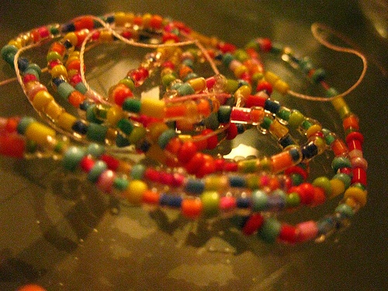
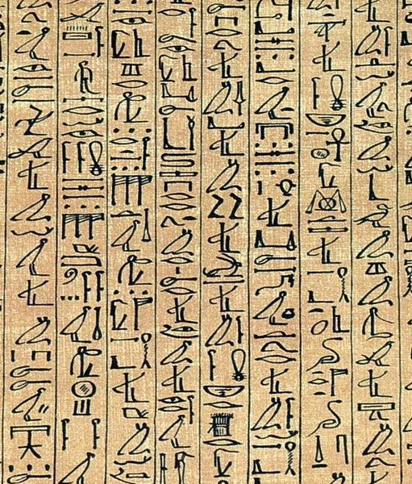
Strings
Formally:
Alphabet (of characters): Σ={ a,b,c}
String (of characters): s = aabbabcaab
All possible strings: Σ* = {a,b,c,aa,ab,ac,aaa,…}
Language (formal): L ⊆ Σ*
Natural Languages:
Our words are the “characters”.
Our sentences are “strings of words”.
String of beads
Papyrus of Ani, 12th century BC

Slide 7
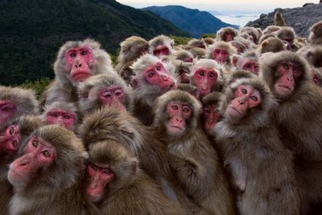
Non-intuitive things about Strings
A computer can “write” the Upanishads, by enumeration (it belongs to the set of all strings of that length).
Very many monkeys with typewriters can also do this (probabilistically, they have no choice)!
This is just a weird artifact of enumeration:
All pictures of all people with all possible hats are 3D matrices
All works of art are 3D matrices of atoms, therefore enumerable, etc.
Mathematically interesting… but not so useful.

Slide 8
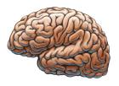
(Language won’t be enough)
Your “knowledge of the world” (knowledge, context, expectations) play a big role in your search experience.
How can you search something you don’t know?
How do you start?
How do you know if you found it?
How do you decide if a snippet is relevant ?
How do you decide if something is false / incomplete / biased ?

Slide 9

Back to Strings… let’s search in Vulkan!
Vulkan Collection:
Dakh orfikkel aushfamaluhr shaukaush fi'aifa mazhiv
Kashkau - Spohkh - wuhkuh eh teretuhr
Ina, wani ra Yakana ro futishanai
T'Ish Hokni'es kwi'shoret
Dif-tor heh smusma, Spohkh
Queries:
Spohkh
hokni (but why?)
futisha (but are you sure?)

Slide 10
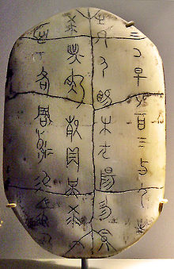
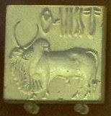
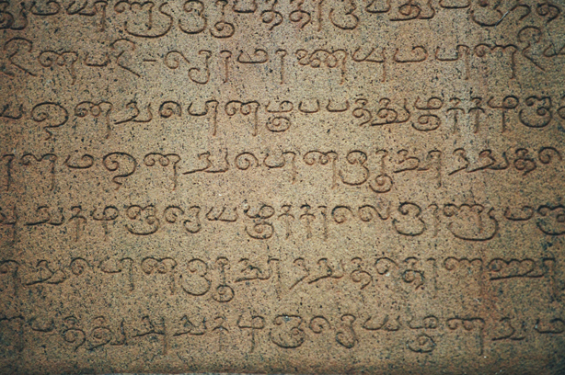
Strings and Characters
What’s a document / page?
A document is a sequence of paragraphs… which is a sequence of sentences… which is a sequence of words… which is a sequence of characters…
But with an awful lot of hidden structure!
“run”, “jog”, “walks very fast”.
“runny egg”, “scoring a run”
“run”, “runs”, “running”.
Harappan Script & Chinese Oracle Bone 26-20 c. BCE 16-10 c. BCE
Tamil Vatteluttu script, 3 c. BCE
Notes:
Harappan Script (Harappan, 26th-20th cent. BC)

Slide 11
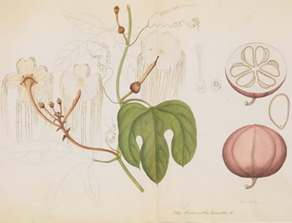
Multiple Levels of Structure
Characters → Words (Morphology, Phonology)
Birds can fly but flies can’t bird!
Words → Meaning (Lexical Semantics)
Jaguar, bank, apple, India, car…
Words → Sentence (Syntax)
I, wait, for, airport, you, will, at
Sentence → Meaning (Semantics)
Indians eat food with chili / with their fingers.
Sentence → Paragraph → Document (Co-reference, Pragmatics, Discourse…)
Like botanists before Darwin, we know VERY MUCH about human languages… but can explain VERY LITTLE!

Slide 12
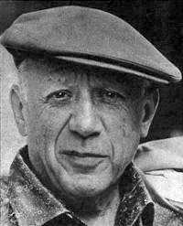


The grand scheme of things
Semantics
born-in
÷£¿≠¥ ÷ŝc£ËËð №£Ë ¿¥r© ŝ© X£≠£g£, Ë÷£ŝ©.
NLP
÷£¿≠¥ ÷ŝc£ËËð №£Ë ¿¥r© ŝ© X£≠£g£, Ë÷£ŝ©.
PER
LOC
LOC
was
№£Ë
Picasso
IR
born
÷ŝc£ËËð
¿¥r©
Pablo
X£≠£g£
÷£¿≠¥
Málaga
Spain
Ë÷£ŝ©
÷£¿≠¥ ÷ŝc£ËËð №£Ë ¿¥r© ŝ© X£≠£g£, Ë÷£ŝ©.
Text
Pablo Picasso was born in Málaga, Spain.
Notes:
Many reasons, some BIG:
Knowledge Representation problem (Plato)
Language Semantics problem (Witgenstein)
Language Parsing problem
Application (?)
Dissambuguation
Ranking
Similarity
…

Slide 13
NLP Stack

Slide 14
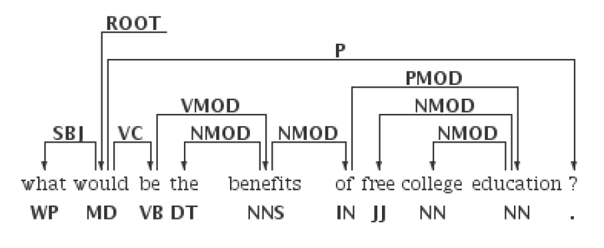
Using Dependency Parsing to Extract Phrases
More phrases:
Non-contiguous
Coordination
Replaces SemRoleLab:
Hard to use Roles beyond NP, VP
Better phrases:
Clean POS errors (link)
Head structure
Better patterns

Slide 15
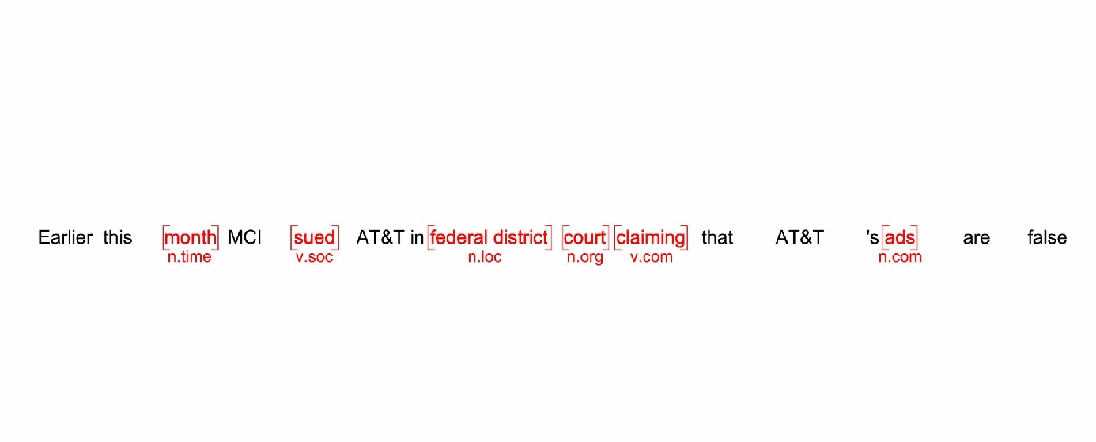
Semantic Tagging
Communication Verb
Time Noun
Location Noun
Social Verb
Communication Noun

Slide 16
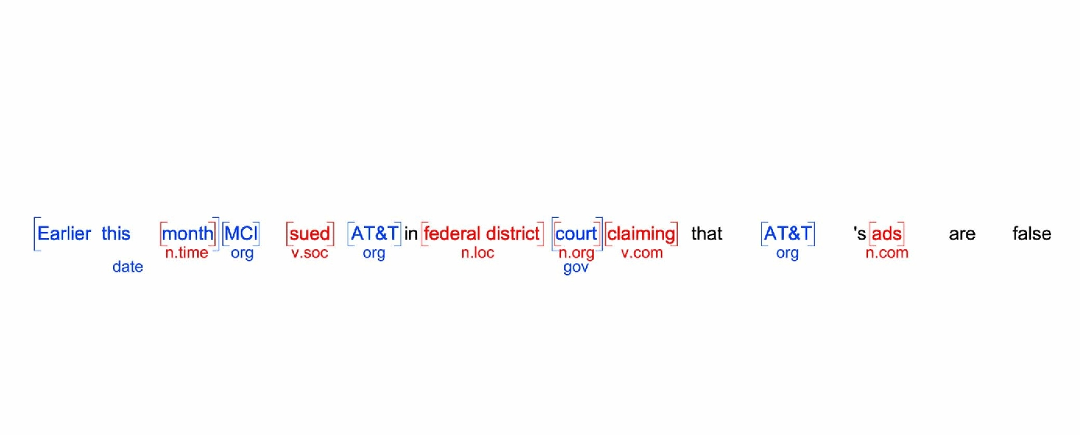
Named Entity Extraction
Goverment Organisation
Date
Organisation
Organisation

Slide 17
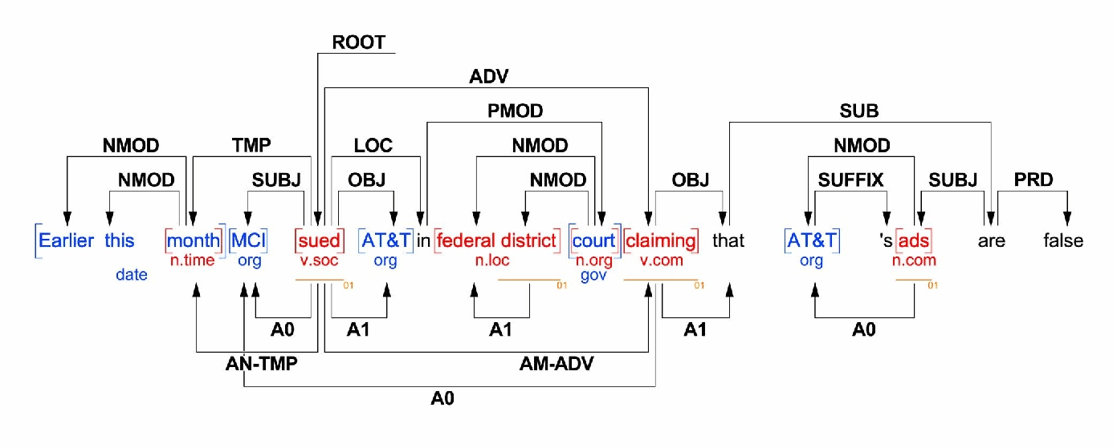
Dependency Parsing

Slide 18
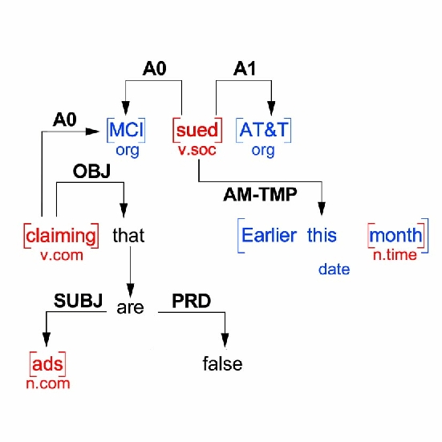
Semantic Role Labeling

Slide 19

Why not use dictionaries?
Two main reasons: ambiguity and unknown terms.
 | Precision | Recall | F
English
Dictionary | 72% | 51% | 60%
ML Tagger | 89% | 89% | 89%
German
Dictionary | 32% | 29% | 30%
ML Tagger | 84% | 64% | 72%
[CONL NER Competition, http://www.cnts.ua.ac.be/conll2003/ner/]

Slide 20
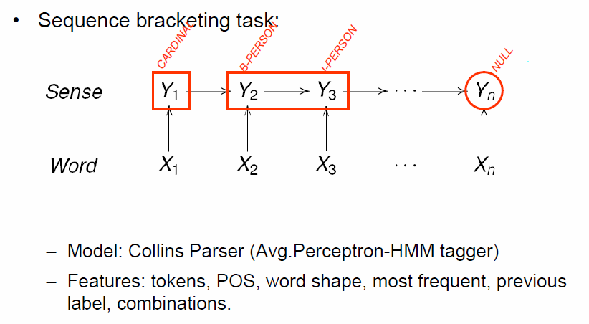
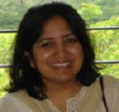
Statistical Taggers (Supervised)
Typically thousands of annotated sentences are needed (for each type-set)!
Notes:
Sunita Sarawagi (IIT Mombai)

Slide 21
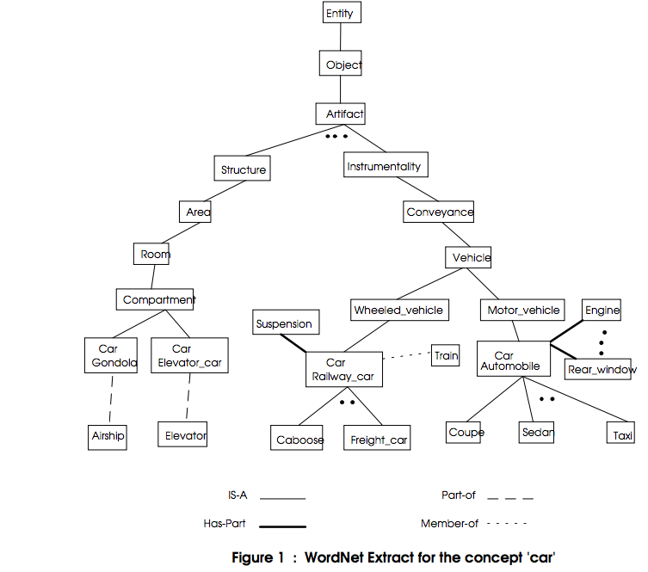
Richardson, R., Smeaton, A. F., & Murphy, J. (1994). Using WordNet as a knowledge base for measuring semantic similarity between words. Technical Report Working Paper CA-1294, School of Computer Applications, Dublin City U.

Slide 22
Bootstrapping Language & Data Typing.
Pablo Picasso was born in Málaga, Spain.
E:PERSON
GPE:CITY
GPE:COUNTRY
artist:name
artist:placeofbirth
artist:placeofbirth
If most artists are persons, than let’s assume all artists are persons.
describes
conll:PERSON
conll:LOCATION
artist
range
wikiPageUsesTemplate
type
type
Pablo_Picasso
artist_placeofbirth
Spain
artist_placeofbirth
Málaga

Slide 23
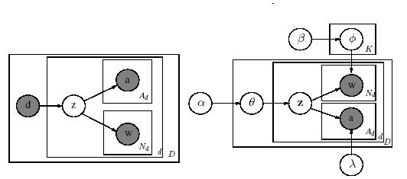
Distributional Semantics (Unsupervised)
“You shall know a word by the company it keeps” (Firth 1957)
Co-occurrence semantics:
I(x,y) = P(x,y) / ( P(x) P(y) ) salt, pepper >> salt, Bush
WA(x,y) = N(x & y) / N (x || y) Britney, Madonna >> Britney,Callas
Semantic Networks pepper, chicken
Distributional semantics
If x has same company as y, then x is “same calss as” y.
Correlation, Non-Orthogonality!
LSI, PLSI, LDA… and many more!
PLSI
LDA

Slide 24
“Applications” on the NLP Stack
Clustering, Classification
Information Extraction (Template Filling)
Relation Extraction
Ontology Population
Sentiment Analysis
Genre Analysis
…
“Search”

Slide 25
Back to Search Engines
Formidable progress!
Navigational search solved!
Formidable increase in Relevance across all query types
Formidable increase in Coverage, Freshness, MultiMedia
Some progress in:
Query Understanding: Flexibility, Dialog, Context…
Slow progress:
Result Aggregation / Summarization / Browsing
Answering Complex Queries
(Natural Language Understanding!)

Slide 26
Applications and Demos

Slide 27
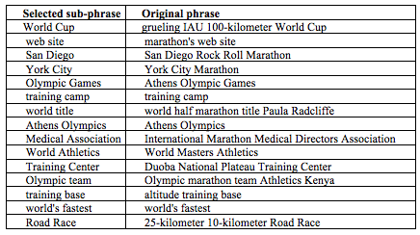
Noun Phrase Selection
Vechtomova, O. (2006). Noun phrases in interactive query expansion and document ranking. Information Retrieval, 9(4), 399-420. (pdf)

Slide 28
Exploiting Phrases for Browsing
DEMO Yahoo! Quest
Nifty: http://snap.stanford.edu/nifty/monthly.html?date=2013-08-01

Slide 29
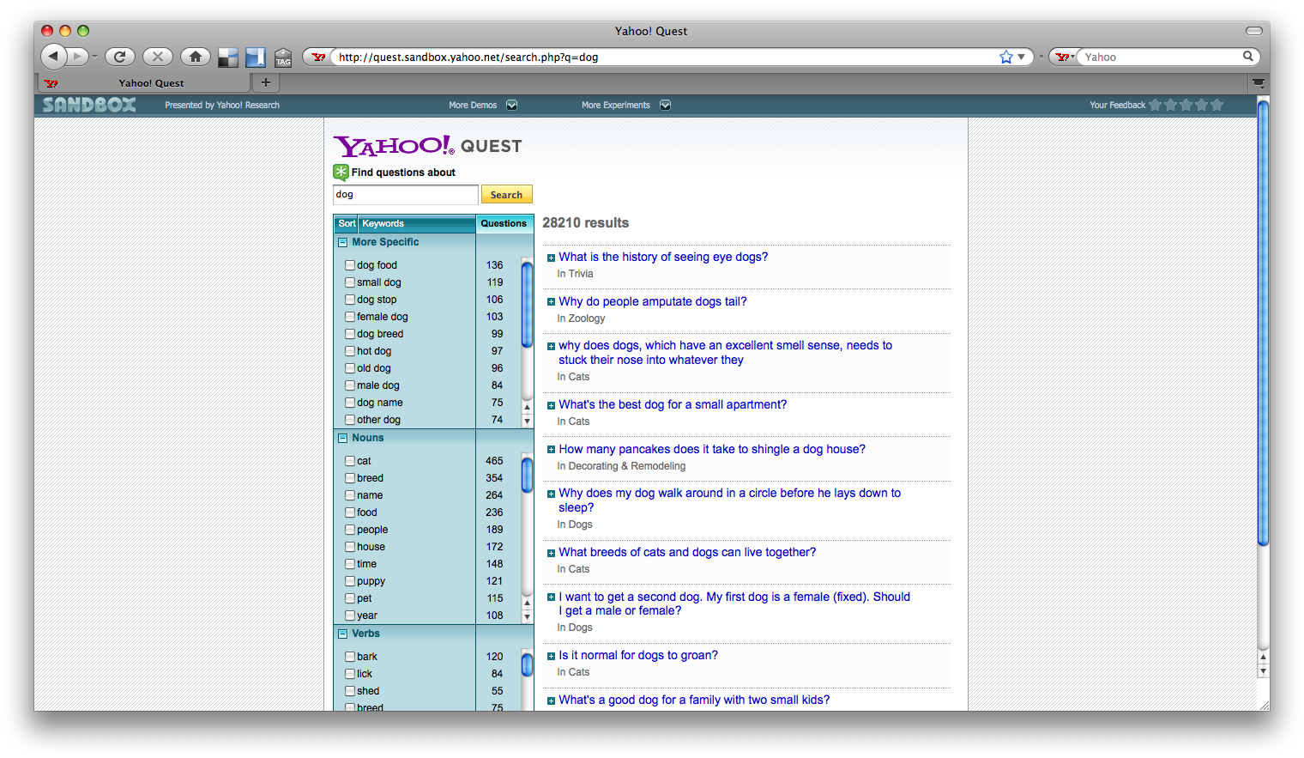

Slide 30
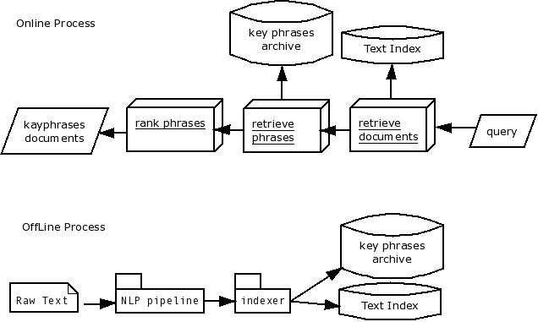

Slide 31
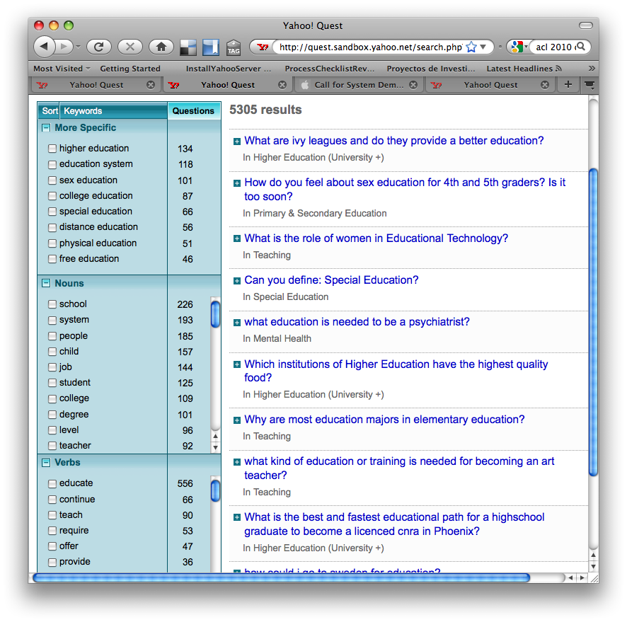

Slide 32
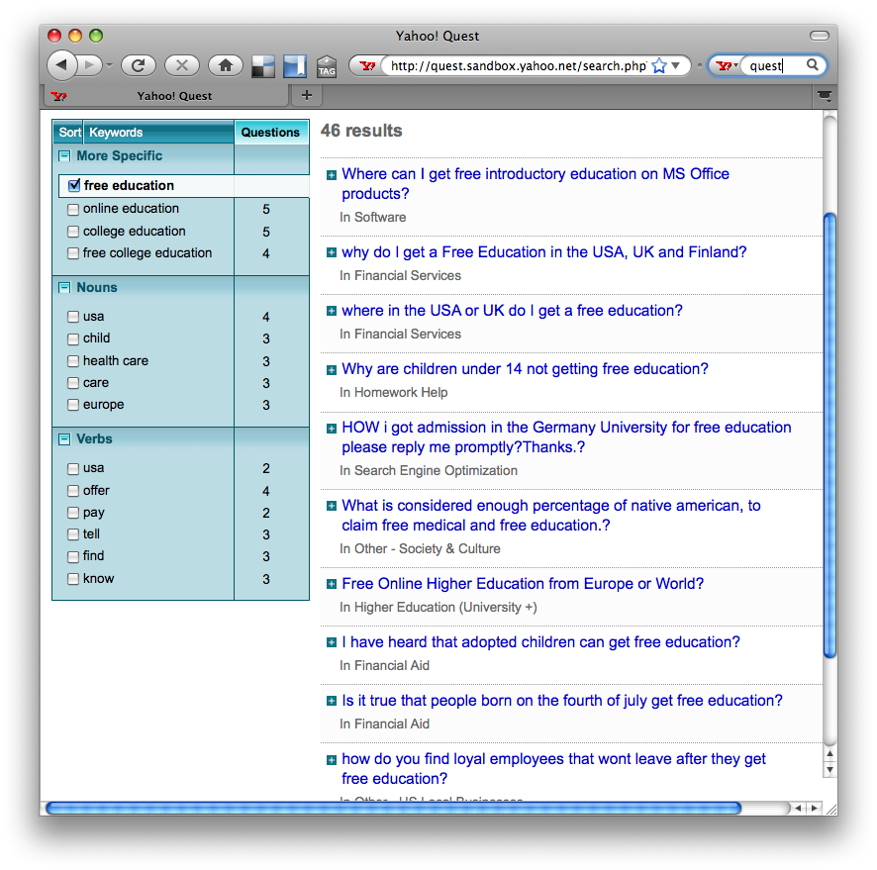

Slide 33
Nifty
http://snap.stanford.edu/nifty/monthly.html?date=2013-08-01

Slide 34
Improving Relevance Ranking using NLP
“Relevance Ranking” “Ad-hoc Retrieval” Given a user query q and a set of documents D, approximate the document relevance: f(q,d;D,W) = P ( “d is Rel” | d, q, D, W )
Much progress in factoid Question Answering (*)
(Who, When, How long, How much…)
Some progress in closed domains
(medical search, protein search, legal search…)
Little progress in open domain, complex questions (i.e. search).
Open Research Problem!

Slide 35

Example: entity containment graphs
Doc #3: The last time Peter exercised was in the XXth century.
Doc #5: Hope claims that in 1994 she run to Peter Town.
English Wikipedia:
1.5M entries,
75M sentences,
148.8M occurrences of
20.3M unique entities.
(Compressed graph: 3Gb )
WSJ:PERSON: “Peter”
WSJ:PERSON: “Hope”
WSJ:CITY: “Peter Town”
WNS:DATE: “XXth century”
WNS:DATE:” 1994”
#3
#5
…
[Zaragoza et. al. CIKM’08]

Slide 36
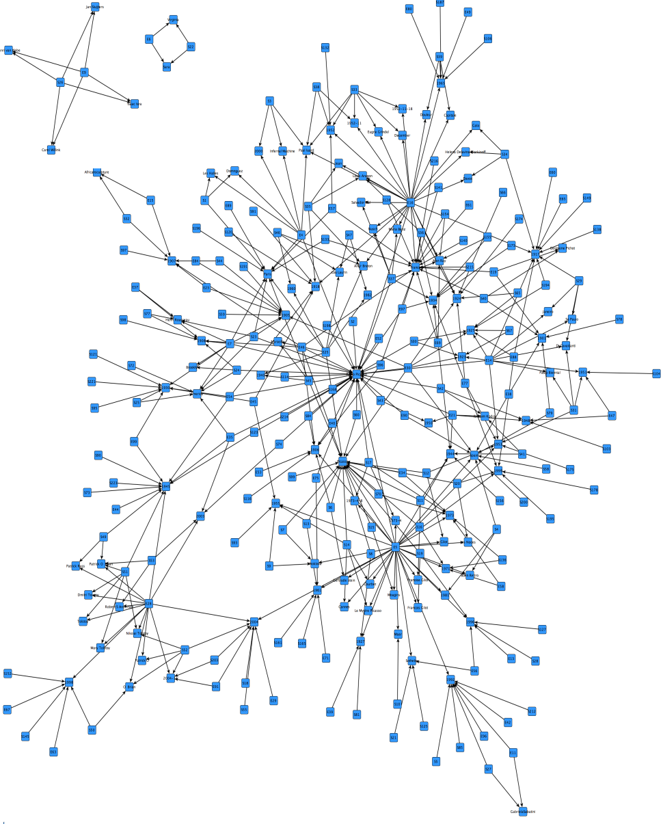
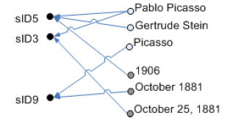
Putting it together for entity ranking
Pablo Picasso and the Second World War
Search Engine
Sentences
Sentence to Entity Map

Slide 37
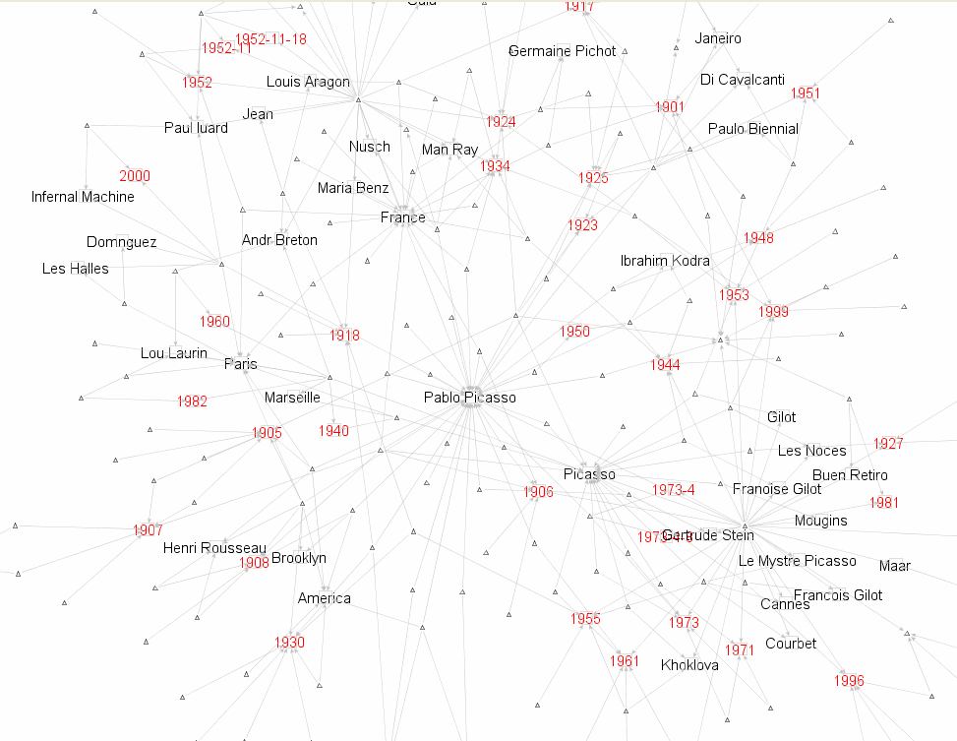
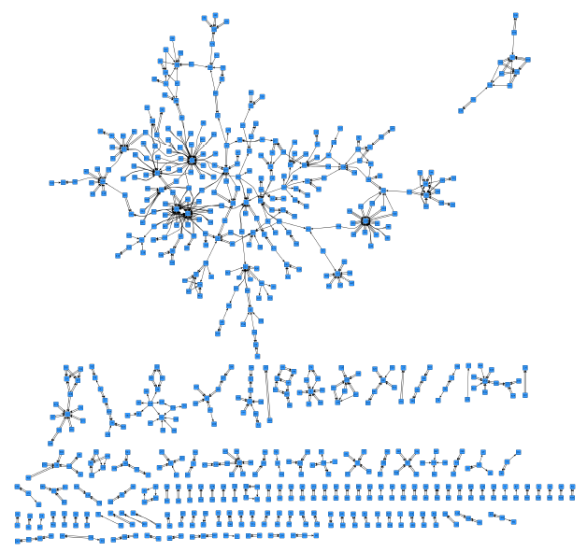
“Life of Pablo Picasso” subgraph

Slide 38
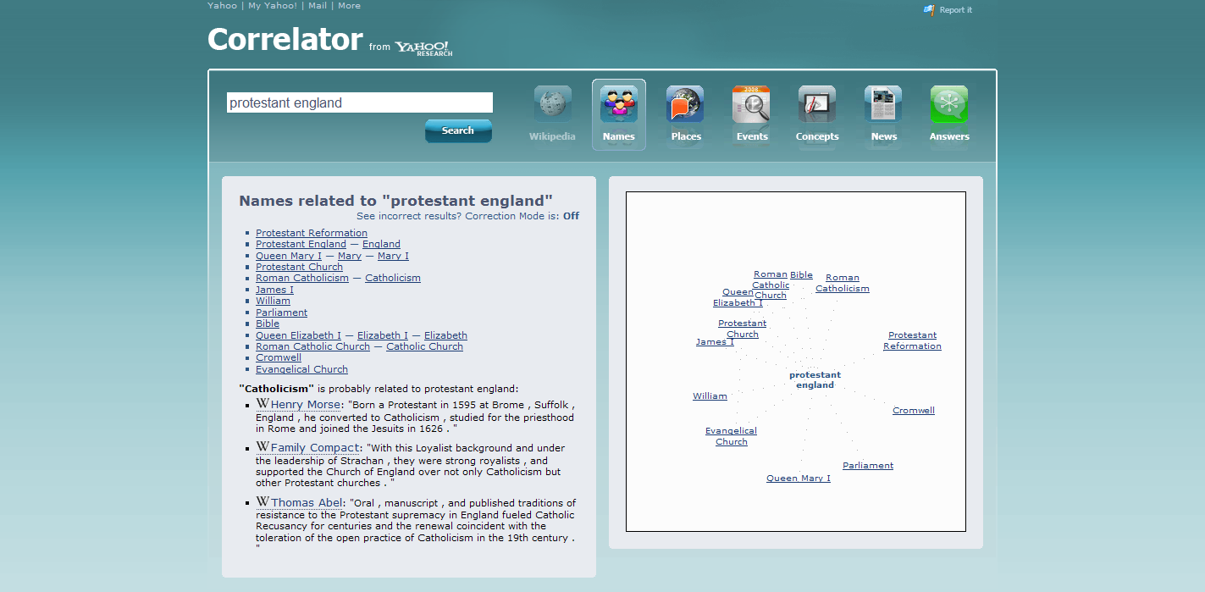

Slide 39
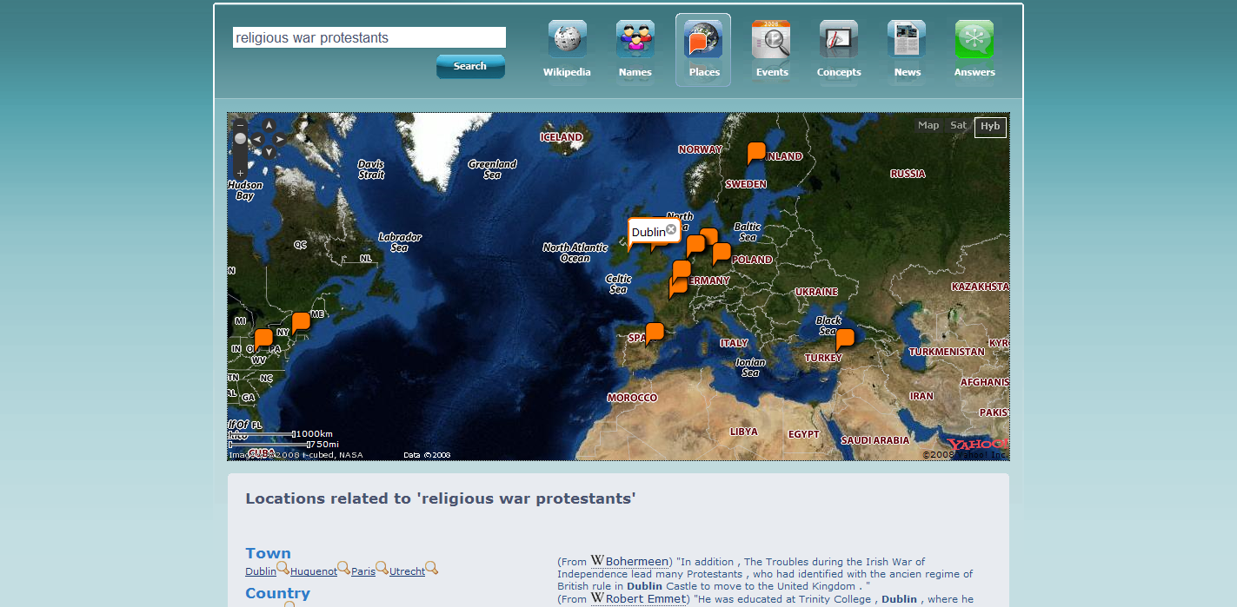

Slide 40
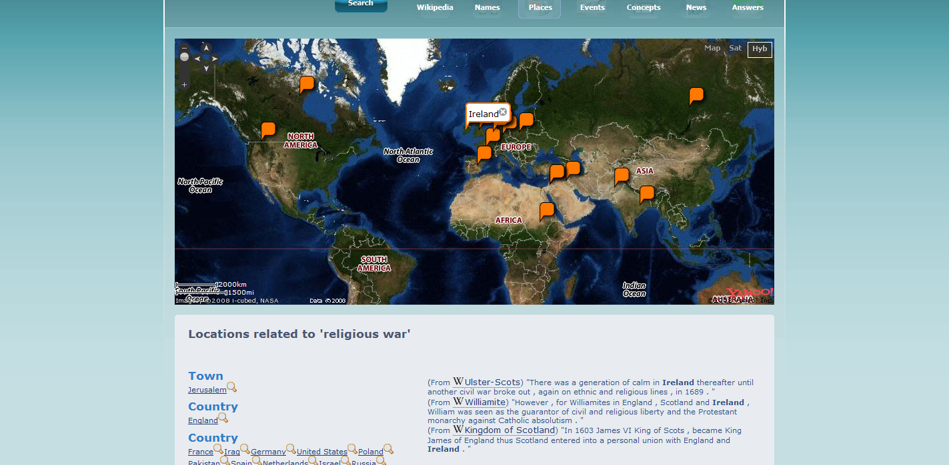

Slide 41
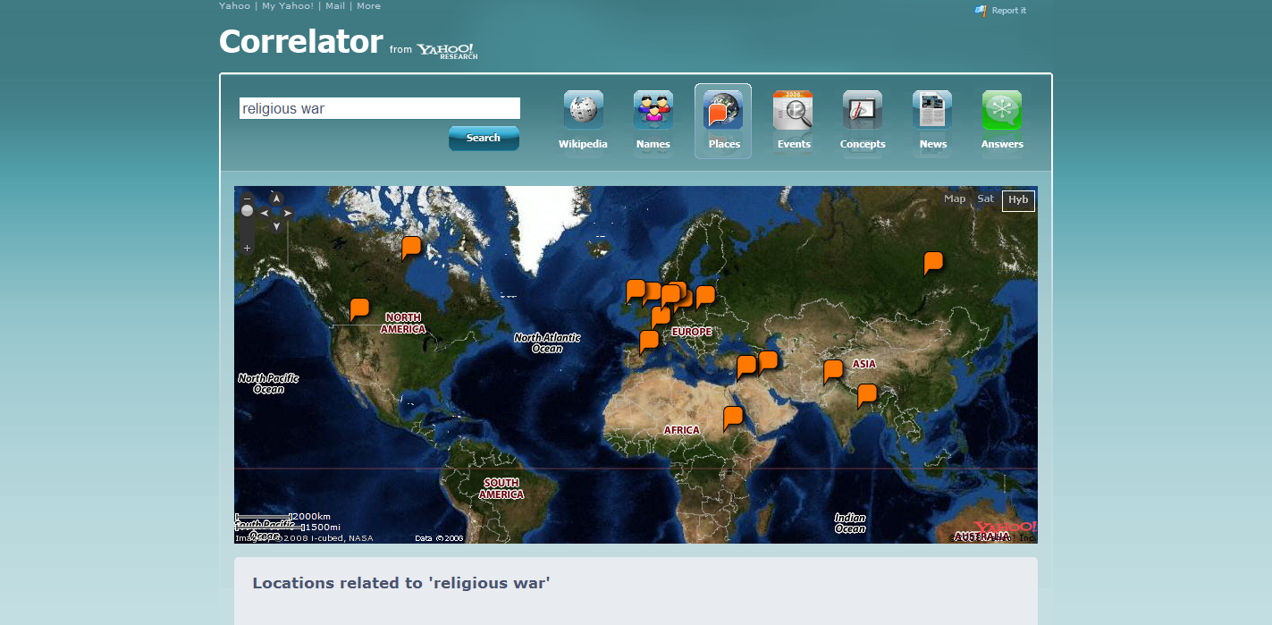

Slide 42
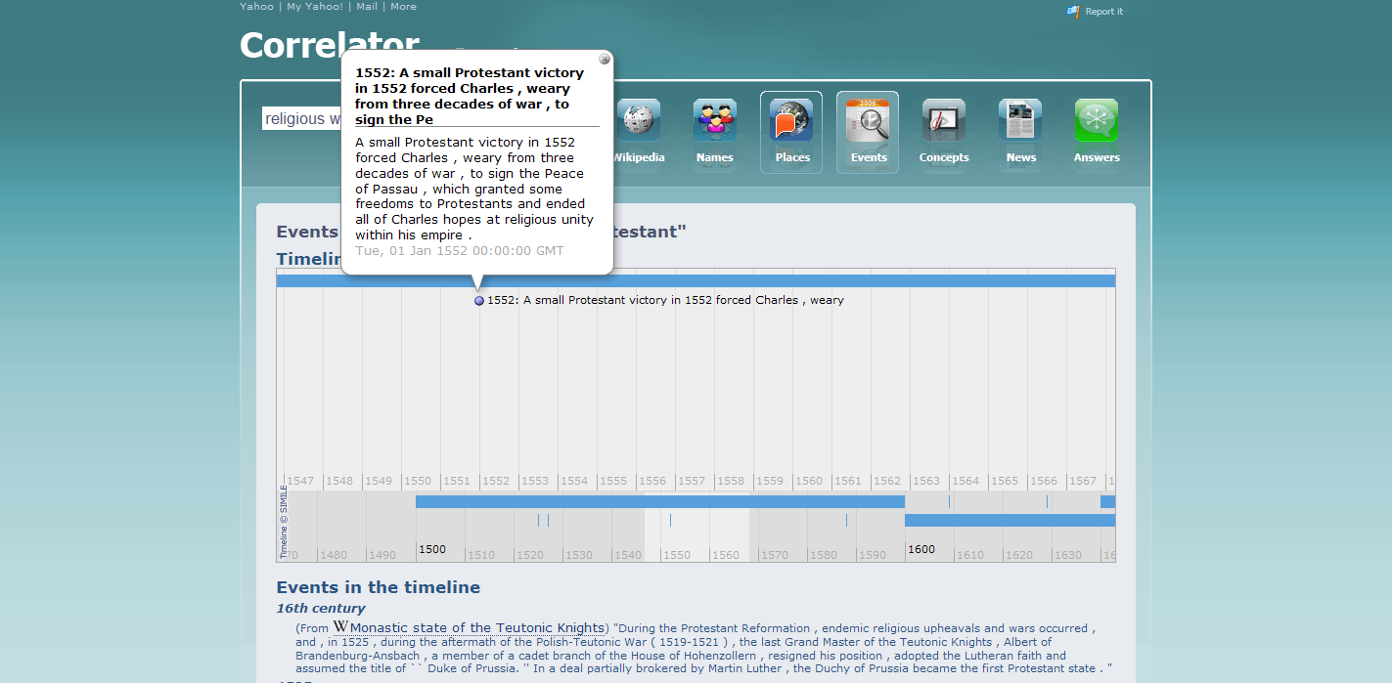

Slide 43
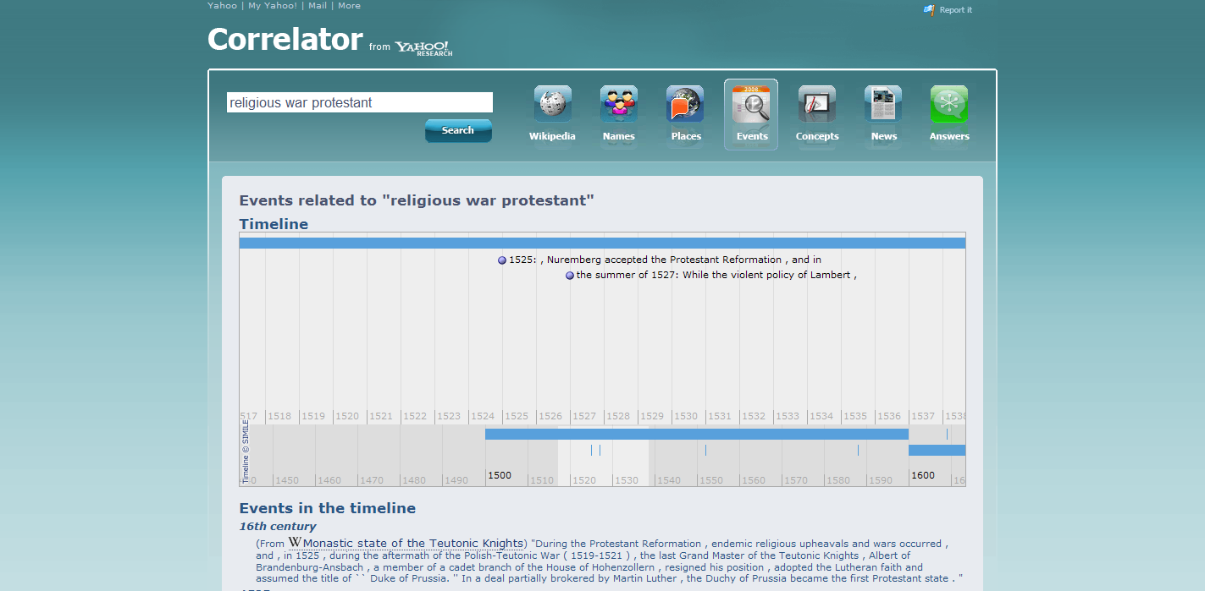

Slide 44
(Websays demo)

Slide 45
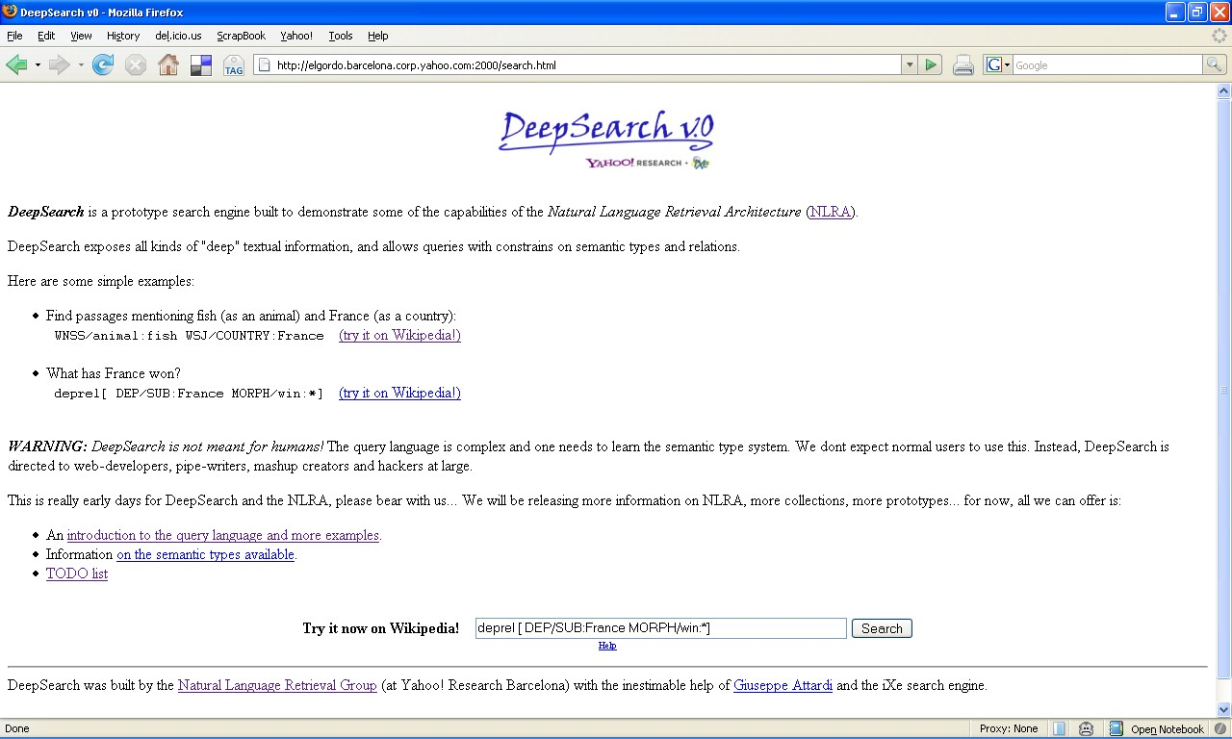
DeepSearch demo by Yahoo Research! and Giuseppe Attardi (U. Pisa)

Slide 46
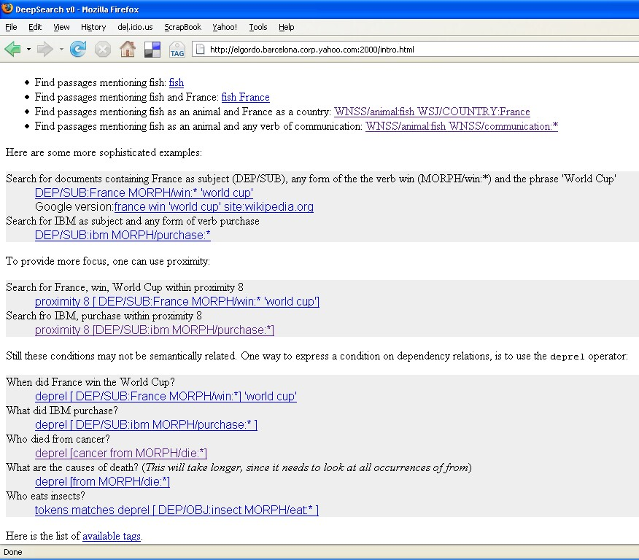

Slide 47
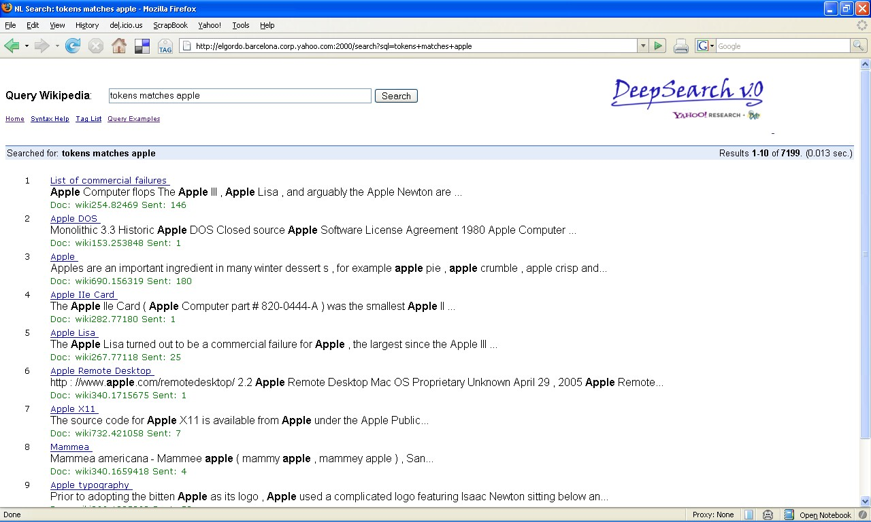
query: “apple”

Slide 48
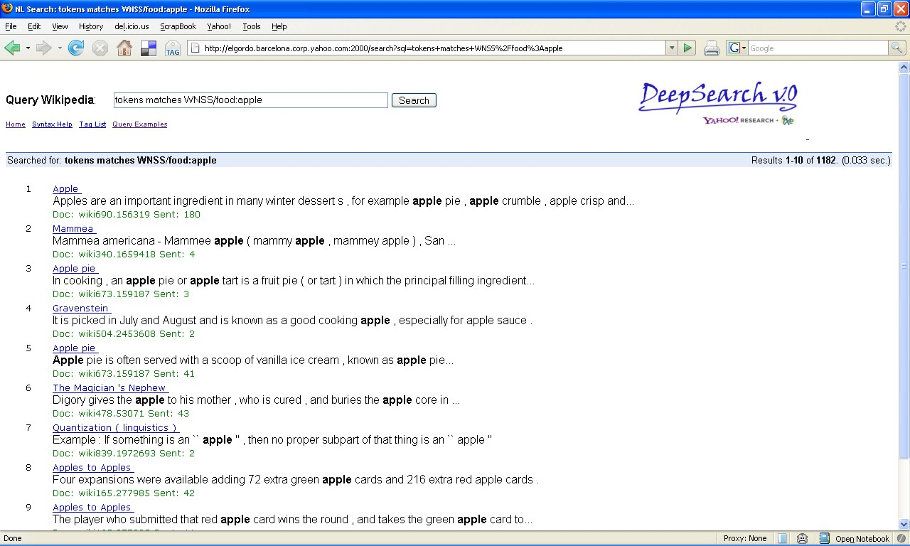
query: “WNSS/food:apple”

Slide 49
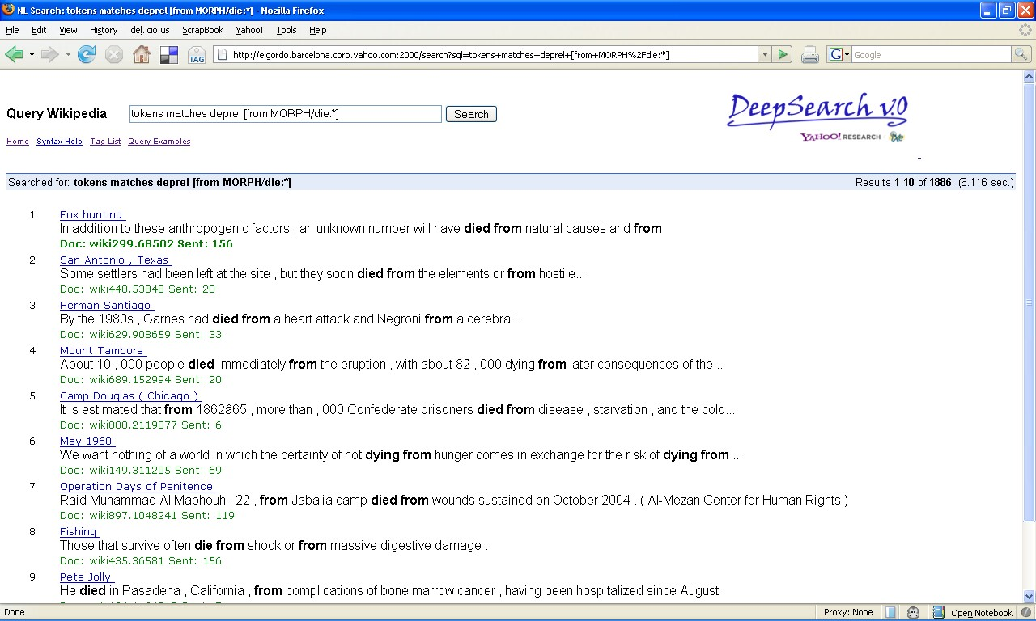
query: “MORPH:die → from”

Slide 50
Paper Walkthrough
[J Gonzalo et. al. 1999]
[Surdeanu et. al. 2008]

Slide 51
Discussion: Why doesn’t NLP help IR?
Pointers:
What is IR? Have you considered:
Query Analysis
https://www.google.es/?gws_rd=cr&ei=qOMmUtfVIOeN0AWSvIGYAQ#q=flights+to+ny+)
https://www.google.es/?gws_rd=cr&ei=qOMmUtfVIOeN0AWSvIGYAQ#q=britney+spears
Question Answering
Query is key, and is not NL
Precision of NLP, destructive effect of “noise”
Baseline precision
Languages, Slangs
Introducing the new features into the old systems.
Semantics, Pragmatics, Context!

Slide 52
Gracias!
hugo@hugo-zaragoza.net
http://hugo-zaragoza-net
http://websays.com
Slides & Bibliographhy: http://bit.ly/18rf5Ne

